Slide 1
WHAT AILS OUR AGRICULTURETHE THE CURRENT SITUATION
Presentation made to
Shri Siraj Hussain, I.A.S.
Secretary
Ministry of Agriculture
Department of Agriculture & Cooperation
Presented by
DR. KIRIT N SHELAT, I.A.S. (Rtd)
NCCSD

Slide 2
THE CURRENT SITUATION PART - 1

Slide 3
WHAT AILS OUR AGRICULTURETHE PROBLEM
National Council for Climate Change, Sustainable Development and Public Leadership
On July2, 2006, Prime Minister of India visited the Vidarbha region of Maharashtra.
The purpose of the visit was to meet farmers
Region affected by suicides by farmers
In one year more than 800 deaths due to suicide
Similar situation prevails in other progressive states like Karnataka, Andhra Pradesh, and Punjab.
More than 10,000 suicides by farmers between 2001-06
Still farmers suicide continue in many parts of our country – in new areas are getting added.
contd…..2

Slide 4
THE STATUS OF INDIAN ECONOMY
National Council for Climate Change, Sustainable Development and Public Leadership
Indian economy doing extremely well
The rate of growth of GDP was around 8% and now about 5%
Poverty in rural areas declined from 90% prior to independence to 25% in 2011.
Country was depending on imports of food grains in the initial years, since has attained self-sufficiency and exports.
Total production of food grains reached 250 million tonnes.
Over all growth in agriculture – slow but sustainable
Despite all this, farmers’ suicides !
contd…..2

Slide 5
THE FARMERS’ SUCIDE AND NAXALISM
National Council for Climate Change, Sustainable Development and Public Leadership
In the same village, with similar land condition, with same crop, one farmer makes profits,
Some stay on and other commits suicide
Not all farmers commit suicide
The young farmers are educated
They take other means and wed Naxalism
Naxalism not a new movement but has taken new roots in many parts of the country.
In 2003 – 55 districts, 2004 – 150 districts, 2014– 170 district – 1/3 of the country covered.
Young persons prefer rather brutalism than committing suicide even if that has risk to their life.
Naxalism is a major challenge to democratic system.
Problem not only of agriculture but is a time bomb clicking which can damage the basic fabric of our constitution
contd…..2

Slide 6
SMALL FARMERS
National Council for Climate Change, Sustainable Development and Public Leadership
121 million agriculture holding
99 million – small farmers about 80% of total holding – 1960-61, this was 62%.
Share in operated area – 44%
Average holding 1.33 ha
Access to irrigation 51%
Income Expend ( NSS 2003 data)
Monthly consumption marginal farmers – Rs.2,482 while income Rs.1,659/- Gap is Rs.823/- per month . Per annum this comes to Rs.9,876/-. Result debt which they can not repay.
contd…..2

Slide 7
National Council for Climate Change, Sustainable Development and Public Leadership
Credit small loans up to Rs.25,000/- declined from 35.2% to
13.4% (of total agriculture advance).
Share of small borrower accounts (less than
Rs.25,000/-) fell to 38% of total account in 2004-05
from 62% in 1991-92.
Insurance Cover Even overall insurance cover is 15% of farmers 2006-
07. Paddy farmer accounted for 36% of all insured.
Source: Dr S. Mahendra Dev, India Gandhi Institute of Development
Research – Mumbai, small farmers in India challenges
opportunities.

Slide 8
POVERTY ESTIMATE
National Council for Climate Change, Sustainable Development and Public Leadership
As per Rangarajan Committee , Planning Commission of India – June 2014, in the rural area percentage of persons below poverty line was 30.9% numbering 26 Crore population as of 2011 (Annexure – A). As per Tendulkar Committee, this is 25.7% in 2011-12. As per Planning Commission press note on poverty estimate – July 2013
Poverty in rural area percentage below
declined from poverty line
1993-94 50.0% 2011-12 25.7%
While in urban area, poverty declined from 31.8% to 13.7% The inequality between urban and rural farmers are growing.

Slide 9
National Council for Climate Change, Sustainable Development and Public Leadership
PRODUCTIVITY GAP AT LOCAL LEVEL
NCCSD jointly with Anand Agriculture University-Dr. Shelat and Dr. Shekh conducted study on productivity gap between average (small) farmers and progressive farmers of Anand (the most fertile district) and Mandvi – kutch(the arid-salinity affected area. The findings were as under.

Slide 10
Gap in Productivity –
Crop wise average yield and Optimum yield-Anand Block, Anand District, Gujarat
Source: Agriculture Production Local Level Plan Shekh & Shelat - NCCSD 2013
Sr No | Crop | Area(ha) | Average yield (qt/ha) | Optimum yield (qt/ha) | Yield gap (qt/ha) | Anand Block Yield gap %
1 | Pearl millet (K) | 3640 | 15.25 | 20.25 | -5.00 | -24.69
2 | Pearl millet (S) | 8751 | 26.78 | 30.65 | -3.87 | -12.62
3 | Rice (K) | 6230 | 28.10 | 35.60 | -7.50 | -21.06
4 | Wheat | 3540 | 28.00 | 34.50 | -6.50 | -18.8
5 | Tobacco (B) | 10612 | 20.00 | 25.62 | -5.62 | -21.9
6 | Castor | 745 | 26.00 | 30.00 | -4.00 | -13.3
7 | Pigeon pea | 205 | 10.00 | 15.24 | -5.24 | -34.3
8 | Sesame (K) | 210 | 4.60 | 7.00 | -2.40 | -34.2
9 | Sesames (S) | 360 | 7.00 | 8.50 | -1.50 | -17.64
10 | Cotton | 927 | 6.57 | 13.19 | -6.62 | -50.18
11 | Green gram (S) | 289 | 4.25 | 7.00 | -2.75 | -39.28
12 | Chickpea (G) | 72 | 15.00 | 20.60 | -5.60 | -27.18
13 | Chickpea (V) | 150 | 18.00 | 22.00 | -4.00 | -18.18
14 | Groundnut (S) | 100 | 17.45 | 23.00 | -5.55 | -24.13
15 | Mustard | 426 | 14.20 | 18.90 | -4.70 | -24.86
16 | Cluster bean (Gum) | 431 | 10.00 | 15.65 | -5.65 | -36.10
Total |  |  | 31113

Slide 11
Horticulture Crops: Gaps in Yield
Sr No | Crop | Area (ha) | Average yield (qt/ha) | Opti­mum yield (qt/ha) | Yield gap (qt/ha) | Yield gap %
1 | Banana | 3120 | 600 | 700 | -100 | -14.2
2 | Papaya | 60 | 415 | 650 | -245 | -36.15
3 | Lemon | 180 | 100 | 120 | -20 | -16.6
4 | Chiku | 60 | 80 | 120 | -40 | -33.33
5 | Ber | 30 | 90 | 150 | -60 | -40
6 | Pomegranate | 25 | 65 | 80 | -15 | -18.75
7 | Aonla | 100 | 90 | 125 | -35 | -28
8 | Mango | 350 | 45 | 85 | -30 | -47.05
9 | Jamun | 25 | 7 | 10 | -3 | -30
10 | Watermelon | 90 | 460 | 520 | -60 | -11.53
11 | Muskmelon | 80 | 300 | 375 | -75 | -20
Total |  |  | 4120

Slide 12
Forage Crops: Gaps in Yield
Sr. No | Crop | Area (ha) | Average yield (qt/ha) | Optimum yield (qt/ha) | Yield gap (qt/ha) | Yield gap %
1 | Hybrid Napier grass (7 to 8 cuts) | 702 | 2000 | 2800 | -800 | -28.57
2 | Maize African tall | 1986 | 600 | 1200 | -600 | -50
3 | Forage sorghum | 2255 | 650 | 800 | -150 | -18.75
4 | Cowpea (Chola ) | 80 | 300 | 400 | -100 | -25
5 | Lucerne (8 to 10 cuts) | 737 | 750 | 1000 | -250 | -25
6 | Oats (2 cuts) | 50 | 450 | 550 | -100 | -18.18
Total |  |  | 5810

Slide 13
Yield Gap in Productivity of Livestock
Sr No | Livestock | Population | Average produc­tion | Optimum produc­tion | Yield Gap | Yield gap %
1 | Buffaloes | 67285 | 4.24 lit /day | 10 lit/day | -5.6 lit./day | -57.6
2 | Cross bred cows | 10000 | 8.15 lit/day | 15 lit/day | -11.85 lit./day | -45.6
3 | Indigenous cow | 13852 | 4.23 lit/day | 8 lit/day | -3.77 lit./day | -47.12
4 | Desi layers / annum | 10158 | 130 no./year | 180 no./year | -50 no./year | -27.7
5 | Improved lay­er/ annum | 427100 | 250 no./year | 300 no./year | -50 no./year | -16.6
6 | Broiler | 130000 | 2.00 kg/birds | 3.5 kg/birds | -1.5 kg/birds | -42.8
7 | Emu farming | 1500 | 8.00 eggs/ bird | 12.00 eggs/ bird | -4.00 eggs/ bird | -33.3
8 | Fisheries (86 ponds) + Chestnut/ Sin­goda | 267 (ha) 267 (ha) | 60000.00 (Net income in Rs) Rs70,000 | 90000.00 (Net income in Rs) Rs 1,20,000 | - Rs 30,000 - Rs 50,000

Slide 14
Rukmavati River Basin Current Agricultural Crops – area
Mandvi- Block,Kutch-District -Crop wise average yield and Optimum yield
Sr. No | Crop | Area (ha) | Average yield (qt/ha) | Optimum yield (qt/ha) | Yield gap (qt/ha) | Yield gap %
1 | Groundnut (K) | 8624 | 15 | 22 | -7 | -31.8
2 | Hy. Cotton | 5279 | 25 | 50 | -25 | -50.0
3 | Moogbean (K) | 3994 | 5 | 8 | -3 | -33.3
4 | Sesamum (K) | 3320 | 3 | 6 | -3 | -50.0
5 | Wheat | 2651 | 30 | 40 | -10 | -25.0
6 | Hy. Castor | 1651 | 30 | 50 | -20 | -40.0
7 | Hy. Bajra (K) | 889 | 20 | 25 | -5 | -20.0
8 | Cluster bean | 578 | 8 | 15 | -8 | -50.0
9 | Hy. Bajra (S) | 228 | 25 | 35 | -10 | -28.6
10 | Groundnut (S) | 150 | 18 | 22 | -4 | -18.2
11 | Isabgol | 60 | 8 | 12 | -4 | -33.3
Total |  | 27424

Slide 15
THE CURRENT SITUATION PART - II

Slide 16
THE PAST EXPERIENCE
National Council for Climate Change, Sustainable Development and Public Leadership
Past experience of early 70s
Green revolution brought fruits to farmers, but poor small and marginal farmers did not benefit.
There were riots in rural areas of our country
The Government of India introduced special programme for assistance of small and marginal farmers – SFDA programme.(1975-80)
This was followed by Integrated Rural Development Programme (IRDP). (1980)
Focus on individual poor family, particularly farmers and artisans.
Special subsidy provided to obtain productive assets and inputs with back up bank credit. The programme has great success –poverty on decline – small and marginal farmers benefited.
But there were left out more than 25% - 30% on average
In some areas this proportion is more.
The left-out of development process needs continuous attention as those who are left out hardcore families due to a variety.

Slide 17
THE LEFT OUT OF DEVELOPMENT PROCESS
In 90s, focus of IRDP programme shifted- indebtedness
Focus changed to non-farm activities
It obtained new banner of SgSy & SgRy
Poor farmers no longer received special individual attention.
Programme moved to non farm activities, Self Help Groups
The farmers left out of development process, not paid attention and continued to remain poor. These families were hard core portion of original programme
A very large segment
NSSO report 2005 on farmers indicated high debt ratio
NSSO REPORT 2013
Andhra Pradesh - 82% 92%
Tamil Nadu - 72% 82%
Punjab - 65%
Kerala - 64%
Karnataka -61%
Gujarat - 51% 42%
Despite Government of India decided to right off debts but problem of indebtedness continue and has enhanced.

Slide 18
THE LEFT OUT OF DEVELOPMENT PROCESS Lack of inputs
Left out poor farmers don’t have access to new technology tools – equipments, high price seeds and information
Extension Administration did not bother about poor farmers
Lack of control on quality seeds and inputs and basic guidance for selection of crop to be grown in rainfed areas based on soil health.
There can be many other reasons like mortgage of land by farmers to private money lenders/local dealers and so on and so forth.
Poor farmers started copying the wealthy farmers who had water resource and new technology, and failed.
(Contd….2)

Slide 19
National Council for Climate Change, Sustainable Development and Public Leadership
The Constraints
As per the 12th Plan working group disadvantaged farmers - Bina Agrawal – 9/11/2011 – Planning Commission of India.
Constraints to small holders are as under:
Poor land access
Poor credit access
Poor access to critical inputs – water, energy, seeds, fertilizer and farm equipments
Neglect by Extension team
Agriculture – increasingly risky
Limited market access.
Impact of climate change

Slide 20
Push & Pull on SMALL FARMERS Preparedness to Act
FINDINGS Of the
NSS-59TH ROUND
(PUBLISHED IN JULY 2005)
Huge gaps
Awareness on technical and institutional development 18%
Farmers liking farming 60%
Seed replacement 30%
Using of testing Labs for seeds, fertilizer etc 2%
Accessing knowledge about technology 40%
From Extension Administration 21%
Input dealers 23%
Related shortage of trained professionals
Only 207 colleges in the country
Yearly intake: Agriculture
Undergraduate 10,049
Postgraduate 1,544
PhD 570
While in other disciplines
Science 20,31,100
Engng’ & Tech 16,700
Medicine 3,13,500
20

Slide 21
Related Systemic Problems
National Council for Climate Change, Sustainable Development and Public Leadership
Productivity reduction aggravated by climate change.
Heavy rain episodes with fewer rainy days, un-timely or delayed rains, variation in temperature or frost and recurring deficit on average rainfall.
Un-predictable phenomena also affect productivity of milch cattle and fish catch.
Worst affected due to crop failure or low yield continue to be small and marginal farmers.
Significant reduction in land area under Agriculture
Rapid urbanization
Indiscriminate growth of industrial townships, mining including illegal mining, infrastructure projects-roads-highways, railways, ports so on so forth.
Farmers sell land; get money, waste on luxury goods, become poor and landless and turn into laborers.

Slide 22
Cross sector & Cumulative Impact
National Council for Climate Change, Sustainable Development and Public Leadership
Disastrous consequences if proper care is not taken:
Current growth rate of Agriculture -2% to 3% may reduce further
Create problems of food security for the country
Enhance inflation &
Create greater dissatisfaction / disharmony.
Many small farmers will slide again below the poverty line.
Educated rural youth will be more frustrated as their urban counter parts may enjoy higher income & prosperity.
Perhaps enhance Naxalism / Social turmoil.
Loss of livelihood
Setbacks to social and economic development.
Could endanger political stability.
Overall setback to entire economy.
22

Slide 23
KNOWLEDGE GAP AT LOCAL LEVEL
National Council for Climate Change, Sustainable Development and Public Leadership
NCCSD is implementing capacity building programme for farmers as a part of NICRA – ICAR programme to promote Climate Smart Agriculture. It conducted a preliminary survey to find out status of knowledge of farmers in 2013-14. The details are as under:

Slide 24
SUMMARY OF FINDINGS AND CONCLUSION:
TABLE-A Effect of respective levels of education among the farmers:
A=Higher Secondary and above level, B=Secondary level and C= Primary level of education
Aspects of Climate Smart Agriculture | Knowledge(%) of Anand district |  |  | Knowledge(%) of Navsari district |  |  | Knowledge (%) of Kutch district
 | A | B | C | A | B | C | A | B | C
1. Knowledge among the farmers about the weather parameters | 47 | 41 | 38 | 59 | 41 | 38 | 59 | 48 | 43
2. Knowledge among the farmers about the sci. application of weather parameters in agriculture | 52 | 42 | 38 | 51 | 42 | 38 | 54 | 45 | 44
3. Knowledge among the farmers about the use of modern scientific technology | 53 | 44 | 31 | 53 | 44 | 31 | 53 | 47 | 43
4. Knowledge among the farmers about the impacts of climate change effect in agriculture | 58 | 49 | 39 | 58 | 49 | 39 | 54 | 52 | 36
5. Knowledge among the farmers about the contact of extension linkages | 49 | 43 | 39 | 42 | 37 | 33 | 42 | 37 | 33
6. Impacts of social participation among the farmers | 42 | 37 | 35 | 39 | 35 | 31 | 39 | 35 | 31

Slide 25
Average knowledge of CSA (%) | 50 | 43 | 37 | 50 | 41 | 35 | 50 | 44 | 38
Average of Education level about CSA (% ) | A= 50% (Higher Education & above level) B= 43% (Secondary level of Education) C= 37% (Primary level of Education)

Slide 26
TABLE-B Effect of irrespective level of education among the farmers.
SUMMARY OF FINDINGS AND CONCLUSION:
Overall Percentage of Knowledge | Knowledge levels about the weather parameters (%) | Knowledge levels about the utility of weather parameters in agriculture (%) | Knowledge levels about the modern scientific technology (%) | Impacts of climate change effect on agriculture (%) | Effect of extension linkages among the farmers (%) | Effect of social participations among the farmers (%)
1. Anand district | 42 | 44 | 42 | 48 | 44 | 38 = (43)
2. Navsari district | 47 | 48 | 53 | 43 | 42 | 31 = (45)
3. Kutch district | 51 | 48 | 53 | 43 | 42 | 31 = (45)

Slide 27
Conti….
It is clearly observed from the survey data(Table-B) that the overall knowledge percentage with respect to irrespective levels of education among the farmers of Anand ,Navsari and Kutch district ,most of the farmers had an average very low levels 44%of knowledge about the climate smart agriculture were registered
The maximum gap of knowledge about the climate smart agriculture among the farmers was observed 57%, 55% and 55% in Anand, Navsari and Kutch district respectively.

Slide 28
OVER LAPPING OF AGRI EXTENSION - ADMINISTRATION
National Council for Climate Change, Sustainable Development and Public Leadership
Constraints in current National Polices and Programmes
Agri Extension network Extension officer at taluka level. One VLW at village level for group of 8-9 villages at Block level – state government
Krishi Vigyan Kendra – ICAR.
ATMA – MANAGE Ministry of Agriculture, Government of India, State Director
NABARD farmers club
Watershed programme - DRDA – Rural Development Department
State Agricultural Universities Extension Education Wing
Public – Private relations messages to farmers by
Fertilizer companies
CSR by private organizations
NGOs
Input dealers - seeds/pesticides
Gramin Bank - Agri tools, Agri equipments
Free helpline phone, SMS service of Ministry of Agriculture
All India Radio, Doordarshan, ETV giving Agro – advisory
There are more than eight agencies and framers get confused – whom to follow - as most often each gives different advise.
Continued-----

Slide 29
Watershed Programme
Major programme of water harvesting, watershed with Ministry of Rural Development is now without focus on Increase in productivity and income of poor member of farmers. It has also no linkage with KVK, Extension Team of Agriculture Department and Agricultural Universities regarding crop/live stock practices. There is also a defunct National Watershed Authority in Planning Commission.
The programme is supervised by Forest Service Officers who have no linkage with poor farmers and farming.
There are now incidence of having new watershed on old sites.
It has become an independent unit and has no connection with District Rural Development Agency.
The participative approach is increasing being lost .

Slide 30
SUSTAINABLE DEVELOPMENT
National Council for Climate Change, Sustainable Development and Public Leadership
Common definition: Pattern of natural resource use to meet human needs while preserving the environment so that these needs can be met not only in the present, but also in the indefinite future.
Context of developing nations: It has wider and different meaning.
It is a long term activity; with significant socio - economic relevance in use of natural resources and implies economic growth.
It aims to provide enough for one’s needs to live / exist and continue to have the essential resource without becoming less.
Includes gradual growth in income for a better quality of life to all with focus on families below poverty line and remote areas.
It provides safety- net in the arena of climate change and meet adverse impact by way of re-capturing losses and providing employment.
It provide access to knowledge and technology at door step of poor families – farmers.

Slide 31
WAY FOREWORD
MINISTRY OF AGRICULTURE MUST REVIVE
Small Farmer Development with focus on individual Poor family
31

Slide 32
Small Farmer Development Agency A New Initiative
The new SFDA needs to be more of scientific, technology and information communication organization linked with the proposed “Krushi Vigyan Prasar” and Integrating Existing District Agriculture Office, ATMA, KVK and NABARD’s farmer clubs.
It should also provide small farmers:
Soil & Moisture analysis information to the poorest on a priority basis
Facilitation for Bank Finance & Subsidy
Crop related guidance including market price & quality of product in demand
Expertise on Adaptation measures needed for changed climate &
Obtain information related to impacts to build a Management Information System for decision making
Link to supply chain for inputs and demand chain for their products; disburse
subsidy including free inputs and provide link with Banks - Kisan Credit Card.
Implement door-step approach to farmers at village in pre-Khariff season&
Monitor and inspect spurious seeds and fertilizer-mix and pesticides.
This can be a new initiative of Ministry of Agriculture.
32

Slide 33
MINISTRY OF AGRI WITH RURAL DEVELOPMENT TALUKA LEVEL ACTION PLAN A New Initiative
National Council for Climate Change, Sustainable Development and Public Leadership
Need to prepare simple, implementable Taluka – level Plan for Sustainable & Climate Resilient Agriculture as part of Comprehensive Agriculture Production Plan (CDAP)
This should integrate programmes of the Ministry of Agriculture and Ministry of Rural Development at the local level and Ministry of Water Resources and non-conventional energy and Ministry of Earth & Sciences.
The NRM Division – ICAR through CRIDA has developed the “Contingency Plan for Weather Aberrations” for more than 100 districts. They have done wonderful work at grass root level
33
Notes:
33

Slide 34
TALUKA LEVEL ACTION PLAN
National Council for Climate Change, Sustainable Development and Public Leadership
Taluka level is a pre-requisite as districts have ( as in Gujarat and elsewhere) more than one agro climatic zone.
The first taluka level plan has to be prepared under expert guidance.
The most important part of this plan is to give every Taluka a growth target to bridge gap between average & optimum productivity at local – village level.
We must note that India has the capacity, knowledge – research and experiences but it is not uniformly distributed.
In-fact this must be made available to each village / farmer.
A special focus should be to
help the poor farmer use the knowledge &
On women farmers with appropriate inputs recognizing the invaluable role they play.
34
Notes:
34

Slide 35
AGRO INDUSTRIES IN VILLAGES
We have rapid industrialization - in fact very good growth in agro industries, but it is only in urban centers . But if agro industries based in villages, that can play a major strategic role by providing local employment, better price to agri produce and support wealth creation and economic growth in areas that have been affected by internal conflicts, natural catastrophes or out-migration resulting from uneven development.
It will reduce migration, especially of young unskilled labour. It can also reverse migration trends by offering new employment opportunities. It can alleviate social pressures and demands on public services within the city. But for achieving this rural areas - remote area will have to be connected with good road and 24 hours three phase electrical supply. This has already happened in Gujarat and can be replicated with little push from the top - in entire country and this can be speeded up by Ministry of Agro Processing.
Current scheme of ACABC is only meant for Agri. graduate. If Farmer’s son is educated up to 10th standard, should be eligible.

Slide 36
National Council for Climate Change, Sustainable Development and Public Leadership
WASTELAND & WETLAND DEVELOPMENT
Effective implementation of wasteland and wetland development polices in 12th plan envisages additional green coverage by one million hectare.
The country has wasteland of 1.30 million hectares. This is mainly saline; in inland areas and in the margins of deserts. In addition to this, there are huge un-surveyed areas on margin of desert.
Wetland is an area of land where soil is saturated with moisture permanently or seasonally covered by sea water.
Nearly 25 lakh hectares of waste land are in our country. A majority of such land is not surveyed and is spread along the huge coast line of the country.
Current programme of rural development need to be merged

Slide 37
Wetland Development
National Council for Climate Change, Sustainable Development and Public Leadership
Wetlands may be converted into major production areas for sea food - fisheries, vegetation, and medicinal plants with changing management practices for production of rice to reduce anaerobic decomposition that is the major source of methane. All these have huge internal and external markets and will be a great support for food security
Technology is available for salinity resistant crops, trees including horticulture.
This could be fruitfully grown in these areas providing sustainable livelihood. This will enhance cultivable areas

Slide 38
Wasteland – Wetland Development
National Council for Climate Change, Sustainable Development and Public Leadership
A private-public partnership programme may introduced by following initiatives.
States may take wasteland development through Public-private will be given added incentives.
Development of wasteland will be accepted as a part of CSR of Companies under IT Act.
While giving license for new area under mining, licensee will sign an agreement to compensate area lost by taking up equal wasteland. Similarly for large urban and Industrial township as well expansion of urban area for Urban Development Authorities.

Slide 39
National Council for Climate Change, Sustainable Development and Public Leadership
URBAN AGRICULTURE
There is need to promote Urban Agriculture
This exists almost with majority of urban households who have some open land.
Even in the multistory building, there is some kind of tree growing, grasses or ornamental plants.
Even people staying in the flats like to keep plants in pots in lobby area.
But there is a gap about knowledge of agricultural practices, what plants they should grow and how to treat them. There are no urban agriculture extension centers or even Agro Service centers where such guidance could be available along with basic inputs of seeds, fertilizers, farm equipments

Slide 40
OPEN AREAS IN URBAN CENTRES
National Council for Climate Change, Sustainable Development and Public Leadership
Increasing urbanization and development of infrastructure, highways, express highways and railways has led to reduction of cultivable land.
Due to abnormal increase in land prices, there is an increasing tendency by land developers and now even retail investor to invest in land on outskirts of even small urban centres or developed villages. If one looks at metropolitan towns like Mumbai, Ahmedabad or Hyderabad land obtained as an investment are spread over approximately 50 to 100 Kms on outskirts of such cities. This has a massive impact on resulting such lands as fallow land.
Town Planning rules need to develop a policy for minimum requirement of plantation of perennial crops on all such open areas of housing, business centers, Infrastructure projects and manufacturing activities before granting building use permission.
Similarly whenever an agriculture land is to converted to non-agriculture land, NA permission must provide for minimum plantation and green cover.
It can also be thought for say 5% from development charges under TP scheme or premium charges for NA permission to be year mark and made available for expanding vegetative cover on waste land for which a public-private partnership scheme could be introduced.
The Ministry of Urban Development need to issue directive to Urban Municipal & Development bodies – including Industries and Mining Township.

Slide 41
Development of Sustainable Food Value Chain for Climate Smart Agriculture
This is key to sustain agriculture and increase income of farmers despite adverse effect of Climate Change
World over demand for food products, dairy products – meat is growing and will increasingly grow due to increased urbanization and growing middle class.
The gap lies - in linking the farm products to from farm to processing /packaging and ultimately to final retail outlet –
– Adverse weather impact – heat stress, spoil food/
vegetable/ fruits/milk creates losses in transit which about
up to 25%. This itself can enhance income by 2.5% to 2 to
some extent in stock of food grains and agriculture
commodities.
– The middle man makes huge money who offers not
only low price but also further takes cut of an average
of 5% for storage losses.
(contd…)

Slide 42
Development of Sustainable Food Value Chain for Climate Smart Agriculture
Hence, a well managed food value chain is pre-requisite for sustainable livelihood. This includes-
Input supply
Grading, sorting, packaging
Storage – silos
Processing
Distribution
Market price information and need / information on demand of quality and quantity of products
Actual marketing – wholesale – retail outlet – inter linking of
Small holders – we have not organized at village level to sell their products, they end of selling to local traders some time this happens due to their indebtedness with them.
(Contd ….)

Slide 43
Development of Sustainable Food Value Chain for Climate Smart Agriculture
This involves –
Public –Private partnership with farmers, with focus on small holder who are more than 80% of total farmers, with initiative and follow up from government and civil society and agri. marketing organization.
This has already happened successfully in milk marketing. Challenge is to make it happened in agriculture produce.
The Public Distribution system.
Even Government distribution and procurement system makes huge losses in transportation due to defective bags and bad storage conditions. There are staging losses due to this. As per an estimate, this is Rs.40,000 crores.

Slide 44
Krishi Vigyan Kendra
Krishi Vigyan Kendra have to be re-oriented and bring down at Block/Taluka level centre for communication of Science and technology to farmers. This will have Knowledge Bank of :
Existing research and development experiences existing in the different parts of the country, ICAR, SAUs, State Governments. cooperatives NGOs and both private & public organizations which have direct relevance to local Block level situation and Agro Climatic condition.
• Empirical experiences to progressive farmers.
• Changing replicable International experiences which are relevant to our conditions.
KVKs are existing centers at district level
Functioning without comprehensive leadership and direction.

Slide 45
Krishi Vigyan Kendra
It can compile and disseminate all information related to climate change
- Weather forecasting (Indian Metrological Department – IMD )
- Weather advisory contingency plan and measures.
its adverse impact, remedial measures - to all tehsils through a Centralized Computer net-working system.
It will also have linkage with Indian Space Research Organization (ISRO), District level Meteorological stations of Ministry of Earth Care and could track details of local level changes in climate and pass it on for analyses and feedback to research stations of different crops of ICAR and SAUS. This centre can be a link with SAUs and KVKs ATMA and Local level State Extension Services. This can in turn be linked directly with village based computer networks wherever feasible or

Slide 46
MISSION FOR WOMEN FARMERS
National Council for Climate Change, Sustainable Development and Public Leadership
Women now occupy 90% of farming including cattle management, but treated as ‘workers’.
This is in addition to their household work, looking after children's education and household purchase.
But now they have become increasingly “decision takers” in all operations including selection of crops, inputs and purchase of new livestock.
Women farmers therefore need better tools – to work both at home and in farm. Tools, which are efficient, reduce time and drudgery
They need to be provided Extension at door step – even All India Radio/ TV can play this role and guided about climate resilient agriculture and market trends of agriculture produce.
Their name should be registered on land records and subsidy should be disbursed to them directly.

Slide 47
“KNOWLEDGE MULTIPLIER HUB”-Why?
Current gaps in productivity between average and optimum point to the lack of effective knowledge transfer to farmers.
The challenge to sustainable development is not about lack of knowledge and research. We have all these. But we are not able to transfer this effectively to all farmers, all villages of our country. We are faced with the challenge of a growing gap in productivity between average and optimum production between one farmer and another in the same location with similar conditions. The challenge is to know the reasons for such gaps and to develop implementation strategies to reduce them.

Slide 48
Objectives of the Knowledge Multiplier Hub
To create awareness among farmer communities about the need and the practice of Climate Smart Agriculture..
To collect, compile and share knowledge and practice on green livelihoods (agriculture, water, forestry, fisheries, and energy) and initiate advocacy movement for adaptation on a larger scale.
To provide capacity building and skill enhancement training on agriculture based livelihood and climate change mitigation efforts.
To generate more sustainable livelihood opportunities for the farmers
To develop best practices and case studies in sustainable livelihood and agriculture.
To act as a web based platform for promoting community based locally relevant and environmentally viable technology and knowledge dissemination initiatives.

Slide 49
Integrated Approach .
National Council for Climate Change, Sustainable Development and Public Leadership
Focus and handholding with farmers below poverty line is pre- requisite.
Climate Smart Agriculture to ensure that (a) more farmers are not pushed behind poverty line (b) to provide food Security and sustainable livelihood is another pre-requisite.
This calls for integrated approach led by Ministry of Agriculture though Taluka level Action plan with strong monitoring on implementation. The department of Agriculture has to be the lead.

Slide 50
Multiple Source of Income
Multiple Source of Income
Small farmers income needs added support and resilient to climate change. This can be made by providing multiple source of income. If one fails other sustains. This is initiative as to be guided local public governance system and civil society. Already this existed in old IRDO approach.
Poultry / Cattle with Crop
Crop system and livestock when they are together, waste of one is resource for other. Milch cattle cows – weekly cash flow to family when incomes from crops are at the end of season. Animal like cow provide gobar and urine which is manure to crops. While most crops residue is feed to animals. Both reduces cost and enhance efficiency. Further livestock constitute a capital which can be converted into cash and incase even if one fail, other supports thus offer a way to escape poverty and provide coping mechanism in vulnerable and variable related environment.

Slide 51
Multiple Source of Income
Rice – Fish: This can be concurrent production system and is prevalent in some parts of our country. Can be useful to propagate rice growing areas of Navsari and Anand. It can add to income and also provide balance diet.
Agro Forestry: Use of trees and shrubs as a part of agriculture system.
It prevents soil erosion
Facilitates water infiltration
Diminish impact if extreme weather
Trees also provide fodder to livestock – improves soil fertility due to enhanced nitrogen and carbon sinks
More of all, it sale of provides alternative income.
This already exists, but needs to be expanded.
Agriculture and Handicraft: Handicraft including tailoring provides alternate source of income and sustains farmers in time of drought when both livestock and crops provides low or no income.

Slide 52
Use of Science and Technology.
National Council for Climate Change, Sustainable Development and Public Leadership
Knowledge economy involves transfer of knowledge technology to those who have it to those who need it.
Country has no dearth of knowledge, expertise and successful experiences, but its failure is to reach out to farmers at door step.
The Gujarat Krishi Mahotsav Model introduced by Hon’ble P.M. is an answer to this.

Slide 53
EPILOGUE
National Council for Climate Change, Sustainable Development and Public Leadership
Country can achieve overall growth more than 9% in agriculture sector provided small farmers are prioritized.
Country has successful experience and its extension administration has expertise.
Challenge is to ensure that this will be made up to individual poor farmers who are left out behind by direct contract and handholding is provided.
The challenge is to increase productivity to match optimum level t reduce cost and get higher returns from market for all its farmers despite adverse impact of climate change.
The challenge is to foresee adverse impact of climate change and meet them. It has already achieved this in many parts of our country which were affected by draught.
These ideas are already conceived but need to be crystallized by framing new /improved programme initiative with strong monitoring but more specifically rate of growth of agriculture need to be enhanced from 4% per annum to 8% per annum.
Indian can and is capable of emerging as a major Food & Agriculture produce nation in the area of Climate Change and perhaps meet deficit which do exist and likely to increase in many parts of the world.

Slide 54
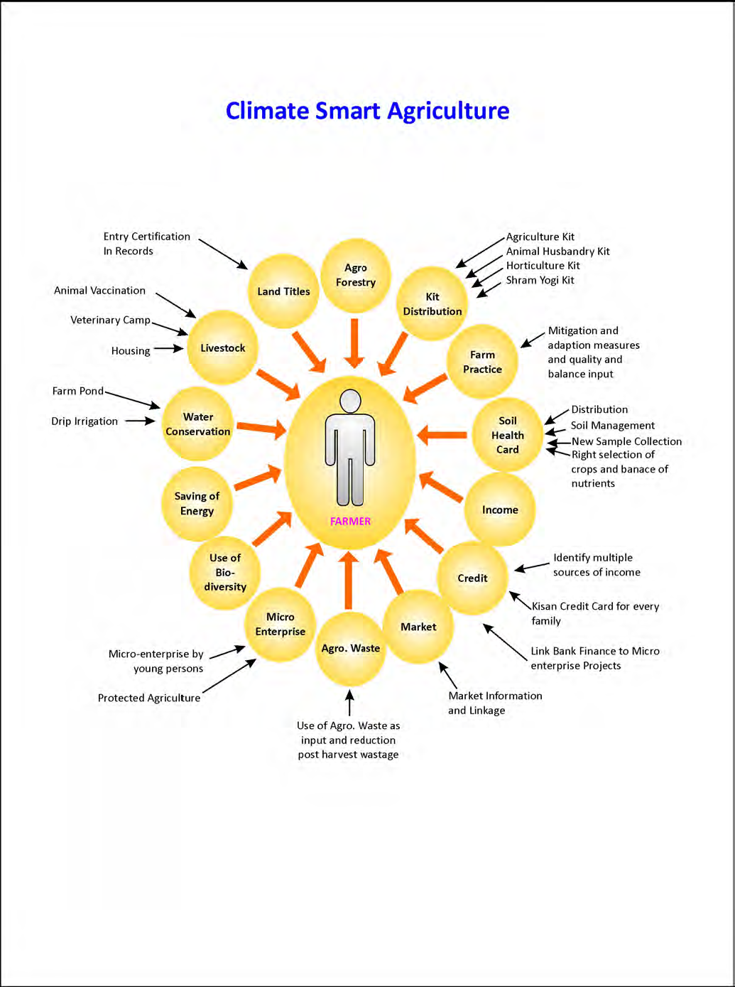

Slide 55
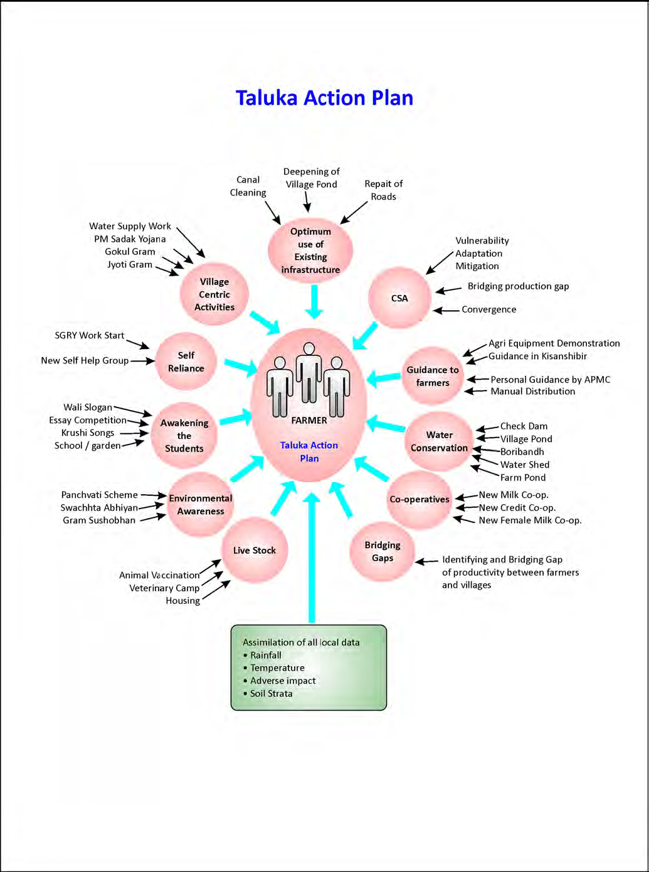

Slide 56
Let's Learn & Share Together for a global mission
Mainstreaming Agriculture for Climate Change Mitigation

Slide 57
Thank You for your patient hearing
Dr. Kirit Shelat
National Council for Climate Change, Sustainable Development
and Public Leadership (NCCSD)
Post Box No. 4146, Navrangpura Post Office, Ahmedabad – 380 009.
Gujarat, INDIA.
Phone: 079-26421580 (Off) 09904404393(M)
Email: drkiritshelat@gmail.com, info@nccsdindia.org Website: www.nccsdindia.org

