Slide 1
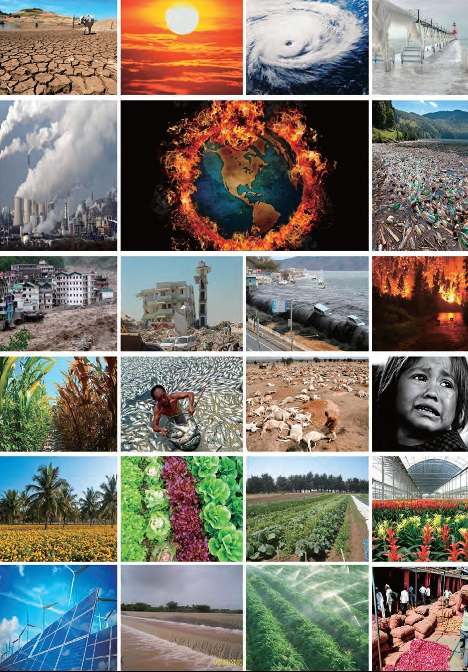
KNOWLEDGE MULTIPLIER HUB
Dr. Kirit Shelat
Executive Chairman,
National Council for Climate Change, Sustainable Development and Public Leadership (NCCSD)
Post Box No. 4146, Navrangpura Post Office, Ahmedabad – 380 009.
Gujarat, INDIA.
Phone: 079-26421580 (Off) 09904404393(M)
Email: info@nccsdindia.org Website:
Dr. Bharat C Patel
Director,
BP Energy & Environmental Consultants
&
Council Member
National Council for Climate Change, Sustainable Development and Public Leadership (NCCSD)
Email: bpatel46@gmail.com , Phone: (609) 721- 3552

Slide 2
Introduction
Agriculture is an important sector of Indian economy. More than 80 per cent of the population depends upon agriculture and allied fields.
It has been widely recognized that transfer of relevant knowledge plays an important role in its growth and productivity, particularly to small and marginal farmers to improve yield and get better market prices.
Given that natural resources like land and water are almost reaching their limits, "knowledge resources” and technological innovation are required to achieve food security.

Slide 3
Conti……….
Management of agriculture knowledge takes place at different levels: individual, within communities, within organizations or institutions and networks.
However the knowledge for agriculture development is more often than not created, documented or disseminated by individual sources or organizations.
Different types of organizations produce different kinds of knowledge and the lack of coordination between public and private agriculture research and extension institutions are often cited as reason for ineffective knowledge transfer to farmers.

Slide 4
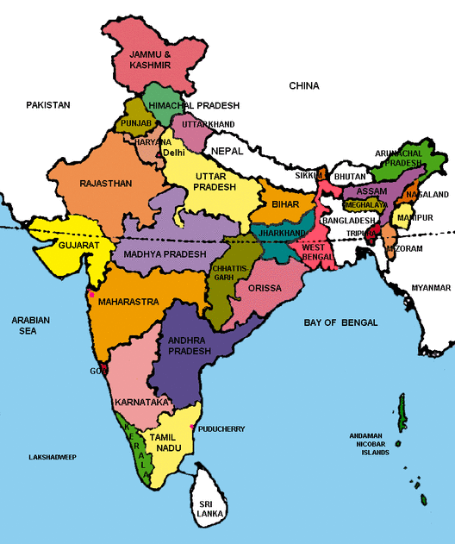
The Indian context
Main agencies engaged in creating knowledge resources for agriculture can be classified into three Broad categories
Public, private and non profit organizations (NGO’s)
Public sector organizations include the Indian Council for Agriculture Research(ICAR) and state agriculture universities.
In additional to these, there are non agriculture universities and research organizations working in agriculture. Private sector companies engaged in the production of seeds, fertilizers, pesticides and export and import of agriculture products are also engaged in knowledge activities via research and development.

Slide 5
Major activities of the three types of organizations
 | Public Sector | Private Sector | NGO’s
Focus | Increase productivity of agriculture crops. Research and Development Education | Increase the productivity of seed fertilizers, pesticides, food processing Export/import of Agriculture Products Research and Development | Involvement in community development. Holistic approach including Human Resources Development and Environment Research and Development
Activities | Training Demonstration and Extension Services | Input supply and market improvement | Extension Services, farmer groups, self employment, self help groups
Knowledge Management | Creation and dissemination of explicit knowledge | Creation of explicit knowledge | Dissemination of knowledge Focus on local knowledge
Objective | Transfer new practices through KVK,ATMA | Commercial and profit making | Development and empowerment
NGOs including co-operatives working in agriculture domain often have a focus on dissemination of best practices and documentation of local knowledge. List the major activities of these three types of organizations.

Slide 6
Food Security and Climate Change: Three intertwined Challenges
Ensuring Food Security
Enough food but in 2010-12 almost 870 million people were estimated to be undernourished (Food and Agriculture Organization of United Nations et al…2012). In addition, another billion people are malnourished.
The paradox is that concomitantly a large number of people mainly in richer countries are over eating, resulting in long-term health issues.
For poor farmers, food is not only a basic need but it is the single, and often fragile, support for maintaining livelihood.
What is true at the household level is also true at the macroeconomic level. There are 32 countries, 20 of them in Africa, facing food crisis and in need of international emergency support. In most of these countries, agriculture is an important source of employment.

Slide 7
Food Security and Climate Change: Three intertwined Challenges
Objective is to ensure food and nutrition security, worldwide. Need to make sure that enough food is accessible to everyone, everywhere, physically and economically.
Between now and 2050, the world’s population will increase by one-third. Most of the additional 2 billion people will live in developing countries and more people will be living in cities.
FAO estimates that production will have to increase by 60 percent by 2050 to satisfy the expected demands for food and feed.
Achievable provided the entire Agriculture sector is moved to adapt climate smart agriculture practices.

Slide 8
Why is Climate Smart Agriculture (CSA) need of time?
What CSA means:
Helps achieve sustainable development goals.
Integrates and coordinates– social, economical and environmental development to meet the challenge of providing sustainable (a) livelihood to farmers (b) food security to hungry millions, and ( c) eradication of poverty.
It is composed of four pillars:
Increase agriculture productivity and income.
Adapt and build resilience to climate change.
Reduce GHG emissions without harming farmer’s interest.
Use agriculture as a major tool for mitigation of CO2 - absorb CO2 and release Oxygen through photosynthesis process. It envisages to achieve this through (a) increased cropping by reducing rain fed areas through integrated water and river basin management (b) expansion of agriculture on wasteland, wetland, degraded fallow areas and urban agriculture.

Slide 9
Climate Smart Agriculture (CSA)
It prepares farmers to be agriculture smart on a regular permanent basis rather than ad hoc or transitory to survive the onslaught impact of climate change.
The challenge before Agriculture Administration, Agriculture Scientists, Extension Services, Public and Private Agricultural Organizations, and Public leadership is to make this happen.
It is an approach for addressing the development efforts towards technical policy and investment condition by mainstreaming agriculture in overall development strategy at local level - village level.

Slide 10
Climate Smart Agriculture (CSA)
Climate Smart and Sustainable Agriculture
Despite adverse climate impact on crops/animals, income to farmers should not decrease. It needs to provide opportunities to farmers to have multiple source of income from agriculture, animal husbandry, fisheries- milch cattle and poultry. So when one fails, other supports.
It provides opportunity to young members of family to acquire multiple skills, support for setting up microenterprise locally based on demand and supply situation, support for setting up protected agriculture and support for farmers on the use of green house technology.
It provides safety net at times of natural calamities – by way of crop insurance – for crops and animal husbandry.
It provides employment in community projects during lean seasons or at times of drought or whenever needed.

Slide 11
Climate Smart Agriculture (CSA)
Climate smart agriculture involves :
Crop pattern based on soil health and moisture analysis of an individual piece of land to support crops which can be sustained by its soil.
Local Weather Advisory directly to the farmers with long term, medium term and short term inputs in order to take precautionary actions.
Immediate Agro Advisory after unexpected weather changes have occurred for timely corrective action to prevent crop loss.
Nutritional and preventive vaccination to cattle and poultry.
All these by direct communication to farmers at their doorsteps, using all available scientific technologies to make agriculture more productive, less costly and linked with value added market mechanism..

Slide 12
There are three kinds of impact of change in climate
A concurrent impact which is taking place over the decades. This has already affected productivity and reduction in water resources, while cost of energy is growing higher | At local level action plan is needed to provide by taking stock of what has happened to soil and its productivity and same about livestock due to changes in weather – increase in temperature etc
Unexpected change in weather pattern during monsoon season like delayed rain, long intervals for rain or heavy rain – flood has already affecting Horticulture crops. | A contingency plan to modify cropping pattern. This has to be part of local level (Taluka Level) action plan and Comprehensive District Agriculture Plan (CDAP). This is already prepared by Agri. Universities but need to be made available to farmers.
Major calamity like floods, cyclone/tornado , cloud burst etc | Need restoration strategy because such disasters some time wipe out entire soil strata and sweet water sources including livestock and shelter
Notes:
12

Slide 13
Climate Smart Agriculture (CSA)
Sustainable DEVELOPMENT
Sustainable development is a pattern of natural resource use that aims to meet human needs while protecting the environment simultaneously.
This ensures that the need for resources can be met not only in the present, but also in the infinite future.
The word “Sustainable development” has well-known implications.
It is a long-term activity. It involves the use of natural resources. It implies economic growth with socio economic and environmental content to provide sustainable livelihood.
Sustainable livelihood means.....
Provide enough to all to live or exist,
It should not become less and that
There is gradual increase in income for better quality of life.
This happens at local level – village level

Slide 14
Indian Situation
India’s success over six decades:
2 % to 3% sustainable agriculture growth.
Brought many out of poverty
Tackled many adverse climate and geographic challenges
Validated research to raise productivity
Several states and individual farmers have achieved average productivity higher than or equal to International level.
Though unequal growth between agriculture and other sectors like services and manufacturing that have average growth of 8% - 10%. , thereby increasing rural and urban divide.
Unequal growth between farmers at local level in same village with similar land and water resources. One makes profit and other fails – commits suicide.
Adverse impacts of climate change pushes even successful farmers back to poverty.
There is a concern regarding farmer suicides and large scale exodus to urban centers.
There are still about 30% farmers below poverty line.

Slide 15
“Knowledge Gap”-NCCSD analysis-
The survey was carried out by NCCSD with the following main objectives under the agro-climatic condition of Anand, Navsari and Kutch district in the state of Gujarat, India with the support of AAU (Anand Agriculture University), NAU(Navsari Agriculture University) and VRTI (Vivekanand Research and Training Institute) in 2013-2014.
The objective of the survey was to :
Study the “knowledge level” among the farmers about the climate smart agriculture based on their level of education, and
Identify gaps.

Slide 16
SUMMARY OF FINDINGS AND CONCLUSION:
TABLE-A Effect of respective levels of education among the farmers:
A=Higher Secondary and above level, B=Secondary level and C= Primary level of education
Aspects of Climate Smart Agriculture | Knowledge(%) of Anand district |  |  | Knowledge(%) of Navsari district |  |  | Knowledge (%) of Kutch district
 | A | B | C | A | B | C | A | B | C
1. Knowledge among the farmers about the weather parameters | 47 | 41 | 38 | 59 | 41 | 38 | 59 | 48 | 43
2. Knowledge among the farmers about the sci. application of weather parameters in agriculture | 52 | 42 | 38 | 51 | 42 | 38 | 54 | 45 | 44
3. Knowledge among the farmers about the use of modern scientific technology | 53 | 44 | 31 | 53 | 44 | 31 | 53 | 47 | 43
4. Knowledge among the farmers about the impacts of climate change effect in agriculture | 58 | 49 | 39 | 58 | 49 | 39 | 54 | 52 | 36
5. Knowledge among the farmers about the contact of extension linkages | 49 | 43 | 39 | 42 | 37 | 33 | 42 | 37 | 33
6. Impacts of social participation among the farmers | 42 | 37 | 35 | 39 | 35 | 31 | 39 | 35 | 31

Slide 17
Average knowledge of CSA (%) | 50 | 43 | 37 | 50 | 41 | 35 | 50 | 44 | 38
Average of Education level about CSA (% ) | A= 50% (Higher Education & above level) B= 43% (Secondary level of Education) C= 37% (Primary level of Education)

Slide 18
TABLE-B Effect of irrespective level of education among the farmers.
SUMMARY OF FINDINGS AND CONCLUSION:
Overall Percentage of Knowledge | Knowledge levels about the weather parameters (%) | Knowledge levels about the utility of weather parameters in agriculture (%) | Knowledge levels about the modern scientific technology (%) | Impacts of climate change effect on agriculture (%) | Effect of extension linkages among the farmers (%) | Effect of social participations among the farmers (%)
1. Anand district | 42 | 44 | 42 | 48 | 44 | 38 = (43)
2. Navsari district | 47 | 48 | 53 | 43 | 42 | 31 = (45)
3. Kutch district | 51 | 48 | 53 | 43 | 42 | 31 = (45)

Slide 19
Conti….
The survey data (Table-B) clearly shows that the overall knowledge percentage with respect to Climate Smart Agriculture of the farmers of Anand, Navsari and Kutch district, irrespective of education level, was very low around 44%.
The maximum knowledge gap among the farmers was observed at 57%, 55% and 55% in Anand, Navsari and Kutch district respectively.

Slide 20
“Productivity Gap”-NCCSD analysis-
NCCSD jointly with Anand Agriculture University, Anand, Gujarat, Dr.Shelat and Dr.Shekh conducted study on productivity gap between average (small) farmers and progressive farmers of Anand, Gujarat (the most fertile district) and Mandvi, Kutch(the arid-salinity affected area. The findings were as under.

Slide 21
Gap in Productivity –
Crop wise average yield and Optimum yield-Anand Block, Anand District, Gujarat
Source: Agriculture Production Local Level Plan Shekh & Shelat - NCCSD 2013
Sr No | Crop | Area(ha) | Average yield (qt/ha) | Optimum yield (qt/ha) | Yield gap (qt/ha) | Anand Block Yield gap %
1 | Pearl millet (K) | 3640 | 15.25 | 20.25 | -5.00 | -24.69
2 | Pearl millet (S) | 8751 | 26.78 | 30.65 | -3.87 | -12.62
3 | Rice (K) | 6230 | 28.10 | 35.60 | -7.50 | -21.06
4 | Wheat | 3540 | 28.00 | 34.50 | -6.50 | -18.8
5 | Tobacco (B) | 10612 | 20.00 | 25.62 | -5.62 | -21.9
6 | Castor | 745 | 26.00 | 30.00 | -4.00 | -13.3
7 | Pigeon pea | 205 | 10.00 | 15.24 | -5.24 | -34.3
8 | Sesame (K) | 210 | 4.60 | 7.00 | -2.40 | -34.2
9 | Sesames (S) | 360 | 7.00 | 8.50 | -1.50 | -17.64
10 | Cotton | 927 | 6.57 | 13.19 | -6.62 | -50.18
11 | Green gram (S) | 289 | 4.25 | 7.00 | -2.75 | -39.28
12 | Chickpea (G) | 72 | 15.00 | 20.60 | -5.60 | -27.18
13 | Chickpea (V) | 150 | 18.00 | 22.00 | -4.00 | -18.18
14 | Groundnut (S) | 100 | 17.45 | 23.00 | -5.55 | -24.13
15 | Mustard | 426 | 14.20 | 18.90 | -4.70 | -24.86
16 | Cluster bean (Gum) | 431 | 10.00 | 15.65 | -5.65 | -36.10
Total |  |  | 31113

Slide 22
Horticulture Crops: Gaps in Yield
Sr No | Crop | Area (ha) | Average yield (qt/ha) | Opti­mum yield (qt/ha) | Yield gap (qt/ha) | Yield gap %
1 | Banana | 3120 | 600 | 700 | -100 | -14.2
2 | Papaya | 60 | 415 | 650 | -245 | -36.15
3 | Lemon | 180 | 100 | 120 | -20 | -16.6
4 | Chiku | 60 | 80 | 120 | -40 | -33.33
5 | Ber | 30 | 90 | 150 | -60 | -40
6 | Pomegranate | 25 | 65 | 80 | -15 | -18.75
7 | Aonla | 100 | 90 | 125 | -35 | -28
8 | Mango | 350 | 45 | 85 | -30 | -47.05
9 | Jamun | 25 | 7 | 10 | -3 | -30
10 | Watermelon | 90 | 460 | 520 | -60 | -11.53
11 | Muskmelon | 80 | 300 | 375 | -75 | -20
Total |  |  | 4120

Slide 23
Forage Crops: Gaps in Yield
Sr. No | Crop | Area (ha) | Average yield (qt/ha) | Optimum yield (qt/ha) | Yield gap (qt/ha) | Yield gap %
1 | Hybrid Napier grass (7 to 8 cuts) | 702 | 2000 | 2800 | -800 | -28.57
2 | Maize African tall | 1986 | 600 | 1200 | -600 | -50
3 | Forage sorghum | 2255 | 650 | 800 | -150 | -18.75
4 | Cowpea (Chola ) | 80 | 300 | 400 | -100 | -25
5 | Lucerne (8 to 10 cuts) | 737 | 750 | 1000 | -250 | -25
6 | Oats (2 cuts) | 50 | 450 | 550 | -100 | -18.18
Total |  |  | 5810

Slide 24
Yield Gap in Productivity of Livestock
Sr No | Livestock | Population | Average produc­tion | Optimum produc­tion | Yield Gap | Yield gap %
1 | Buffaloes | 67285 | 4.24 lit /day | 10 lit/day | -5.6 lit./day | -57.6
2 | Cross bred cows | 10000 | 8.15 lit/day | 15 lit/day | -11.85 lit./day | -45.6
3 | Indigenous cow | 13852 | 4.23 lit/day | 8 lit/day | -3.77 lit./day | -47.12
4 | Desi layers / annum | 10158 | 130 no./year | 180 no./year | -50 no./year | -27.7
5 | Improved lay­er/ annum | 427100 | 250 no./year | 300 no./year | -50 no./year | -16.6
6 | Broiler | 130000 | 2.00 kg/birds | 3.5 kg/birds | -1.5 kg/birds | -42.8
7 | Emu farming | 1500 | 8.00 eggs/ bird | 12.00 eggs/ bird | -4.00 eggs/ bird | -33.3
8 | Fisheries (86 ponds) + Chestnut/ Sin­goda | 267 (ha) 267 (ha) | 60000.00 (Net income in Rs) Rs70,000 | 90000.00 (Net income in Rs) Rs 1,20,000 | - Rs 30,000 - Rs 50,000

Slide 25
Rukmavati River Basin Current Agricultural Crops – area
Mandvi- Block,Kutch-District -Crop wise average yield and Optimum yield
Sr. No | Crop | Area (ha) | Average yield (qt/ha) | Optimum yield (qt/ha) | Yield gap (qt/ha) | Yield gap %
1 | Groundnut (K) | 8624 | 15 | 22 | -7 | -31.8
2 | Hy. Cotton | 5279 | 25 | 50 | -25 | -50.0
3 | Moogbean (K) | 3994 | 5 | 8 | -3 | -33.3
4 | Sesamum (K) | 3320 | 3 | 6 | -3 | -50.0
5 | Wheat | 2651 | 30 | 40 | -10 | -25.0
6 | Hy. Castor | 1651 | 30 | 50 | -20 | -40.0
7 | Hy. Bajra (K) | 889 | 20 | 25 | -5 | -20.0
8 | Cluster bean | 578 | 8 | 15 | -8 | -50.0
9 | Hy. Bajra (S) | 228 | 25 | 35 | -10 | -28.6
10 | Groundnut (S) | 150 | 18 | 22 | -4 | -18.2
11 | Isabgol | 60 | 8 | 12 | -4 | -33.3
Total |  | 27424

Slide 26
Poverty Estimate
Planning Commission of India and Tendulkar Committee Report estimate poverty level at 25.7% in 2011-12.
While in urban area, poverty declined from 31.8% to 13.7%
Poverty in rural area declined from | percentage below poverty line
1993-94 | 50.0%
2011-12 | 25.7%

Slide 27
“KNOWLEDGE MULTIPLIER HUB”-Why?
Current gaps in productivity between average and optimum point to the lack of effective knowledge transfer to farmers.
The challenge to sustainable development is not about lack of knowledge and research. We have all these. But we are not able to transfer this effectively to all farmers, all villages of our country. We are faced with the challenge of a growing gap in productivity between average and optimum production between one farmer and another in the same location with similar conditions. The challenge is to know the reasons for such gaps and to develop implementation strategies to reduce them.

Slide 28
Objectives of the Knowledge Multiplier Hub
To create awareness among farmer communities about the need and the practice of Climate Smart Agriculture..
To collect, compile and share knowledge and practice on green livelihoods (agriculture, water, forestry, fisheries, and energy) and initiate advocacy movement for adaptation on a larger scale.
To provide capacity building and skill enhancement training on agriculture based livelihood and climate change mitigation efforts.
To generate more sustainable livelihood opportunities for the farmers
To develop best practices and case studies in sustainable livelihood and agriculture.
To act as a web based platform for promoting community based locally relevant and environmentally viable technology and knowledge dissemination initiatives.

Slide 29
Current Models and Constraints:
Current Models-
1 Web based
2 Radio and TV bulletins by Government
3 News notes in news papers and magazines.
Constraints –
Web based portals are generally in English – India has officially 22 languages and not all are English savy. Even educated farmers do not understand .
The internet connectivity it is limited at village level
Radio and TV networks, including news papers are popular modules but most often not up to date. By the time they broadcast weather warning the event may taken place.
Hence there is need for effective mass communication model that can provide basic information to farmers right at their door step as well as processes that will provide the ability to access relevant knowledge by email/toll free phone/written letter/Hub

Slide 30
ACTIVITIES AT THE “Knowledge Multiplier Hub”
Setup KMH web portal
Through Action Research develop current, timely and relevant CSA material specific to state, national and international context.
Through Action Research provide marginal and small farmers skill and information on how to access finance.
Elements of CSA to be addressed:
Water Cycle
Soil Management, Soil and Climate change and Soil Health Card.
Energy Savings and Climate Change
Animal Husbandry
Poultry
Fisheries
Organic Farming
Biotechnology
Weather Forecast.
Agri Entrepreneurship
Access to Finance
Agro and Food Processing
Climate Justice
Women Farmer
Multiple Sources of Income
Microenterprise
Value added Agriculture
Finance for S.T/M.T and L.T
Waste Management, Biogas, Vermicompost, Compost Pit.
Urban Agriculture
Renewable Energy
Water Recycling

Slide 31
Suggested organizational framework

Slide 32
Communication Team-Use all available comunication. methods through ICT to reach out
The fourth group is the Resources Assembling Group. Resources will be required by the second and third groups. The second group will use them and feed them to the first group in an actionable form
The second group is the Mentor/Coach Group. This group will be in good part women and men who are retired from active life and who have the inclination to help build the knowledge base to assist poor, small & marginal farmers and animal holders.
The third group will be the Reference Librarians. They will feed the second group who in turn will feed the first group.
The first group is the Leader-in-Action Group. This will be an increasing one. This will be core group lead by Principal Investigator and team

Slide 33
About NCCSD
NCCSD is the outcome of the deliberations that took place during an International Conference on “Global Warming, Agriculture, Sustainable Development & Public Leadership” which was organized at the Gujarat Vidyapith – Ahmedabad in March 2010 by the International School for Public Leadership (ISPL) along with other organizations. In a Round Table Meet at New Delhi in April, 2010, presided by Prof. M S Swaminathan and Justice B P Singh, it was felt that a special organization needs to be created to follow up ideas and it was decided to setup "National Council for Climate Change, Sustainable Development and Public Leadership” (NCCSD).
NCCSD is promoting Sustainable and Climate Resilient Agriculture with the involvement of Public Leadership. NCCSD has become leading Environmental NGO under the leadership of our President Justice B. P. Singh, Formerly Judge, Supreme Court of India. NCCSD is a non-profit organization. The NCCSD was registered under Bombay Charitable Trust Act 1950 Rule-29-No. E/19344/Ahmedabad as Public Trust on 17th September 2010. Its mission is to promote sustainable livelihood, climate resilient & sustainable agriculture in arena of global warming.

Slide 34
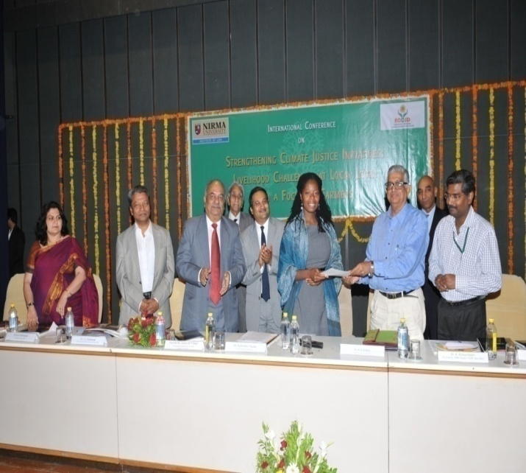
NCCSD has signed MOU with Florida Agricultural and Mechanical University (FAMU) for technology transfer and collaborative. Executive Director of Sustainability Institute Ms. Abena Ojetayo visited India in November, 2014 and participated in International Conference on Climate Justice organized by NCCSD.

Slide 35
WHAT WE DO?
NCCSD is organizing Inter-action Meet and Think-Tank Meet for policy formulation and sensitization on issues related to farmers with their participation.
NCCSD is organizing Interactive and Capacity Building to Farmers with focus on local level leaders, young farmers and women farmers.
It is train to young faculty members and students on Leadership and Climate Smart Agriculture.
NCCSD is conducting action research work for developing communication modules including guidebook, posters and documentary films for farmers.
NCCSD is sensitizing State and Central Government on important policy issues which concern farmers. It is also taking up similar issues with UNFCCC and UN at international level
NCCSD is publishing books on important issues related to farmers and agriculture.

Slide 36
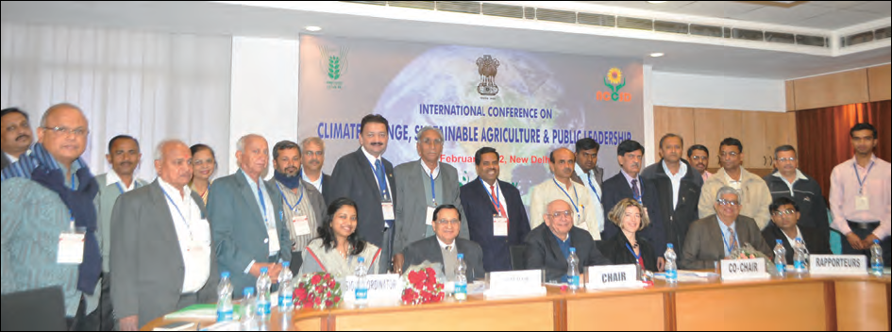
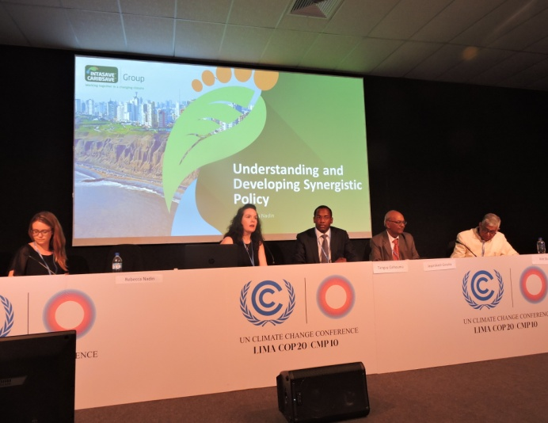
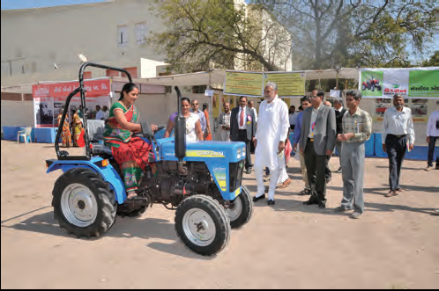
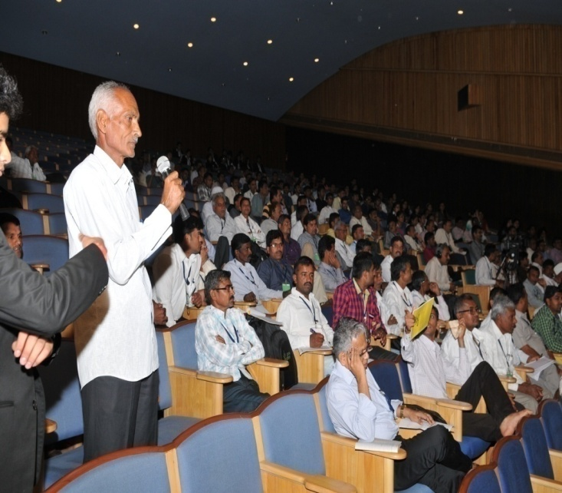
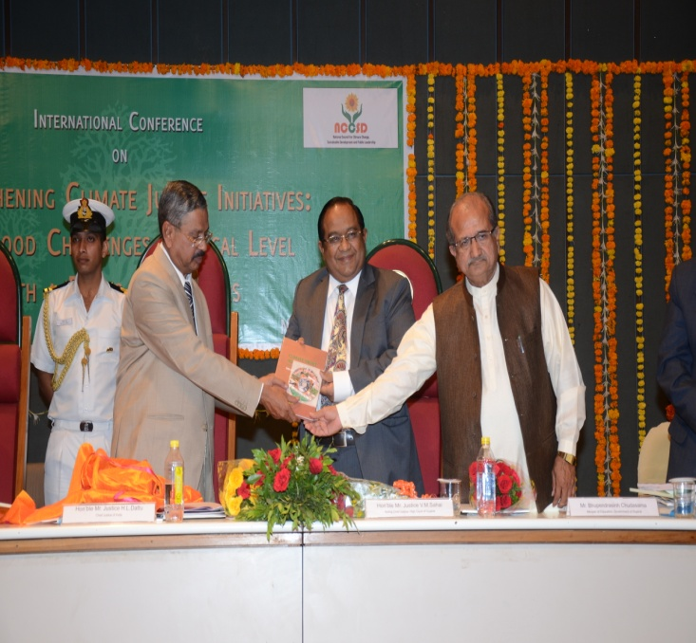
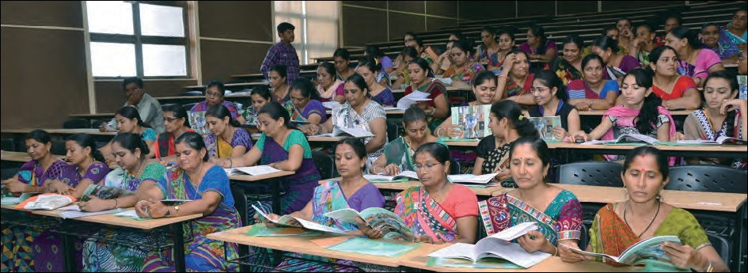

Slide 37
Book on “Climate Smart Agriculture - the way forward: The Indian perspective”- by DR Kirit N. Shelat
Kindly visit the following links for this book.
http://www.discovery.org.in/climate_change/index.htm
http://www.discovery.org.in/climate_change.htm

Slide 38
Thank You for your patient hearing

