Slide 1


Energy – Water – Food Nexus Challenges Ahead
Dr. V.K. Singh
Director
Central Research Institute for Dryland Agriculture (CRIDA)
Indian council of Agricultural Research (ICAR)
India

Slide 2
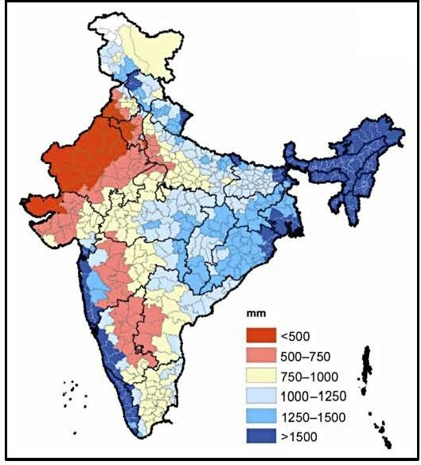
Climate Change and Indian Agriculture
Agriculture depends on monsoon (51% area rainfed)
Changing pest & diseases incidence
Small & marginal land holdings (86%)
Latest IPCC AR-6 Report, 8 Aug 2021 (South Asia)
  Increase in rainfall, high inter annual variability
  Intense and frequent heatwaves
  Temperature increase
  Sea level rise

Slide 3
Why Nexus?
Already Water is a scarce resource in many places. GEO-4 estimates that by 2025 two-thirds of the global population will be living in areas experiencing water stress
Agriculture is likely the biggest user of freshwater resources; expanding and intensifying bioenergy production could add to existing pressures
As the integrity of water systems declines, they are less able to provide fundamental ecosystem services such as the provision of clean water, natural filtration services, natural habitat for fisheries etc.
Global challenges such as climate change, population growth, change in living standards and energy demand will further impact the world’s water supplies

Slide 4
Energy-Food Systems and Integrated Planning
Irrigation Fertilizers Harvesting Tillage Processing Storage
Integrated Water Resource Management
Pumping Water/Wastewater treatment Drainage Desalination Water distribution
Irrigation Processing
ENERGY
WATER
FOOD
Energy generation cooling Extraction Transport Bioenergy Production
Water Quality
Bioenergy Production

Slide 5
The Food-Energy Irrigation Nexus
AGRICULTURE
Re-aligning food procurement policies
Providing incentives to grow low water consuming crops
Better field water management techniques
Depleting Groundwater
Lack of crop diversification
Water-Energy-Agriculture Nexus
Wastage/Misdirected
Energy and Agriculture Subsidies
GROUNDWATER
GW laws and regulations
Supply augmentation through MAR
Demand management through community participation
ELECTRICITY
Demand side management
Supply management through rationing
Increasing efficiency of pumps
Institutional reforms

Slide 6
Food-irrigation and energy nexus
India’s irrigation sector is depending on groundwater
Much of this groundwater is pumped using electricity
Groundwater use is more than sustainable recharge in most states leading to groundwater over-exploitation
Electricity is Subsidized in most (though not all) states
This creates a nexus where one sector (agriculture) is dependent on unsustainable trends groundwater and electricity sectors

Slide 7
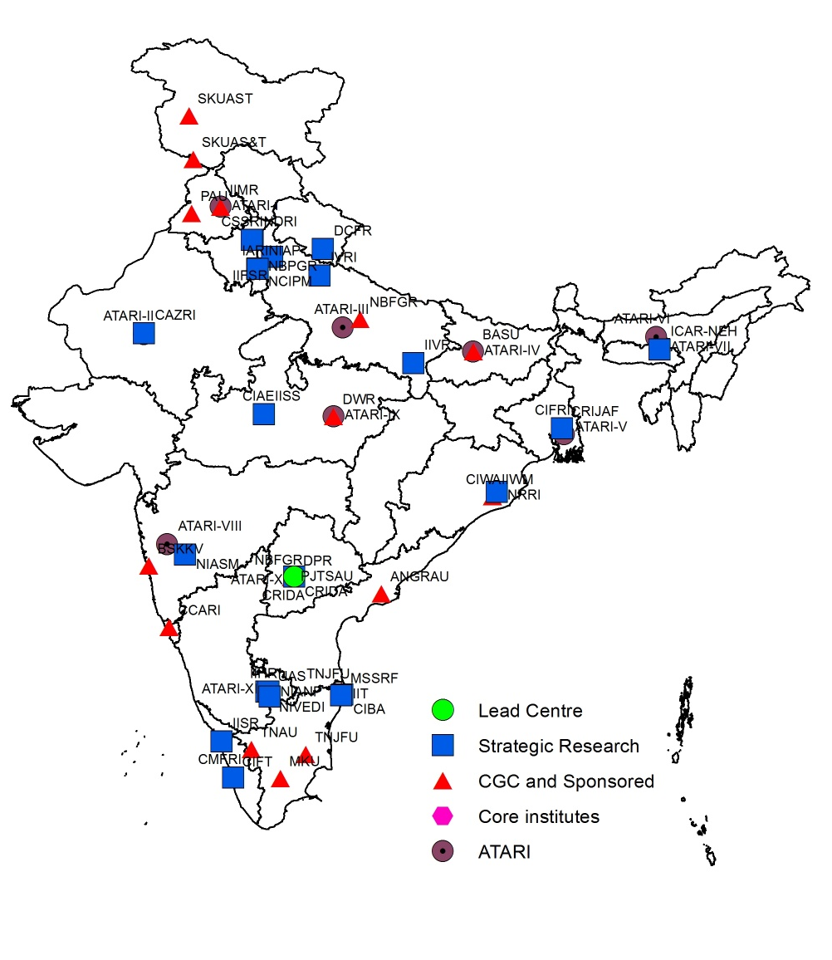
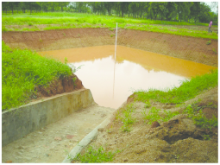
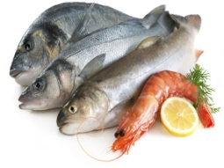

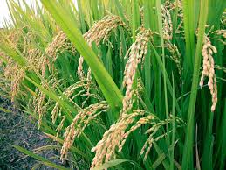
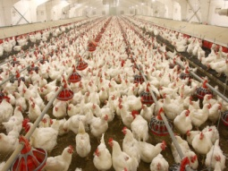
Initiated in 2011
National Innovations in Climate Resilient Agriculture (NICRA)
Objectives
NICRA Network
To undertake strategic and applied research on climate change adaptation and mitigation
To validate, demonstrate and assess the impact of climate resilient technologies on farmers' fields
To strengthen the capacity of scientists, farmers and other stakeholders on climate resilient agriculture
Enhance the resilience of Indian agriculture to climatic variability & climate change
Unique Project-brings all sectors of agricultural scientists on one platform
(crops, horticulture, livestock, fisheries, NRM and social sciences)

Slide 8
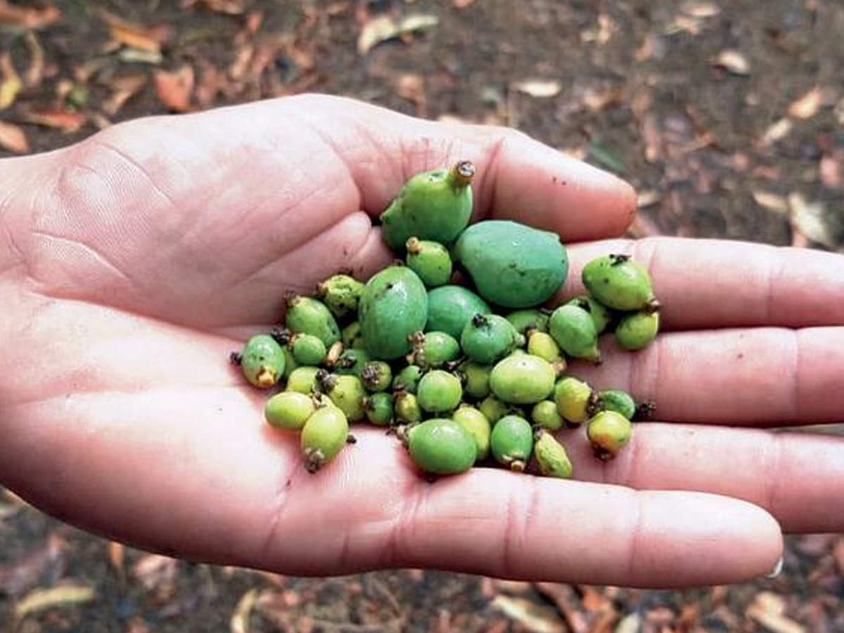
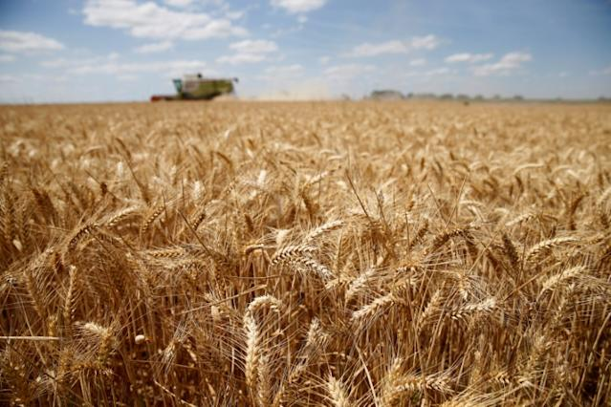
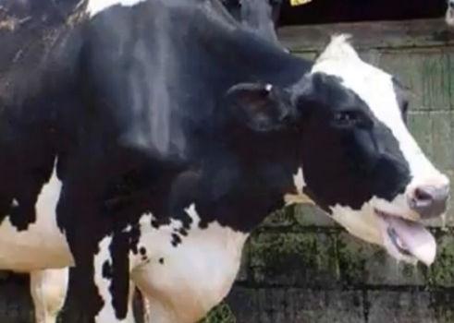
Rajasthan
MP, Jharkhand, Bihar
Heat Wave Impact (2022)
Punjab, UP, Haryana &MP
Lemon
Mango
J&K, Punjab
Wheat
Poultry mortality
Reduction in milk yield

Slide 9
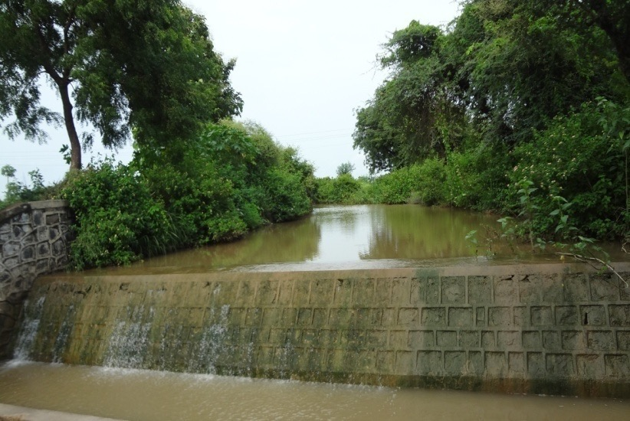
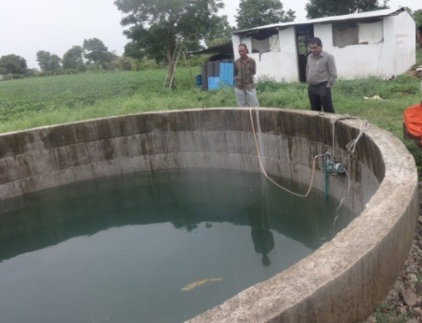
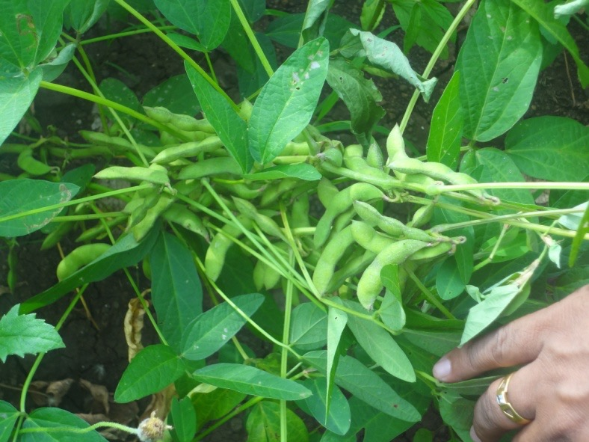
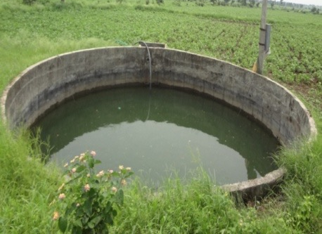
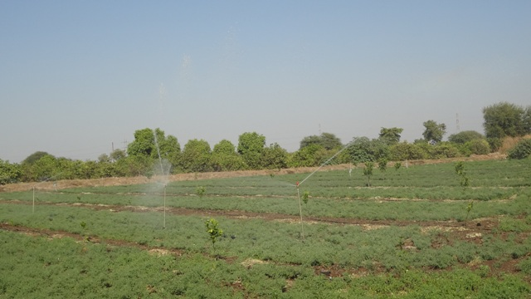
Rainwater Harvesting and Efficient Utilization is Key for Resiliency
Renovation of Check dams
NICRA village at KVK, Amravati - 62 wells recharged, benefitting 218 farmers covering 131.7 ha
Soybean
Crop | Yield (q/ha) |  | % increase
 | With supplemental irrigation | Without supplemental irrigation
Soybean Js-9305 | 6.85 | 3.85 | 77.23
Soybean Js-335 | 4.50 | 2.90 | 55.17
Chickpea

Slide 10
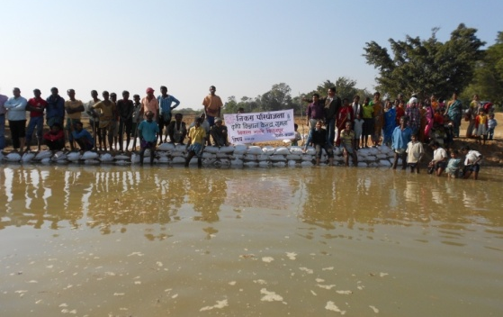
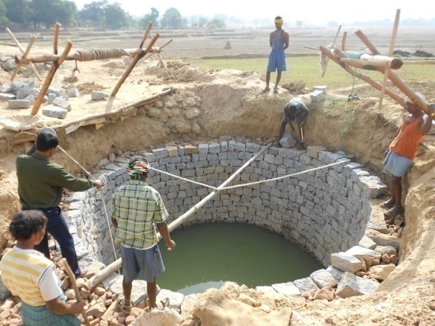
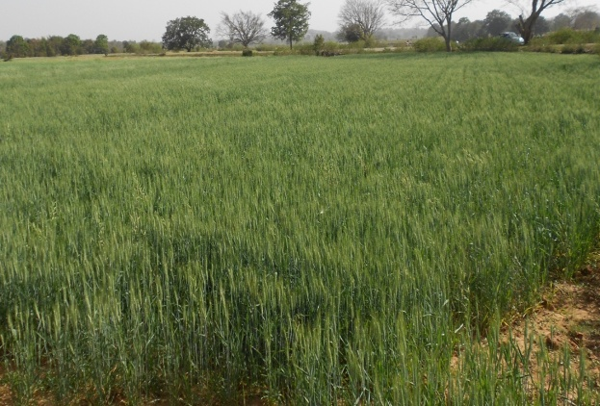
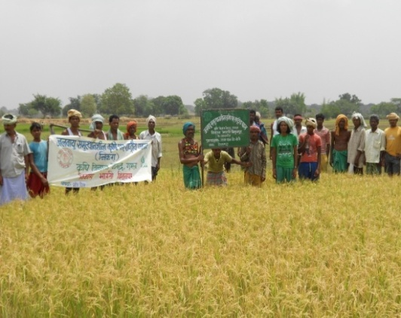
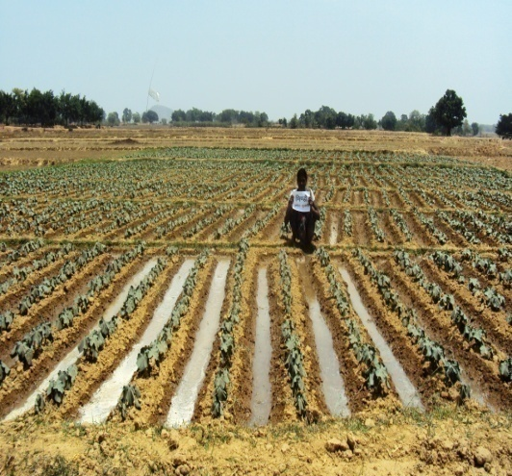
Soil and Water Management
Packaging Farm Pond Technology
Borbanda, Low cost water harvesting for protective irrigation in Paddy (improved the yields by 10-30%)
Low-cost recharging of open and bore wells
Green leaf manuring to enhance soil organic carbon
Tank silt recycling for Soil Health, Mid-Season Droughts and Improved Crop Productivity
Water productivity enhancement through in-situ water harvesting
Measurement of Water table
The harvested water was used for protective irrigation in Paddy which has improved the yields by 10-30% .
About 61 ha area was brought under rabi cropping (wheat and vegetables) in the NICRA village which has increased returns significantly.

Slide 11
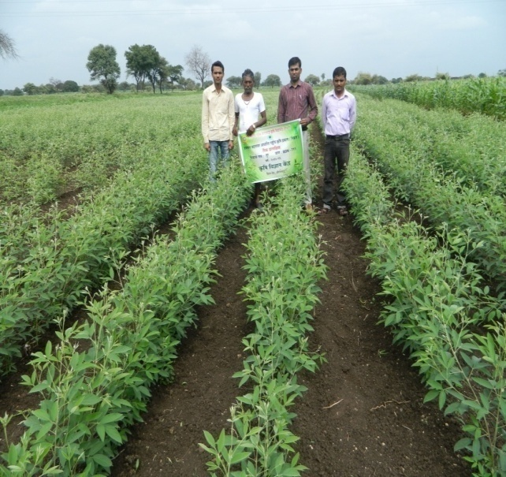
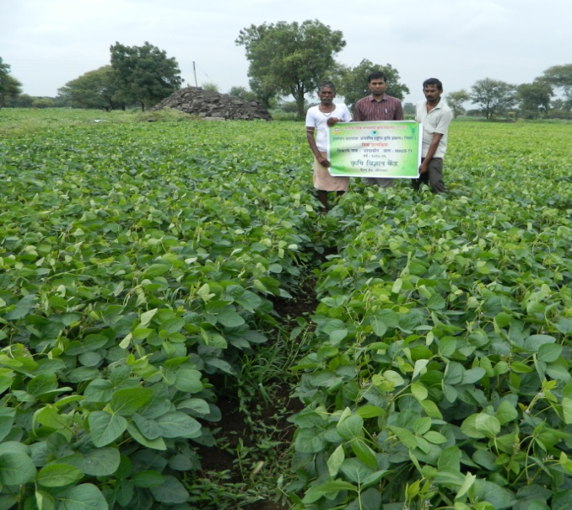
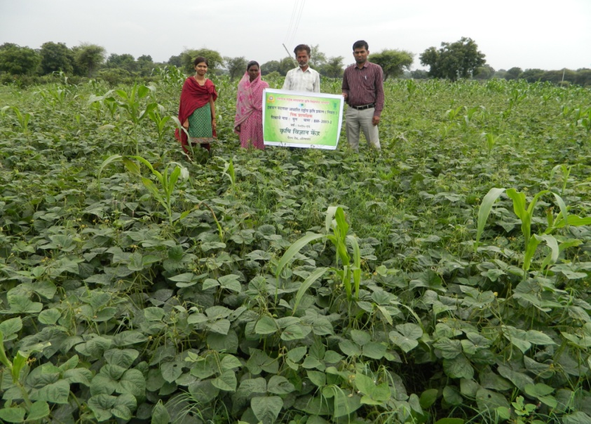
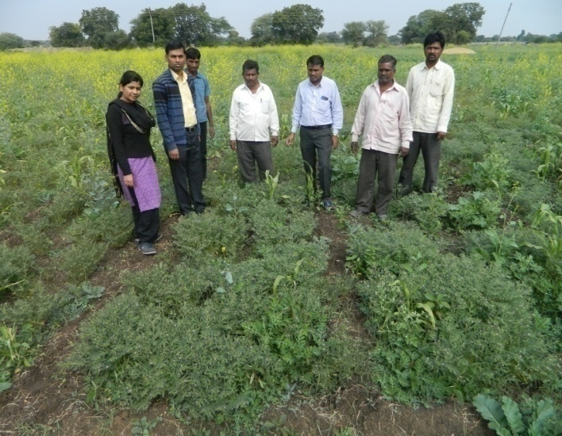
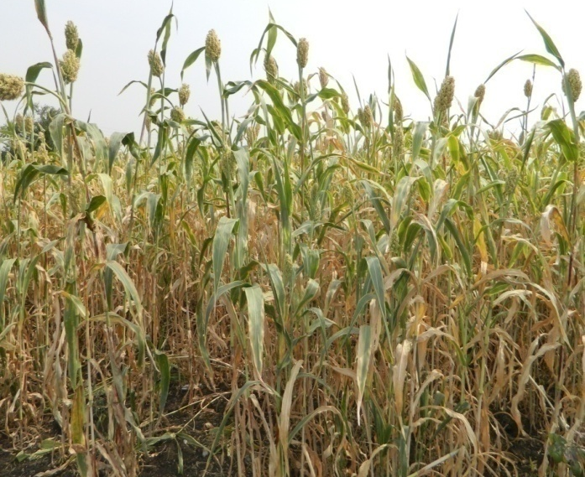
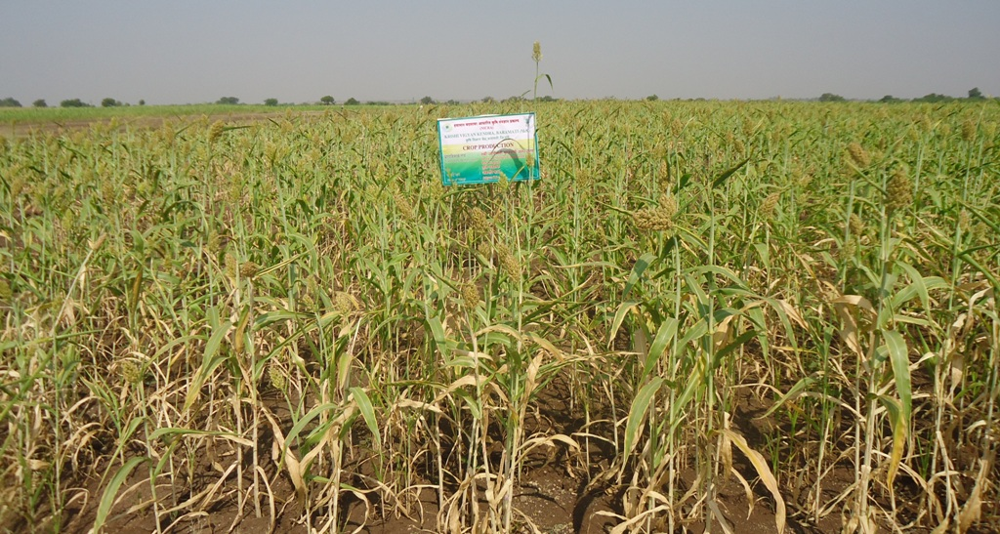
Short Duration Drought Tolerant Crop Varieties
+20%
+28%
+30%
Pigeonpea (BDN-711)
Soybean (MAUS-71)
Greengram (BM-2003-2)
+11%
+14%
+27%
Chickpea (Akash)
Rabi Sorghum (Parbhani Moti)
Phule Anuradha
Significant improvement in yields were observed in comparison to the farmers practice.

Slide 12
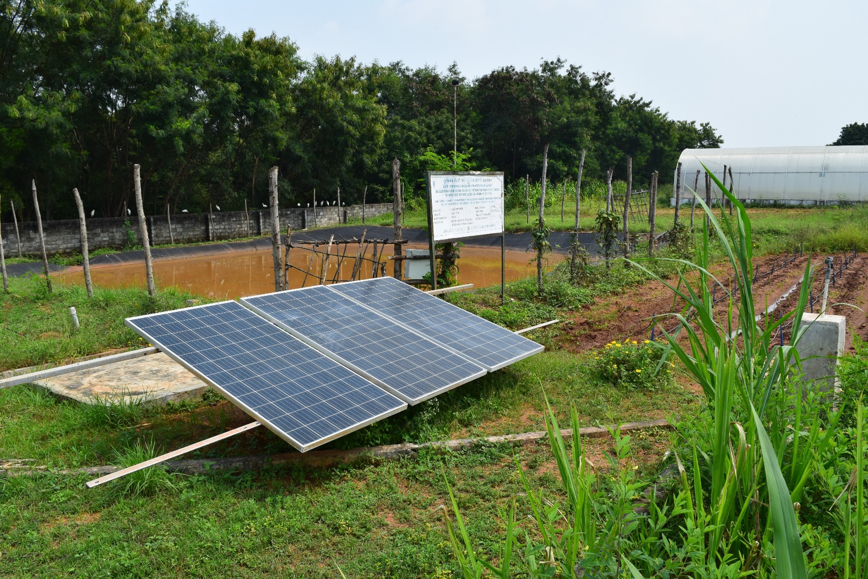
Solar Energy in Agriculture Promotional Strategies
Off Grid – Solar Pumps and Solar Mini-grids
Costs reducing significantly
Solar pumps are promoted by high capital subsidy as climate mitigation agenda
Solar mini-grids sell electricity to farmers and charge tariff depending on the ownership of the system

Slide 13
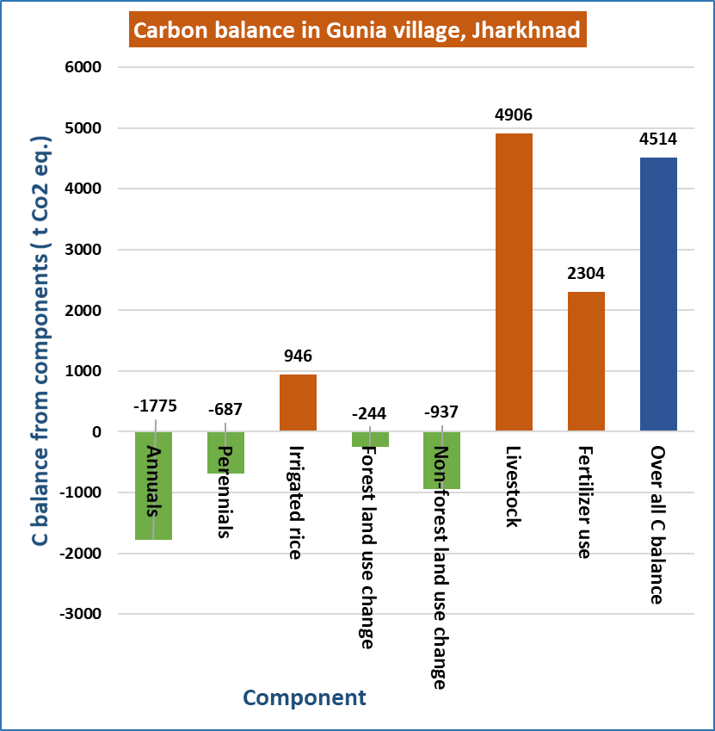
Mitigation Achieved due to Adoption of Resilient Technologies
(Gunia village, Gumla district, Jharkhand)
Emissions (t CO₂ eq.) :
Livestock (4906)
Fertiliser use (2304)
Irrigated rice (946)
Sinks (t CO₂ eq.) :
Annuals ( - 1775 )
Perennials (- 687)
Non forest land use change (-937)
Forest land use change (- 244)
Village : Gunia | Gross fluxes in GHGs ( t CO₂ eq.)
Gumla district, Jharkhand | Without project | With project | Balance
Total (For village /20 year period) | -6963 | -2449 | 4514
Per ha | -14 | -5 | 9
Per ha /annum | -0.6 | -0.3 | 0.4

Slide 14
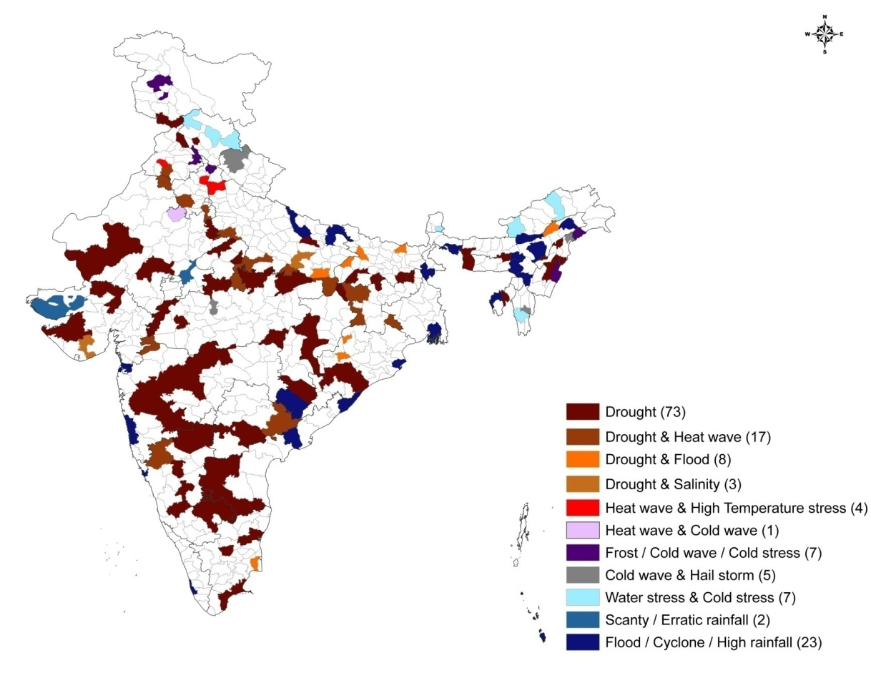
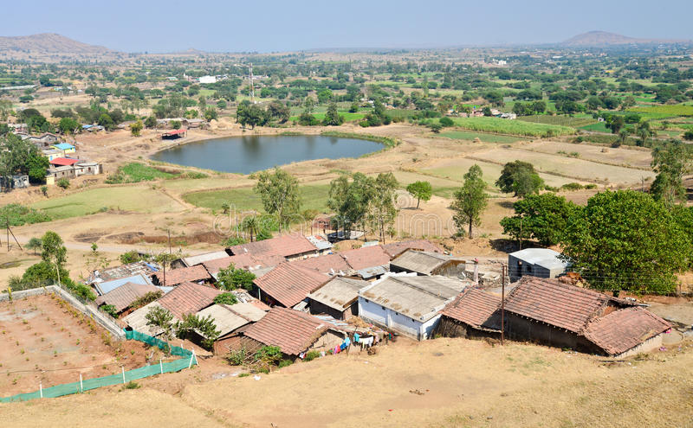
Climate Resilient Villages (CRVs)
Enhancing resilience and adaptive capacity of farmers to Climate Variability
One cluster village each in
151 climatically vulnerable districts
29 States, 352 Technologies, 446 villages, 203,650 ha, 183,752 households

Slide 15
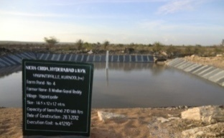
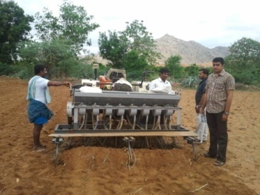
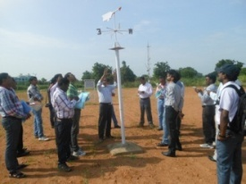
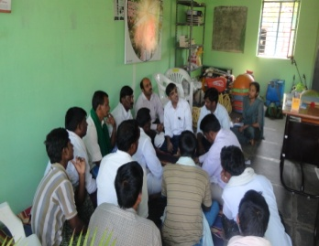
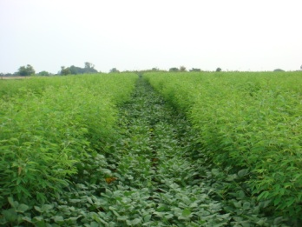
Technological Options for Climate Resilient Village
Weather
Village weather stations
Automatic weather stations
Weather based agro-advisory
Documenation of aberrant weather conditions
Awareness building through extension
Real time measures adverse weather
Water
Aquifer recharge
Ground water recharge
In-situ-moisture conservation
Farm ponds
Efficient application system
Drainage
Integrated farming system
Flood diversions
Community management of water
Crop
Drought tolerant varieties
Flood tolerant varieties
Saline tolerant varieties
Intercrop /systems
Efficient rice systems
Nutrient
Soil health cards
SSNM
Legumes
INM
Precision application
Fertigation
Manuring
Carbon
Village organic resource inventory
Residue recycling
Conservation agriculture
Tank silt
Agro forestry
Livestock management

Slide 16
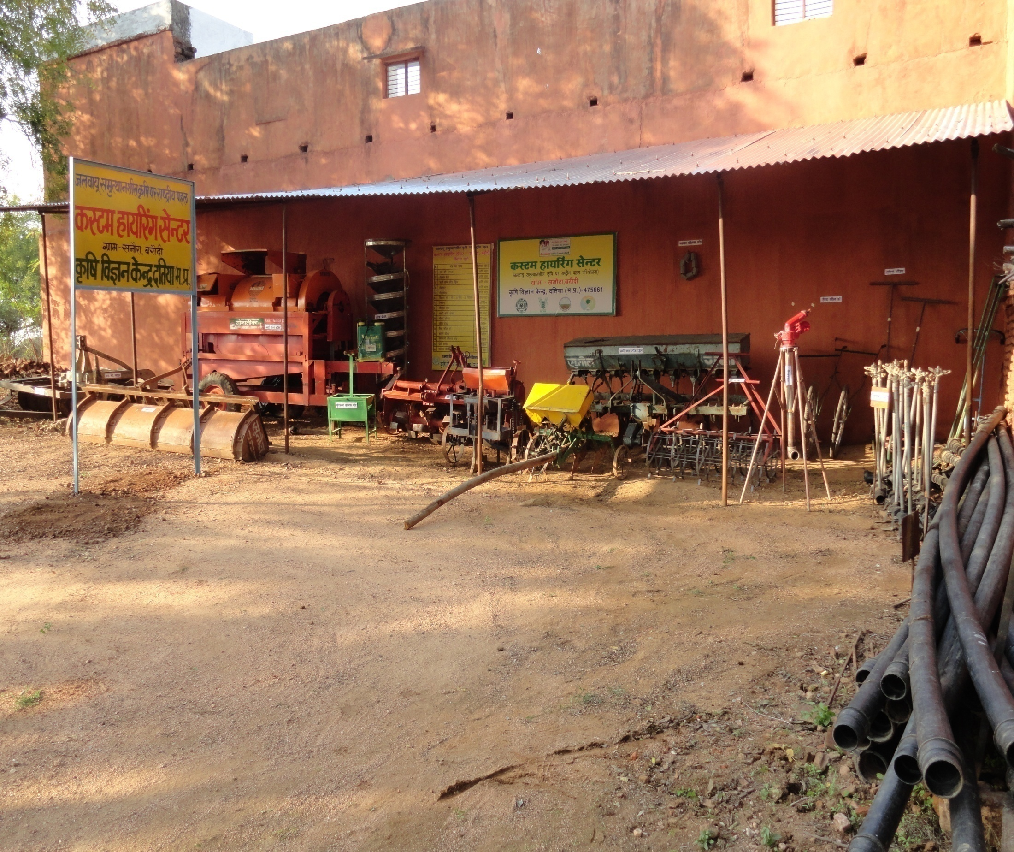
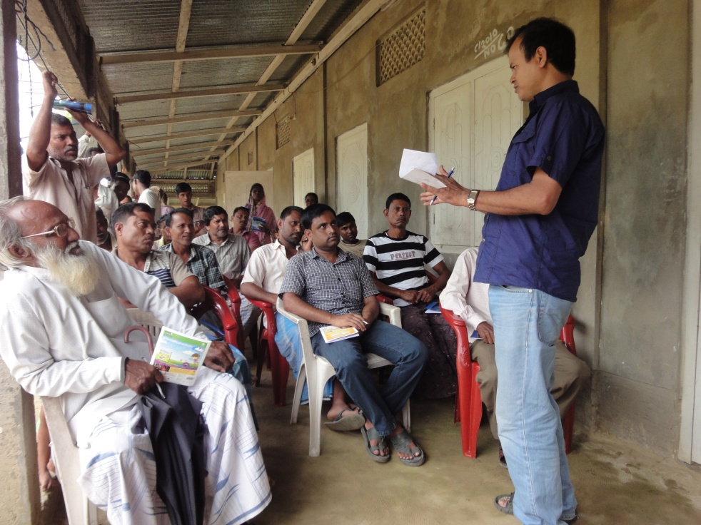
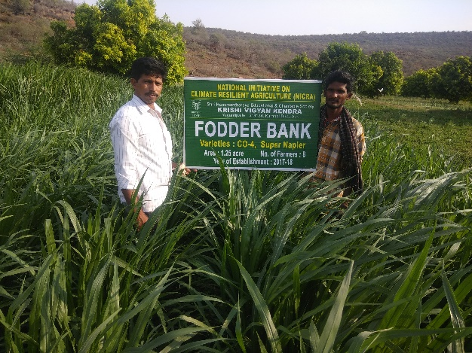
Innovative Village Level Institutions
Village Climate Risk Management Committees (VCRMC)
Custom Hiring Centre
Seed production systems
Fodder production systems
Commodity Based Organizations (CBOs)
…..for Spread of Resilient Practices

Slide 17

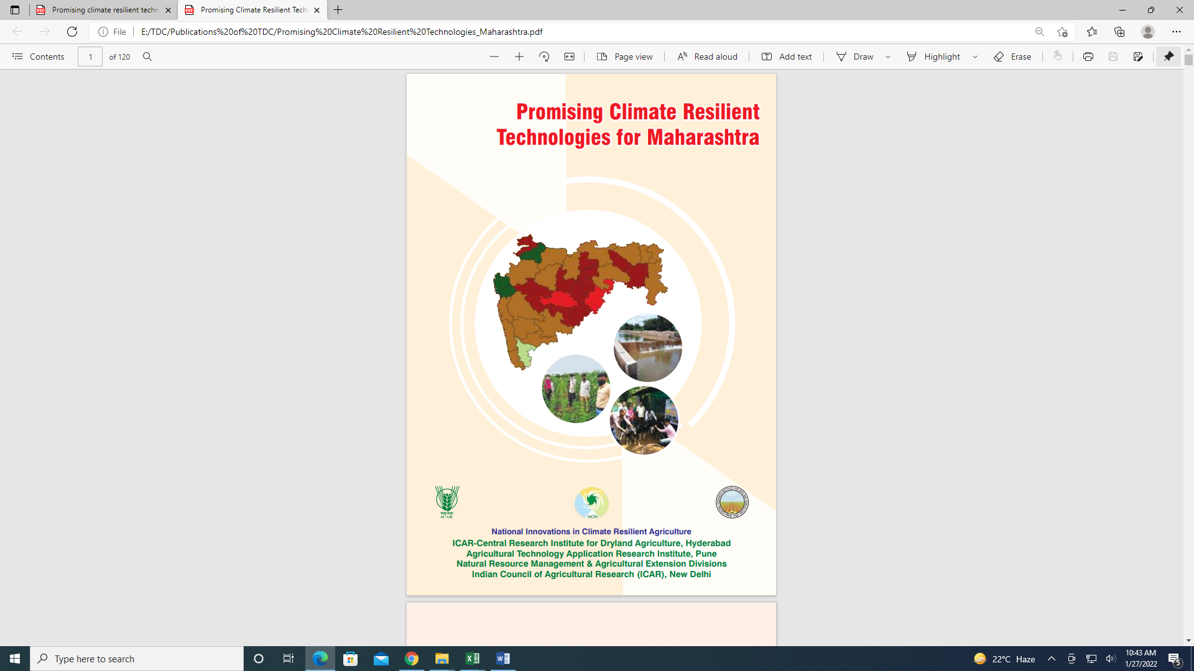
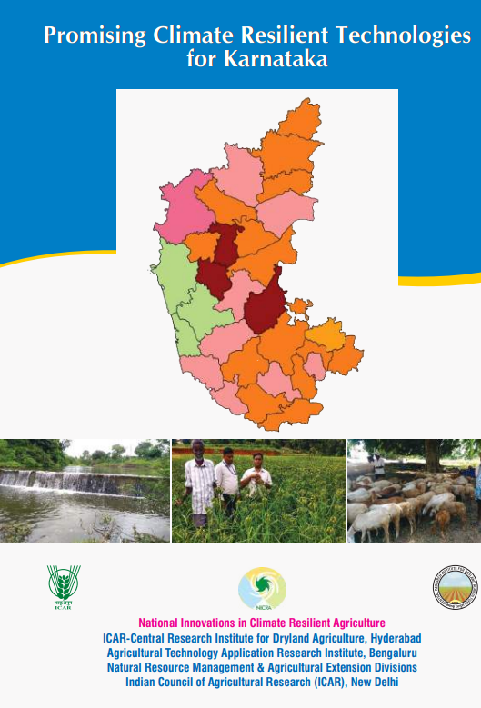
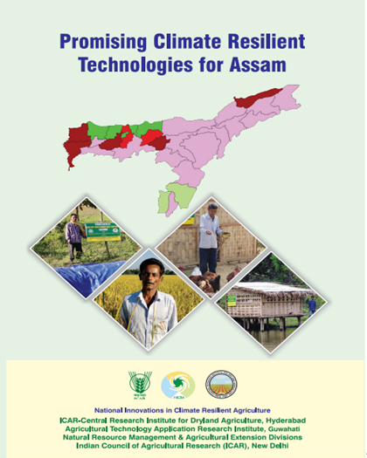
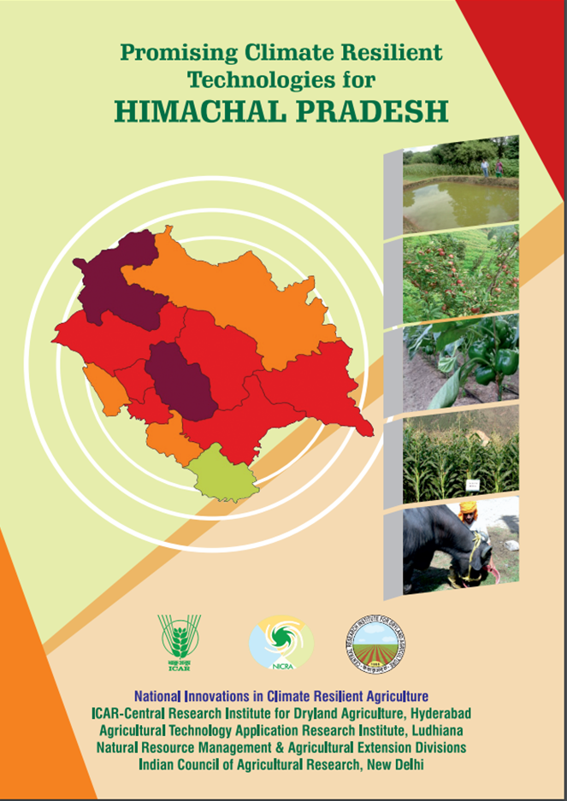

Promising Resilient Technologies Identified for States
73 Technologies
60 Technologies
53 Technologies
53 Technologies
56 Technologies
Completed for 5 states, remaining under progress
Evidences of the performance of resilient practices are documented by video films (25)

Slide 18
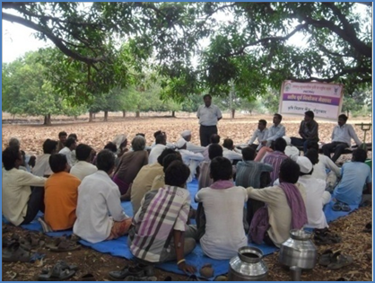
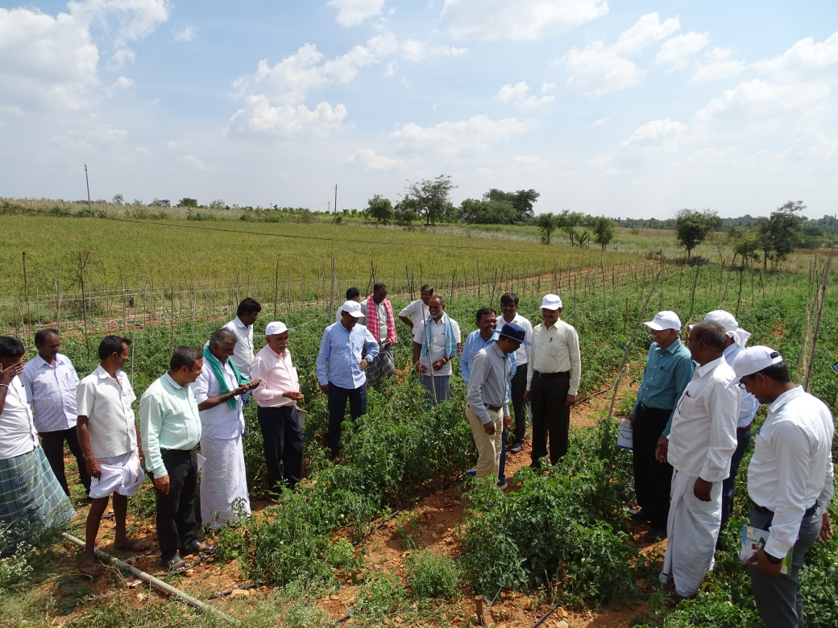
Building Capacities of Stakeholders
Key for Achieving Resilience
Scientists – 1200
Research Fellows - 380
Ph.D & M.Sc. Students - 160
18,610 demonstrations benefiting 5,15,690 farmers
20,741 Capacity building programs benefiting 7,07,227 farmers
Sensitized on various aspects of climate change/ variability and impacts on agriculture
Built capacities on various resilient practices leading to enhancement in their adaptive capacity

Slide 19









Up-scaling of Climate Resilient Agriculture
  Project on Climate Resilient Agriculture (PoCRA) in state of Maharashtra, 5000 villages, US $ 649 million (World Bank)
  Consortium for scaling up climate smart agriculture in South Asia, (C-SUCSeS) by C-CAFS, implemented in 8 member states of SAARC, US $ 1.5 million (ADB)
  Climate Resilient Agriculture initiative started in Telangana, Bihar & Tamil Nadu

Slide 20




