Slide 1


Climate Resilient Development
Indian Perspective
Agriculture Sector
ON 9th NOVEMBER
Side event on Achieving Climate Resilient Development in Africa and Asia
By
Dr. Kirit Shelat, I.A.S. (Retd)
Executive Chairman
National Council for Climate Change, Sustainable Development
and Public Leadership (NCCSD)-Ahmedabad

Slide 2
India is a large country with very many Agro-climatic zones.
It has second largest arable land and highest number of farmers.
The country has had very many droughts- famines in the last century. To take illustration of Gujarat, Gujarat has had every third year drought and fifth year famine (no rains at all) in the fifties – sixties – even seventies.
There was large scale migration of cattle – human – deaths – food scarcity – rationing of food and essential commodities. Food was required to be imported from USA.

Slide 3
Contd……
In the seventies, India introduced new varieties Hybrid Seeds – supported by fertilizer and pasting management.
This changed agriculture productivity.
This was backed Land Reforms and land was transferred actual tillers by land lords.
Agricultural credit was streamlined.
A massive programme for rural poor was undertaken – known Integrated Rural Development.

Slide 4
Contd….
Gujarat took up massive Climate Resilient Development programme in the year 2000 onwards.
It introduced scientific agriculture; farmers’ land soil was tested to know its fertility and lack of nutrients. It introduced Soil-Health Cards – to advise each farmer which crops his soil is capable sustaining and what nutrients are lacking. It started door-step meets by agri. scientists and extension team with farmers and introduced seed replacement. Prior to sowing season to guide about crop selection, crop practices, selection of inputs and to answer to the question from farmers.

Slide 5
Contd….
It took up massive water harvesting programme – construction of 100000 check dams and ponds. It linked all water scarcity villages with drinking water pipe line from Sardar Sarovar Dam. It inter-linked rivers. It introduced massive micro irrigation programme. It promoted multiple schemes for farmers income through animal husbandry and handicrafts.
As outcome – Gujarat Agriculture developed from minus growth 2000 to 11 per cent average growth from 2004 onwards.

Slide 6
Indian Perspective
This approach was adopted at all India level.
Further Climate Smart Agriculture was promoted with massive Capacity Building Programme – re-skill – up-skill farmers and build climate smart farmers with objective increase in their income despite intense adverse weather events and double income every five years.

Slide 7
In agriculture more specifically
  Promote Horticulture
  Drip Irrigation
  Vermi-wash – cow-dung mixed with agro-waste.
  Natural farming
  New crops suitable to agro – climate and soil.
  Climatic related services weather advisory followed by agro – advisory.
  Crop Insurance
  Credit to Farmers by Kisan Credit Card.
  Promotion of sea-weeds.

Slide 8
Contd….
  Strengthening of agriculture infrastructure – horticulture, live stock development – warehousing – market yards.
  Producer organization for marketing FPOs and cooperatives.
  Solar Energy
    Private Sector on wasteland / desert areas
    Rooftop Solar – domestic – rural – urban
    Farm – Panels – Water pumping – excess sold to grid.

Slide 9
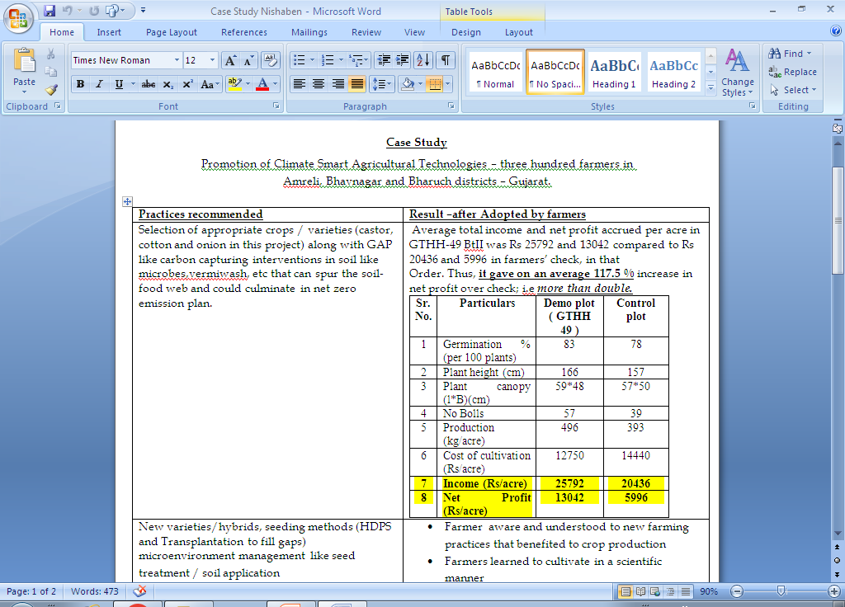
CASE STUDY-1
Promotion of Climate Smart Agricultural Technologies – three hundred farmers in Amreli, Bhavnagar and Bharuch districts – Gujarat.

Slide 10
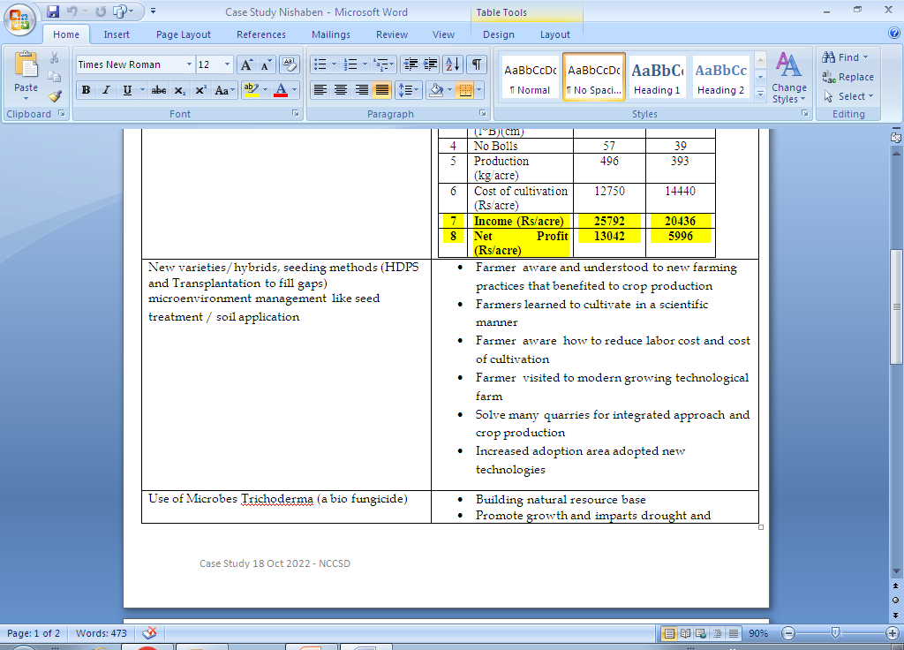
Contd….

Slide 11
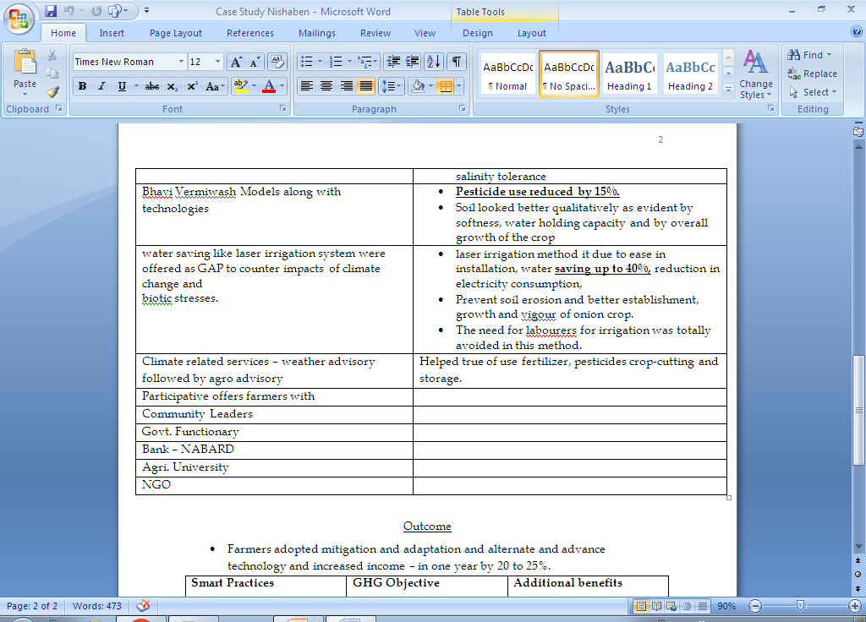
Contd….

Slide 12
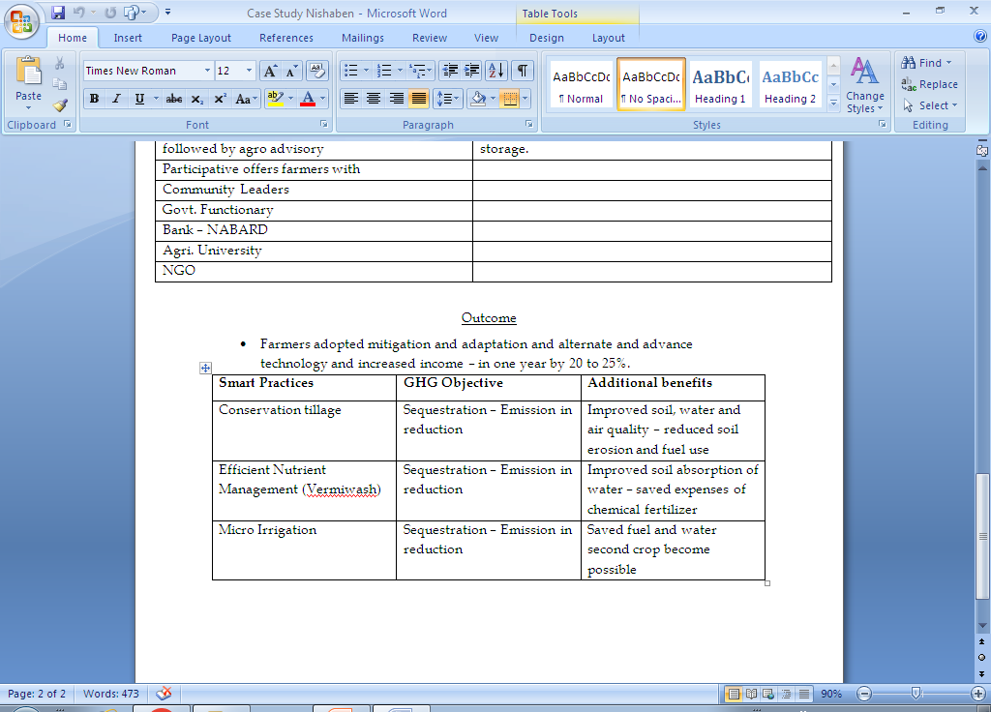
Contd….

Slide 13
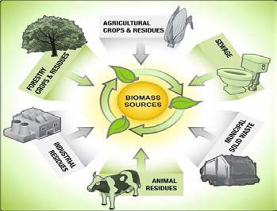
CASE STUDY -2

Slide 14
Fuel Briquettes from Agro Waste
Gujarat has more than 200 units making fuel briquettes from crop residues. This needs to be popularized – by developing Bankable Plan and remoting rural youth to under take it. Even FPO can be promoted. Groundnut oil industries and castor oil mills are using residues as fuel. In Ludhiana recently 40units modified their Boilers to use Agrowaste.
In Kutch ,Gujarat – coal from Baval-Propsopis juliflora–is produced and well marketed. Baval grows and expands on its own in the margin area of desert–on waste land local people are making ‘coal ’ from it and it is an income generating activity.
This needs to be expanded for entire Rann of Kutch–where they can be grown and coal can be produced and it can be self-sustaining income generating activity. It will also reduce salinity ingress and advancement of desert.

Slide 15
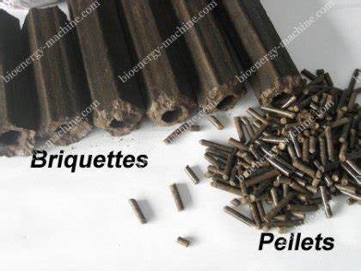
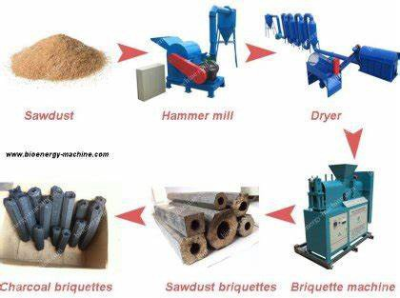
Contd….

Slide 16
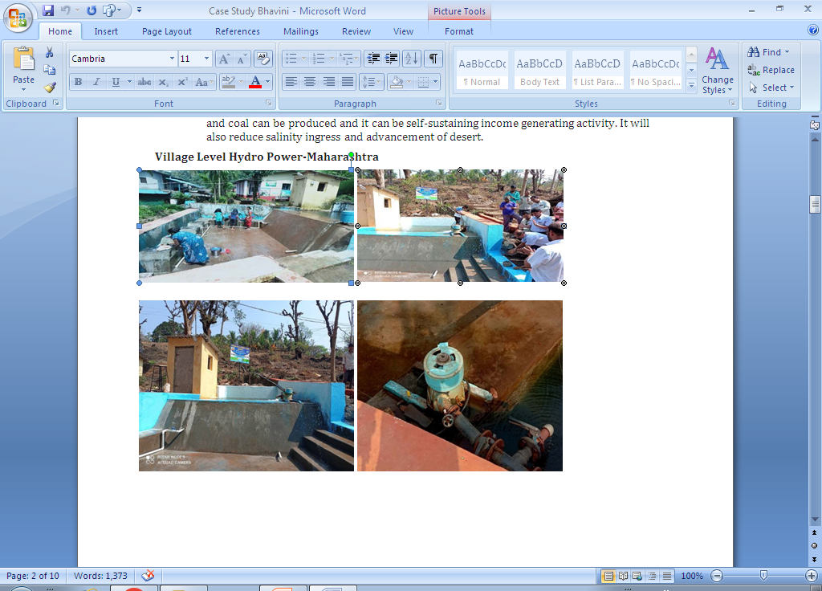
CASE STUDY-3 Village Level Hydro Power-Maharashtra

Slide 17
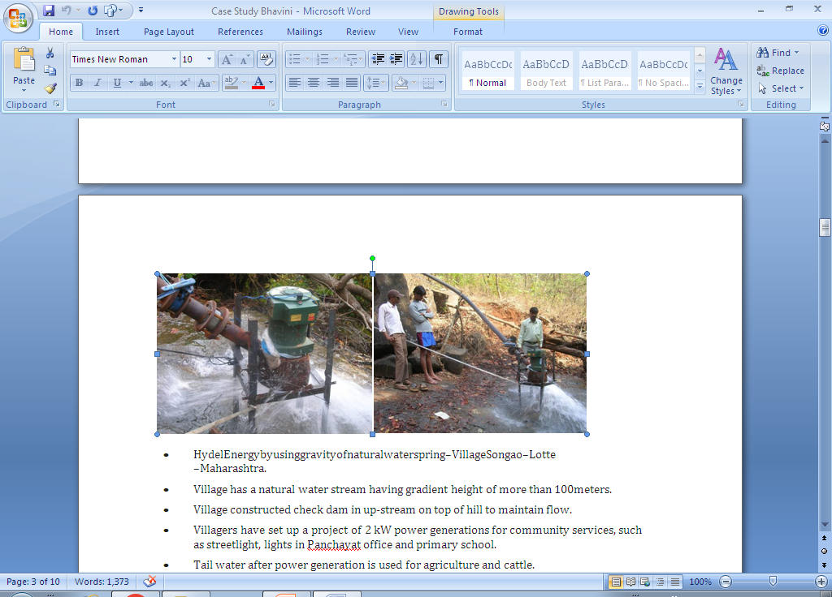
Contd….

Slide 18
Contd….
HydelEnergybyusinggravityofnaturalwaterspring–VillageSongao–Lotte-–Maharashtra.
Village has a natural water stream having gradient height of more than 100meters.
Village constructed check dam in up-stream on top of hill to maintain flow.
Villagers have set up a project of 2 kW power generations for community services, such as streetlight, lights in Panchayat office and primary school.
Tail water after power generation is used for agriculture and cattle.
Mechanism is simple. It comprises of cylindrical caste iron easing housing an alternator which is connected to turbine through the shaft. Water is used to turn turbine to generate energy.

Slide 19
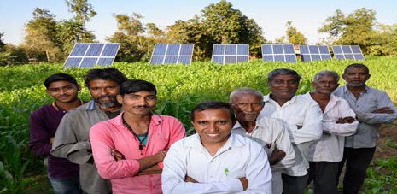
CASE STUDY-4Pilot Project on Solar Farming: CropProductionwith1MWSolarPower

Slide 20
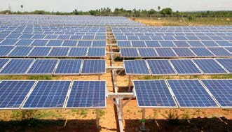
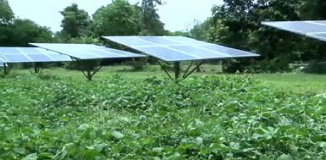
Contd…..

Slide 21
Contd….
1MW Solar PV Pilot Project undertaken by AAU in collaboration with Gujarat Industries Power Company Limited (GoG) at Village DHUNDHI , Anand District.
1.5ha cultivatable area – Solar panel size 2x1m, 310 Wp capacity
Number of Rows=17;Totalsolarpanels=3240
Distance between two rows=10m
Spacing between two panels=25,150 and grown(Kharif, rabi and summer seasons)–Groundnut,Soybean,Pearlmillet,Pigeonpea,Wheat,Mustard,Okra,Greengram,Maize,Cotton,Amaranthus,etc.
Powergeneration of 4320 to 4560kWh/day. The power generated is sold to Madhya Gujarat Vij Company Limited

Slide 22
Contd….
The farmer could get the benefit of power generation along with crop production as an additional income.
State and Central governments gave 60 per cent subsidy on the cost of the project. The farmer is required to bear 5per cent cost, while 35 per cent will be provided to him as an affordable loan with interest rates of 4.5-6%
For the first 7 years, farmers will get INR 3.5 per kWh sold.
This is now under scheme Surya Kisan Yogna. In Gujarat 4520 farmers are benefiting by selling excess electricity generated and have extra source of Income.

Slide 23
CASE STUDY-5 Banas Bio-CNG Unit
The Banas, Asia’s largest milk processing cooperative located at Palanpur in the state of Gujarat, India developed a 3500 cubic meter Biogas reactor exclusively for the production of Bio-CNG and organic manure production. The plant uses cattle dung and agricultural waste as a feedstock. The project was commissioned under “Swachh Bharat Mission”, the vision of Shri Narendra Modi, Prime Minister of India. Shri Shankarbhai Chaudhary, Chairman of the dairy was instrumental behind the world –class development.

Slide 24
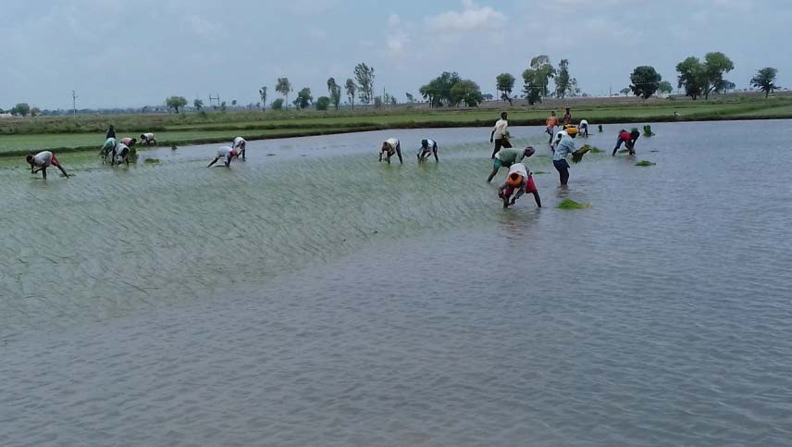
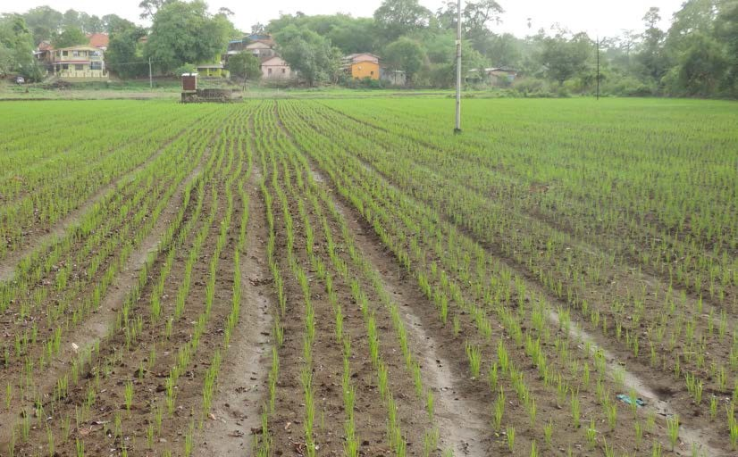
CASE STUDY-6 Rural Energy Security Focusing Farmers
Rice being staple food for more than 50% of the population, its sustainable production is of utmost importance. The two essential resources, the excess water and the skilled labour are both becoming limited. Not requiring the transplanting and the puddling ; SRT gives relief to the tune of 50% reduction in both the input requirements.

Slide 25
CASE STUDY-7-“Zero Waste Village” by Solid and Liquid Waste Management” Genesis:
Khanderaopura village (Padra block of Vadodara District, Gujarat)is a village having population of 1500 having 185 households.
In 2016 this village had anoutbreak of Cholera and it earned a bad name.It remained focus of media for a long period. Shroff Foundation Trust was requested to look in to the problems of sanitation & hygiene of this village.
Thus, it was decided by the village community that this village would need to be qualified for ODF and the drainage line would be repaired to make it functional.

Slide 26
CASE STUDY-8 -Use of Technology –City Sewage Treated and Recycled for Agriculture
Jalna is a city located in Marathwada and receives very less rainfall and is drought prone area. Having population of around 3.0 lakhs, availability of domestic sewage is sufficient including in summers. Farmers of Jalna here facing shortage of water for agriculture and therefore it was decided to treat the city sewage (from nearby nallah) through Bioflter Technology and reuse for agriculture. Since then the farmer are able to take 3-4 crops per year and their problem of water shortage was completely resolved.

Slide 27
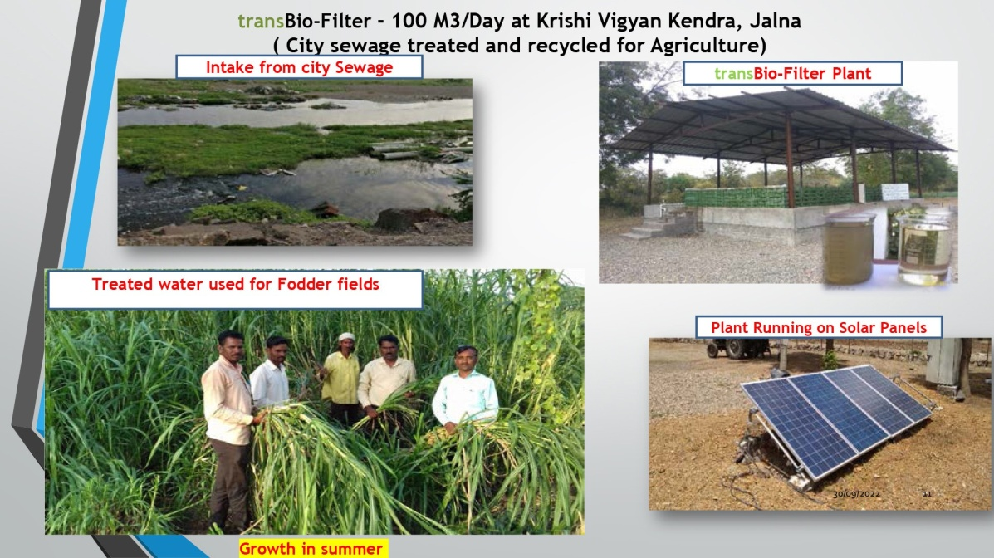
Contd….

Slide 28
Introduction to Rural Liquid Waste Management
The Jal Jivan Mission (2019) provide for minimum 55 litres per capita per day (LPCD) supply of water through tap. Half of the States are providing 70 litres or 100 litres LPCD. Considering 65% of it is generated as waste, the grey water (including blackwater) would be in the range of 40 to 60 LPCD.
Thus, 1000 population would generate an average 50 KLD (taking in to account for next 5 years).
Treatment of wastewater is a big challenge. The big central treatment plants have proved to be ineffective because of the high cost of operation, increasing load of pollutants, inadequate technology, and very high capital costs.
Bio-filters technology qualifies to be a decentralised effective, efficient, cost-effective system for addressing the issues flagged above.
The treated water has added nutrients worth (Rs. 1.60 per thousand litres) and is acceptable for Agriculture, land scape as per CPCB norms of 2017. The nutrient rich water can fetch Rs.2.00 per thousand litres.
The treated water supply supplements dwindled water supply in summer to support summer crops.

Slide 29
Contd….
The indirect benefit is also equivalent saving of extraction / distribution expenditure of Agriculture Water (Rs.5/- to Rs. 10/- per thousand litres depending on source and distance of transport).
Ultimately, Waste Water Treatment is crucial for reducing pollution load in ground water and streams & rivers.
Bio-Filter technology also obviate the generation of sludge and hence its management, it also can handle black water (septic tanks).

Slide 30
Challenges of Dry lands
To resolve the challenges of drylands in terms of water scarcity, we have made an attempt at 3-4 different locations viz (KVK-Jalna, Villages - Khanderaopura, Chikodra & Kukma) using recycled waste water and observed encouraging results.
This could provide adequate water for irrigation through the year to take 3-4 agriculture crops.

Slide 31
PRIORITIES AGRICULTURE
Latest Reports on Global Warming–IPCC 2022 highlight the increasing adverse impact of the climate change. Apart from adverse weather events – continuing rise in temperature will further affect productivity in the agriculture sector – food crops, fruit crops, yield from milch animals and fisheries catch and like.
The key challenges to the world today and in immediate future are -
  Food security
  Food to hungry millions – whose numbers are growing every day.
  Food productivity
  Need for maximum Co2 absorption.
The attention of UNFCCC – both ‘Parties’ and non-party – observers and organizations need to be focused on agriculture and farmers as failure of above will have adverse impact on peaceful life of entire habitat.

Slide 32
Contd….
Agriculture with its photo synthesis process – is only known technology for absorbing Co2 from atmosphere and need to be promoted and used as a major Mitigation Tool. Agriculture provides soil organic carbon sequestration, is one of most effective for climate change adaptation and mitigation strategy.
It must be realized that due to growing urbanizations, massive and rapid increase in transportation and manufacturing activities – GHG emissions are growing to be unabated. Only expansion of agriculture on more lands – useable arable wasteland – growing sea-weeds in the sea and like, can solve problems – as they will provide increased food availability, livelihood and reduce Co2 from atmosphere.

Slide 33
Contd…..
COP-27, therefore, need to come out with a clear agenda to support farmers and agriculture sector and perhaps an action plan can be launched – to include
  Exchange Bank – For assimilating successful agricultural practices, technology, expertise from nations / organizations those who have it and making available to those who need it by registering demand for support for technology, communication practices, climate related service – weather forecasting, expertise and financial needs.
  Prioritize agriculture and farmers and earmark resources for them by Green Fund, CTCN, World Bank.
  Global movement to bring wasteland and un-used arable lands under agriculture, agro-forestry, silvi – pastural cum animal husbandry development and encourage massive carbon sequestration and livelihood.

Slide 34
Contd…..
  Develop specific programme / policy which can be adapted by nations for restoration of agriculture land devastated by washing away in floods or eroded due to droughts.
  Promote sea-weeds and like vegetable in the ocean areas for carbon sequestration and livelihood.
Remove discrimination against agriculture and farmers. Agriculture – Vegetation absorbs Co2 and release oxygen. Carbon Credit is given to activities which reduce Co2. But agriculture and farmers are not given ‘Credit’ for absorption of Co2 – by plants – in soil, stem and seeds. Further while calculating emission of GHG by manufacturing sector only direct emission is counted – but what is not counted, and added to their account, is removal of agriculture on land where they have set up industry, and due to that reduction on absorption of Co2.

Slide 35
Dr.Kirit Shelat, I.A.S.(Rtd.)
Executive Chairman – NCCSD
National Council for Climate Change Sustainable
Development and Public Leadership (NCCSD)
Patel Block, Rajdeep Electronic's Compound,
Near Stadium Six Road, Navrangpura,
Mobile: 091 9904404393
Email: drkiritshelat@gmail.com
Website: www.nccsdindia.org

