Slide 1


Prioritizing Agriculture for Climate Change Adaptation and Mitigation
NCCSD,INDIA
Informal Consultations and the Technical Dialogue of the First Global Stock take under the Paris Agreement-
Executive Office ,UNFCCC
By
Dr. Kirit Shelat, I.A.S. (Retd)
Executive Chairman
National Council for Climate Change, Sustainable Development
and Public Leadership (NCCSD)-Ahmedabad

Slide 2
Interesting Aspects of Carbon Assimilation by Plants
The atmospheric CO₂ stimulates the process of photosynthesis and consequently plant growth. The extent of this stimulation varies for forest (up to 60 %), for pastures, and crops (about 14 %)
There are three basic types of photosynthesis: C₃, C₄, and CAM. Each type has its own advantages and disadvantages. Approximately, 35 % of the terrestrial plants are C₃ species, while 1 % is C₄. 4% use the CAM pathway of photosynthesis (Bowes, 1993)
(Bowes G. 1993: Facing the Inevitable: plants and Increasing Atmospheric CO₂. Annual Reviews of Plant Physiology and Plant Molecular Biology, 44:309-332)
According to one estimate, a single row of trees with or without shrubs can reduce particulate matter by 25% and each hectare (2.471 acres) of plantation can produce enough oxygen for about 45 persons per year/day
The foliage of a single mature beech tree (Fagus sylvatica), for example, can extract more than 2.5kg of CO₂ from the atmosphere, and produce 1.7kg (3.7lb) of oxygen in one hour, which in theory is enough for the needs of ten people in a year

Slide 3
Carbon Sequestration
Actions taken to sequester carbon in biomass and soils have a positive impact on environment and biodiversity
The increase in soil carbon storage increases the soil fertility, land productivity and prevents soil degradation. Therefore, this constitutes a win - win situation, but we need to take note of it and enhance its function
In fact we have gone through such adversities due to change in climate or otherwise over last centuries and in many places, we have overcome such difficult situation by persistent efforts by balancing management and use of soil, water and vegetation in sun-lit areas of India.

Slide 4
Let us look at some experiences

Slide 5
Carbon storage (t/ha) of different crops
No. | Crops | Aboveground | Belowground | Total
1 | Cabbage | 2.51 | 0.22 | 2.73
2 | Brinjal | 3.23 | 0.37 | 3.6
3 | Coriander | 0.8 | 0.07 | 0.86
4 | Sugarcane | 8.51 | 2.93 | 11.44
5 | Spider lily | 4.8 | 1.54 | 6.36
6 | Grass | 1.35 | 0.25 | 1.6

Slide 6
Carbon sequestration by some grains (t/ha)
 | Grain | Straw | Aboveground | Belowground | Total
Wheat | 0.91 | 1.3 | 2.155 | 0.286 | 4.596
Maize | 1.1 | 1.98 | 3.08 | 0.4356 | 6.5956
Rice | 0.85 | 1.2 | 1.9 | 0.264 | 4.064

Slide 7
Carbon Storage Per ha
Crops | Grain/Seed carbon ton/ha only
Castor | 924.6
Soyabean | 372.6
Cotton | 313.0
Source: Dr. Sumankumar Jha, College of Agro Forestry, Navsari Agriculture University, Navsari, Gujarat, India
The carbon storage is evident and significant across annuals to perennials and would serve as a classical example of w/w situation.

Slide 8
Rice Cultivation: Facts on Sequestering CO₂
Rice cultivation is both an important sequestration process of CO₂ from the atmosphere and an important source of GHG emission
For example, the global paddy rice output was 607.3 mt at 14% moisture content in 2004
At the grain/straw ratio of 0.9 for most currently planted rice varieties, the global rice straw output in 2004 was about 676 million tonnes at 14% moisture content
This means that in 2004, rice sequestered about 1.74 billion tonnes of CO₂ from the atmosphere to produce about 1.16 billion tonnes of biomass at 0% moisture content emissions
Rice crops acts a sink for CO₂ e.g. NICRA Studies

Slide 9
Carbon sequestration in Silvipasture Systems in rangelands (after 4 years)
Systems | Total carbon Sequestration (vegetation + soil) Mg carbon ha⁻¹
Panicum maximum | 32.29
Cenchrus ciliaris | 28.62
Stylosanthes hamata | 14.74
P. maximum + S. hamata + Leucaena leucocephala | 46.17
P. maximum + S. hamata + Grewia optiva | 41.40
C. ciliaris + S. Hamata + Dalbergia sissoo | 36.68
C. Ciliaris + S. hamata + Acacia tortilis | 36.76

Slide 10
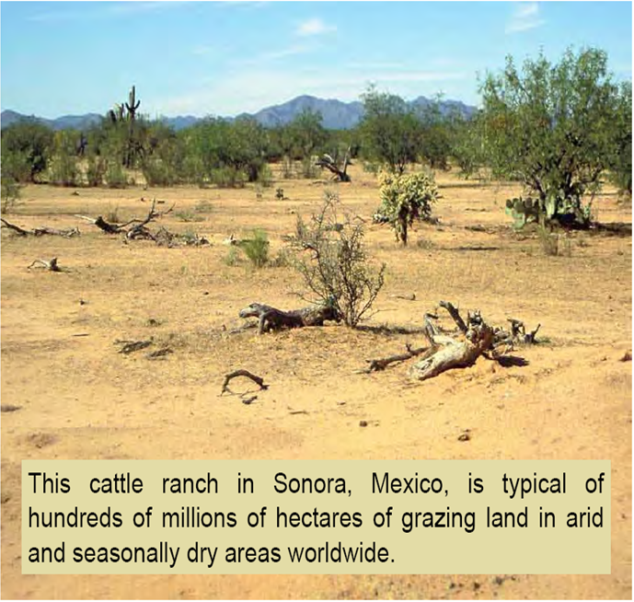
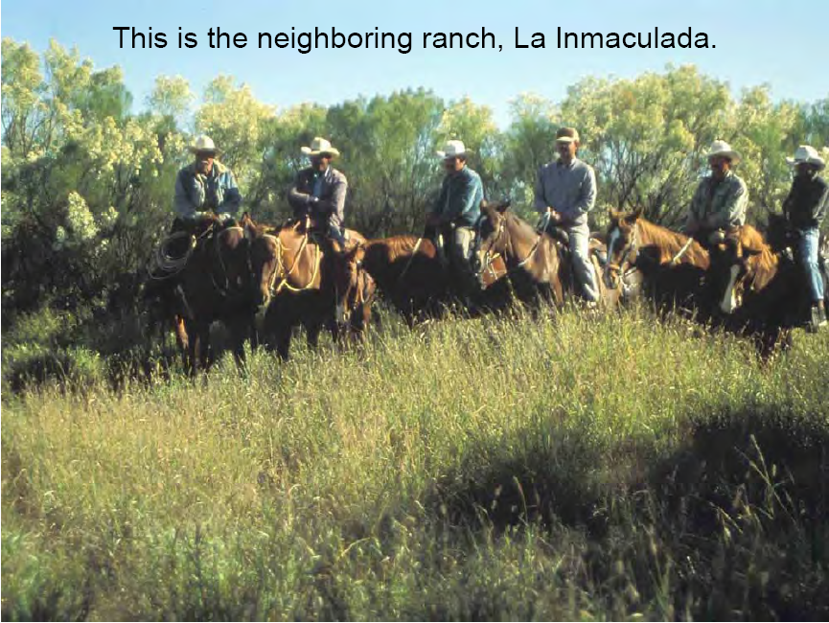
The International Experience
Same area
Same rainfall
Same soils
Same plant species
Same season (pictures taken on the same day)
La Inmaculada actually has more cattle than the drier range
The only different is management

Slide 11
Consumption of CO₂ (ha⁻¹)
Says Tony Lovell, one ha is 10,000 sq. m. If a hectare of soil 33.5 cm deep, with a bulk density of 1.4 t m⁻³ is considered, there is a soil mass per hectare of about 4,700 t
If appropriate management practices were adopted and these practices achieved and sustained a 1% increase in soil organic matter (SOM), then 47 t of SOM per ha will be added to organic matter stocks held below the soil surface
This 47 t of SOM will contain ~27 t of soil C(I.e. 47 t at 58% C) per ha
In the absence of other inputs, this Cmay only be derived from the atmosphere via the natural function known as the photosynthetic process. To place approximately 27 t of soil C per hectare in, ~100 t of CO₂ must be consumed out of the atmosphere by photosynthesis
A 1% change in SOM across 5 billion ha (estimated waste land in the world) will sequester 500 billion tonnes of physical CO₂

Slide 12
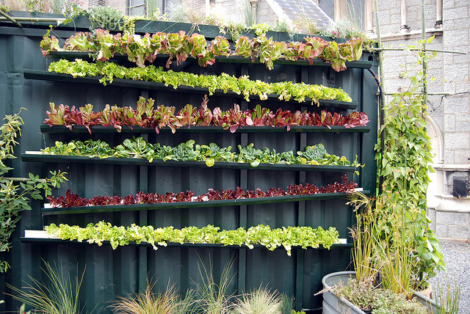
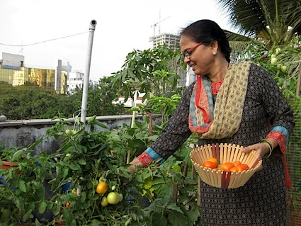
Urban Agriculture - A new Initiative
Need to promote Urban Agriculture/Vertical
Majority of urban households have some open land
Even in the multi-storey buildings, there is some kind of tree grows, grasses or ornamental plants
Even people staying in the flats like to keep plants in pots in lobby area
A gap about knowledge of agricultural practices regarding plants to be grown and treating them
Agro-techniques of these urbanized plants are different
No urban agriculture extension centers or even Agro-Service centers where such guidance could be available along with basic inputs of seeds, fertilizers, farm equipments, etc.

Slide 13
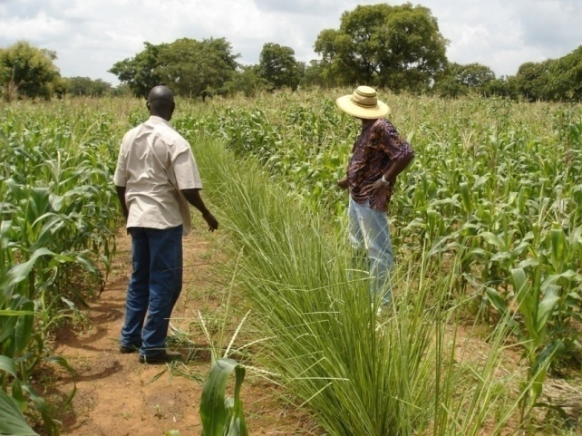
Some plants have a special role to play
Vetiveria zizanioides (Vetivar System in Agriculture)
Sequestered C per plant – 2.5 kg/ year
Reduce erosion and improve soil texture
Can covert sandy soil to productive land by using mulch/compost
Crop yield increase through better soil structure and fertility
Moisture retention and water quality
Decrease surface water run-off and increase ground water recharge by 70%
A good fodder
Good base for mushroom cultivation
Wastewater treatment
Stabilization of fish ponds
A similar plant is “Prosopis juliflora” – Ganda Baval
Salinity resistant plant - important bio-fuel - can grow on any degraded or saline soil including desert area.
Similarly Bamboos and mangroves are very important species

Slide 14
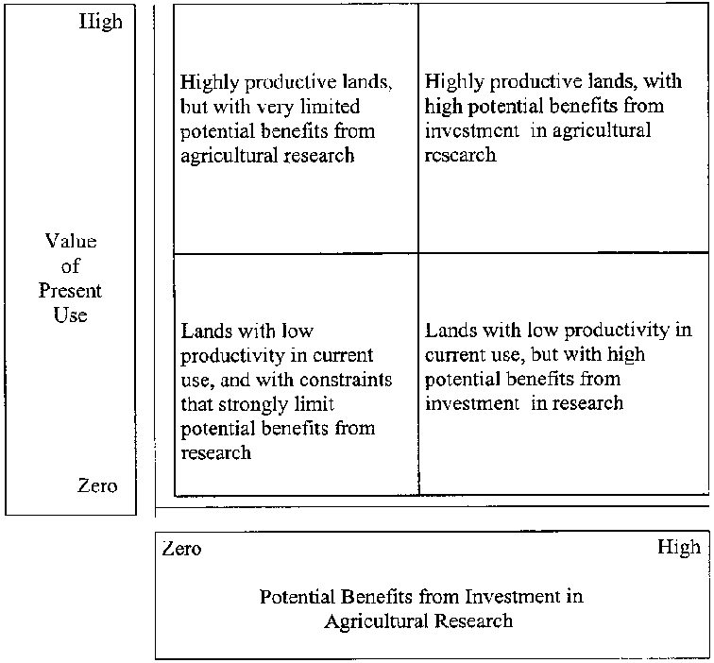
Land Management
high present use value are favoured agricultural lands,
low present use value are marginal agricultural lands,
lands at low or zero intensity of use

Slide 15
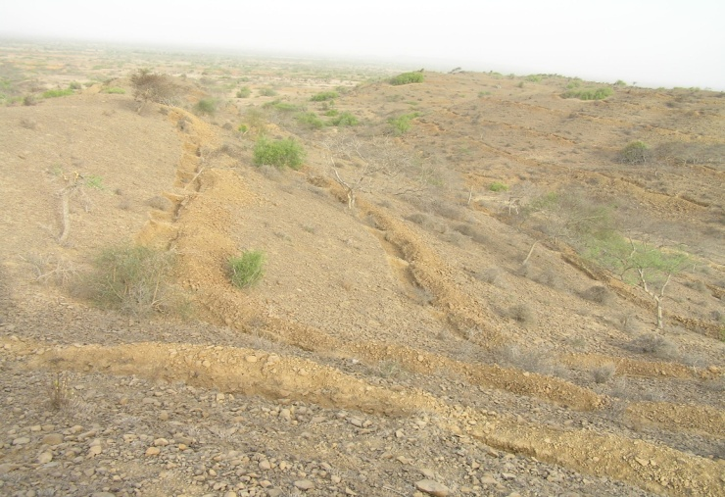
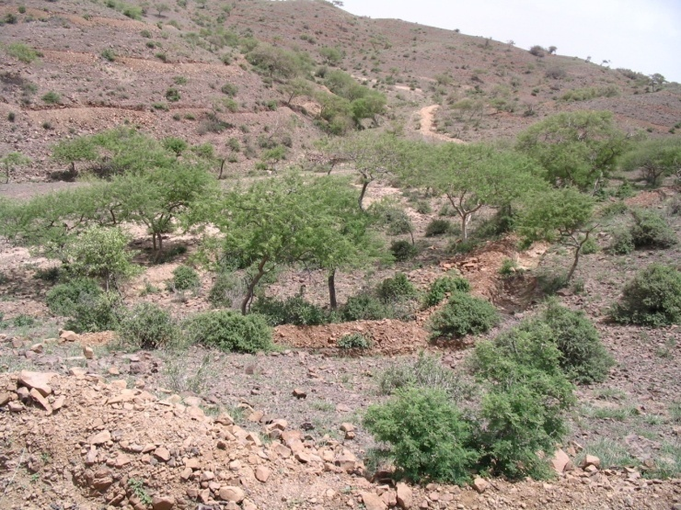
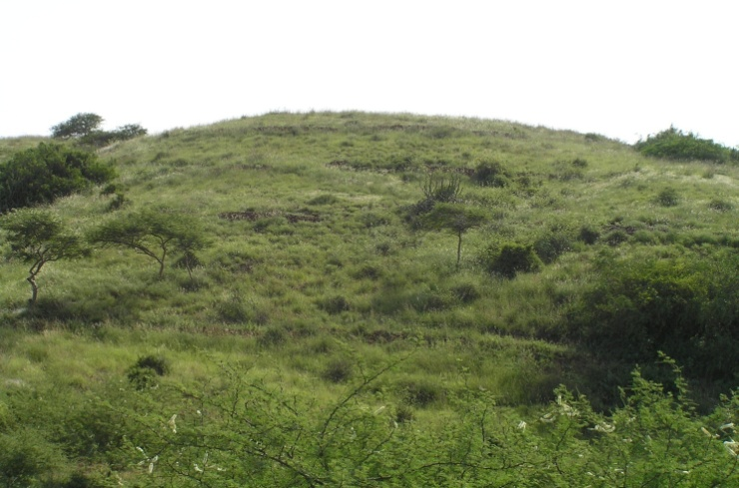
Use of Wasteland
May-06
India has wasteland of 1.30 m ha – mostly acidic and/or saline
This may be similar in other parts of developing world
Technology is available for salinity – resistant crops, trees including horticulture. This could be fruitfully grown in these areas providing sustainable livelihood. This will help enhance cultivable areas
Acid soil treatments could further improve agricultural production, for instance, in the highly eroded soils, particularly in the hills
PPP programme
August-06
August-07

Slide 16
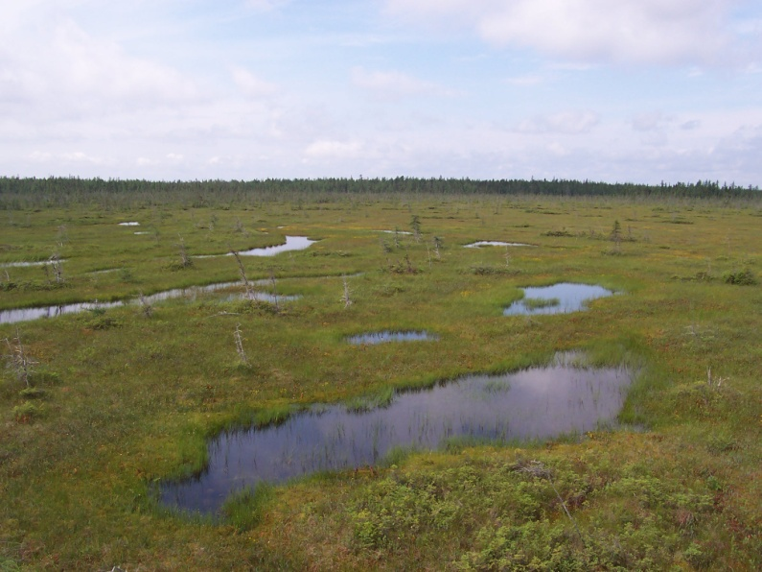
Use of Wetland
A majority of such land is not surveyed and is spread along the huge coast line of the country
Wetlands may be converted into major production areas for sea food - fisheries, vegetation, and medicinal plants, makhana, lotus and sighada with changing management practices for production of rice sto reduce anaerobic decomposition that is the major source of methane
All these have huge internal and external markets and will be a great support for food security
A PPP model could be introduced. This is essential to make up reduction in the area under agriculture due to industrialization, mining, expansion of urban areas and infrastructure of highways and railways
Wetland is an area of land where soil is saturated with moisture permanently or seasonally covered by sea water

Slide 17
Points to ponder about GHGs due to AGRICULTURE
Agriculture is depicted as source for GHG emission and in reality it not true. In fact, agriculture absorbs and assimilates CO₂.
The figures referred to (i.e. 28% by agriculture) are misleading as they are not ‘Net Emission’ figures and they depict over-estimations.
……….. If CO₂ absorption is taken into account, agriculture has plans.
GHG emissions are partially shown for industries. Industrial areas/mining takes away agriculture. So, much less CO₂ absorption takes. This is in addition net discharges of gases which industries establishment makes.
Hence agriculture can be used as a nature’s tool to mitigate global warming.
India has second largest arable land in the world.
Once agriculture projects get benefit from International resources, India can use its wasteland and wetlands.

Slide 18
Thanks
Dr.Kirit Shelat, I.A.S.(Rtd.)
Executive Chairman – NCCSD
National Council for Climate Change Sustainable
Development and Public Leadership (NCCSD)
Patel Block, Rajdeep Electronic's Compound,
Near Stadium Six Road, Navrangpura,
Mobile: 091 9904404393
Email: drkiritshelat@gmail.com
Website: www.nccsdindia.org

