Slide 1
Energy Security Challenges

Slide 2
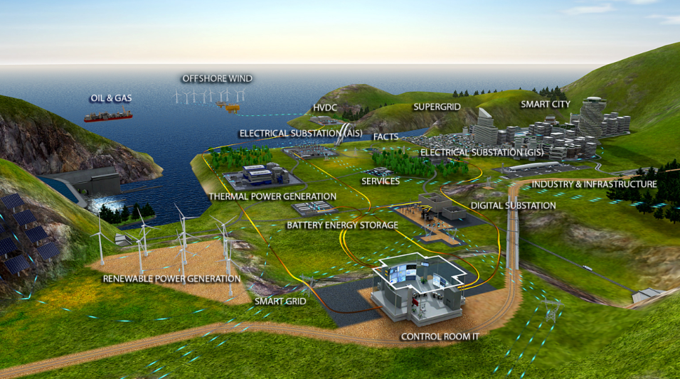
Energy Landscape

Slide 3

Challenges faced by Transmission Utilities
  “ROW” not available / delayed
  ….Space Constraint for new substations
  ….”Environmental” constraints
  ….People’ dissent for ROW
…..Resolve congestion with minimum customer interruption “
…..“Zero –Shut down requirement”
…..“RE integration (speed, uncertainty)”
….Delayed projects lead to delayed asset monetization
SPACE
  …Optimal Resources Utilization
  …Increased Budgetary Constraints
  Increasing Competitive market
CAPITAL
TIME
Sterlite Power is uniquely positioned to overcome the challenges in energy delivery
© SPTL
3
Notes:
3
Kerala (Density no.)
Delhi (Density no)?
This may create some interest of audience for setting context on the Upgrade Projexrs,

Slide 4
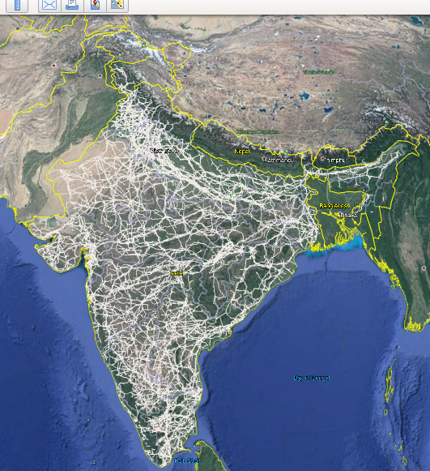
Ageing of Transmission Lines
Growth in Transmission Lines in Ckm (66kV & Above)
Aged Transmission lines in C-km (66kV & Above) (>30 years)
1,92,288 Ckm
© SPTL
4
Notes:
4
Kerala (Density no.)
Delhi (Density no)?
This may create some interest of audience for setting context on the Upgrade Projexrs,

Slide 5
Grid Congestion

Slide 6
Congestion in Grids
Transmission Congestion - limits of transmission capacity are exceeded by actual flows in the transmission network (in individual elements or in pockets).
Results in violation of network security limits - thermal, voltage, stability limits.
Temporary Congestion - outage of a network element for maintenance or due to faults
Permanent Congestion - during peak loads or under given load-generation scenario
With rapid increase in consumption pattern and ongoing massive Renewable integration to Grid, the likelihood of such bottlenecks occurring in transmission network increases.

Slide 7
Congestion Examples
Based on POSOCO data – operational feed back July’21:
For 59% of the time-lines were N-1 non-compliant. Further, decommissioning of units at Korba East has caused more loading on these lines
Lines are N-1 noncompliant. For more than 24% of the time, lines were N-1 non-compliant in Mar 2021.
Tamil Nadu &APTRANSCO 230kV System heavily loaded Whole Year
Downstream network of Mysore 400/220kV SS heavily loaded during Peak demand scenario of SR
More than 10 transmission corridor were overloaded due to some tripping event in the grid – POSOCO data Aug’21

Slide 8
Uprating & Upgrading of Transmission Lines

Slide 9
Transmission Line Increased Utilization Options – Uprate/Upgrade
CIGRE Working Group Recommendations
CIGRE – Working Group B2.13 Doc 353

Slide 10
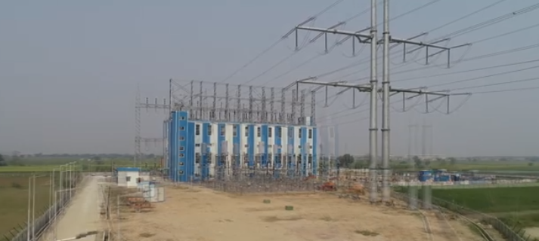
Upgrade Solutions
Substation Upgrade
Terminal Substation Upgrade go hand in hand with Line upgrades
Continuity of Operations can be ensured through proper execution planning
Innovative Solutions to accommodate substation in smaller / available spaces
Sterlite Power : One Stop Solution Provider for Line and Substation Upgrade

Slide 11
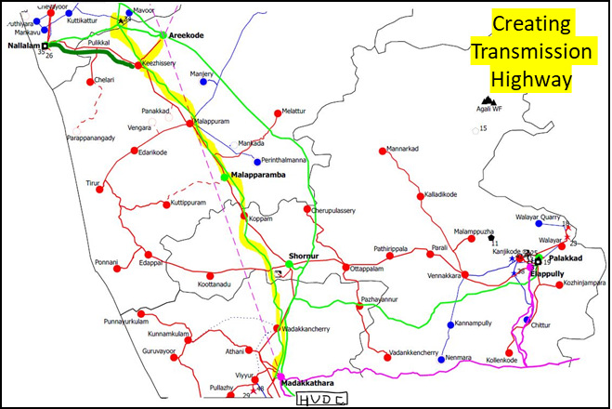
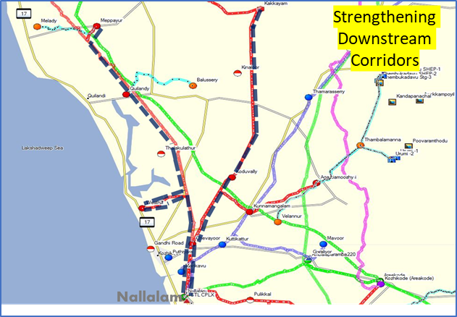
Upgrade Solutions
Case Study: Transformational Solution (KSEB- Kerala, India)
Estimated benefit on Time, Space and Cost dimensions
Time
Estimated execution time, Months
-50+ %
Option 1
Option 2
Space
New ROW required, kms
Conversion of 220kV S/C to 400/220 MCMV line
Conversion of 66 kV S/C to 110 kV D/C line
Reconductor Existing lines with HTLS conductors
117
-95%
Option 1
Option 2
Capital
Estimated execution cost, INR Crores
-45%
Option 1
Option 2

Slide 12
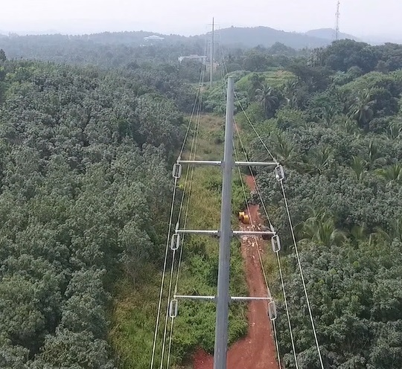
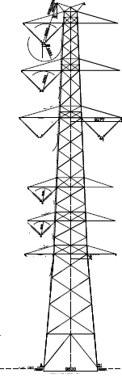
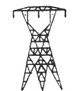
Upgrade Solutions
Case Study: Transformational Solution (KSEB- Kerala, India)
Malapuram- Manjeri: 66 kV S/C to 110kV D/C
Madakkathara- Areekode: 220 kV S/C to 400/220 kV MCMV
Challenges addressed:
Densely populated state
High level urbanization
Fertile agricultural land
Difficult to access site
Increase Power delivery
Evacuation of 2000MW
20 times increase in power
HTLS conductor
Mono pole based solution with AL59 conductor
4x times increase in power

Slide 13
Impact study due to change in Wind Zone on Indian Transmission Network

Slide 14
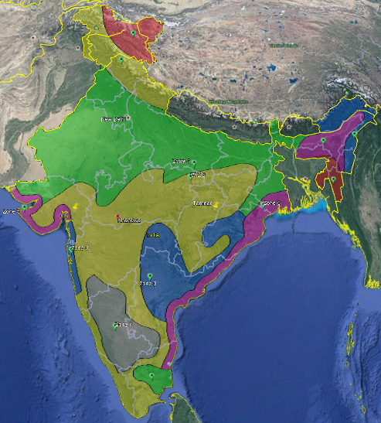
WindMap: IS 875 (2015)
Wind Zone | Wind Speed (m/s) | Colour
6 | 55
5 | 50
4 | 47
3 | 44
2 | 39
1 | 33

Slide 15
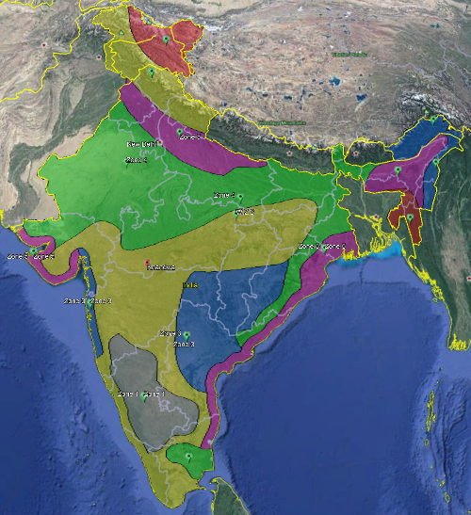
WindMap: NBC 2016
Wind Zone | Wind Speed (m/s) | Colour
6 | 55
5 | 50
4 | 47
3 | 44
2 | 39
1 | 33

Slide 16
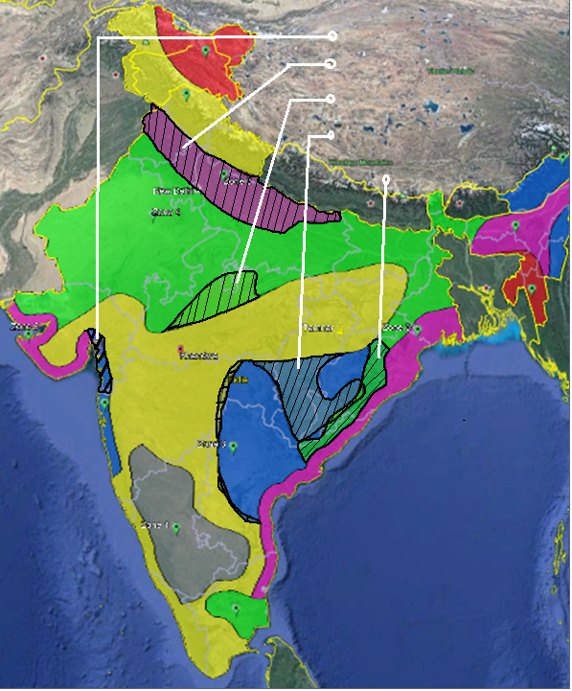
WindMaps Overlapped
WZ-5 TO 3
WZ-4 TO 5
WZ-2 TO 4
WZ-2 TO 3
Wind Zone | Wind Speed (m/s) | Colour
6 | 55
5 | 50
4 | 47
3 | 44
2 | 39
1 | 33
WZ-3 TO 4

Slide 17
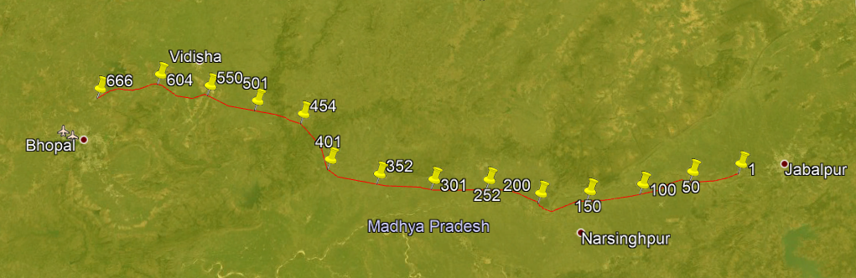
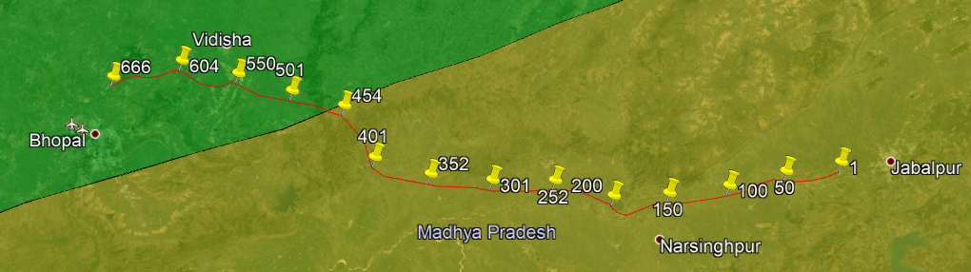
2.BDTCL (Bhopal-Jabalpur) (765kV)
Before
WZ-2
Jabalpur
Bhopal
After
WZ-2
WZ-4
Jabalpur
Bhopal
29.4 % i.e. 196 Out of 666 Nos. 765kV S/C Tower changed from WZ-2 to WZ-4. This link carrying 650 MW Power

Slide 18
Renewable Energy Integration

Slide 19
RE Challenges
RE generation is variable - varies with weather conditions
Cannot be ramped up and down like fossil fuel generation
Creates complexity in matching supply with demand
Energy Storage has to be planned – batteries, Hydrogen Fuel cells or pumped storage
Transmission Line construction period to be matched with RE Gestation period- about 18 months – becomes difficult due to RoW challenges and land availability for sub-stations

Slide 20
RE Considerations
Reconsideration on grid operation- make best use of flexibility of installed assets to compensate for RE generation variations
Investment in smart technologies and solutions like STATCOMS and HVDC for grid stability
Have more digital solutions to enable :
Grid operators to have greater understanding and control
Improve Grid flexibility
Improving ability to integrate increasing RE generation
Uniform policy on RoW and identification of sub-station land by Government (Central/State)

Slide 21
Climate related issues
Shifting weather patterns- causing greater stress on project execution due to unseasonal rains/floods
Rapidly changing hydrology of rivers causing risk to towers in mid stream/ river banks
Need to digitise wind maps and clearly demarcate wind zone transition, cyclone prone areas
Develop a digitised soil data base to optimally design foundations and structures

Slide 22
Conclusions/Suggestions
Urgent review/update required in Technical Regulations
Need to urgently upgrade CEA technical regulations to facilitate new technology absorption
Review on clearances being adopted for high voltage lines (phase to phase and live metal clearance)
Use of outdoor GIS technology
Open up Intrastate projects for TBCB route
Have all stake holders as part of Planning Studies / RPC meetings
Move towards a more mechanised construction methodology – Sterlite is the market leader on this

Slide 23
Thank you

