Slide 1
Sustainable Food Value Chain
Dr. Kirit N Shelat
Executive Chairman, NCCSD

Slide 2
Key Message
The application of the sustainable and inclusive food value chain approach directly links to Climate Smart Agriculture (CSA) and can help to improve performance along the value chain from input supply, to food production, to post-harvest handling and storage, processing, distribution, marketing and retail, consumption and disposal patterns of waste.
Value is captured and determined by consumers when they buy the product, which trickles down to production and support provider levels. In developing countries middle- man-traders who also act as a wholesaler / strait take away major portion of income – difference between price paid to farmer and market price paid by consumers. Hence farmers and consumers’ awareness needs to be raised regarding buying and selling methods, reduction wastage while harvesting and stacking and that are reuse and recycle waste as compost or to generate energy from, such as biogas.

Slide 3
Government support and investment, as well as public-private partnerships, are needed to ensure that sustainable technologies and practices are adopted.
Capacity building to help smallholders adopt more sustainable production and marketing practices as well as to help them find other uses (reuse or recycling) for their agro waste .

Slide 4
The sustainable and inclusive food value chain framework
The sustainable and inclusive food value chain can be defined as:
“Improve current methods of farmers and private players / cooperatives and their successive coordinated value-adding activities that transform raw agricultural materials into food products that are sold to final consumers and disposed after use, in a manner that is profitable throughout the chain. It generates benefits to individual farmers and society and does not permanently deplete natural resources.”
(adapted from FAO, 2013)

Slide 5
Small Farmers – as Key Player
One of the characteristics of the sustainable value chain is its inclusiveness. Value chain development is inclusive of all farmers with focus on the poorest of the poor, rather smallholder farmers that have the capacity and those that are commercially oriented.

Slide 6
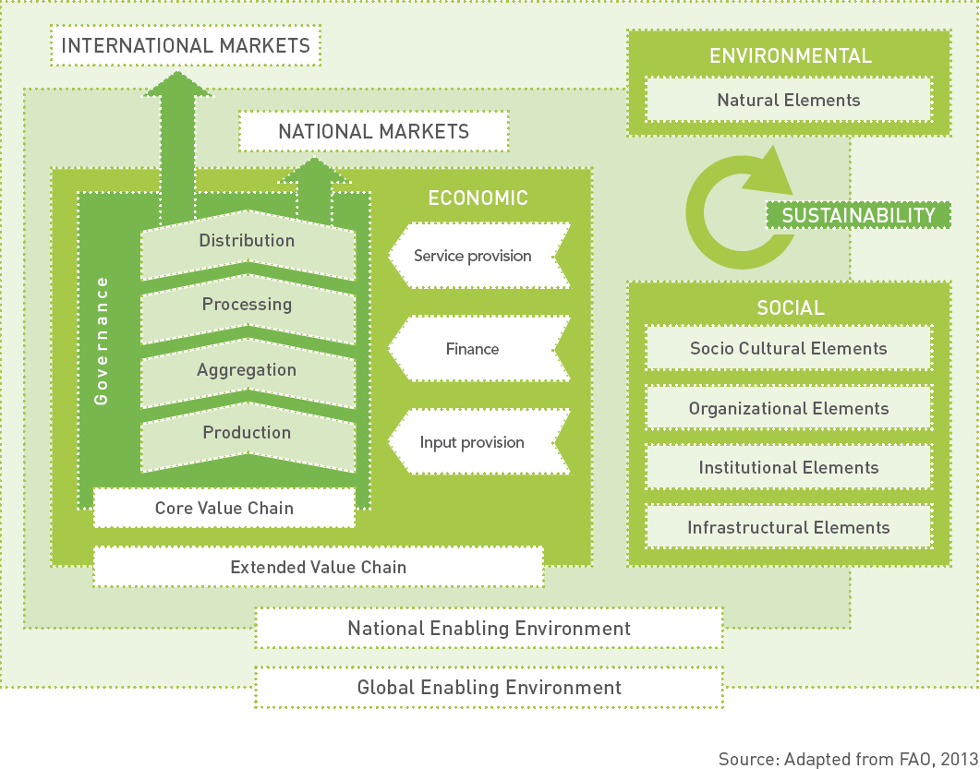
The sustainable food value chain framework

Slide 7
The sustainable value chain framework (see above Figure) includes:
the value chain actors: Apart from farmers and manufacturers, these are mainly traders and APMC, government departments, Agro Industries, cooperatives etc.
four core functions or stages: production (farming), aggregation, processing and distribution (wholesale, retail). The aggregation stage is where basically post-harvest handling and food storage takes place; and
governance structure: refers to APMC – where the production are sold through auction and the government mechanisms which includes public distribution system

Slide 8
The sustainability of the food value chain revolves around three dimensions.
An economic dimension, which focuses on activities that each actor or service provider provides that is commercially viable (profitable) or services that are fiscally viable.
A social dimension, which refers local level traders who control farmers and buy at a low price to cartels of traders who control overall supply and ways of governments policies to free small holders from their clutches and also provide fare price shops.
An environmental dimension, which refers to the sustainable use of agro waste by vermicompost at farmers level, or individual community bio-gas plants and use of urbanities food waste for energy.

Slide 9
The sustainable and inclusive food value chain development and its ten basic principles
The sustainable and inclusive food value chain approach and CSA are complementary.
The aim of value chain development is to achieve a positive or desirable increase in a value addition to farmers when sales his produce and get higher income. A value chain development intervention can range from improving business operations at production, processing, storage level or the relationship between different actors or the access to knowledge, information and innovation (UNIDO, 2011).

Slide 10
The sustainable and inclusive food value chain development (SIFVCD) can be divided into three phases:
understanding performance
2. improving performance
3. measuring performance
Within each phase different principles apply as shown in next Figure.

Slide 11
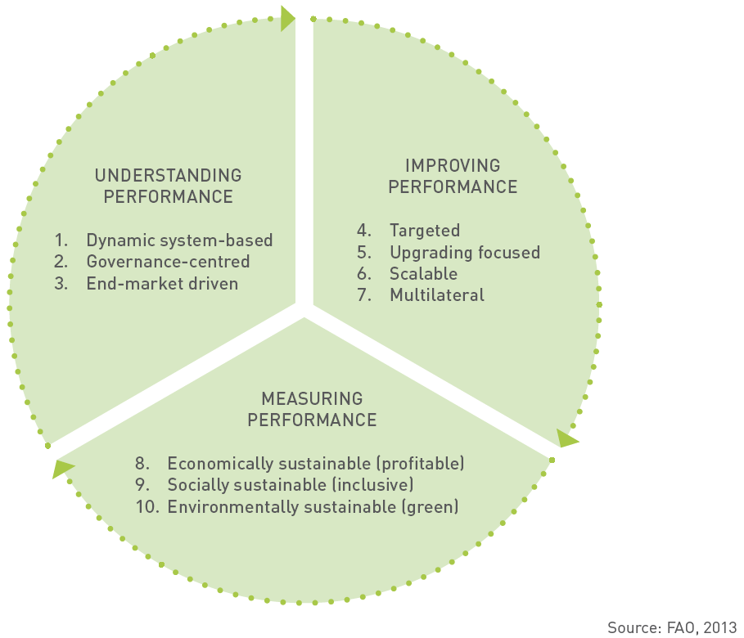
The ten principles of SIFVCD

Slide 12
Causes of food losses and waste
Food is mostly lost and wasted, because of the way food is:
• produced;
• handled after harvest;
• stored;
• preserved; and
• processed.
In addition, food is lost and wasted due to people’s lack of access to better market as a result of:
• insufficient income;
• forced to make sale to local traders can money leader
• lack of or inadequate infrastructure, such as roads, railways, waterways, port infrastructure.

Slide 13
In with end users – consumers it is due to among others:
how food is stored;
prepared and cooked; and
Wastage due to people buying more food than they need, put more food on their plates than they can eat).

Slide 14
Food production stage
Vegetable commodities and products
Pre-harvest cultivating and harvesting practices influence the post-harvest life of products due to decisions made regarding what, when and how to plant and when to harvest (FAO, 1998).
Pre-harvest – this includes selection crop, quality of seeds, cultivation practices, quantity of water, type of soil all affect post-harvest quality, shelf life and post-harvest losses. The selection crop should be based on soil fertility and farmers should be guided by soil health analysis.
Good post-harvest practices can also prolong the post-harvest life of particular fruits and vegetables.
Sometimes food may be lost due to premature harvesting as farmers may decide to harvest crops earlier, because they are food insecure or need to generate income.
It may also happen that harvesting is undertaken too late or that losses occur during harvesting due to damage and/or spillage.

Slide 15
Good agricultural practices and rules of harvesting
Good agricultural practices involve adequate soil management, selection of crop which soil fertility can support, use of certified seeds, including management of weeds, crop protection and maintenance of crop hygiene.
The latter involves the collection and removal of decaying plants, fruits and weed that can lead to infections in vegetables and fruits, which may result in post-harvest losses and waste.
The basic rules of harvesting with the aim to get the crops in the best possible condition to the market are:
harvest during the lowest temperature of the day: early morning or late afternoon;
do not harvest produce when it is raining or when there is dew, when the produce is wet it is more likely to decay as well as it is more vulnerable to damage; and
make sure to protect the harvested produce from sunlight if it cannot be immediately transported.

Slide 16
Livestock production and dairy products
Losses and waste in the livestock and dairy production sector may occur due to various reasons. During livestock production, losses and waste may occur due to poor feeding or diseases, e.g. swine fevers, tick-borne - which may lead to animal death.
During dairy production, losses and waste may occur due to poor milking techniques, illnesses, infection or diseases, which have a negative impact on milk production (FAO, 2011b; FAO, 2011d).
It is important have closed container for milk when it is taken sale to centre – open vessel spills over and makes losses.
Good livestock production and dairy farming practices include proper management and housing, nutrition (adequate and nutritious) of feed and water, milking hygiene and animal health through vaccinations and drugs

Slide 17
Post-harvest handling and food storage stage and food processing stage
Vegetable commodities, livestock and dairy products and fish commodities
Food losses and waste of crop, livestock and fish products at the post-harvest handling & storage stages and at the processing stage may occur due to:
spoilage, as a result of lack of or inadequate cooling facilities and lack of adequate infrastructure for transportation;
spillage, contamination, and degradation are a result of poor and inadequate handling during transport and storage. They are also due to processing, such as during washing, peeling, slicing and boiling of fruits, vegetables.
inadequate preservation of the products;
• packaging, as a result of damaging due to use of poor quality containers.
(FAO, 1989; Parfitt et al., 2010; FAO, 2010b; FAO, 2011d)

Slide 18
Good post-harvest handling and storage practices
A variety of practices and technologies are available for reducing post-harvest losses related to post-harvest handling and storage. Good handling practices in order to avoid mechanical damages include ensuring that:
containers are not too full if they need to be stacked on top of each other;
containers are not dropped or thrown;
produce is not directly put on the soil, in particular soil with a high moisture content;
containers and field containers are clean;
the produce is not brought into contact with oil, gasoline or chemicals that should not be applied;
produce is largely kept in the shade to reduce the temperature of fresh produce;
produce is field packaged, which reduces costs by improving the speed of post-harvest handling and reduces losses and waste
(FAO, 1989)

Slide 19
Other possible interventions to reduce food losses include:
immediate transportation after harvesting of crops, and landing in the case of fish;
using improved preservation and processing techniques including threshing and solar drying of produce;
using low cost and efficient storage and cooling structures; and
using practices, i.e. pasteurization and milk processing into cheese and yoghurt, to maintain product quality and extend post-harvest life.

Slide 20
Food distribution, marketing and retail stage
Transportation conditions
Road infrastructure
Quality of Transportation – tempos, tractors, trucks, railways.
Refrigeration – cold chain – cooling vessels, refrigerator, cold storage
Carbon dioxide emissions associated with transport
Eating locally and seasonally produced food to reduce GHGs

Slide 21
Market access constraints: physical, structural, information and organization
Constraint | Disadvantaged areas
Physical | Poor roads, high transport costs, perishable goods, low value/weight produce.
Structural | Asymmetry of market relations: cartels of traders, agro-processors or marketing boards whose market power allows excess profit shares.
Skills, information and organization | Lack of understanding of how markets operate, lack of information, lack of relevant skills.

Slide 22
Public Distributions System
In our country government buys food grains and makes available through fare price network – at a specified price – which is subsidized to poor families.
This system involves – procurement, packing, transportation to storage – godowns and from there to retail FPS.
Entire system needs modern management and practices that have described for farmers to reduce transportation losses, storage losses and spoilage – which is huge.

Slide 23
Public actions to support food chain interventions to reduce, reuse or recycle food stuffs
Government can not directly reduce, reuse or recycle food stuffs. The farmers need to change management practices, technologies and behavior in order to reduce, reuse or recycle their produce. However, the government needs to create an enabling environment.
Set an example by itself by reducing godown and transits losses in public distribution system
Creating a policy and institutional enabling environment for incentivizing reduction in losses
Awareness raising and advocacy for reuse – recycle waste – agro, cow dung and urine, and food

Slide 24
Building partnerships and alliances by promoting women self help groups for village level group market and local processing, encouraging and assisting youth to set-up micro-enterprise and adapt modern agricultural practices.
Supporting product and process innovation and research at the stage assign specific responsibilities to agricultural universities
Capacity development – farmers, godown maneger, APMC managers and even housewives.

Slide 25
Minimum Support Price
In our country government has policy not to allow farm produces price fall down unnaturally by cartels.
It declares minimum support prices and setup dopers to purchase at that price.
Farmers should not sell below minimum support price – and whenever needed sell his produce to such centres
In current year farmers have sold cotton and paddy to such centres.

Slide 26
Creating a policy and institutional enabling environment
An important driver for improved practices along food supply chains is the enabling environment that supports and motivates the private sector to invest and make changes.
Factors that are considered to be crucial for the success of food loss reduction, reuse and recycling interventions are monitoring auction (against trader cartel ) in APMCs, public infrastructure, promoting village self help groups or produces cooperatives.
Implementation of food laws and standards based on sound and common approaches to interpretations of standards by different actors (officials, food processors, consumers).

Slide 27
Awareness raising and advocacy
Increasing awareness among farmers, retailers and consumers for reduction of food waste. Therefore both the public and policy makers need to be informed about the issue, and advised on behavioral change with regard to improved food use.

Slide 28
Building partnerships and alliances
Alliances can be built within the food supply chains between producers, processors, distributors, retailers and consumers like setting up of cooperative of producers using village level self help groups like Amul Chain in milk & milk products.
This could lead, for example, to the development of markets for products that are from a traditional commercial point of view labeled as ‘sub-standard’, but are nevertheless safe and of good nutritional value.

Slide 29
Supporting product and process innovation
Product and process innovation are crucial factors in reducing losses, creating local level processing facilities and promoting micro- enterprises.

Slide 30
Capacity development
It is essential to develop knowledge and capacity of small- and medium-scale traders to organize themselves in associations, cooperatives – producers companies, apply quality management systems, and improve packaging, storage – even with private processing there 4% to 6% losses in transit and handling.
In addition, it is important to develop capacities of officials of state level cooperation cooperatives, national government officials and development agencies and even NGOs in the use of food loss assessment methodologies and tools, in the establishment and enforcement of food quality and safety standards, and in the design of policies and strategies targeting food waste.

Slide 31
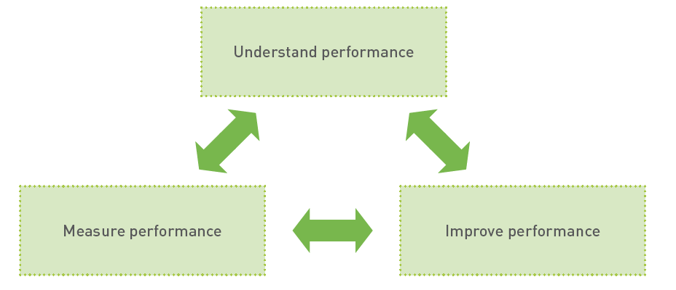
Step-by-step approach for chain actors to improve their performance along the sustainable and inclusive food value chain
The three steps are visually outlined below in Figure
Step-by-step approach for how to improve performance along the sustainable and inclusive food value chain

Slide 32
Step-by-Step approach
Step 1: Understand performance
Identify gaps in current system:
Farmers – practices
Farmers cooperative – how they operate
Local producers – how the process and done
APMC – how auction are conducted
Transport – mechanism – quality of trucks, tempos
Market price information – to farmers & consumers
Prices at village level to consumers in reasons thereof and who fixes market price
Cold-storage – godown
Bank – financial support – against pledged goods

Slide 33
Step 2: Improve performance
Develop realistic strategy in consultation of all stakeholders – being together under one umbrella for upgrading activities and multilateral partnerships.
Develop a workable implementation plan for the upgrading activities and multilateral partnerships

Slide 34
Step 3: Measure performance
Measure the impact once the plan is introduce in terms of economic, social and environmental intended outcomes:
Measure the impact of the development strategy in terms of its economic, social, and environmental outcomes in relation to the vision developed under step 2.
In this way, the impact assessment then contributes to understanding the performance of the chain in a continuous development cycle.

Slide 35
Conclusions
We have discussed an important areas in developing food security – which most often neither given importance or measured in terms of impact. In reality it can add to farmers income by 5 % to 25% and it can add to food availability by 5% to 20% which very significant contributions.
The sustainable and inclusive food value chain approach focuses on three sustainability dimensions – economic, social and environmental— which are directly linked to three pillars of CSA. This approach can contribute to CSA by helping to identify interventions at every stage of the food value chain to enhance the performance of the chain.

Slide 36
Through understanding, improving and measuring performance, waste streams that occur along the food value chain can be analysed. This includes not only reducing food losses and waste, but also looking at reusing and recycling food stuffs that still have an economic value as they can serve other uses, such as reusing waste for human consumption or animal feed, as compost or to generate energy. This not only provides economic benefits, but also social (i.e. employment generation) and environmental benefits.
This approach not only include farmers and agri. administration – but needs crucial support from Rural Development and Food & Civil Supplies Department and Trade Associates.

Slide 37
Other areas where public intervention may be needed include awareness raising, agricultural research and development as well as capacity building support in order to help smallholders adopt more sustainable practices that are climate smart and help consumers to reduce, reuse or recycle their waste.
Furthermore, we have outlined a step-by-step approach of how chain actors can analyze their interventions along the sustainable and inclusive food value chain with the aim to improve their performance in all three sustainability dimensions—economic, social and environmental.

