Slide 1
Strengthening Climate Justice Initiatives: Focus on Farmers
Presented by-
Dr. Kirit Shelat-Executive Chairman, NCCSD-INDIA

Slide 2
Objective to Strengthen the call to reduce Climate burdens faced by farmers in particular through a Climate Justice perspective
1. Highlight
The Legal basis of Climate Justice
Approaches to ensure
Timely delivery of Justice embedded in Comprehensive framework of sustainable development.
Special focus on marginalized and affected farmers
Cross cutting impacts
Precautionary approaches
Inclusive public policies
2. Hear the voices of farmers
Demonstrate inclusiveness in deliberations through their participation
Define opportunities to establish veracity of their observations to strengthen scientific temper.

Slide 3
The Contours of justice & the need for farmer focus
Facets of justice
Fairness, moral rightness and a scheme or system of law that benefits every citizen.
Natural and legal rights.
Farmer focus : Go beyond piece meal solutions
Highly vulnerable and need speedy justice
Have to tackle cross cutting consequences of Inclement weather and markets, adaptation by crops, diseases, post – harvest management
Need
Locally adapted and inclusive knowledge systems
Build on their understanding
Empowers them to access emerging knowledge
Livelihood opportunities with livestock, fisheries, land and water management, bio resources conservation
Viable and locally feasible Climate smart practices that are not “re – packaged & redundant”
Overcome drudgery &
Establish other enabling circumstances including infrastructure, crop insurance, food security, alternative livelihoods, soil / water / bio resources augmentation & multiple safety nets

Slide 4
Indian Situation
India’s success over six decades:
2 % to 3% sustainable agriculture growth.
Brought many out of poverty
Tackled many adverse climate and geographic challenges
Validated research into raise productivity
Several States & individual farmers with average productivity, higher than, or equal to International level.
But there is unequal growth between agriculture and other sector like services and manufacturing. Later have average growth of 8% - 10%. This is Increasing rural and urban divide.
Further there unequal growth between farmers at local level in same village with similar land, and, water resources, one makes profit and other fails – commits suicide.
Adverse impacts of climate change pushes even successful farmers back to poverty
Farmers suicide / Large scale exodus to urban centers.
There are still about 30% farmers below poverty line.

Slide 5
Some Important leads
Across India as a whole
Drought in 2002 reduced 15 million hectares of the rainy-season crops - loss of > 10% in food grain production.
2013 delayed monsoon rains caused a fall in rice cultivation.
Terminal heat stress is lowering yields of late-sown wheat yields and cold waves during December 2002-January 2003 significantly affected mustard, mango, guava, papaya, brinjal, tomato and potato in northern India.
Cold wave in 2006 damaged 50-60 % of young and 20-50 % old mango trees.
Heat waves
Nearly 20 lakh birds perished in June 2003.
Can reduce a milk yield by 10-30% in first lactation and 5-20% in second and third lactation periods in cattle and buffaloes.
Anand Agricultural University for Gujarat
3°C increase could reduce
CERES-Peanut (Groundnut) yield by 31.2% / yr.
CERES-Wheat by about 44% / yr.

Slide 6
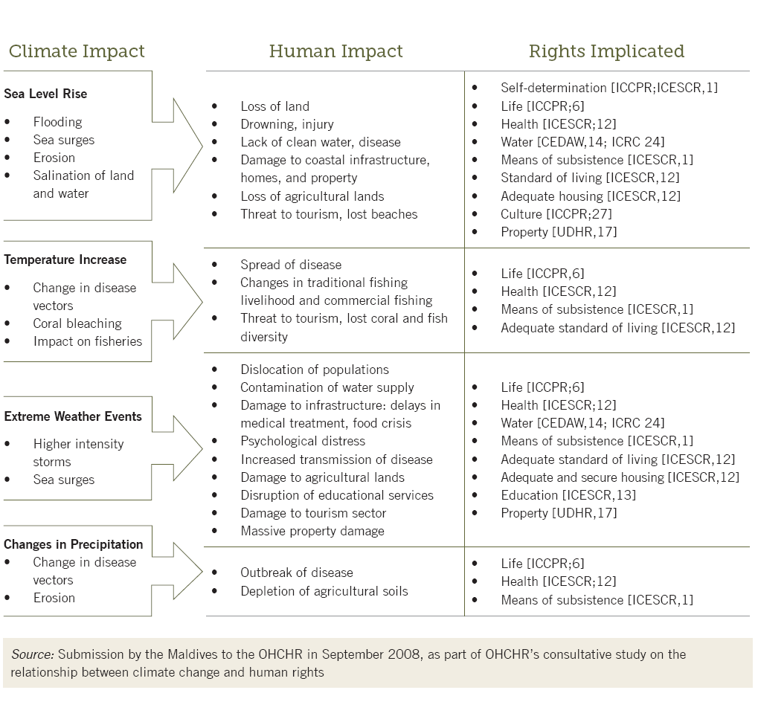
Climate change and Human Rights

Slide 7
Small farmers stare at big losses-In India
In the current year
Monsoon delay has pushed 20 of the 75 districts in UP to the brink of drought.
Worst-hit are in Meerut, Kanpur and Varansi, where dry spell has damaged paddy.
Unusual rain has harmed crops in parts of Bankura, Purulia and East Midnapore in Bengal
Large-scale flooding, after heavy rains affected 23 districts in Odisha and entire regions of Kashmir.
This has affected over all productivity and production of food and other crops.
Source: Economic Times, 7 September, 2014

Slide 8
The centrality of the farmer &The Indian perspective to tackle challenges
Important challenges (amongst others) persist.
Approximately 25% people are still below poverty line and are most vulnerable.
Those who have come out poverty line are in danger –Zone being thrown back below poverty line.
Safety nets dealing with inputs and marketing are riddled with leakages.
Delay in insurance payments

Slide 9
Observed Impact On Agriculture In India.
Industry and urban township are mostly implicated in the creating the externality through the release of pollutants and other emissions. They have to be made responsible for the challenges caused and sustained support to overcome challenges in the longer term too.
These are locally felt challenges of a global phenomenon and can be seen as externalities that the farmers are not responsible for. The stakeholders responsible for creating these challenges cannot be determined as there is no direct cause and effect relationship.
But it is important to deliver justice to the affected communities in a timely manner. These should include technical, technological and financial inputs & safety--net so that the farmers can tackle climate related challenges immediately and sustain such transitions in the future too or for that matter advisory on Climate Smart Practices.

Slide 10
CURRENT SYSTEM FOR MEETING THESE CHALLENGES.- The Indian Perspective
Disaster-Reconstruction policy:
This is National Policy to provide immediate help to people affected by natural calamities-it includes advance precautionary measures like shifting of population
Government provides financial assistance to affected at time of natural calamities like floods/cyclone-
Cash doll payment-for 15 days
Assistance for Household Kit
Assistance for Replacing livestock-lost/Died.
Assistance for Repair /Restore Houses collapsed or washed Away.
Crop and cattle insurance.
Financial assistance in case of death of adult members of family
Employment Guarantee Scheme (Act)-MNREGA(Mahatma Gandhi National Rural Employment Guarantee Act)
This act provides assured employment in Communities Projects to those who have no source of livelihood and in certain cases even one’s own farm laborer work is permitted like Farm Pond. This is available round the year. This scheme is very popular. It has also raised rural wage of agriculture and allied workforce.

Slide 11
Conti………
Crop and cattle Insurance.
Government provides
Subsidy in premium
Majority crops are including horticulture crops are Covered.
Minimum Support Price. (MSP) (Govt. of India, Agri .Mini Website)
Government provides a mechanism to purchase agriculture produce-include food grain at a specific price- if the market price is lower. Government sets up purchase depots to buy at MSP. This protects farmers in time of falling price due to bumper crops or Speculative Movement.

Slide 12
Conti………….
Food Security:
In September 2013, Government of India has introduced National Food Security Act. The Act provided for food security to both urban and rural poor. Approximately 67% of rural population-81 crore of population is entitled to receive subsidized food grain form Public Distribution System. The rate recommended imbalance are:
Rice-Rs 3/-Kg(5 kg per person/month)
Wheat –Rs 2/- Kg
Coarse Grain Rs 1/- Kg
11 states have introduced this scheme. There are some operational issues-Which are being sorted out.
This is a massive scheme and provides food security covering all rural poor families which include poor farmers.
Grievance Redressal-
The justice system judiciary has created legal Aid Cell- to guide and even provide a lawyer without any fees for those who cannot afford.
Lok Adalats-These are open courts to settle issues by calling aggrieved parties together.
Public Administration:---District Level
Government of Gujarat has setup at District level Committee headed by the Minister (In charge of District), Secretary (In charge of District) and District Collector.
Every month they meet to here aggrieved persons whose problems have not been resolved. This is a public hereing with concerned department. By District Administration from citizen-both rural and urban.
This administration works in each District effective.
Those who are not satisfied with the decision or want to take up the matter at Higher Level Department.

Slide 13
Why Climate Justice Is Needed
The changes in weather have now increasing severe impact on habitat. Its aberrations are increasing.
As mentioned earlier farming has become very risky business.
Despite very many schemes and statutes all above there are people who get left-out .These are same poor Families who are left out of development process-and who are more than 25% of rural families. They have been left out because they are not get capable to reap the benefit of Schemes. Hence they need individual help.
This is especially at time of their crop-failure or Cattle death or Washing away of crop and soil.
Despite different provision in law and schemes to assist there are loopholes and inequity as will be seen from following :

Slide 14
Glaring Example of Inequity -Forever Agriculture
Crop Insurance
Average settlement period (1 to 2 years) While requirement is immediate for resowing
Car Insurance and Medical Insurance -Normally Insurance company makes direct payment-Cashless provisions but farmers have to wait.
Inputs Seeds
Seeds fails germinate or less germination in relation to quantity of seeds –but failure of certified seed-replacement is not easy-There are no warrantee provision.
But in case of Consuble and non-consuble goods immediate exchange / replacement within stipulated period in case product fails to meet standards depicted
Sale of Agriculture produces
Gets banned for exports if there is internal (within country) shortage & price rise and farmers looses higher value from its sale if exports
Industrial products -There is no such ban

Slide 15
The International Inequality to Agriculture
There enough provision to safeguard ,Human rights in UNFCCC resolution.
But In the current discussion & policy framework Conference of parties in UNFCCC deliberations, agriculture is addressed from the point of view of food security, food to hungry millions but not from view of sustainable livelihood to farmers and role of agriculture and of farmers for mitigation is not prioritised. Agriculture vegetation due to its unique photosynthesis process is only known technology which naturally absorbs Co2 from atmosphere and releases oxygen. This unique function is not given due importance and farmers are advised do mitigation by reducing use of fertilizer which they need get higher productivity
Conversely agriculture is treated on par with industry, mines, new urban areas for releases (a) GHG-But later release directly by its operations (b) reduce absorption of Co2 which to take place by agriculture on same land acquired by them. Hence their impact on global warming is double by on the other hand.
The while calculating GHG emission by agriculture –absorption by it co2 is not given deduction. Policy framework for Carbon Credit is industry oriented. No farmer or their organisation can fill up such complicated forms to avail carbon credit-But Pandits do not recognise this-At international level in Conference of Parties, Agriculture needs to be given recognition of the role and farmer given support as Global Warming is international phenomena but its impact is at local level ,village level and the main suffer or of these un–foreseen to foreseen calamities is farmer who tends to lose his only source of livelihood

Slide 16
March Towards Climate Justice
The impact of climate change on agriculture is increasingly evident from the frequent and diverse occurrences of natural calamities. But Some of Our farmers have devised certain solutions to combat them.
There are traditional Experiences. Research Scientists have also evolved certain workable solutions.
Civil society working in rural areas has contributed. There are convergence of efforts with Government Schemes which are focused on this-but despite all these with same land ,and water, availability one farmers makes profit-other fails and commits suicide or migrate to urban Centre.
There are productivity gaps between farmers of same villages- Farmers who have low yield-of crops or milch cattle are in majority and they continue to remain poor and their poverty is on increase in arena of climate change.
They are left out of development process.
They have not been able seize opportunity or assistance that are available –
They have very limited capacity to air their grievances and many of them in clutches of rural rich.
They need focused attention-support-capacity building-
The young among them are restless-and like to wed brutality-and this is spreading –It is a direct challenge to the public Governance system. Hence to tackle this situation handholding is the need.
In recent studies it has been brought out that such a situation leads –if not attended –both by National Government and International organization like UNFCCC lead to a normally and local war lords taking over such vulnerable countries.

Slide 17
Introduce-Climate Smart and Sustainable Agriculture (CSA)
CSA endure to ensure that despite change in climate and its adverse impact on crops/animals, income to farmers should not decrease. It provides opportunities to have multiple sources of income from agriculture and animal husbandry - milch cattle and poultry, fisheries, when one fails, other supports.
It provides opportunity to young members of family to acquire multiple skills, support for setting up microenterprise locally, based on demand and supply situation. It provides safety net at the time of natural calamities – by way of insurance – for crops & animal husbandry along with employment in community projects.
Climate smart agriculture involves:
-Crop pattern based on soil health & moisture analysis to support crops which can be sustained.
-Agro – advisory .
Crop production that contributes to food security by addressing current and projected climate change impacts through adaption and mitigation and provides an opportunity to win-win situation despite adverse changes.
It provides institutional arrangement for mass communication and a way to bridge productivity gaps at local level between farmers by reaching out farmers at their door step.

Slide 18
Ensure Accountability and Involvement of public leadership
The government machinery strives to combat the climate adversities and the agricultural losses. The government schemes need to reach out to poorest. It is time to establish the culture of commitment through fixing the accountability to implement the scheme in spirit .The climate Justice enables the farmers to voice their problems and Communicate and involve public leadership to ensure that poor’s-are no longer “left outs”.
The public leadership has to take up these difficult challenges head on. By Public leadership we mean both elected and non elected members of public Governance System-and it includes all three wings-the legislature, the judiciary and executive.

Slide 19
NCCSD’s Initiative-on Climate Justice
NCCSD has held an International conference on in November 2014,this was addressed by Chief Justice of India and presided over By Governor of Gujarat.
There were more than 400 participants and 150 farmers
All above issued were deliberated and conference passed follows:-

Slide 20
The conference unanimously resolved as under-March of Climate Justice
Give voice to farmers, understand their options and empower them to act.
Identify areas where there is apparent in-equity in laws, schemes, procedures and safety net provision.
Suggest inclusive sustainable legal and administrative process with the involvement of all stakeholders to reduce inequality through appropriate redresal system and with protective assistance to get it and declare authorities responsible for its regulation and make them accountable
Strengthen governance through local level public leadership who should be made statutorily responsible under Panchayati Raj System should be made responsible to communicate to entire village weather forecast and agro advisory.-
Improvement in existing legal framework and tools to suggest ensuring preventive and remedial action to reduce vulnerability through transparent credible, long – lasting and effective but quick enforcement of climate and related policies.
To develop capacity building programmes which to trains farmers in Climate Smart Agriculture make them ready to give voice to their concern and sharing of their difficulties with leadership initiatives.
To design and develop sustainable development with built in legal framework to ensure effective implementation and accountability of those in public and private Governance System who are responsible to provide it.

Slide 21
Conti……….
To disseminate information on weather and Agro-advisory with Vice chancellor of Agriculture Universities are responsible to make that available.
To lead a smooth transition process through which income does not become less, but it grows gradually like that of non-farm sector, despite adverse impacts.
To prepare future generation of farmers and leaders to convert these adversities in to opportunity.
It is urged that united Nation and UNFCCC and Conference of Parties take note of direct impact of Global Warming on farmers and related impact on Food Security for hungry millions and enhanced social-turmoil resulting into violence and deaths of poor people. It is urged that Global resources be diverted to support poor farmers, provide technology transfer “Those who have it to those who need it” to bridge productivity gaps and climate Smart Agriculture.
It was uniformly further resolved that participants conference-Which included farmers-that international community will find just and smart way to provide them relief for act and omission of others.

Slide 22
Book on “Climate Smart Agriculture - the way forward: The Indian perspective”- by DR Kirit N. Shelat
Kindly visit the following links for this book.
http://www.discovery.org.in/climate_change/index.htm
http://www.discovery.org.in/climate_change.htm

Slide 23
Thank You for your patient hearing
Dr. Kirit Shelat
Executive Chairman,
National Council for Climate Change, Sustainable Development and Public Leadership (NCCSD)
Post Box No. 4146, Navrangpura Post Office, Ahmedabad – 380 009.
Gujarat, INDIA.
Phone: 079-26421580 (Off) 09904404393(M)
Email: info@nccsdindia.org Website: www.nccsdindia.org

