Slide 1









Non-Formal Education Center (NFEC) a one-stop Center for
Climate Resilient Agricultural
Implementing institutes:
Vivekanand Research & Training Institute (VRTI)
National Council for Climate Change & Sustainable Development (NCCSD)- India

Slide 2
Vision
In the arena of changing climate, develop a one-stop Center to serve local, regional, national, and global farmers, and provide them with solutions for different climate-resilient agricultural practices

Slide 3
Mission
The Mission of the Center is to build the capacity of farmers on the subject of climate resilient agriculture through hands-on training, which will help them not only sustain farm productivity under adverse climatic conditions, but to increase productivity, and thus profitability

Slide 4
Initial phase
Collaboration with Florida A&M University (FAMU) for technical support
Volunteers from USA conducted training in India under ‘Farmer to Farmer’ (F2F) programme

Slide 5
Capacity building programme in Agriculture sector
No. of training assignments – 13
Total no. of trainees – 4,654
  Male trainees: 3,370
  Female trainees: 1,284

Slide 6
Major topics covered
Farm Sanitation & Good Agricultural Practices
Integrated Soil Management Practices
Crop Water Quality Management & irrigation
Empowerment of Women in Development
Food Safety in Agriculture
Farm business management & record keeping
Integrated nutrient management & composting of farm waste

Slide 7
Major recommendation adopted by farmers
Proper manure management and application of organic matter in soil
Rain water harvesting and water management
Involving women farmer in farm decision making
Post harvest management in different crops

Slide 8
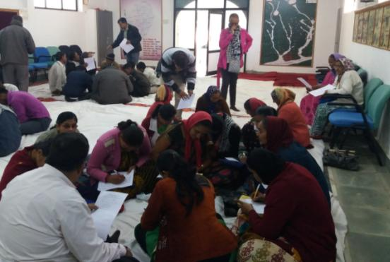
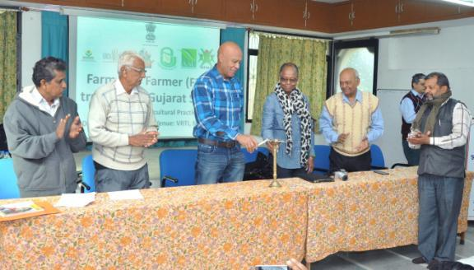

Slide 9
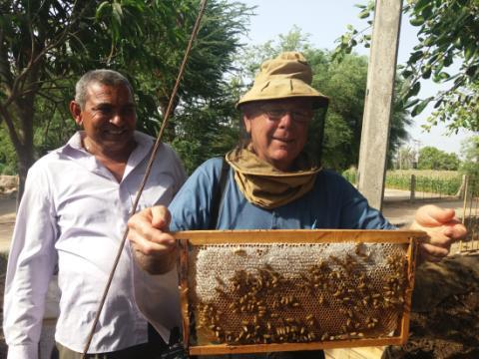
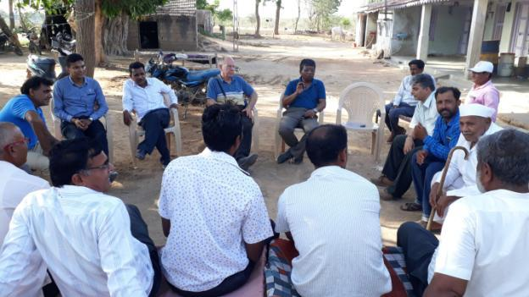

Slide 10
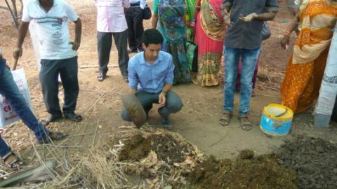
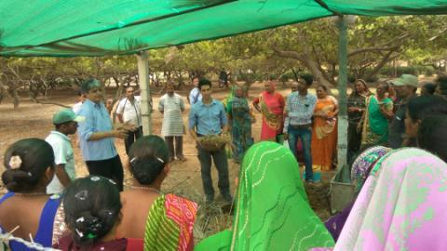
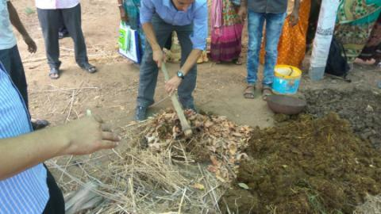
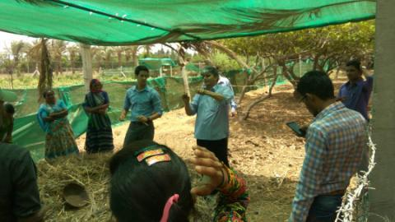

Slide 11
Strengthening the center
Practical guidance and hands on training to farmers through
  Demonstration farm at VRTI
  Soil & water testing laboratory

Slide 12
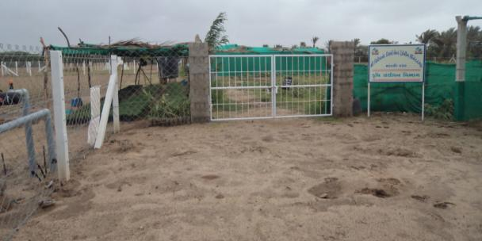
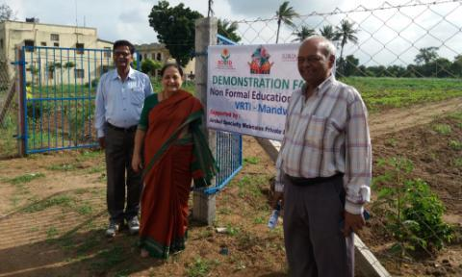
Demonstration Farms at VRTI

Slide 13
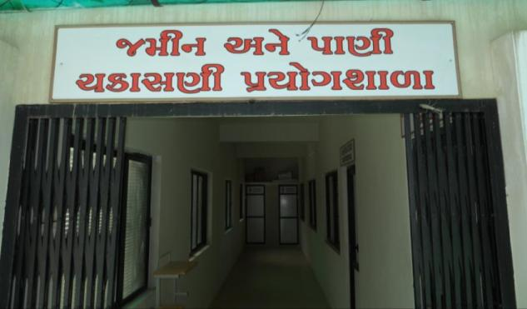
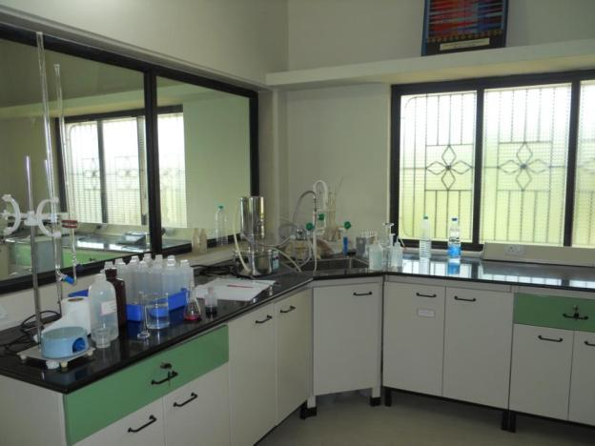
VRTI - Soil & Water testing laboratory

Slide 14
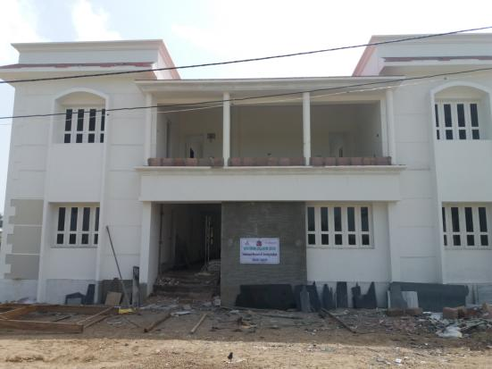
New building for
Non Formal Education Center

