Slide 1

“Meeting Challenge of Climate Change through Integrated Mitigation & Adaptation for Sustainable Agriculture: through community based, locally adapted strategies & Leadership”
Dr. Kirit Shelat – I.A.S. (Retd.)
Executive Chairman - National Council for Climate Change,
Sustainable Development & Public Leadership

Slide 2
NICRA supported Capacity Building Programme for adaptation of Climate Resilient Agriculture to NCCSD
NCCSD has trained more than 5000 Farmers in Gujarat.
NCCSD in the Process has developed learning material in Form of ‘Guide Book’,’ Video films’ and Posters.
The Guidebook have been revised Every year after basic Guidebook has developed to incorporates problems faced by farmers and ways to solve them.

Slide 3
Conti………….
The First Guide book was ‘Baldalata Havaman ma Kushal Kheti’. This was later on distributed by Government of Gujarat to all villages in the Year 2014.
This was added with new guide book on Value Added Agriculture in year 2015.
Followed by comprehensive new book released by Union Agricultural Minister for State Shri Parshottam Rupala in October 2016.The latest edition includes ways to meet problem due to Salinity ingress, frost etc-with focus on new issues raised by farmers and their solution.

Slide 4
Conti…………
The Hindi Edition was brought out in year 2016 and Circulated to all states and state like U.P. has already using it.
While under NICRA only funding for first Guidebook has made available NCCSD mobilized State Government and other donors to support rest of editions-books and distributed to Non-trainee farmers also .

Slide 5
Conti……………….
This unique contribution of the PROCESS included :-
        Developing a Guide Book in consultation with Agricultural Scientists.
        Testing it with Farmers.
        Firm up it with incorporating issues raised by farmers.
        Make it available to all farmers.
        These process was repeated every years.
The most importantly there was Convergence with State Government, Field Agricultural Team , State Agricultural University and direct dialog with farmers every year.

Slide 6
NICRA Contribute to all Indian Farmers
The learning material developed for 5000 farmers was reached out to all farmers of Gujarat . In this way NICRA Contributed for devloping a module for transfer technology for devloping Climate Resilient Agriculture to not only Gujarat but for entire country.

Slide 7
Case Study-1
“Watermelon – a crop of hope
The objective of the training programme is to provide incentives to the farmers so as to increase production and productivity of agriculture and allied sectors. Six villages namely Chichinagavntha, Kudkas, Chikar (Rambhas), Gaurya, Chikar (Zawada) and Bheskatri are covered by KVK Waghai under CRIDA Training project for the uplift of farmers in agriculture and allied sectors. Seeing the availability of water in seepage fed rivers/ nalas during Dec to March, KVK has tried the cultivation of watermelon in all the adopted villages which not only gave good returns but also became a main cash crop during the summer.

Slide 8
Case Study-2
“Dairy Farming-A boon for tribal areas”
By CRIDA Training, he came to know about some welfare schemes for tribals and the Benefit and purchased one HF cross-bred cow worth Rs. 16,000/- by receiving loan with 50% Subsidy. As cross bred cow was the new enterprise for him, he often faced so many troubles for proper guidance. In the beginning he was not able to maintain the proper health of his animals. He started to visit the KVK in order to get the guidance for maintaining the dairy animals. Scientists of KVK were impressed to see his keen interest in dairy farming as a result, this village was adopted by KVK. Through PRA, it was found that the farmers of this village were rearing the animals with traditional method, imbalance use of feeds and fodder as well as facing the chronic problem of anoestrus, repeat breeder and poor growth. The Scientists of KVK started a series of activities ie training, demonstration, exposure visit etc to deal with the existing problems and observed a positive impact. At present, Sh. Kamlesh Chaudhari has adopted the scientific concepts to rear his animals as per the suggestions given by KVK scientists. He uses proper concentrate, fodder, mineral mixture, timely vaccination, de-worming and diagnosis as per the guidance provide by the scientists of KVK through training , demonstration, and very frequently farm and home visits.
Due to adoption of improved practice, his constant efforts and hard work and timely support from KVK and other line departments and Vasudhara dairy he could achieved very impressive growth in dairy farming

Slide 9
Case study-3
Science Lighting the way:-
Intense training of CRIDA as well as on field demonstration for the farmers in the KVK campus at Deesa followed over a period of time. Thereafter, a careful examination of his farm and soil was done and then kharadi was told that he should diversify to papaya.He was trained in all the scientific cultivation techniques through regular intervention and demonstration .He was also introduced to other progressive papaya growers who shared their experience and success stories. This proved to be major motivating factor.
A determined Kharadi put all his energy into introducing the new scientific farming methods on his farm. The quantity and quality of his crops improved considerably and the net income per hectare increased by an impressive five times. The soil on his farm was conserved and therefore, he continued to get better produce due to minimum tillage. His confidence and experience in scientific method improved his social standing too; he was not only elected to the village Panchayat but also became its education secretary .He is now a respected member of the farm science club.

Slide 10
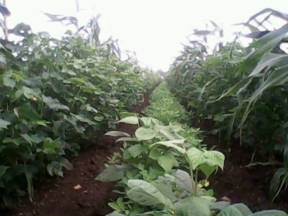
Case study-4
Using traditional agriculture technique:-“ Amrutpani”
From beginning he do not want and do not like to use chemical fertilizer and pesticide so based on there traditional knowledge he started using “Amrutpani” –the traditional pesticide –instead of chemical fertilizer .he took the mud pot and fill with 10 litter of water. Add 0.250jiggery, Neem leaves 1 kg, AKADO- Calotropis procera (Ait.) leaves 1 kg Cowdung-1 kg Cow Urine 1 lit,Gram floor 0.250 gm. He mixture everything and keep it for 8-10 days air tight.After 10 days the solution is ready he gave the name “Amrutpani” .he used this solution from starting to end of crop cycle for cotton .Every 15 days he spray this solution and because of this the height if cotton plant is 6.5 feet and the number of ball is 245-250.Also increased the production as compare to normal production. It increased 1o-12 Mann(12*20=200-240 kg) To seeing this the other farmer also started to make it and using it..Many farmers visited Arvindbhai farm .he used this solution for groundnut crop also. Especially for seed treatment for groundnut seed so none of the seed was failed and “fungus” was controlled and also he used this solution as a pesticide so he got more production and less expense.
Also because of this “Amrutpani” the wild animals like pig and Blue bull was not entered in the crop so crop was not damaged by them. Earlier because of this type of damage the production cost is decrease and expanses is increase. If we have to prepare Amrutpani Solution –all the material are available at village level so affordable and easy accessible for all rural community of farmers. It is traditionally homemade and chemical is not used so there is no hazardous for using this.

Slide 11
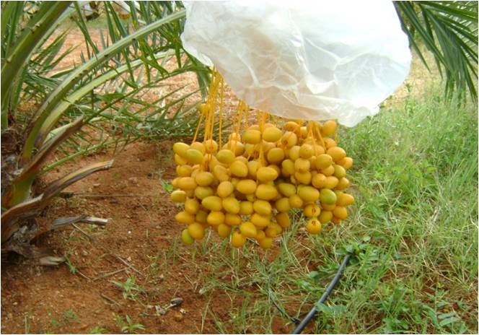
Case study-5
Farmers-"Using tissue culture tech."
No. of Plants : 636
Year of planting : 2007
First Fruiting : 2009
Production : 8000 KGS
Second Fruiting : 2010
Production : 14600 KGS
Third Fruiting : 2011
Production : 22000 KGS
Forth Fruiting : 2012
Production : 36000 KGS
Fifth Fruiting : 2013
Production : 44000 KGS
Sixth fruiting : 2014
Production : 19000 KGS (no rains)
Seventh Fruiting : 2015
Production : 100 % Flowering
Earlier the land was barren and Agriculture become not viable and sustainable so farmer do not want o continue the work
By using tissue culture
Average farm gate price/kg:-Rs 70.0
Income from Rs:- 560000 to Rs. 3080000
Average per Acre income RS. 44000 TO RS. 242000

Slide 12
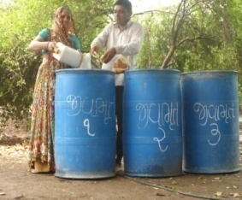
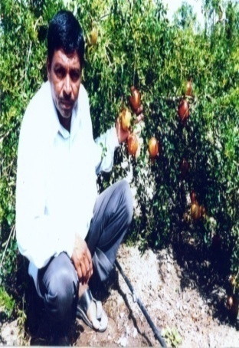
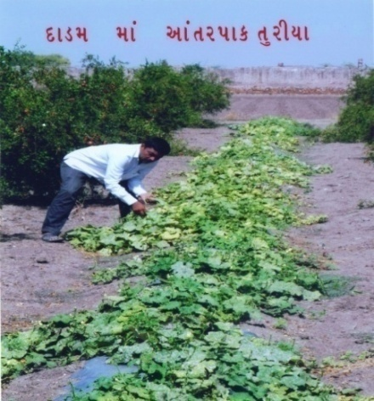
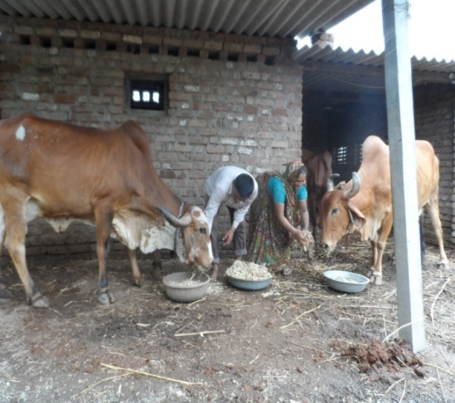
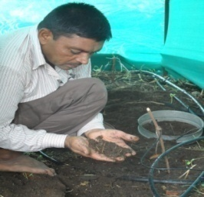
Case study-6
“Using Integrated technology on time “
I took the training from Junagadh Agriculture University for CRIDA and use Guide book and adopted the new technology. Also whatever waste is available in farm I collect it and put in the pit so it’s converted in the compost and now I started to use this compost as a fertilizer. I lay the compost surrounding the plant so no waste of fertilizer in monsoon and maintain the humidly in whole season. This technique is suitable and favorable in our crop and even in our land. So we continue the technology and Started cultivate the intercrop like Bottelguard and watermelon and in this we used mulching technique-Plastic mulch- and started sawing the crop after 15th September and using drip in absence of rain water. Through using this technique we earn net profit /Acre are as under.

Slide 13
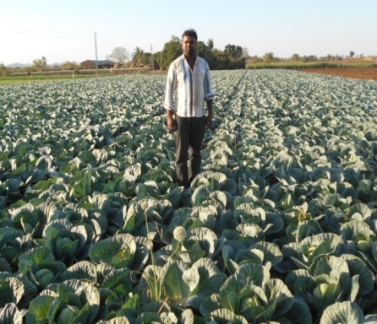
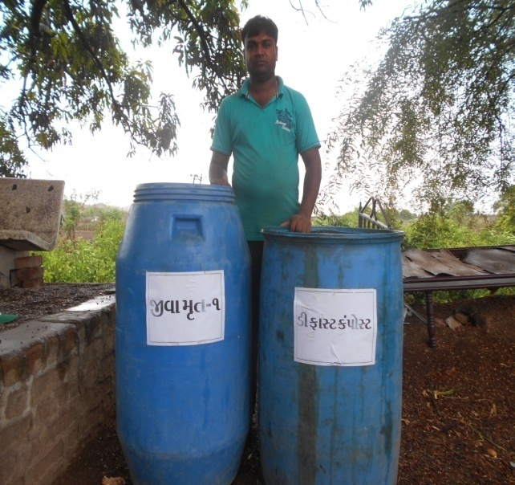
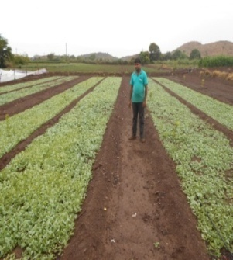
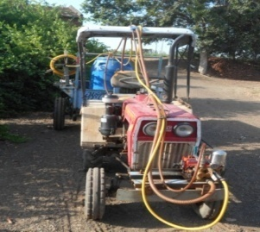
Case study-7
Not hard work but required smart work with technology ion Agriculture-Said Maheshbhai Young farmer
I shared my Experience to other farmers and I insist that the other young farmer also continue there traditional trade .if they use technology and change the perception and see agriculture as a Business. Agriculture is the best if we upgrade our knowledge and use technology and method on appropriate time .Now I stated to produce the vermicompost and used it for the same.

Slide 14



National Council for Climate Change, Sustainable Development and Public Leadership
Thank You
Dr. Kirit Shelat
National Council for Climate Change, Sustainable Development
and Public Leadership (NCCSD)
Post Box No. 4146, Navrangpura Post Office, Ahmedabad – 380 009.
Gujarat, INDIA.
Phone: 079-26421580 (Off) 09904404393(M)
Email: info@nccsdindia.org Website: www.nccsdindia.org

