Slide 1


“GUJARAT AGRICULTURE”
THE CURRENT SITUATION
Presentation made to
Shri Babubhai B. Bokhiriya
Hon’ble Minister Agriculture and Water Resource
Government of Gujarat
On 5th August 2015
Presented by
DR. KIRIT N SHELAT, I.A.S. (Rtd)
NCCSD

Slide 2
THE CURRENT SITUATION PART - 1

Slide 3

WHAT AILS OUR AGRICULTURE
On July2, 2006, Prime Minister of India visited the Vidarbha region of Maharashtra.
The purpose of the visit was to meet farmers
Region affected by suicides by farmers
In one year more than 800 deaths due to suicide
Similar situation prevails in other progressive states like Karnataka, Andhra Pradesh, and Punjab.
More than 10,000 suicides by farmers between 2001-06
Still farmers suicide continue in many parts of our country – in new areas are getting added.
contd…..2

Slide 4
THE STATUS OF INDIAN ECONOMY
Indian economy doing extremely well
The rate of growth of GDP was around 8% and now about 5%
Poverty in rural areas declined from 90% prior to independence to 25% in 2011.
Country was depending on imports of food grains in the initial years, since has attained self-sufficiency and exports.
Total production of food grains reached 250 million tonnes.
Over all growth in agriculture – slow but sustainable
Despite all this, farmers’ suicides !
contd…..2

Slide 5
FARMERS’ SUCIDE AND NAXALISM
In the same village, with similar land condition, with same crop, one farmer makes profits,
Some stay on and other commits suicide
Not all farmers commit suicide
The young farmers are educated
They take other means and wed Naxalism
Naxalism not a new movement but has taken new roots in many parts of the country.
In 2003 – 55 districts, 2004 – 150 districts, 2014– 170 district – 1/3 of the country covered.
Young persons prefer rather brutalism than committing suicide even if that has risk to their life.
Naxalism is a major challenge to democratic system.
Problem not only of agriculture but is a time bomb clicking which can damage the basic fabric of our constitution
contd…..2

Slide 6
SMALL FARMERS
121 million agriculture holding
99 million – small farmers about 80% of total holding – 1960-61, this was 62%.
Share in operated area – 44%
Average holding 1.33 ha
Access to irrigation 51%
Income Expend ( NSS 2003 data)
Monthly consumption marginal farmers – Rs.2,482
while income Rs.1,659/-
“ Gap is Rs.823/- per month “.“Per annum this comes to Rs.9,876/-. Result debt which they can not repay. “
contd…..2

Slide 7
Credit small loans up to Rs.25,000/- declined from 35.2% to
13.4% (of total agriculture advance).
Share of small borrower accounts (less than
Rs.25,000/-) fell to 38% of total account in 2004-05
from 62% in 1991-92.
Insurance Cover Even overall insurance cover is 15% of farmers 2006-
07. Paddy farmer accounted for 36% of all insured.
Source: Dr S. Mahendra Dev, India Gandhi Institute of Development
Research – Mumbai, small farmers in India challenges
opportunities.

Slide 8
POVERTY ESTIMATE
As per Rangarajan Committee , Planning Commission of India – June 2014, in the rural area percentage of persons below poverty line was 30.9% numbering 26 Crore population as of 2011 (Annexure – A). As per Tendulkar Committee, this is 25.7% in 2011-12. As per Planning Commission press note on poverty estimate – July 2013
Poverty in rural area percentage below
declined from poverty line
1993-94 50.0% 2011-12 25.7%
While in urban area, poverty declined from 31.8% to 13.7% The inequality between urban and rural farmers are growing.

Slide 9
THE PAST EXPERIENCE
Past experience of early 70s
Green revolution brought fruits to farmers, but poor small and marginal farmers did not benefit.
There were riots in rural areas of our country
The Government of India introduced special programme for assistance of small and marginal farmers – SFDA programme.(1975-80)
This was followed by Integrated Rural Development Programme (IRDP). (1980)
Focus on individual poor family, particularly farmers and artisans.
Special subsidy provided to obtain productive assets and inputs with back up bank credit. The programme has great success –poverty on decline – small and marginal farmers benefited.
But there were left out more than 25% - 30% on average
In some areas this proportion is more.
The left-out of development process needs continuous attention as those who are left out hardcore families due to a variety.

Slide 10
THE LEFT OUT OF DEVELOPMENT PROCESS
In 90s, focus of IRDP programme shifted- indebtedness
Focus changed to non-farm activities
It obtained new banner of SgSy & SgRy
Poor farmers no longer received special individual attention.
Programme moved to non farm activities, Self Help Groups
The farmers left out of development process, not paid attention and continued to remain poor. These families were hard core portion of original programme
A very large segment
NSSO report 2005 on farmers indicated high debt ratio
NSSO REPORT 2013
Andhra Pradesh - 82% 92%
Tamil Nadu - 72% 82%
Punjab - 65%
Kerala - 64%
Karnataka -61%
Gujarat - 51% 42%
Despite Government of India decided to right off debts but problem of indebtedness continue and has enhanced.

Slide 11
THE LEFT OUT OF DEVELOPMENT PROCESS
Lack of inputs
Left out poor farmers don’t have access to new technology tools – equipments, high price seeds and information
Extension Administration did not bother about poor farmers
Lack of control on quality seeds and inputs and basic guidance for selection of crop to be grown in rainfed areas based on soil health.
There can be many other reasons like mortgage of land by farmers to private money lenders/local dealers and so on and so forth.
Poor farmers started copying the wealthy farmers who had water resource and new technology, and failed.
This was also true for Gujarat.
(Contd….2)

Slide 12
The Constraints
As per the 12th Plan working group disadvantaged farmers - Bina Agrawal – 9/11/2011 – Planning Commission of India.
Constraints to small holders are as under:
Poor land access
Poor credit access
Poor access to critical inputs – water, energy, seeds, fertilizer and farm equipments
Neglect by Extension team
Agriculture – increasingly risky
Limited market access.
Impact of climate change
Indebtedness
These are true for all small holders across the country including Gujarat

Slide 13
Push & Pull on SMALL FARMERS Preparedness to Act
FINDINGS Of the
NSS-59TH ROUND
(PUBLISHED IN JULY 2005)
Huge gaps
Awareness on technical and institutional development 18%
Farmers liking farming 60%
Seed replacement 30%
Using of testing Labs for seeds, fertilizer etc 2%
Accessing knowledge about technology 40%
  From Extension Administration 21%
  Input dealers 23%
Related shortage of trained professionals
Only 207 colleges in the country
Yearly intake: Agriculture
Undergraduate 10,049
Postgraduate 1,544
PhD 570
While in other disciplines
  Science 20,31,100
  Engng’ & Tech 16,700
  Medicine 3,13,500

Slide 14
Related Systemic Problems
Productivity reduction aggravated by climate change.
Heavy rain episodes with fewer rainy days, un-timely or delayed rains, variation in temperature or frost and recurring deficit on average rainfall.
Un-predictable phenomena also affect productivity of milch cattle and fish catch.
Worst affected due to crop failure or low yield continue to be small and marginal farmers.
In Gujarat since last few years horticulture especially Mangoes and Sapato are affected due to un-seasonal rain and frost.
Significant reduction in land area under Agriculture
Rapid urbanization
Growth of industrial townships, mining including illegal mining, infrastructure projects-roads-highways, railways, ports so on so forth.
Farmers sell land; get money, waste on luxury goods, become poor and landless and turn into laborers.
Rich farmers buy land in interior areas and create new share croppers who can not avail bank loan as land is not on their name.

Slide 15
Cross sector & Cumulative Impact
Disastrous consequences if proper care is not taken:
Current growth rate of Agriculture -2% to 3% may reduce further
Create problems of food security for the country
Enhance inflation &
Create greater dissatisfaction / disharmony.
  Many small farmers will slide again below the poverty line.
  Educated rural youth will be more frustrated as their urban counter parts may enjoy higher income & prosperity.
  Perhaps enhance Naxalism / Social turmoil.
  Loss of livelihood
  Setbacks to social and economic development.
  Could endanger political stability.
  Overall setback to entire economy.
  This has already enhanced social un-rest in very many parts of our country.
15

Slide 16
GUJARAT
Agriculture and allied sectors
The growth of agriculture and allied sectors is still a critical factor in the overall performance of the state economy. During the period 2004-05 to 2013-14(Q), the GSDP for agriculture sector including animal husbandry sector had increased from Rs. 26746 crore to Rs. 52843 Crore at constant price. The growth rate ranged between 6% to 9% per annum.
Gujarat had minus or almost 1% to 2% growth rate prior to year 2000. This scene was changed and its has emerged as a leading agriculture state with sustainable growth in agriculture in last decade except for last two years with continuous decline in food grains and oil seeds.

Slide 17

Income ,Investment and indebtedness
NSSO REPORT - 2013
About 52 percent of Agriculture household in the country were estimate to be indebted. In Gujarat state ,about 42.6 percent of the agriculture household were estimated to be indebted.
Among the major State Andra pardesh had the highest share of indebted agriculture household in the country (92.0 percent) followed by Telengana (89.1 percent) and Tamil nadu (82.5 percent). While Gujarat state stands at 13th place (42.6 percent)
The average Monthly expenses (Rs) and receipt (Rs) for crop production per agriculture household for Gujarat state is Rs 2250 and Rs 5773 respectively. Which is higher than all India average of Rs 2192 and Rs 5542 respectively.
The average monthly expenses (Rs) and receipt (Rs) for farming of animal per agriculture household for Gujarat State is Rs 2399 and Rs 4874 respectively, which is significantly higher then all India average of Rs 1388 and Rs 2604 respectively.

Slide 18
Table 3.3 (a) Population Below Poverty Line (Tendulkar Methodology) (Figs. in Percentage)
State | 2009-10 |  |  | 2011-2012
 | Rural | Urban | Total | Rural | Urban | Total
Gujarat | 26.70 | 17.90 | 23.00 | 21.54 | 10.14 | 16.63
All India | 33.80 | 20.90 | 29.80 | 25.70 | 13.70 | 21.92

Slide 19
PRODUCTIVITY GAPS AT LOCAL LEVEL
NCCSD jointly with Anand Agriculture University-Dr. Shelat and Dr. Shekh conducted study on productivity gap between average (small) farmers and progressive farmers of Anand (the most fertile district) and Mandvi – kutch(the arid-salinity affected area. The findings were as under.

Slide 20
Gap in Productivity –
Crop wise average yield and Optimum yield-Anand Block, Anand District, Gujarat
Source: Agriculture Production Local Level Plan Shekh & Shelat - NCCSD 2013
Sr No | Crop | Area(ha) | Average yield (qt/ha) | Optimum yield (qt/ha) | Yield gap (qt/ha) | Anand Block Yield gap %
1 | Pearl millet (K) | 3640 | 15.25 | 20.25 | -5.00 | -24.69
2 | Pearl millet (S) | 8751 | 26.78 | 30.65 | -3.87 | -12.62
3 | Rice (K) | 6230 | 28.10 | 35.60 | -7.50 | -21.06
4 | Wheat | 3540 | 28.00 | 34.50 | -6.50 | -18.8
5 | Tobacco (B) | 10612 | 20.00 | 25.62 | -5.62 | -21.9
6 | Castor | 745 | 26.00 | 30.00 | -4.00 | -13.3
7 | Pigeon pea | 205 | 10.00 | 15.24 | -5.24 | -34.3
8 | Sesame (K) | 210 | 4.60 | 7.00 | -2.40 | -34.2
9 | Sesames (S) | 360 | 7.00 | 8.50 | -1.50 | -17.64
10 | Cotton | 927 | 6.57 | 13.19 | -6.62 | -50.18
11 | Green gram (S) | 289 | 4.25 | 7.00 | -2.75 | -39.28
12 | Chickpea (G) | 72 | 15.00 | 20.60 | -5.60 | -27.18
13 | Chickpea (V) | 150 | 18.00 | 22.00 | -4.00 | -18.18
14 | Groundnut (S) | 100 | 17.45 | 23.00 | -5.55 | -24.13
15 | Mustard | 426 | 14.20 | 18.90 | -4.70 | -24.86
16 | Cluster bean (Gum) | 431 | 10.00 | 15.65 | -5.65 | -36.10
Total |  |  | 31113

Slide 21
Horticulture Crops: Gaps in Yield
Sr No | Crop | Area (ha) | Average yield (qt/ha) | Opti­mum yield (qt/ha) | Yield gap (qt/ha) | Yield gap %
1 | Banana | 3120 | 600 | 700 | -100 | -14.2
2 | Papaya | 60 | 415 | 650 | -245 | -36.15
3 | Lemon | 180 | 100 | 120 | -20 | -16.6
4 | Chiku | 60 | 80 | 120 | -40 | -33.33
5 | Ber | 30 | 90 | 150 | -60 | -40
6 | Pomegranate | 25 | 65 | 80 | -15 | -18.75
7 | Aonla | 100 | 90 | 125 | -35 | -28
8 | Mango | 350 | 45 | 85 | -30 | -47.05
9 | Jamun | 25 | 7 | 10 | -3 | -30
10 | Watermelon | 90 | 460 | 520 | -60 | -11.53
11 | Muskmelon | 80 | 300 | 375 | -75 | -20
Total |  |  | 4120

Slide 22
Forage Crops: Gaps in Yield
Sr. No | Crop | Area (ha) | Average yield (qt/ha) | Optimum yield (qt/ha) | Yield gap (qt/ha) | Yield gap %
1 | Hybrid Napier grass (7 to 8 cuts) | 702 | 2000 | 2800 | -800 | -28.57
2 | Maize African tall | 1986 | 600 | 1200 | -600 | -50
3 | Forage sorghum | 2255 | 650 | 800 | -150 | -18.75
4 | Cowpea (Chola ) | 80 | 300 | 400 | -100 | -25
5 | Lucerne (8 to 10 cuts) | 737 | 750 | 1000 | -250 | -25
6 | Oats (2 cuts) | 50 | 450 | 550 | -100 | -18.18
Total |  |  | 5810

Slide 23
Yield Gap in Productivity of Livestock
Sr No | Livestock | Population | Average produc­tion | Optimum produc­tion | Yield Gap | Yield gap %
1 | Buffaloes | 67285 | 4.24 lit /day | 10 lit/day | -5.6 lit./day | -57.6
2 | Cross bred cows | 10000 | 8.15 lit/day | 15 lit/day | -11.85 lit./day | -45.6
3 | Indigenous cow | 13852 | 4.23 lit/day | 8 lit/day | -3.77 lit./day | -47.12
4 | Desi layers / annum | 10158 | 130 no./year | 180 no./year | -50 no./year | -27.7
5 | Improved lay­er/ annum | 427100 | 250 no./year | 300 no./year | -50 no./year | -16.6
6 | Broiler | 130000 | 2.00 kg/birds | 3.5 kg/birds | -1.5 kg/birds | -42.8
7 | Emu farming | 1500 | 8.00 eggs/ bird | 12.00 eggs/ bird | -4.00 eggs/ bird | -33.3
8 | Fisheries (86 ponds) + Chestnut/ Sin­goda | 267 (ha) 267 (ha) | 60000.00 (Net income in Rs) Rs70,000 | 90000.00 (Net income in Rs) Rs 1,20,000 | - Rs 30,000 - Rs 50,000

Slide 24
PRODUCTIVITY GAPS – MANDVI-KUTCH
Rukmavati River Basin Current Agricultural Crops – area
Mandvi- Block,Kutch-District -Crop wise average yield and Optimum yield
Sr. No | Crop | Area (ha) | Average yield (qt/ha) | Optimum yield (qt/ha) | Yield gap (qt/ha) | Yield gap %
1 | Groundnut (K) | 8624 | 15 | 22 | -7 | -31.8
2 | Hy. Cotton | 5279 | 25 | 50 | -25 | -50.0
3 | Moogbean (K) | 3994 | 5 | 8 | -3 | -33.3
4 | Sesamum (K) | 3320 | 3 | 6 | -3 | -50.0
5 | Wheat | 2651 | 30 | 40 | -10 | -25.0
6 | Hy. Castor | 1651 | 30 | 50 | -20 | -40.0
7 | Hy. Bajra (K) | 889 | 20 | 25 | -5 | -20.0
8 | Cluster bean | 578 | 8 | 15 | -8 | -50.0
9 | Hy. Bajra (S) | 228 | 25 | 35 | -10 | -28.6
10 | Groundnut (S) | 150 | 18 | 22 | -4 | -18.2
11 | Isabgol | 60 | 8 | 12 | -4 | -33.3
Total |  | 27424

Slide 25
PRODUCTIVITY GAPS – MANDVI-KUTCH
Rukmavati River Basin Current Agricultural Crops – area
Mandvi- Block,Kutch-District -Crop wise average yield and Optimum yield
It will be seen that the difference in productivity at local level with almost same quality of land is more than 20% -up to 50% between progressive farmers and average poor farmers.
Simply bridging this gap at local level can enhance income and production by 25%.
This is true for Anand which is an advanced agriculture district and Mandvi-Kutch which is having arid area

Slide 26
KNOWLEDGE GAP AT LOCAL LEVEL
NCCSD is implementing capacity building programme for farmers as a part of NICRA – ICAR programme to promote Climate Smart Agriculture. It conducted a preliminary survey to find out status of knowledge of farmers in 2013-14. The study has conducted by Dr. Rathod in Navsari, Anand and Kutch District. The details are as under:

Slide 27
SUMMARY OF FINDINGS AND CONCLUSION:
TABLE-A Effect of respective levels of education among the farmers:
A=Higher Secondary and above level, B=Secondary level and C= Primary level of education
Aspects of Climate Smart Agriculture | Knowledge(%) of Anand district |  |  | Knowledge(%) of Navsari district |  |  | Knowledge (%) of Kutch district
 | A | B | C | A | B | C | A | B | C
1. Knowledge among the farmers about the weather parameters | 47 | 41 | 38 | 59 | 41 | 38 | 59 | 48 | 43
2. Knowledge among the farmers about the sci. application of weather parameters in agriculture | 52 | 42 | 38 | 51 | 42 | 38 | 54 | 45 | 44
3. Knowledge among the farmers about the use of modern scientific technology | 53 | 44 | 31 | 53 | 44 | 31 | 53 | 47 | 43
4. Knowledge among the farmers about the impacts of climate change effect in agriculture | 58 | 49 | 39 | 58 | 49 | 39 | 54 | 52 | 36
5. Knowledge among the farmers about the contact of extension linkages | 49 | 43 | 39 | 42 | 37 | 33 | 42 | 37 | 33
6. Impacts of social participation among the farmers | 42 | 37 | 35 | 39 | 35 | 31 | 39 | 35 | 31

Slide 28
Average knowledge of CSA (%) | 50 | 43 | 37 | 50 | 41 | 35 | 50 | 44 | 38
Average of Education level about CSA (% ) | A= 50% (Higher Education & above level) B= 43% (Secondary level of Education) C= 37% (Primary level of Education)

Slide 29
TABLE-B Effect of irrespective level of education among the farmers.
SUMMARY OF FINDINGS AND CONCLUSION:
Overall Percentage of Knowledge | Knowledge levels about the weather parameters (%) | Knowledge levels about the utility of weather parameters in agriculture (%) | Knowledge levels about the modern scientific technology (%) | Impacts of climate change effect on agriculture (%) | Effect of extension linkages among the farmers (%) | Effect of social participations among the farmers (%)
1. Anand district | 42 | 44 | 42 | 48 | 44 | 38 = (43)
2. Navsari district | 47 | 48 | 53 | 43 | 42 | 31 = (45)
3. Kutch district | 51 | 48 | 53 | 43 | 42 | 31 = (45)

Slide 30
Findings
It is clearly observed from the survey data(Table-B) that the overall knowledge percentage with respect to irrespective levels of education among the farmers of Anand ,Navsari and Kutch district ,most of the farmers had an average very low levels 44%of knowledge about good farm practices and climate smart agriculture were registered i.e. 66% farmers are not aware of new technology or practices.
Lack of effective agriculture extension network seemed apparent cause of this gap both in related to productivity and knowledge.
The maximum gap of knowledge among the farmers was observed 57%, 55% and 55% in Anand, Navsari and Kutch districts whose education up to primary level. In case of those who above higher secondary level, this was only slightly better.

Slide 31
OVER LAPPING OF AGRI EXTENSION - ADMINISTRATION
Constraints in current Polices
and Programmes
Agri Extension network Extension officer at taluka level. One VLW at village level for group of 8-9 villages at Block level – state government
Krishi Vigyan Kendra – ICAR.
ATMA – MANAGE Ministry of Agriculture, Government of India, State Director
NABARD farmers club
Watershed programme - DRDA – Rural Development Department
State Agricultural Universities Extension Education Wing
Public – Private relations messages to farmers by
  Fertilizer companies
  CSR by private organizations
  NGOs
  Input dealers - seeds/pesticides
  Gramin Bank - Agri tools, Agri equipments
Free helpline phone, SMS service of Ministry of Agriculture
All India Radio, Doordarshan, ETV giving Agro – advisory

Slide 32
OVER LAPPING OF AGRI EXTENSION - ADMINISTRATION
Constraints in current Polices
and Programmes
There are more than eight agencies and framers get confused – whom to follow - as most often each programme gives different advise.
Gujarat did overcome this barrier through Krishi Mahotsav approach.
It involved visit to every village in pre-Kharif operations. This had immense benefit.
It also involved providing Soil Health Cards to farmers of very village with details of soil fertility required nutrient, but most importantly which crops can grow on his soil and which crop will be sustained based on soil fertility.
It provided free kit to 15 poor farmers per village.
This was backed by massive check dams
This approach is currently diluted even Soil Health Card given only fertility gap.

Slide 33
Watershed Programme
Major programme of water harvesting, watershed with Ministry of Rural Development is now without focus on Increase in productivity and income of poor member of farmers. It has also no linkage with KVK, Extension Team of Agriculture Department and Agricultural Universities regarding crop/live stock practices.
The programme is supervised by Forest Service Officers who have no linkage with poor farmers and farming.
There are now incidence of having new watershed on old sites. Watershed Department has become an independent unit and has no connection with District Rural Development Agency or focus on poor farmers or for that increase in productivity each survey number of land which is in that watershed area.
The participative approach is increasingly being lost .

Slide 34
ANNEXURES

Slide 35
DEVELOPMENT IN IMPORTANT SECTORS OF GUJARAT ECONOMY
 | Table-3.1 : Area and Production
SR No | Crop | Area Production (‘000 Hectares) |  | Production (‘000 Hectares) |  | Percentage (+) / (-) No. over previous year 2013-14
 |  | 2013-14 | 2014-15 @ | 2013-14 | 2014-15 @ | 2013-14 | 2014-15 @
1 | 2 | 3 | 4 | 5 | 6 | 7 | 8
1 2 3 4 5 6 7 8 | Rice Wheat Jowar Bajra Total Food grains Cotton(*) Groundnut Total Oil seeds | 788 1500 128 694 4436 2519 1843 3079 | 811 1212 66 518 3748 3010 1356 2597 | 1636 4694 175 1413 9382 10088 5446 7470 | 1708 3695 84 1116 7947 10066 3366 5338 | 2.92 -19.20 -48.44 -25.36 -15.51 19.49 -26.42 -15.65 | 4.40 -21.28 -52.00 -21.02 -15.30 -0.22 -38.19 -28.54
(*) Production in ‘000 bales of 170 kgs. each, @ Second Advanced Estimate
Source: Growth Rate of Gross State Domestic Product in Only Agriculture Sector at Constant 2004-05 Prices (2005-06 to 2013-14)
conti--- (CSO & Ministry of Agriculture .Govt. of India (as on 31.10.2014)

Slide 36
Sr. No. | States/UTs | 2005- 06 | 2006- 07 | 2007- 08 | 2008- 09 | 2009- 10 | 2010- 11 | 2011- 12 | 2012 -13 | 2013-14 (P) | Average 2005-06 to 2013-14
1 | A & Nicobar Islands | -24.66 | 15.46 | 7.49 | 0.55 | -0.26 | 4.36 | 3.32 | 4.09 | 2.25 | 1.40
2 | Andhra Pradesh | 6.67 | 1.58 | 18.78 | 0.30 | 0.38 | 3.78 | -1.69 | 6.12 | 4.42 | 4.48
3 | Arunachal Pradesh | -6.03 | 19.35 | 25.60 | -13.56 | -1.95 | 25.29 | 10.56 | -4.27 | 6.17 | 6.80
4 | Assam | 1.92 | 1.68 | 3.03 | 1.22 | 6.48 | 3.29 | 4.79 | 4.35 | 4.45 | 3.47
5 | Bihar | -13.54 | 30.57 | -8.78 | 22.05 | -15.38 | 19.91 | 13.53 | 9.23 | -11.58 | 5.11
6 | Chandigarh | 3.58 | -0.52 | 0.28 | 6.40 | -14.62 | -3.66 | -17.64 | -7.21 | -0.27 | -3.74
7 | Chhattigarh | 17.96 | 4.97 | 11.50 | -14.21 | 10.88 | 25.89 | 3.10 | 11.18 | 1.03 | 8.03
8 | Delhi | -3.38 | 1.15 | -3.11 | -0.79 | 28.62 | 8.28 | 1.71 | 1.79 | 3.31 | 4.18
9 | Goa | 25.36 | -21.57 | 5.50 | -10.38 | 1.20 | 1.15 | 1.97 | -3.84 |  | -0.08
10 | Gujarat | 27.05 | -1.08 | 10.53 | -8.71 | -1.11 | 25.50 | 5.75 | -8.31 |  | 6.20
11 | Haryana | -2.09 | 14.66 | -0.29 | 7.39 | -1.75 | 5.33 | 8.08 | -1.51 | 3.27 | 3.68
12 | Himachal Pradesh | 4.14 | -5.09 | 11.91 | -1.73 | -18.14 | 29.08 | -7.13 | 10.63 | 17.71 | 4.60
13 | Jammu and Kashmir | 0.53 | 1.65 | 1.40 | 4.42 | -0.30 | 10.66 | 2.52 | -4.22 | 5.82 | 2.50
14 | Jharkhand | 3.36 | 13.83 | 5.84 | 20.51 | -9.28 | 5.09 | 31.88 | 7.25 | 9.21 | 9.74
15 | Karnataka | 11.04 | -3.50 | 14.04 | 1.35 | 3.95 | 16.17 | -8.23 | -3.16 | 0.64 | 3.59
16 | Kerala | 6.25 | -8.17 | -2.24 | 2.08 | -3.01 | -7.28 | -0.75 | 5.62 |  | -0.94
17 | Madhya Pradesh | 7.98 | 2.77 | -1.77 | 9.59 | 9.38 | 0.17 | 19.85 | 20.16 | 24.99 | 10.35
18 | Maharashtra | 11.45 | 16.22 | 16.30 | -19.88 | 4.18 | 24.79 | -1.30 | -2.51 | 3.83 | 5.90
19 | Manipur | -1.09 | 0.02 | 13.21 | 12.29 | 16.73 | -22.33 | 3.64 | 3.17 |  | 3.21
20 | Meghalaya | 7.75 | 1.83 | -0.64 | 5.58 | 0.85 | 2.09 | 6.03 | 2.82 | 6.35 | 3.63
21 | Mizoram | 2.54 | 4.06 | 22.60 | 20.38 | 12.73 | 20.48 | -4.26 | -0.68 |  | 9.73
22 | Nagaland | 1.77 | 0.42 | 0.21 | 5.95 | 3.53 | 9.22 | 5.57 | 4.00 | 4.19 | 3.87
23 | Odisha | 3.47 | 1.59 | 5.33 | 1.74 | 9.48 | 2.30 | -5.72 | 12.72 | -3.53 | 3.04
24 | Puducherry | 10.92 | 17.70 | 3.93 | 22.94 | -27.07 | 27.49 | -11.39 | 17.26 | 27.36 | 9.90
25 | Punjab | 0.78 | 2.87 | 4.00 | 1.89 | -0.57 | 1.56 | 1.75 | -0.05 | 0.21 | 1.38
26 | Rajasthan | 0.45 | 8.23 | 1.48 | 4.74 | -3.41 | 41.96 | -0.33 | 0.03 | 0.04 | 5.91
27 | Sikkim | 4.67 | 0.22 | 4.71 | 5.40 | 4.75 | 5.50 | 41.56 | 2.20 | 3.54 | 8.06
28 | Tamil Nadu | 11.49 | 15.42 | -4.69 | -2.70 | 6.56 | 7.69 | 11.05 | -13.04 | 8.22 | 4.45
29 | Tripura | 2.20 | 8.41 | 19.06 | 1.76 | -1.65 | 7.22 | 8.46 | 3.75 |  | 6.15
30 | Uttar Pradesh | 2.35 | 2.37 | 3.58 | 3.95 | -0.82 | 4.89 | 5.97 | 4.95 | 2.68 | 3.32
31 | Uttarakhand | -4.20 | 5.21 | 1.97 | -6.69 | 13.41 | 4.65 | 3.71 | 2.30 | 3.48 | 2.65
32 | West Bengal | 1.84 | 1.01 | 6.14 | -3.52 | 8.31 | -2.10 | 0.20 | 3.86 | 5.69 | 2.38

Slide 37
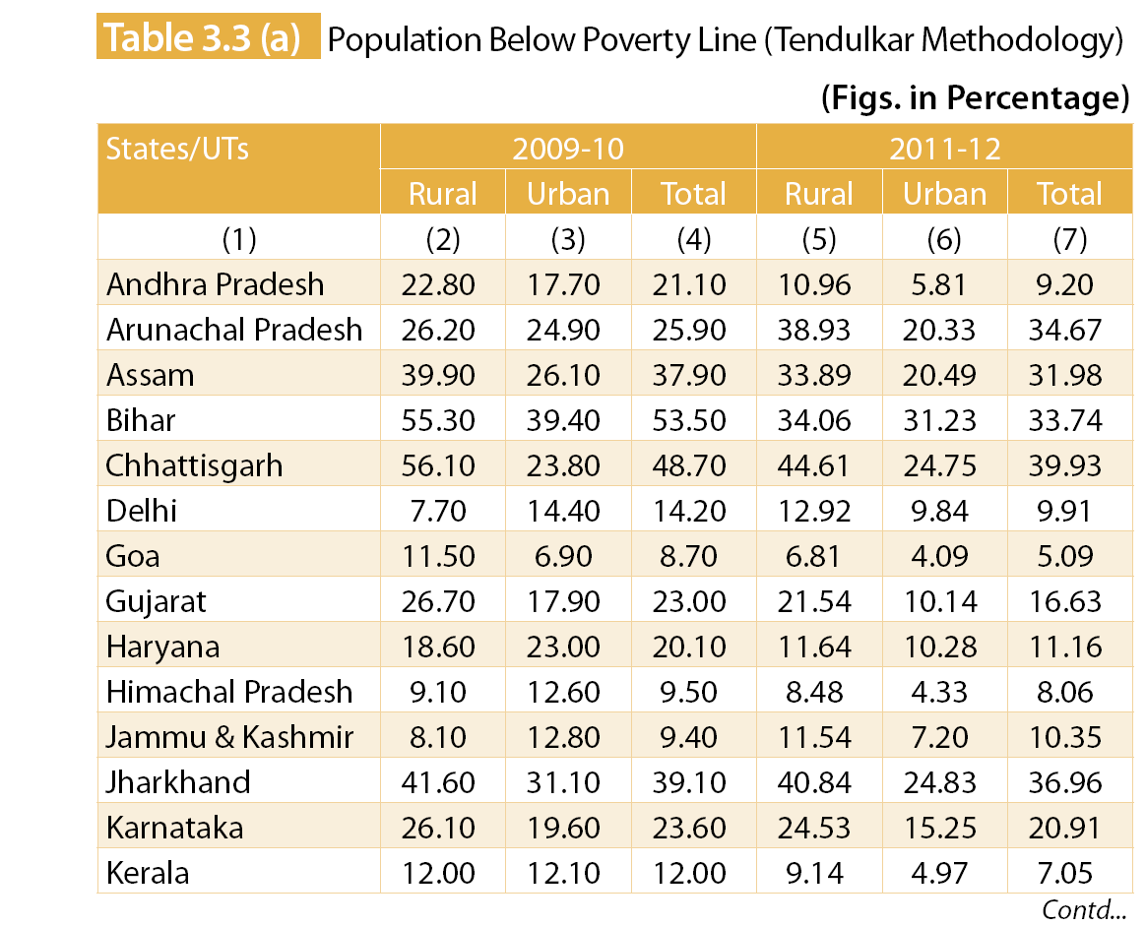

Slide 38
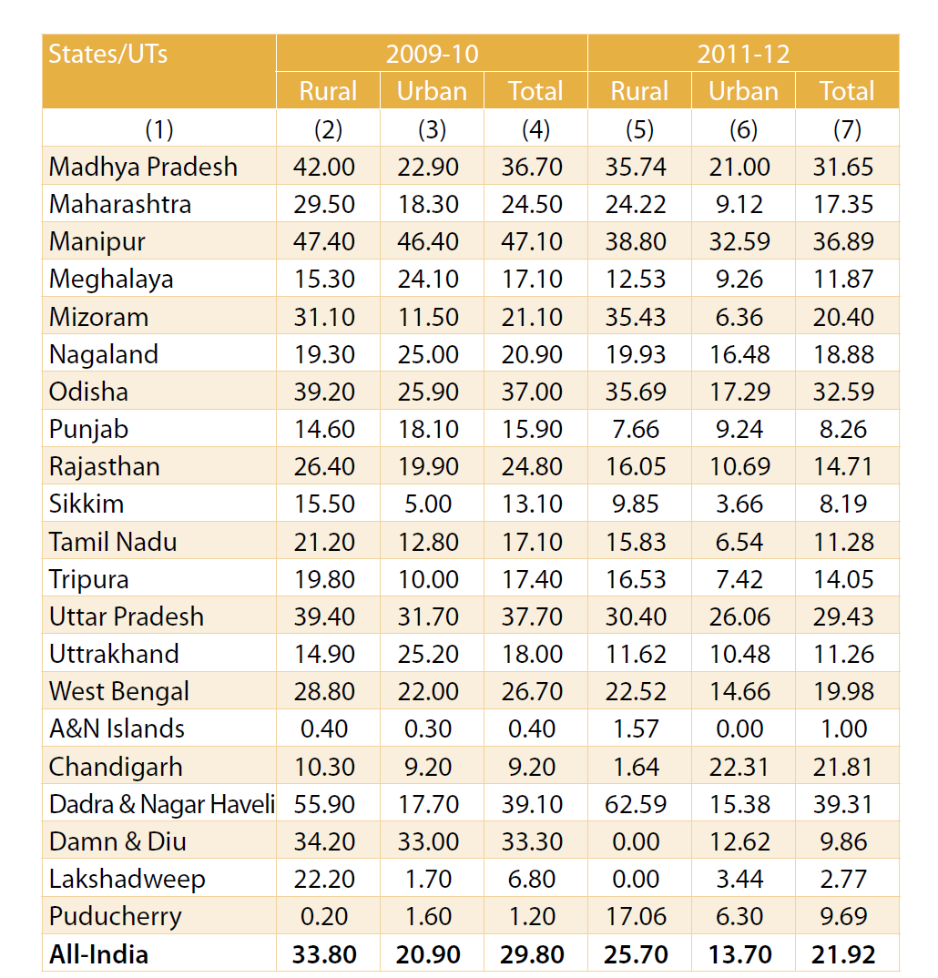

Slide 41
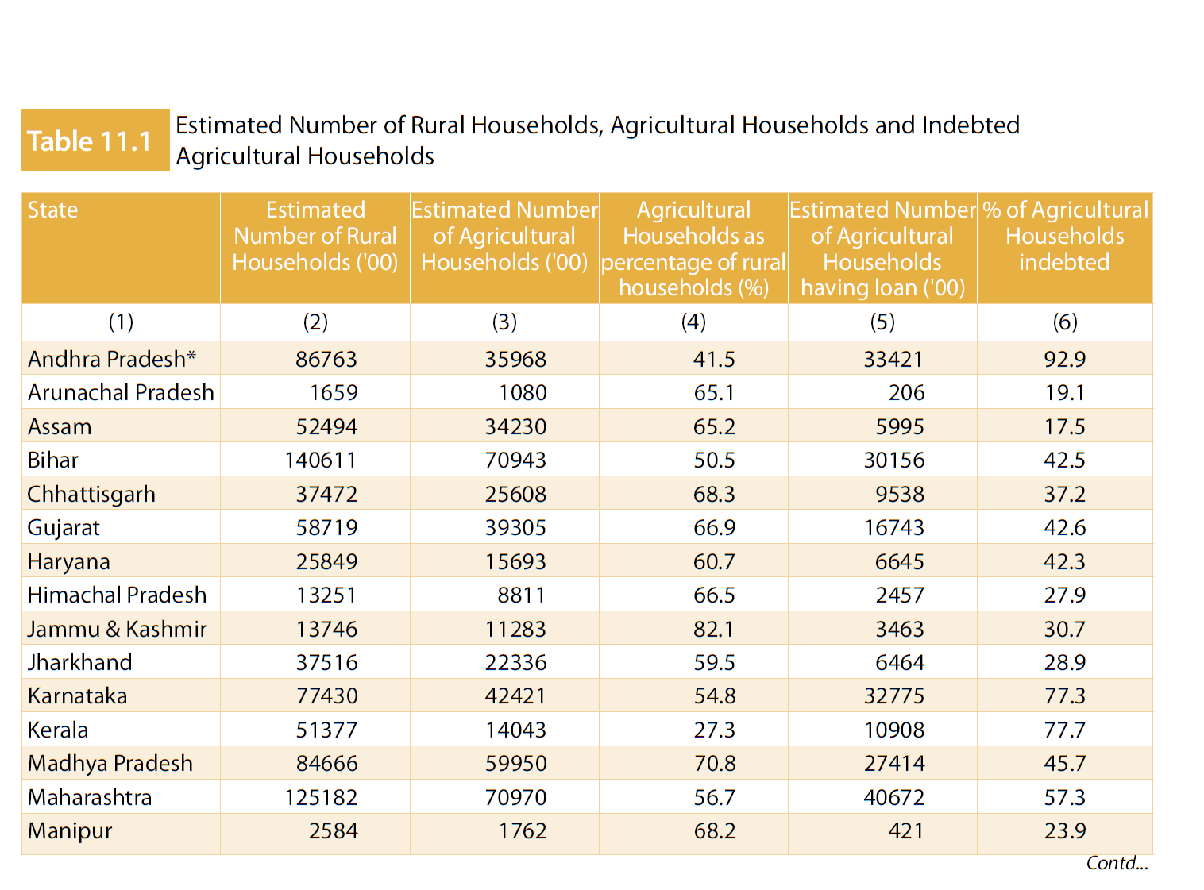

Slide 42
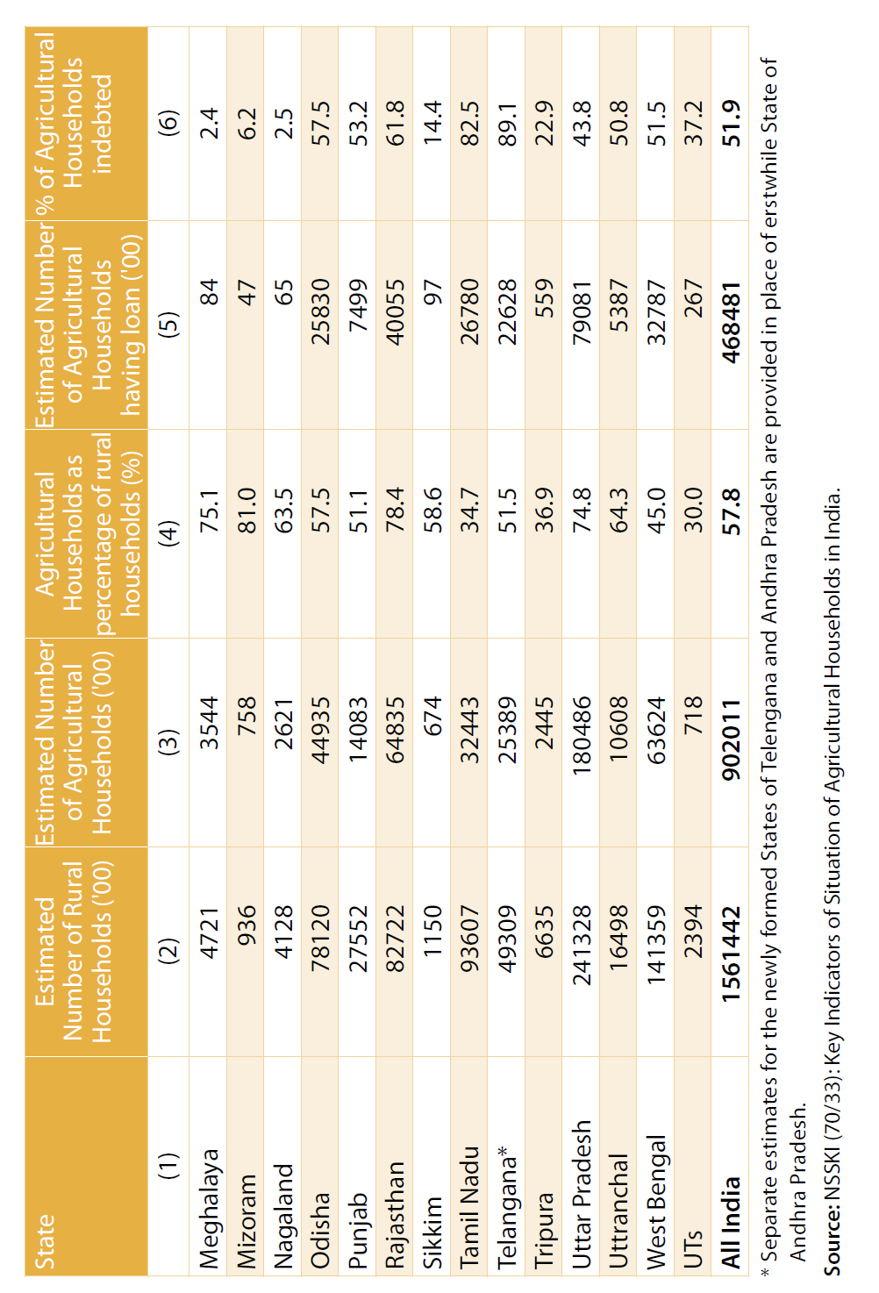

Slide 43
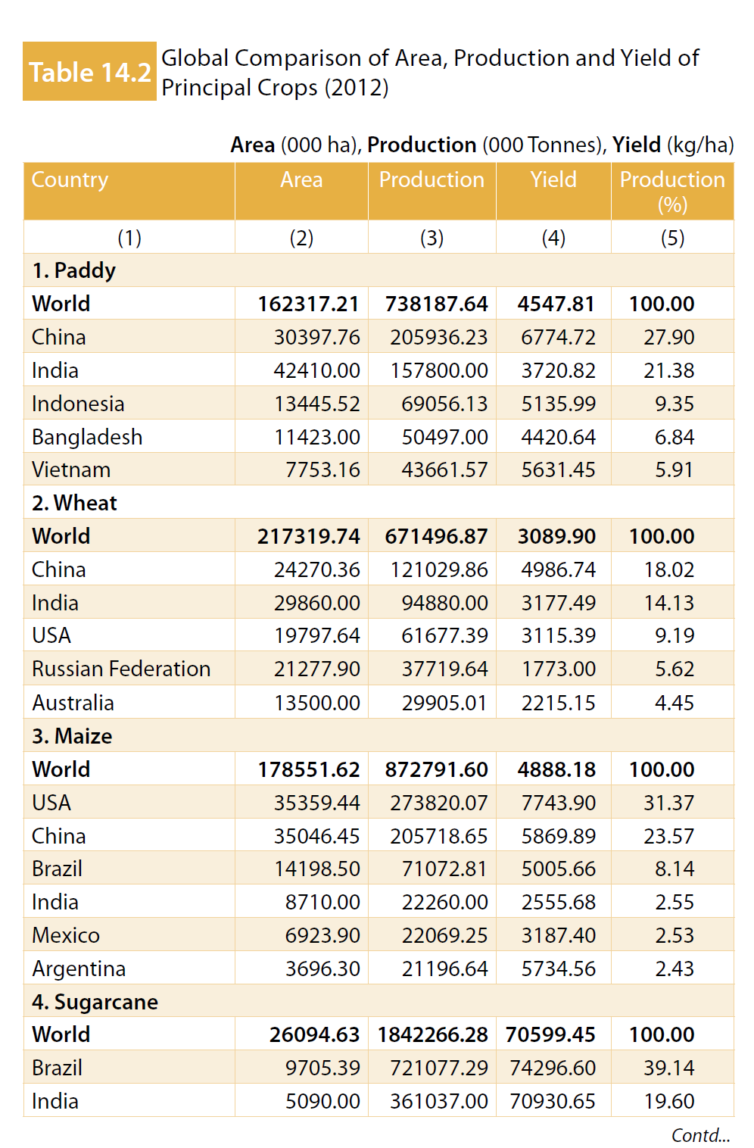

Slide 44
THE WAY FOREWORD
PART - 11

