Slide 1


“GUJARAT AGRICULTURE”
THE CURRENT SITUATION
Presentation made to
Shri Babubhai B. Bokhiriya
Hon’ble Minister Agriculture and Water Resource
Government of Gujarat
On 5th August 2015
Presented by
DR. KIRIT N SHELAT, I.A.S. (Rtd)
NCCSD

Slide 2

WAY FOREWORD
PART - II
AGRICULTURE MUST REVIVE
Small Farmer Development with focus on individual Poor family
2

Slide 3
SUSTAINABLE DEVELOPMENT
Common definition: Pattern of natural resource use to meet human needs while preserving the environment so that these needs can be met not only in the present, but also in the indefinite future.
Context of developing nations: It has wider and different meaning.
It is a long term activity; with significant socio - economic relevance in use of natural resources and implies economic growth.
It aims to provide enough for one’s needs to live / exist and continue to have the essential resource without becoming less.
Includes gradual growth in income for a better quality of life to all with focus on families below poverty line and remote areas.
It provides safety- net in the arena of climate change and meet adverse impact by way of re-capturing losses and providing employment.
It provide access to knowledge and technology at door step of poor families – farmers.

Slide 4
Farmer Development Agency
There is a need to have special organization for small farmers. All Agriculture Department at district and taluka level can be brought under it. Today they are operating independently from one another. This would include Dy. Director Agriculture, Animal Husbandry, District Agriculture Officer, Fisheries officer, watershed Agency, ATMA and KVK. The Agency will have special focus on each individual small farmers.
It should also provide small farmers:
  Soil & Moisture analysis information to the poorest on a priority basis
  Facilitation for Bank Finance & Subsidy
  Crop related guidance including market price & quality of product in demand
  Expertise on Adaptation measures needed for changed climate &
  Obtain information related to impacts to build a Management Information System for decision making
Link to supply chain for inputs and demand chain for their products; disburse subsidy including free inputs and provide link with Banks - Kisan Credit Card.
Implement door-step approach to farmers at village in pre-Khariff season&
Monitor and inspect spurious seeds and fertilizer-mix and pesticides.
This can be a new initiative of Ministry of Agriculture.
4

Slide 5
DEPARTMENT OF AGRI WITH RURAL DEVELOPMENT
TALUKA LEVEL ACTION PLAN
A New Initiative
Need to prepare simple, implementable Taluka – level Plan for Sustainable & Climate Resilient Agriculture as part of Comprehensive Agriculture Production Plan (CDAP) . All under CDAP taluka plan exists, but it is limited only to Agri. Department activities.
This should integrate programmes of the Department of Agriculture and Rural Development at the local level and that of Water Resources and non-conventional energy and BAISAG.
“Contingency Plan for Weather Aberrations” are prepared by State Agriculture Universities, but they are in English and perhaps available on Website only. They need to be made available to farmers at village level.
5
Notes:
5

Slide 6
TALUKA LEVEL ACTION PLAN
Taluka level is a pre-requisite as districts have ( as in Gujarat and elsewhere) more than one agro climatic zone.
The first taluka level plan has to be prepared under expert guidance.
The most important part of this plan is to give every Taluka a growth target to bridge gap between average & optimum productivity at local – village level.
We must note that India has the capacity, knowledge – research and experiences but it is not uniformly distributed.
In-fact this must be made available to each village / farmer.
A special focus should be to
  help the poor farmer use the knowledge &
  On women farmers with appropriate inputs recognizing the invaluable role they play.
6
Notes:
6

Slide 7
AGRO INDUSTRIES IN VILLAGES
We have rapid industrialization - in fact very good growth in agro industries, but it is only in urban centers . But if agro industries based in villages, that can play a major strategic role by providing local employment, better price to agri produce and support wealth creation and economic growth in areas that have been affected by internal conflicts, natural catastrophes or out-migration resulting from uneven development.
State has now very strong horticulture development, but value addition is limited.
It will reduce migration, especially of young unskilled labour. It can also reverse migration trends by offering new employment opportunities. It can alleviate social pressures and demands on public services within the city. But for achieving this rural areas - remote area need to be connected with good road and 24 hours three phase electrical supply. This has already happened in Gujarat. Hence this is possible and needs to be expanded. Agro Industries Corporation can be assigned this task.

Slide 8
WASTELAND & WETLAND DEVELOPMENT
We have huge wasteland. This is mainly saline; in inland areas and in the margins of deserts. In addition to this, there are huge un-surveyed areas on margin of desert.
Wetland is an area of land where soil is saturated with moisture permanently or seasonally covered by sea water.
Nearly 25 lakh hectares of waste land are available. Majority of such land is not surveyed.

Slide 9
Wetland Development
There are vast wetlands in the state.
Wetlands may be converted into major production areas for sea food - fisheries, vegetation, and medicinal plants with changing management practices for production of rice to reduce anaerobic decomposition that is the major source of methane. All these have huge internal and external markets and will be a great support for food security
Technology is available for salinity resistant crops, trees including horticulture and rice.
This could be fruitfully grown in these areas providing sustainable livelihood. This will enhance cultivable areas

Slide 10
Wasteland – Wetland Development
A private-public partnership programme may introduced by following initiatives.
State may take wasteland development through Public-private will be given added incentives.
Development of wasteland will be accepted as a part of CSR of Companies under IT Act.
While giving license for new area under mining, licensee will sign an agreement to compensate area lost by taking up equal wasteland. Similarly for large urban and Industrial township as well expansion of urban area for Urban Development Authorities.

Slide 11
URBAN AGRICULTURE
There is need to promote Urban Agriculture
This exists almost with majority of urban households who have some open land.
Even in the multistory building, there is some kind of tree growing, grasses or ornamental plants.
Even people staying in the flats like to keep plants in pots in lobby area.
But there is a gap about knowledge of agricultural practices, what plants they should grow and how to treat them. There are no urban agriculture extension centers or even Agro Service centers where such guidance could be available along with basic inputs of seeds, fertilizers, farm equipments

Slide 12
OPEN AREAS IN URBAN CENTRES
Increasing urbanization and development of infrastructure, highways, express highways and railways has led to reduction of cultivable land.
Due to abnormal increase in land prices, there is an increasing tendency by land developers and now even retail investor to invest in land on outskirts of even small urban centres or developed villages. If one looks at metropolitan towns like Mumbai, Ahmedabad or Hyderabad land obtained as an investment are spread over approximately 50 to 100 Kms on outskirts of such cities. This has a massive impact on resulting such lands as fallow land.
Town Planning rules need to develop a policy for minimum requirement of plantation of perennial crops on all such open areas of housing, business centers, Infrastructure projects and manufacturing activities before granting building use permission.
Similarly whenever an agriculture land is to converted to non-agriculture land, NA permission must provide for minimum plantation and green cover.
It can also be thought for say 5% from development charges under TP scheme or premium charges for NA permission to be year mark and made available for expanding vegetative cover on waste land for which a public-private partnership scheme could be introduced.
Department of Urban Development need to issue directive to Urban Municipal & Development bodies – including Industries and Mining Township.

Slide 13

Development of Sustainable Food Value Chain for Climate Smart Agriculture
This is key to sustain agriculture and increase income of farmers despite adverse effect of Climate Change
World over demand for food products, dairy products – meat is growing and will increasingly grow due to increased urbanization and growing middle class.
The gap lies - in linking the farm products to from farm to processing /packaging and ultimately to final retail outlet –
– Adverse weather impact – heat stress, spoil food/
vegetable/ fruits/milk creates losses in transit which about
up to 25%. This itself can enhance income by 2.5% to 2 to
some extent in stock of food grains and agriculture
commodities.
– The middle man makes huge money who offers not
only low price but also further takes cut of an average
of 5% for storage losses.
(contd…)

Slide 14
Development of Sustainable Food Value Chain for Climate Smart Agriculture
Hence, a well managed food value chain is pre-requisite for sustainable livelihood. This includes-
Input supply
Grading, sorting, packaging
Storage – silos
Processing
Distribution
Market price information and need / information on demand of quality and quantity of products
Actual marketing – wholesale – retail outlet – inter linking of
Small holders – we have not organized at village level to sell their products, they end of selling to local traders some time this happens due to their indebtedness with them.
(Contd ….)

Slide 15
Development of Sustainable Food Value Chain for Climate Smart Agriculture
This involves –
Public –Private partnership with farmers, with focus on small holder who are more than 80% of total farmers, with initiative and follow up from government and civil society and agri. marketing organization.
This has already happened successfully in milk marketing. Challenge is to make it happened in agriculture produce in case like Macins in North Gujarat
The Public Distribution system.
Even Government distribution and procurement system makes huge losses in transportation due to defective bags and bad storage conditions. There are staging losses due to this. As per an estimate, this is Rs.40,000 crores.

Slide 16
MISSION FOR WOMEN FARMERS
Women now occupy 90% of farming including cattle management, but treated as ‘workers’.
This is in addition to their household work, looking after children's education and household purchase.
But now they have become increasingly “decision takers” in all operations including selection of crops, inputs and purchase of new livestock.
Women farmers therefore need better tools – to work both at home and in farm. Tools, which are efficient, reduce time and drudgery
They need to be provided Extension at door step – even All India Radio/ TV can play this role and guided about climate resilient agriculture and market trends of agriculture produce.
Their name should be registered on land records and subsidy should be disbursed to them directly.

Slide 17
“KNOWLEDGE MULTIPLIER HUB”-Why?
Current gaps in productivity between average and optimum point to the lack of effective knowledge transfer to farmers.
The challenge to sustainable development is not about lack of knowledge and research. We have all these. But we are not able to transfer this effectively to all farmers, all villages of our country. We are faced with the challenge of a growing gap in productivity between average and optimum production between one farmer and another in the same location with similar conditions. The challenge is to know the reasons for such gaps and to develop implementation strategies to reduce them.

Slide 18
Objectives of the Knowledge Multiplier Hub
To create awareness among farmer communities about the need and the practice of Climate Smart Agriculture..
To collect, compile and share knowledge and practice on green livelihoods (agriculture, water, forestry, fisheries, and energy) and initiate advocacy movement for adaptation on a larger scale.
To provide capacity building and skill enhancement training on agriculture based livelihood and climate change mitigation efforts.
To generate more sustainable livelihood opportunities for the farmers
To develop best practices and case studies in sustainable livelihood and agriculture.
To act as a web based platform for promoting community based locally relevant and environmentally viable technology and knowledge dissemination initiatives.

Slide 19
Multiple Source of Income
Multiple Source of Income
Small farmers income needs added support and resilient to climate change. This can be made by providing multiple source of income. If one fails other sustains. This is initiative as to be guided local public governance system and civil society. Already this existed in old IRDO approach.
Poultry / Cattle with Crop
Crop system and livestock when they are together, waste of one is resource for other. Milch cattle cows – weekly cash flow to family when incomes from crops are at the end of season. Animal like cow provide gobar and urine which is manure to crops. While most crops residue is feed to animals. Both reduces cost and enhance efficiency. Further livestock constitute a capital which can be converted into cash and incase even if one fail, other supports thus offer a way to escape poverty and provide coping mechanism in vulnerable and variable related environment.

Slide 20
Multiple Source of Income
Rice – Fish: This can be concurrent production system and is prevalent in some parts of our country. Can be useful to propagate rice growing areas of Navsari and Anand. It can add to income and also provide balance diet.
Agro Forestry: Use of trees and shrubs as a part of agriculture system.
It prevents soil erosion
Facilitates water infiltration
Diminish impact if extreme weather
Trees also provide fodder to livestock – improves soil fertility due to enhanced nitrogen and carbon sinks
More of all, it sale of provides alternative income.
This already exists, but needs to be expanded.
Agriculture and Handicraft: Handicraft including tailoring provides alternate source of income and sustains farmers in time of drought when both livestock and crops provides low or no income.

Slide 21
Use of Science and Technology.
Knowledge economy involves transfer of knowledge technology to those who have it to those who need it.
Country has no dearth of knowledge, expertise and successful experiences, but its failure is to reach out to farmers at door step.
The Gujarat Krishi Mahotsav Model introduced by Hon’ble P.M. is an answer to this.

Slide 22
FOCUS ON DEVELOPMENT OF ANIMAL HUSBANDRY
There is phenomenal increase in dairy, poultry and meat products.
There are huge wastelands available in the state
Districts like Kutch, Mehsana, Patan, Banaskatha can have special focus on development of
1. Original breeds of cows and buffalos
2. Poultry development
3. Sheep and goat development
4. Major development in grasslands to support cattle
and livestock

Slide 23
EPILOGUE
Country can achieve overall growth more than 9% in agriculture sector provided small farmers are prioritized.
Country has successful experience and its extension administration has expertise.
Challenge is to ensure that this will be made up to individual poor farmers who are left out behind by direct contract and handholding is provided.
The challenge is to increase productivity to match optimum level t reduce cost and get higher returns from market for all its farmers despite adverse impact of climate change.
The challenge is to foresee adverse impact of climate change and meet them. It has already achieved this in many parts of our country which were affected by draught.
These ideas are already conceived but need to be crystallized by framing new /improved programme initiative with strong monitoring but more specifically rate of growth of agriculture need to be enhanced from 4% per annum to 8% per annum.
Indian can and is capable of emerging as a major Food & Agriculture produce nation in the area of Climate Change and perhaps meet deficit which do exist and likely to increase in many parts of the world.

Slide 24
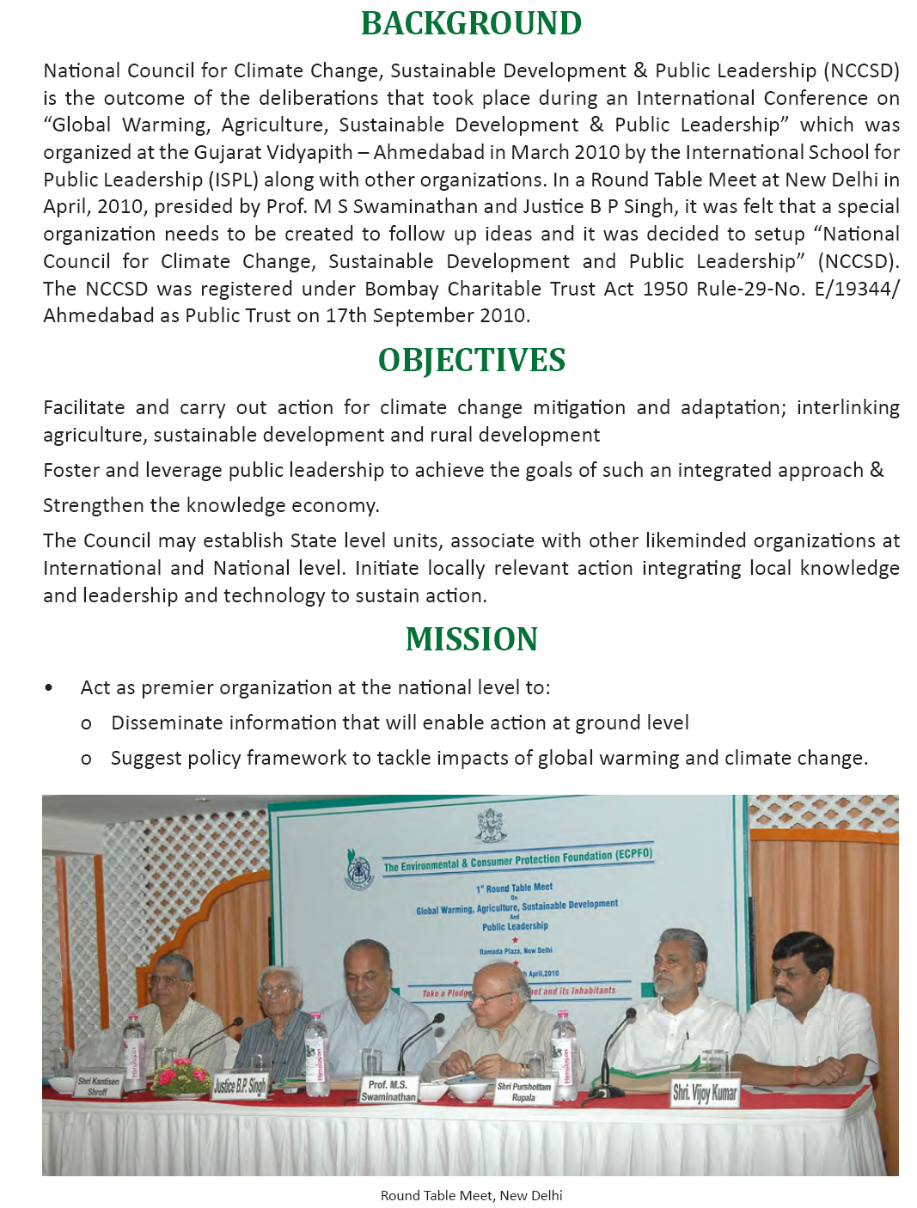
ABOUT NCCSD

Slide 25
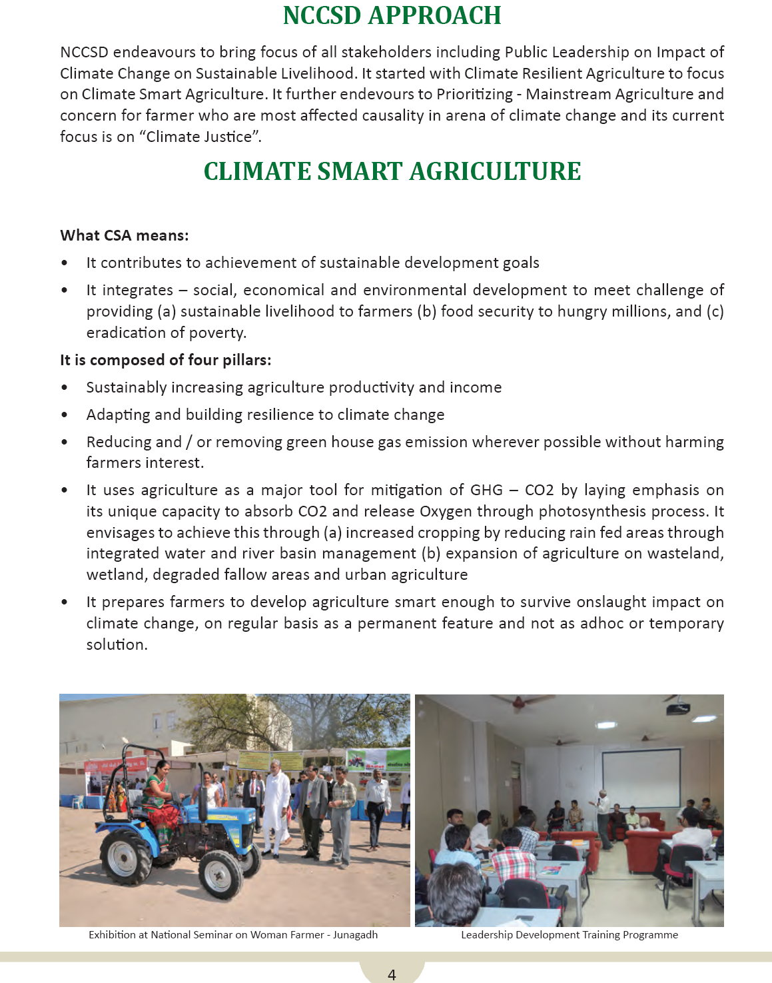
NCCSD -APPROACH

Slide 26
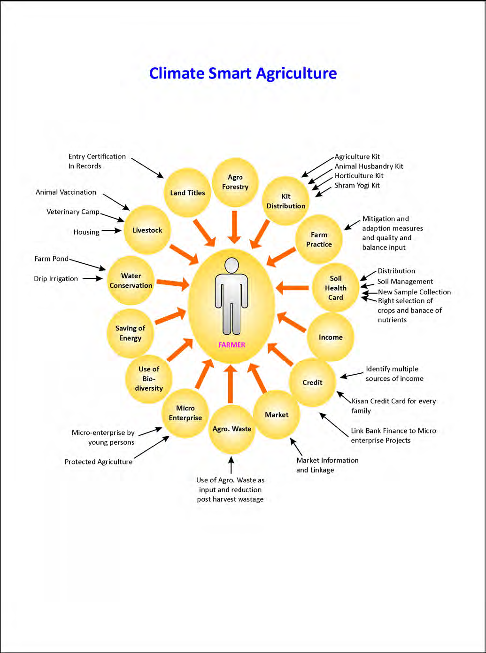

Slide 27
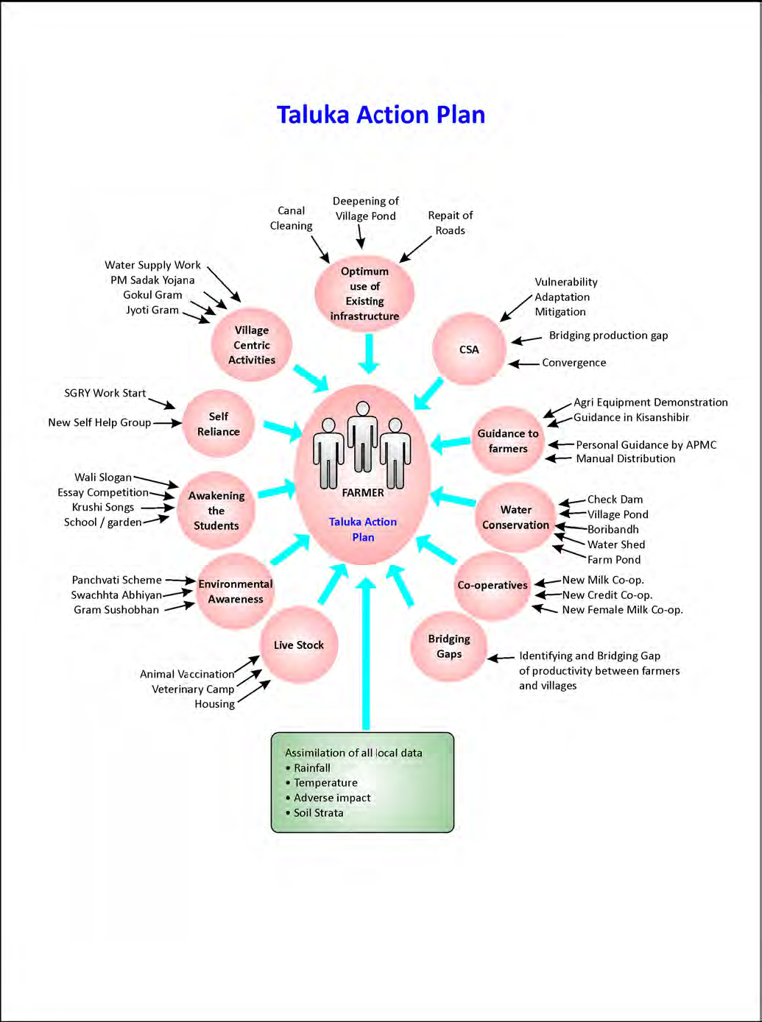

Slide 28

Let's Learn & Share Together for a global mission
Mainstreaming Agriculture for Climate Change Mitigation

Slide 29

Thank You for your patient hearing
Dr. Kirit Shelat
National Council for Climate Change, Sustainable Development
and Public Leadership (NCCSD)
Post Box No. 4146, Navrangpura Post Office, Ahmedabad – 380 009.
Gujarat, INDIA.
Phone: 079-26421580 (Off) 09904404393(M)
Email: drkiritshelat@gmail.com, info@nccsdindia.org Website: www.nccsdindia.org

