Slide 1
Farmer to Farmer Project Building Climate Smart Farmers Dr. O.S. Mbuya Dr. Kirit Shelat
Climate Smart Agriculture Project INDIA
National Council for Climate Change Sustainable Development and Public Leadership (NCCSD)- India

Slide 2
Climate Change and Farmers
The continuing and increasing adverse weather events all are affecting farmers across the world. While Global Warming is International Phenomena- its adverse impact is at village level on Farm Land- most often farmers finds his only source of Income depleting – by crop failure or low productivity.

Slide 3
GUJARAT – INDIA
Gujarat is situated on the western coast of India. Diverse in its topography, it has 1600 km coast line and is home to the largest desert in the country known as Rann of Kutch.
The state has had all possible handicaps faced by agriculture such as 70% of agriculture being rain-fed, recurrent droughts, untimely/irregular rainfall and some areas receiving rain only three to four days in a year.
Gujarat’s agriculture suffered heavily whenever there were droughts. The growth rate of agriculture used to be negative during such years. In a normal year, the agricultural growth rate used to be 1 to 3%.

Slide 4
Conti………
In the new millennium, Gujarat, with determination and persistent efforts, changed the agriculture scenario. From 2004 onwards, agriculture witnessed a major turnaround with a growth of 11% per year. This was an initiative in all 18,000 villages known as “Krishi Mahotsav” – the festival of Agriculture.
This was led from top by Chief Minister (Who is now the Prime Minister), Shri Narendra Modi. For action at bottom - the village level and at individual farmer level.
Entire model was developed based on the needs of farmers and to provide knowledge and technology to them at their door steps.
The speaker was responsible for developing policy and the detailed implementation framework and to develop module to monitor its implementation.

Slide 5
Strategic partners of the project
Florida Agriculture & Mechanical University (FAMU), Florida – USA with USAID
National Council for Climate Change & Sustainable Development
Vivekanand Research & Training Institute
Anand Agriculture University
Junagadh Agriculture University
Agriculture Technology Management Agency, Government of Gujarat, Government of India
This convergence of efforts for global technology transfer through Public – Private Partnership

Slide 6
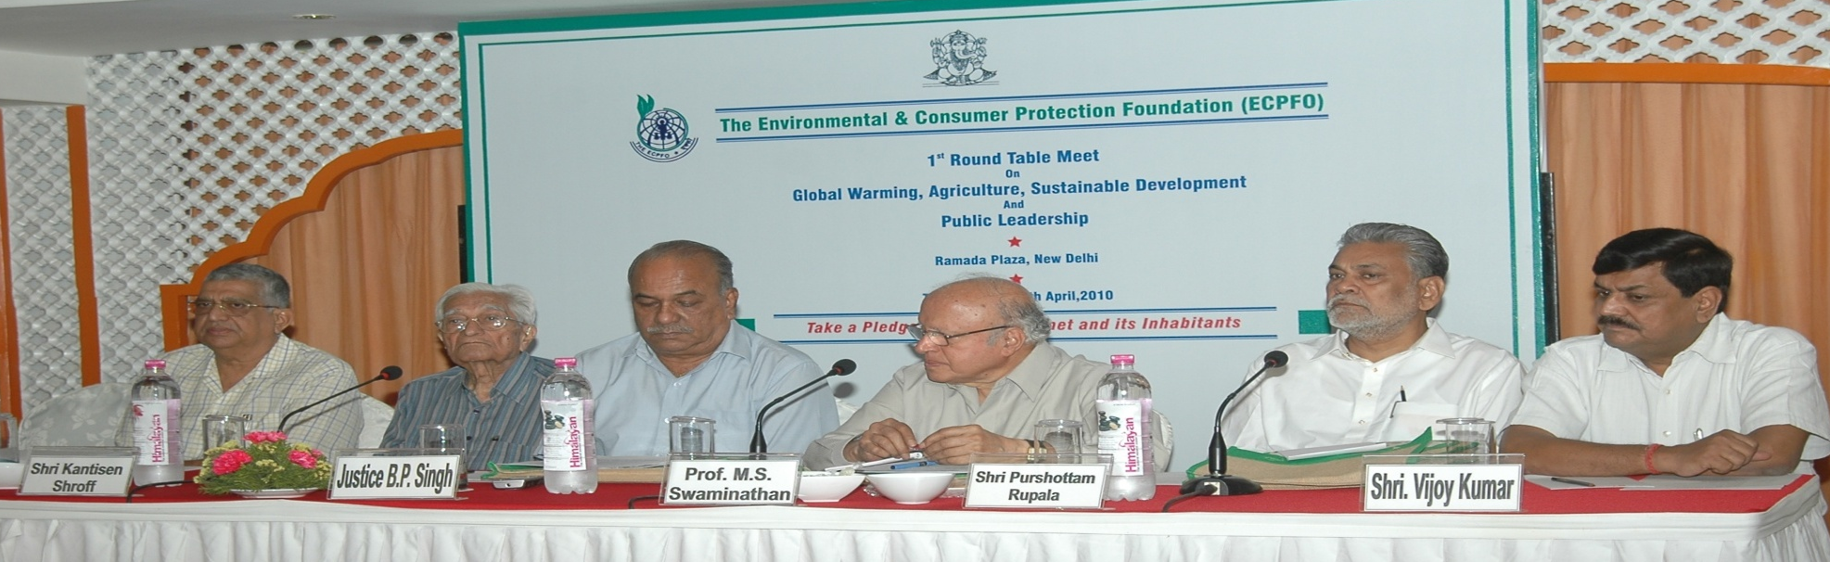
NCCSD-Background
National Council for Climate Change, Sustainable Development and Public Leadership
NCCSD is the outcome of the deliberations that took place during an International Conference on “Global Warming, Agriculture, Sustainable Development & Public Leadership” which was organized at the Gujarat Vidyapith – Ahmedabad in March 2010 by the International School for Public Leadership (ISPL) along with other organizations. In a Round Table Meet at New Delhi in April, 2010, presided by Prof. M S Swaminathan and Justice B P Singh, it was felt that a special organization needs to be created to follow up ideas and it was decided to setup "National Council for Climate Change, Sustainable Development and Public Leadership” (NCCSD). The NCCSD was registered under Bombay Charitable Trust Act 1950 Rule-29-No. E/19344/Ahmedabad as Public Trust on 17th September 2010.

Slide 7
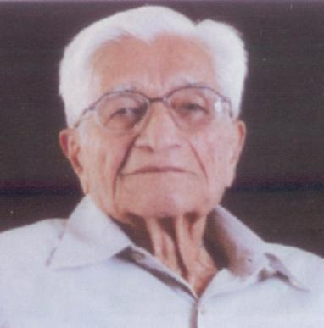
Vivekanand Research & Training Institute A vision of Mr. Kantisen Shroff
Working with principles:
Trusteeship philosophy
Better understanding of Natural resources
Community mobilization and participation
Respect Traditional Wisdom & Utilize it
VISION:
Efficient use of natural resources which promotes sustainable development in synergy with surrounding environment.
MISSION:
Need based community development with focus on capacity building of community, linkages with different institutions involved in rural development and promote decentralized agro industrialization

Slide 8
NCCSD had organized International Conference on Climate justice in 2014 and NCCSD Signed MOU with “Florida Agricultural and Mechanical University.”

Slide 9
Project Development Mission to assist Farmers to mitigate and adapt to climate change through the application of Climate Smart Agricultural Practices.
The project “Farmer to Farmer” is joint Endeavour by FAMU with NCCSD.
FAMU has been working on developing Adaptation and Mitigation Practices- which can help farmer to prevent his losses and sustain his agriculture & has developed climate smart agricultural practices under International Agriculture Programs Headed by Dr. Harriet Paul and Dr Mbuya-Faculty Director, FAMU-Sustainability Institute.

Slide 10
Conti……..
Objectives:
Strengthen the portfolio of agricultural technologies at that would help improve the productivity
Assist to develop a five year strategic plan for the Non formal Education Center, in its role as a non formal education and outreach facility for extending climate smart agriculture to farmers across the state of Gujarat and India.
Address and transfer locally suitable bio technology for value addition in existing crops.
Develop good agricultural practices for better price in market.
Identify local level processing of agri-commodities to generate wealth in rural areas and provide entrepreneur opportunity to rural youth.
In short project aim to “Promote sustainable livelihood and contribute to food security for hungry millions

Slide 11
Initiate 1 year project with FAMU ,NCCSD and VRTI Mandvi in 2016

Slide 12
-Dr. O.S. Mbuya: Integrated Soil Management Practices

Slide 13
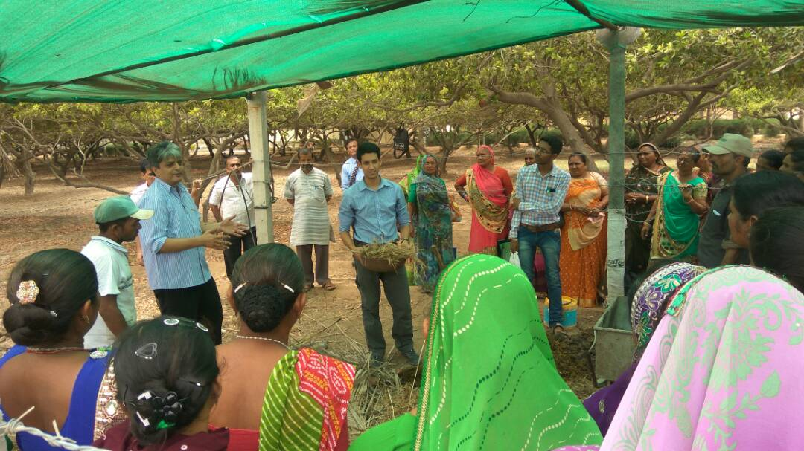
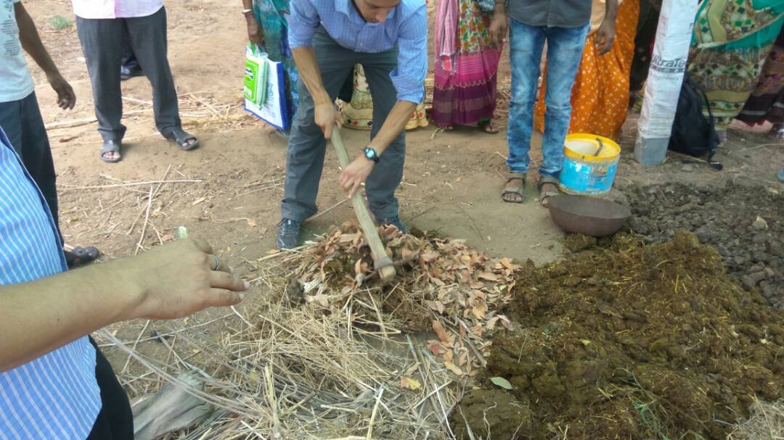
Improving Organic Carbon in Saline Soil Using Organic Compost
Trainers demonstrate how to develop compost.

Slide 14
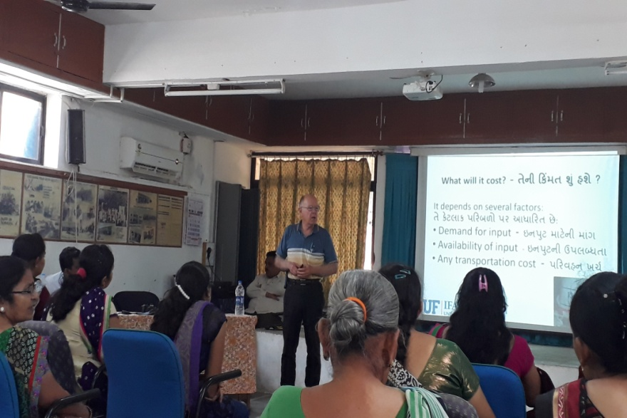
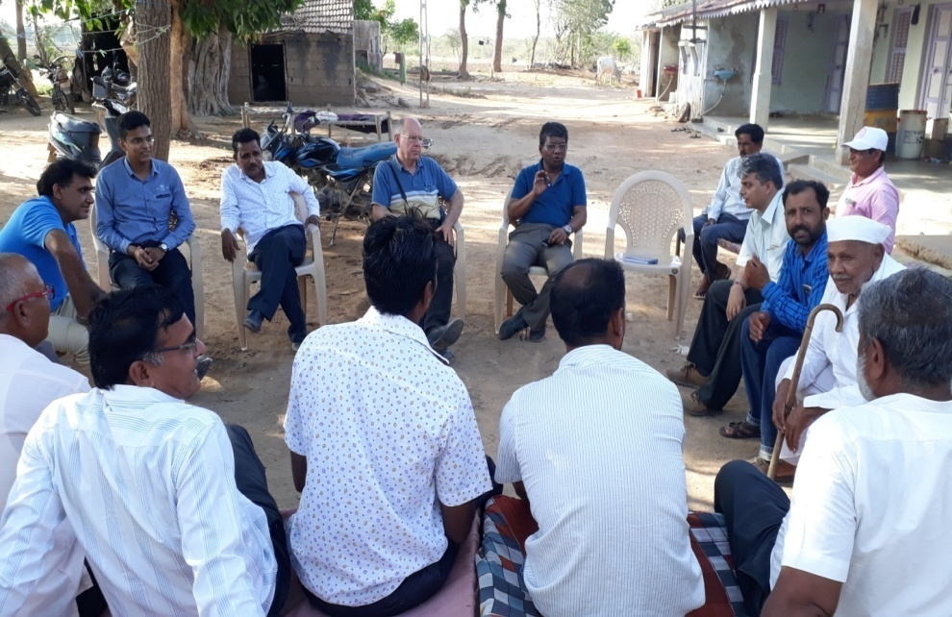
Training of Trainers (TOT) for Extension & agricultural development programme
Trainers also visit farmers- interact with village Community at Village Level.

Slide 15
Current Status :
No. of FAMU experts completed training assignments – 13
Total no. of trainees – 4,654
Male trainees: 3,370
Female trainees: 1,284
This covers about 13 District of Gujarat
Training of Trainers were also conducted to continue this project
Training modules of the subjects covered by FAMU volunteers have been developed in local language

Slide 16
Major recommendation adopted by farmers
Proper manure management and application of organic matter in soil
Rain water harvesting and water management
Involving women farmer in farm decision making
Post harvest management in different crops

Slide 17
Strengthening the Project
VRTI has set up :
Permanent“ Non Formal Education Center” – under banner of this center about 350 farmers have been trained for by local trainers
Soil and Water Test Lab.
Demonstration- Model Farm.
Indentified and developed 50 farmers who have setup model farm in their villages
Guidebook in local language for farmers is in developing phase

Slide 18
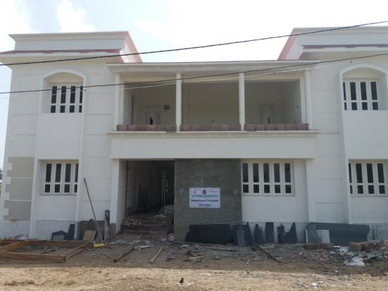
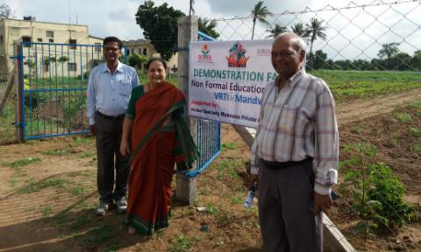
The Outcome of this project is VRTI set up the “Non formal Education centre” at Mandvi -Kutch for farmers with demonstration farm .
Non-Formal Education center (under final Stage of Construction.
Demonstration Farm

Slide 19
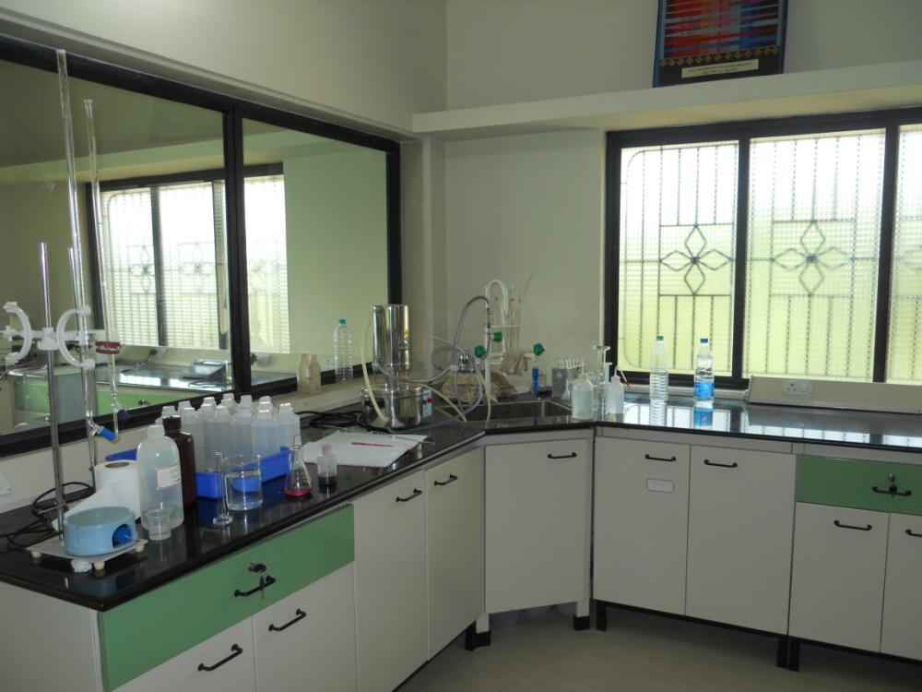
VRTI - Soil & Water testing laboratory at VRTI

Slide 20
The future action plan: Phase II – FAMU Farmer to Farmer Project- India.
New Subjects:
Future Agriculture:
Enhancing doubling income of farmers.
Food Security.
Food For hungry millions.
Development of Livelihood Resilience
Bio Technology: Tissue culture Bio-pesticides, Bio- Fertilizer genetic crops.
Livestock Management:
Fisheries
Sea Weeds
Agri- Entrepreneurship
Sea- Water – over ground and underground ingress and its control.
Exchange Visit:
Trainers.
Farmers.
Facilitator.
Extending the module developed in first phase to other states of India and in other countries.
Consolidating the work done in phase one-
Development of Non- Formal Education Center-VRTI-Mandvi-Kutch.
Setting of Test lab for Soil & Water- at Mandvi-Kutch.
Development of Model Farms.
Monitoring and Feedback from Model Farms and Farmers.
Development of Training Material.
Development of Guide Book-
Trainers.
Farmers.
Development of Web Site.
Dissemination knowledge to non-participating farmers.
Strengthening of Networking between FAMU-VRTI-NCCSD- ATMA –AAU, JAU,SDAU- Government of Gujarat.

Slide 21
Partnership with State Agricultural University
Sign MOU Between Florida Agricultural & Mechanical University (FAMU) and Anand Agricultural University (AAU) in nearer future for partnership on national and global issues of mutual interest.
Also Partnership with Florida Agricultural & Mechanical University (FAMU)and JAU-Junagadh Agriculture University

Slide 22
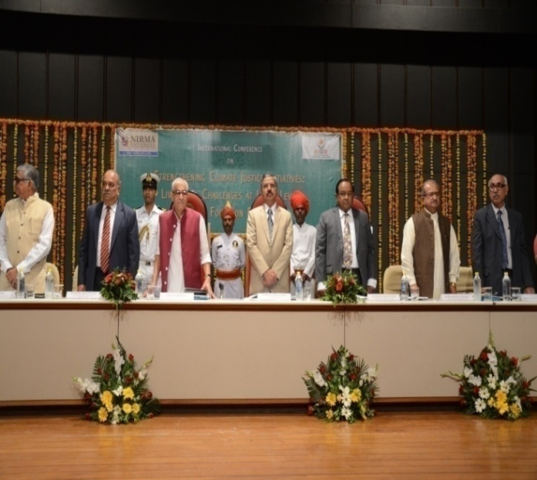
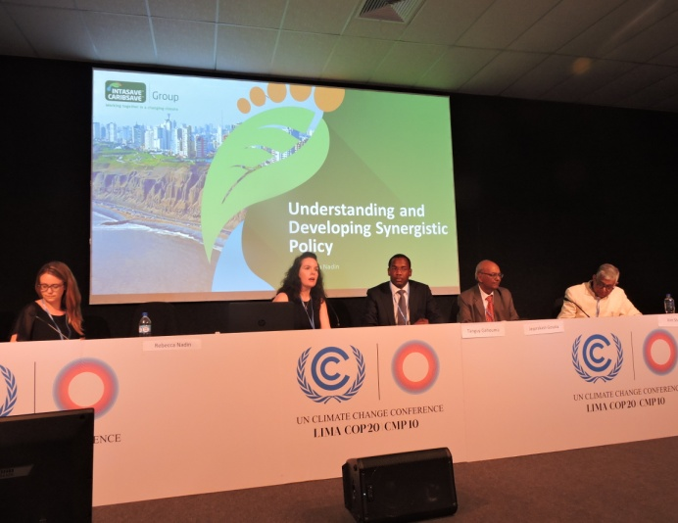
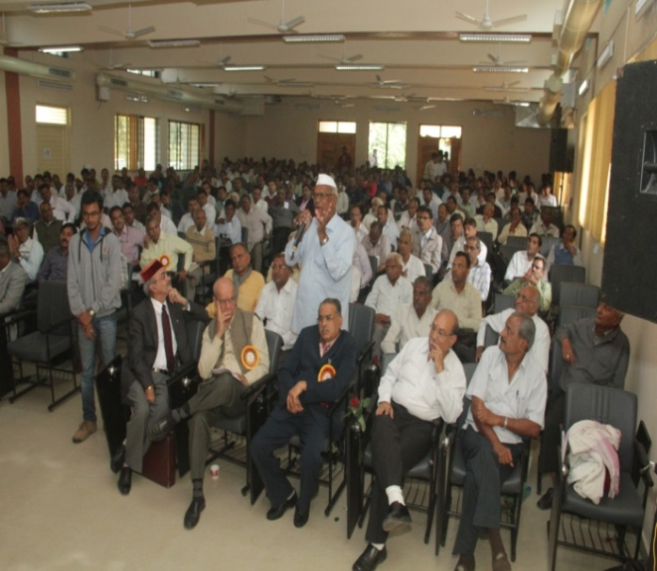
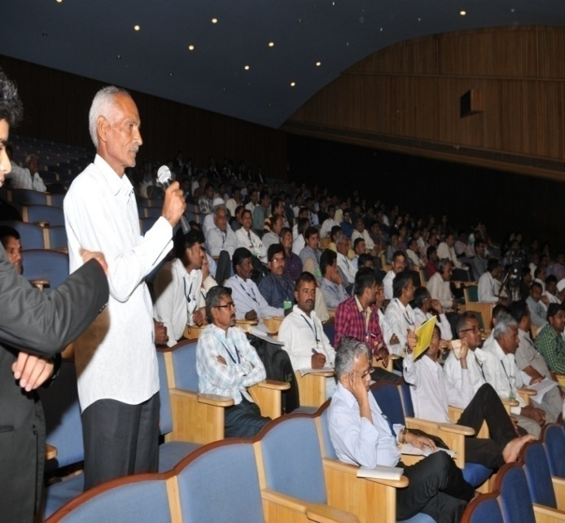
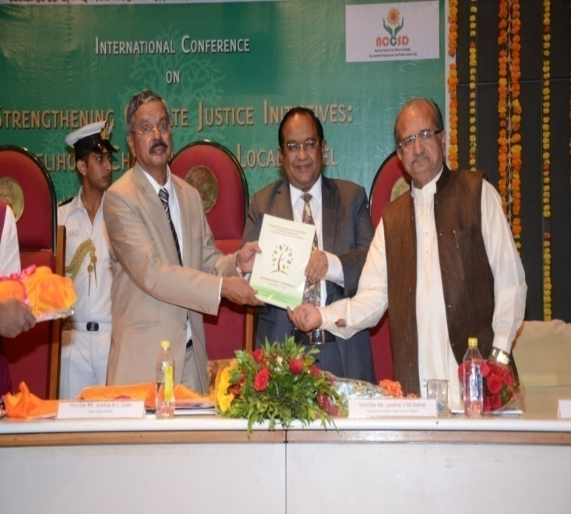
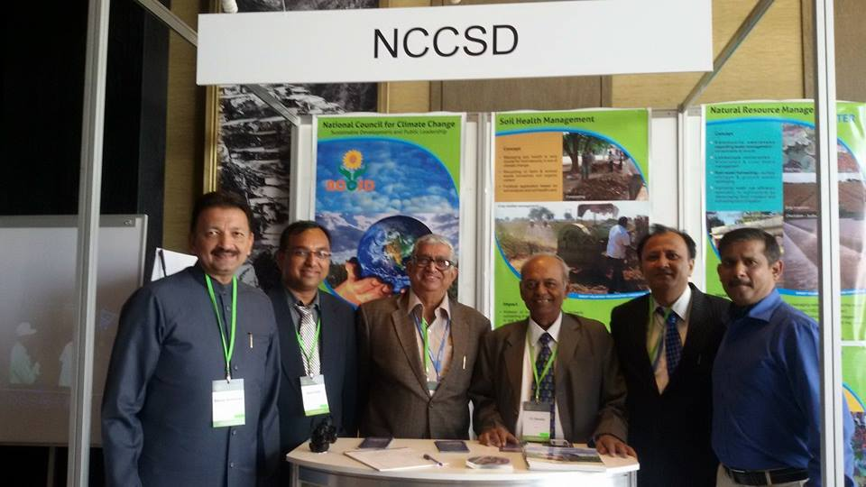
Thanks

