Slide 1


CLIMATE SMART CITIES
THE ROLE OF PUBLIC LEADERSHIP
International Symposium on
Combating Climate Change in C40 Megacities
22ND April 2015
By
Dr. Kirit Shelat, I.A.S. (Retd)
National Council for Climate Change, Sustainable Development
and Public Leadership (NCCSD)
Ahmedabad
INDIA

Slide 2


CLIMATE SMART CITIES
Climate change and its impacts are well known and almost every citizen’s concerned about it. While in case of Agriculture, its impact is at local level - farmers are to be prepared to become smarter than climate to maintain their productivity despite Vagaries of weather.
In case of cities, this is opposite. Cities create pollution both air and water. They reduce absorption of CO₂ which used to take place earlier due to existing vegetation cover. Citizens are facing its direct local level impact, increasing health hazards, new virus and poor quality of drinking water, mosquito menace so & so forth.
The Climate Smart city concept envisages to meet these challenges.
National Council for Climate Change, Sustainable Development and Public Leadership

Slide 3
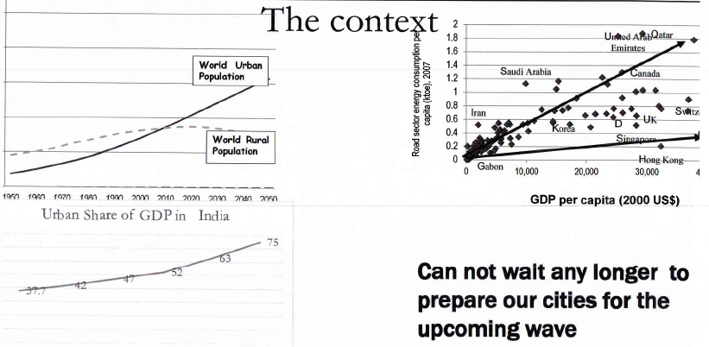
Over view
Source: National Conclave on building smart cities _ draft concept note, Ministry of Urban Development, Government of India.
National Council for Climate Change, Sustainable Development and Public Leadership

Slide 4
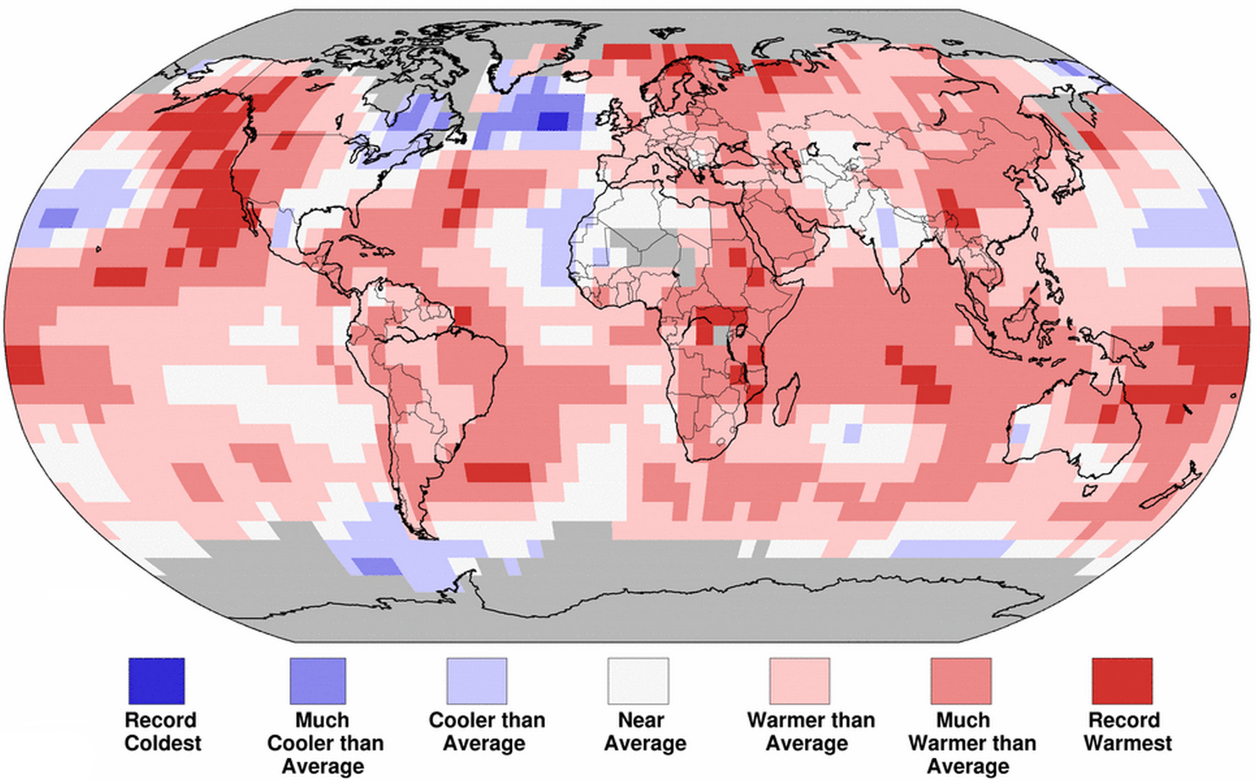
Global Warming
Source: Bloomberg: Global Temperature Records Just Got Crushed Again

Slide 5
Indian Urban Scene
377 million people are living in Urban areas of our country (31%).
In next 15 years , this will increase by 157 millions
By 2050 another 500 million will be added and half of the population of the country will be living in urban areas.
31% of population living in urban areas contribute 60% country’s GDP
National Council for Climate Change, Sustainable Development and Public Leadership

Slide 6
Why Smart Cities
Rapid urbanization has:
Increased burden on existing local infrastructure within the cities due to increasing density and growing high rise building.
Expansion of outskirts areas which do not have basic infrastructure for clean water, drainage and road connectivity.
Expectations of citizens are increasing and so is their awareness about responsibility of local Authorities.
National Council for Climate Change, Sustainable Development and Public Leadership

Slide 7
What is Smart City
Says Union Minister, Urban Development Dr. Venkaiah Naidu – Smart Cities are one that make Urban life comfortable and improve living standards through:
Good governance , efficient health care services and education.
24 X 7 power supply and water supply
Efficient transportation
High quality sanitation
Employment to needy
Robust cyber connectivity
Benefits to all irrespective of income, age and gender
National Council for Climate Change, Sustainable Development and Public Leadership

Slide 8
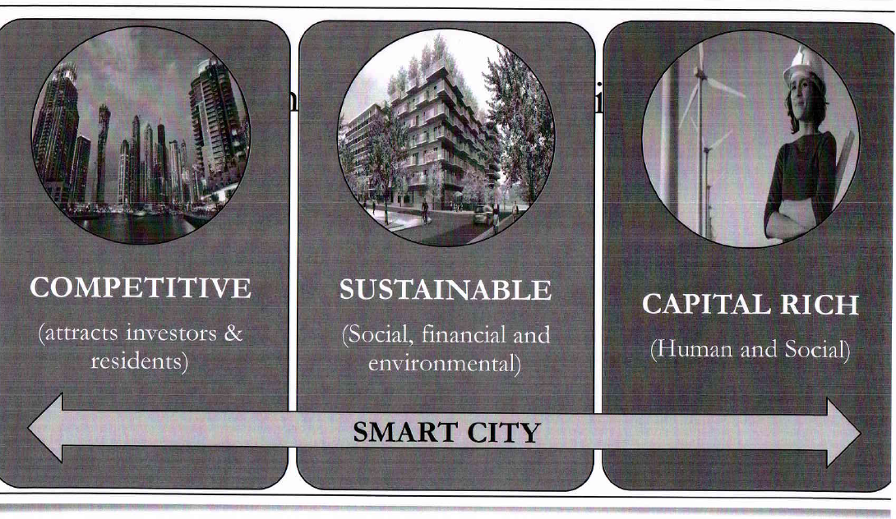
Source: National Conclave on building smart cities _ draft concept note, Ministry of Urban Development, Government of India.
National Council for Climate Change, Sustainable Development and Public Leadership

Slide 9
Key features of a “Smart City
Public leadership – both elected and non-elected with active participation of citizens | 24 x 7 availability of high quality utility services (water, power etc)
Capacity building of both official and non-official members of City Corporation | Comprehensive planning NOT sector specific
Smooth transport system - public transport, traffic flow that avoids traffic jams and fumes. Policy for Auto Fuel efficiency. | Focus on both supply and demand Revenue mobilization
Jobs/livelihoods, entertainment, safety and security, health care, hygiene and education , capacity building of youth as a responsible civic citizen. | Citizen grievance redressal, slum development with amenities. Citizen made aware about their role to keep city clean
Energy efficiency, water conservation, recycling waste water | Solid waste and waste water management, Urban Agro Forestry - roof top solar panel.
National Council for Climate Change, Sustainable Development and Public Leadership

Slide 10
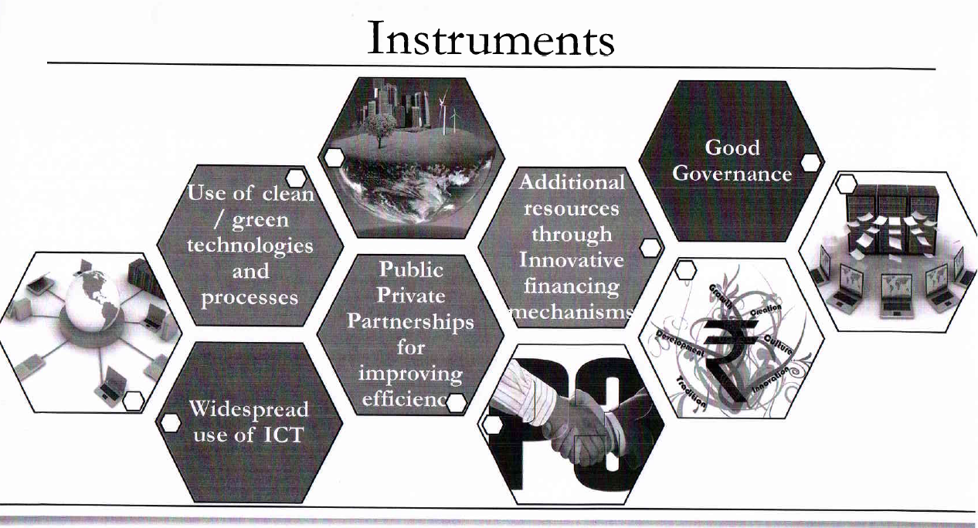
Instruments
Source: National Conclave on building smart cities _ draft concept note, Ministry of Urban Development, Government of India
National Council for Climate Change, Sustainable Development and Public Leadership

Slide 11
Public Leadership
What we mean by public leadership is
Elected and non-elected members of Public Governance System.
In the context of City Governance, this means
- Elected members of Municipal Corporation like
Ward representatives or Corporators.
- The Mayor of the city and Chairman of various
committees
- The Municipal Commissioner with all heads of
departments including allied organizations like City
transport services, Municipal hospitals and like
National Council for Climate Change, Sustainable Development and Public Leadership

Slide 12
Public Leadership contd..
The City Police Commissioner, The Traffic Police and its Management
The local Judiciary.
The entrepreneurs (a) local business enterprises including manufacturing activities and services(b) Real Estate developers
Local operators of public utility service like:
- Electrical supply and distribution companies
- Tele communication services
- T. V. cable services
- Domestic Gas & Petroleum distribution
Regional Transport Authority – RTO
National Council for Climate Change, Sustainable Development and Public Leadership

Slide 13
Public Leadership
Stake holders like citizens including slum dwellers & people residing in Kaccha huts and road dwellers.
Educational Institutions
NGOs – Civil Society members
Road side vendors - hawkers – The non formal sector
National Council for Climate Change, Sustainable Development and Public Leadership

Slide 14
Expectation from City – Municipal Corporation and their leaders – Major and Commissioner
A clear and practical vision for taking the city forward – make city climate smart.
Clear identification of economic drivers and plan for developing economy , employment and infrastructure
Plan for 24 x 7 utility services like electricity, water, sanitation etc monitoring its implementation
Plan for health, sanitation, education, entertainment, non formal sectors.
ICT enablement of all services related to citizen.
Green technologies and energy efficiency for all, Government and Commercial - non-government building.
Mobilization resources
Quick grievances redressal system.
Recycling – Solid waste & Waste water
Promotion of Urban green cover and solar energy
Automobile fuel efficiency.
National Council for Climate Change, Sustainable Development and Public Leadership

Slide 15
EXPECTATION FROM STAKEHOLDERS - CITIZENS
Follow rules and regulations and building by Laws
Domestic and commercial garbage disposal
Cleanness within housing societies, apartments, malls
Traffic and parking discipline
Payment of Municipal taxes
Avoid wasteful use of water and energy
Alert on failure of Civic services and brining it to the notice of Administration.
Promotion of vegetative cover – plants/trees and solar panels.
National Council for Climate Change, Sustainable Development and Public Leadership

Slide 16
The Challenges
There is need to fine tune the urban governance and also urgent need to uplift urban life to a higher level with a focus on:
Slum dwellers
Road side residents
Non formal sector
The effective urban governance requires smart leadership that is willing to take responsibility and act with initiatives in wide range of areas which includes cutting barriers and providing equal services to all with focus on poor families
National Council for Climate Change, Sustainable Development and Public Leadership

Slide 17
The Challenges
Alert and able to question and monitor work of own staff, service providers and that of other utility services
Raise resources – taxation and fees for services
Prevent fellow citizens from violating rules and enforce rules.
Provide transparent administration and strict monitoring of contracts related to maintenance and infrastructure.
Ward Officers and Corporators: vigilant in their areas and communicative with residents and Municipal service staff.
National Council for Climate Change, Sustainable Development and Public Leadership

Slide 18
Capacity Building
It is important that both elected and nonelected members of urban governance are trained to meet the expectation of citizen and be responsible to them and learn how to make city climate smart and effectively participate in management of city with involvement of citizens.
National Council for Climate Change, Sustainable Development and Public Leadership

Slide 19
Identify Gaps
Urban areas have been existing
Now there is phenomenal hafazard/un-regulated expansion on peripheral areas
The future demands enormous new urban areas, affordable housing to meet demand of migrants from rural areas
National Council for Climate Change, Sustainable Development and Public Leadership

Slide 20
Identify Gaps
The Urban development administration need to:
Identify gaps within existing city net work and bridge gaps in line of Climate Smart City concept.
Regulate hafazard expansion with enforcement city town planning norms for building, use and bring them within preview of city limits.
Plan for future demand and create ultra smart cities with public private participation.
Enhance green cover through vegetation in open areas and roof tops.
National Council for Climate Change, Sustainable Development and Public Leadership

Slide 21
Impact of Climate Change
Urban areas do create and are responsible for enhanced GHG emission as:
They replace existing vegetable/agriculture which use to absorb CO2 and release oxygen through photosynthesis process.
Create GHG emission by energy use.
Hence maximum emphasis need to be in reduction of pollution, air and water.
Facilitate slums with basic infrastructure or rehabilitate in new colonies.
Create affordable houses for poor families
Already local Disaster Management Plan and its implementation strategy exists.
Emphasis should be to communicating citizens on weather forecasting of impeding natural calamity like heavy rain, flooding of river or cyclone. Citizens need to alerted in advance about precautionary measures needed.
National Council for Climate Change, Sustainable Development and Public Leadership

Slide 22
URBAN AGRICULTURE
Many urbanities end up buying high cost ornamental plants with high mortality and go on replacing it every year and spend good money.
But they need to be guided about plants/vegetation that could survive in urban climate. Kitchen garden could be promoted open areas and even in pots – roofs – top farming can be taking up.
This will go long way in reduction in CO2 levels and balance nature.
National Council for Climate Change, Sustainable Development and Public Leadership

Slide 23
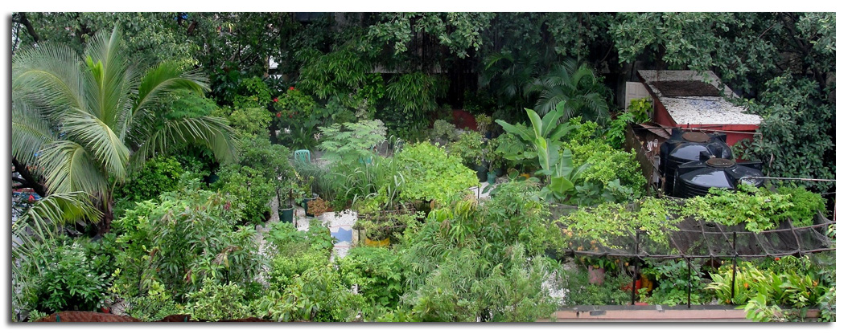
Sow and Reap, Grow and Eat
Creating green spaces
Mumbai Port Trust Terrace garden at Victoria Dock
National Council for Climate Change, Sustainable Development and Public Leadership
Notes:
2323

Slide 24
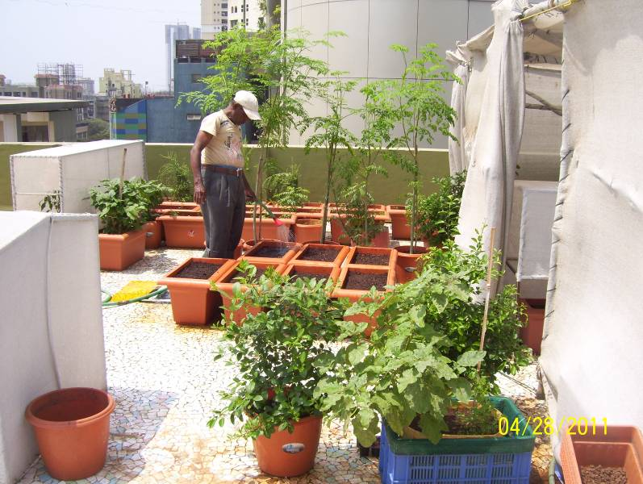

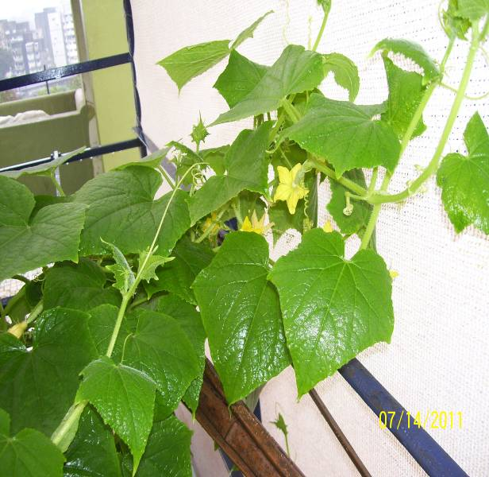
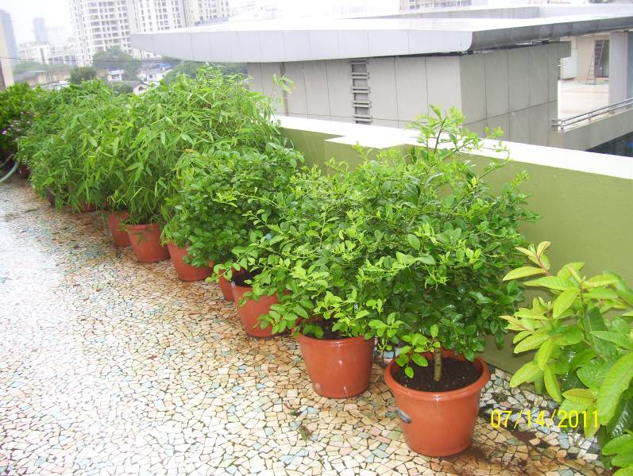
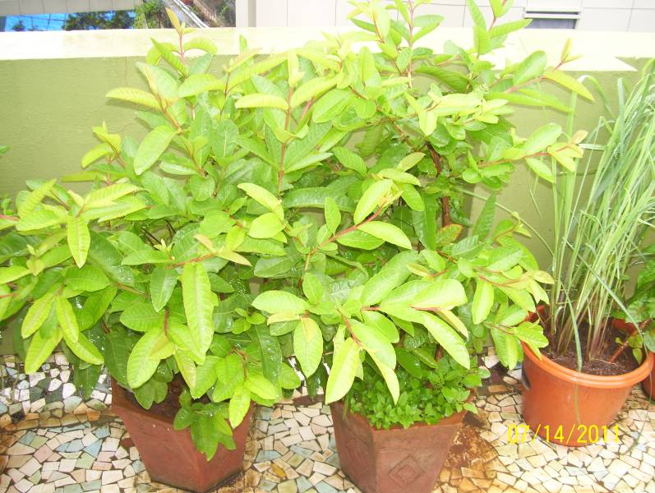
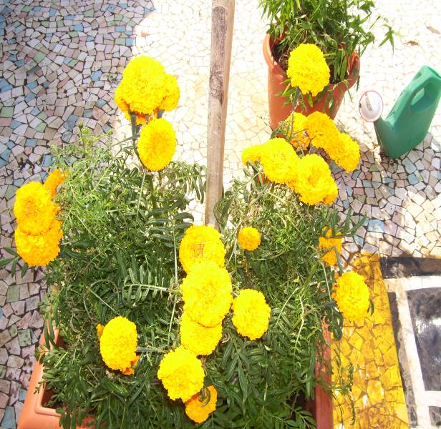
Urban Agriculture – Soil + Compost (75 + 25 %), excellent results.
Mumbai Port Trust
National Council for Climate Change, Sustainable Development and Public Leadership

Slide 25
FRANCE DECLARATION
France has recently passed a new Law mandates that all new commercial buildings that are built in France must be covered by either plants or solar panels.
National Council for Climate Change, Sustainable Development and Public Leadership

Slide 26
Benefits of Green Roofs
Green roofs assist with storm water management because water is stored by the substrate, then taken up by plants. They also retain rainwater and moderate the temperature and act as natural filters for the water that does run off. They delay the time at which runoff occurs, which results in decreased stress on sewer systems during peak periods.
National Council for Climate Change, Sustainable Development and Public Leadership

Slide 27
Benefits of Green Roofs
The plants on green roofs do a great job of capturing airborne pollutants and other atmospheric deposition. They can also filter noxious gasses. They also absorb CO₂ and release Oxygen.
They open up new areas for community gardens, commercial and recreational space in busy cities where this space is generally quite limited.
Source: Dr. Alanna Ketler, Agency France Press – 20th March 2015.
National Council for Climate Change, Sustainable Development and Public Leadership

Slide 28
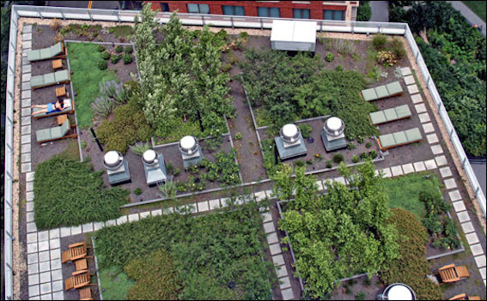
National Council for Climate Change, Sustainable Development and Public Leadership

Slide 29
Mass Communication
It is important that the city team provide information to citizens - how to obtain civic services and certificates of birth and death.
It needs to provide timely warning at the time of heavy rain and floods. In the arena of climate change, such events are with increasing intensity and are sometime un seasonal.
Awareness of rules and regulations that citizen must follow by mass communication – Radio, T.V, house to house leaflets etc.
National Council for Climate Change, Sustainable Development and Public Leadership

Slide 30
New urban challenge
The public leaders – the Civic leaders – both Mayor and his Council, the Municipal Commissioner and his team have to prepare themselves to meet these challenges.
They have to ensure that they city maintains air and water pollution standard.
They have to develop and maintain infrastructure not only for existing needs but for new areas that are coming up.
The state leadership has to ensure that detailed Town approvals are well in time to meet existing and future demands.
National Council for Climate Change, Sustainable Development and Public Leadership

Slide 31
New Regulation for Urban Areas Smart Cities
The State Public Leadership needs to have vision, a detailed plan and strategy for its implementation keeping in view of existing and future needs – Urban areas and its development.
It should also provide better quality of life in surrounding villages so that citizens tired of pollution can move there.
Construction of building and roads should be with enclosure on all sides to prevent flying of cement dust. This should be compulsory condition in private or public contract.
Roof top green cover or solar power panel for new and existing high raise building be compulsory.
National Council for Climate Change, Sustainable Development and Public Leadership

Slide 32
The challenge to State and Central Public Leadership
The new regulations for urban areas smart cities
Government must lay down norms for management of solid waste and waste water (as they already exist for industrial areas ) for high rise flats in existing city limit and for new township areas and ensusre it compliance
Compulsory recycling of solid waste that can be used as a fertilizer and recycle of waste water for irrigation.
Introduce fuel efficiency norms for vehicles.
All auto rickshaw should converted into CNG based fuel to prevent use of Kerosene. City like Ahmedabad has already implemented this for more than 100000 auto rickshaws.
National Council for Climate Change, Sustainable Development and Public Leadership

Slide 33
CONCLUSION
Climate Smart city is not a new concept, but so far not given emphasis. But now it is a need of time to save community from hazards of local pollution. Use of modern technology is must. The national, state level and city leadership can certainly take up this challenge to make “Cities Climate Smart”
National Council for Climate Change, Sustainable Development and Public Leadership

Slide 34

JAI HIND

Slide 35

Let's Learn & Share Together for a global mission
Mainstreaming Agriculture for Climate Change Mitigation

Slide 36

Thank You for your patient hearing
Dr. Kirit Shelat
National Council for Climate Change, Sustainable Development
and Public Leadership (NCCSD)
Post Box No. 4146, Navrangpura Post Office, Ahmedabad – 380 009.
Gujarat, INDIA.
Phone: 079-26421580 (Off) 09904404393(M)
Email: info@nccsdindia.org Website: www.nccsdindia.org

