Slide 1


Doubling of Farmer’s Income in Arena of
Climate Change on- 30th May 2017
By
Dr. Kirit Shelat, I.A.S. (Retd)
National Council for Climate Change, Sustainable Development
and Public Leadership (NCCSD)
Post Box No. 4146, Navrangpura Post Office, Ahmedabad – 380 009.
Gujarat, INDIA.
Phone: 079-26421580 (Off) 09904404393(M)
Email: drkiritshelat@gmail.com

Slide 2
Current Situation
Recognize that we have done well. We have sustainable agriculture growth. Poverty has declined from 90% to 20%. We should be proud of this. In fact in Gujarat Farmers have doubled their income in last decade.
The credit for this goes to Our Development Administration and Agriculture Scientist and Our Farmers Who are adaptive to new ideas.

Slide 3
Current Situation
Country has stable Agriculture Growth. The Government has taken very many new intiatives.This includes:
      Liberal Crop Insurance.
      E Marketing
      Integrated irrigation scheme.
      Introduction of Soil Health Card.
      Assured Employment in community and in Some case in personal farmland.
      Food Security
      Multiple Skill Initiative and so on
      Hence this challenges is not un Surmountable .We are capable for achieving. But there are challenges –Climate Change –Barriers to development and Over lapping of Administrative network. We need to Face them carefully in an Action Plan Mode

Slide 4
Global warming
Global warming is an international phenomenon but its impact is at local level – Farm–land – farmer suffers most. Heavy rain, flood, cyclone or lack of rain – are washing away upper crust, and or drying soil moisture which results into low yield or crop failure. The entire Agricultural sector - crops, horticulture, livestock and fisheries are affected.

Slide 5
Climate Change
Adverse Weather Events – Even a Good Rail fall Year | Cross Cutting Impact
Increased Temperature | Low crop productivity – crop failures
Hot and cold wave | Low productivity in livestock – fisheries - poultry
Unseasonal frost | Washing away of fields – upper crust washed away.
Recurrent droughts – in many areas despite good monsoon. | Livestock – poultry – cattle - loss

Slide 6
Climate Change
Recurrent delayed rain | Deterioration quality of harvested produce and loss in quantity.
Increased delay between two spells | Increased attack of pests.
Single heavy rain episodes in isolated places | New viral fiver in livestock - which also affects human e.g. bird flue – swine flue
Cyclone | Sprayed fertilizer or pesticides loose impact.

Slide 7
Climate Change
Heavy rain – followed by floods | Seed - germination fails and re-seeding needed.
Hail storm | Ready to harvest crop tilts and loosing quality of its produce and hence reduced income to farmers.
Dust storm – In some case by big acidic content | Field gets drenched with water logging.
Under ground and over ground salinity ingress | Soil moisture lost – soil dries up and hence reduced income to farmers.
Tail of river meeting sea – gets salinity intrusion in river bed. e.g Tapi River

Slide 8
Barriers to Government Initiatives for
Doubling of Income of Farmers
Barriers to initiative for Doubling of Farmers Income
Poverty: | 20% of families in rural area are still below poverty. As per NSO-2013 in Gujarat, 45% and in AP 85% indebted. These farmers do not get access to bank finance – crop insurance – new assets – technologies cannot buy seeds – if germination fails.

Slide 9
Barriers to Government Initiatives for
Doubling of Income of Farmers
Share Croppers: | Due to increased urbanization – villages are loosing identity. Rich farmers buy land in interior area and give work on share cropping basis to original owners. The land on outskirts of urban areas are bought by the developers - original holder becomes share cropper. In both the situation no fresh investment or bank loan / crop insurance is available. This is growing at a alarming rate.

Slide 10
Barriers to Government Initiatives for
Doubling of Income of Farmers
Water Resources - Getting scarce and depleted. | Even in good monsoon year many villages have to be fed by water tankers due to drying up of under-ground and over-ground water resources. Huge pumps (un-authorized) by multi storied building and new private and public township and industries are drying up under ground storage. This also consequently drags saline under ground water. The water quality of tube wells, is contaminated and saline. This affects crops – yield and milk – There is huge evaporation in open canals – of major dam including SSNL with increasing temperature.

Slide 11
Loss of Farm Produce
Can increase income – 5% to 25%
Farm Level | Dispatch to Market
Farmers loose between 5% to 25% of agriculture produce due to inefficient and un-scientific Practises: | Packaging and transforming in bags with holes.
Untimely harvest | Loss due to open thrashing – sometime even on road.

Slide 12
Loss of Farm Produce
Storing harvest produce in open before bring to home/ godown. | Using transport carrier – Tempos ,which also transports pesticides – kerosene – oil affects quality of produce as it catch bad smell. Some vegetables-fruits are placed at bottom – while food grain bags on top crushing vegetables.
Unhygienic storage. | Neelgai, monkeys and pigs spoil and eat away harvested produce and farmers stare as helpless persons.

Slide 13
Doubling of Income
Hence, challenge is how to Build Climate Smart Farmer?.Farmer who can manage his crops and do not fail – despite these adverse continuing situation.
What precisely is challenge?
We want to provide sustainable livelihood to all our families:
This means – that one should have;
  Enough to live and survive
  Income should not become less
  Income increases gradually on par with other sector of economy.
Hence Hon’ble Prime Minister has given target of doubling income of farmers.

Slide 14
Doubling of Income
Challenge is to increase – doubling income of farmers in Arena of Climate Change and face challenge of increasing threat to food security and enhancement poverty in rural areas. For example due to recurrent droughts average yield of food grain in Gujarat is in decline. As per report Nav Gujarat Samay, it has come down from 2097 kg per ha – in 2013-14 to 1552 kg per ha in 2016-17. The other data reveal that food grain production declined from 100 lakhs tones in 2010-11 to 79.47 lakhs tones in 2014-15. This shows how serious is challenge.

Slide 15
Doubling of Income
At national level also situation is same – country was required to import wheat after gap of many years. The average growth rate is below 2 per cent in last two years.
Hence it must be realized that country as a whole is still vulnerable – so are farmers. In order to double their income in such a situation – when even after so many years of development we are dependent on good monsoon – more concerted and serious action plan is needed at local level.
This is a serious message to our Agricultural Scientists – The Agricultural Universities and ICAR.

Slide 16
Doubling of Income – The Way Forward-I
Threshold –Decide per anum growth | What is current level of agricultural growth? What is current level per hectare productivity of crops – including Horticulture crops – livestock - Fisheries
Instruments for enhancing Productivity and Income
Multiple cropping | Increasing per farm number of crops – Twice or thrice a year
Improving productivity | Promote Bio-Tech GM crop Tissue Culture Seed Replacement Good Agriculture Management Practices.

Slide 17
Way Forward
Selection of crops based on soil health and water analyses – select crops which will be sustained by soil.
Research by Agriculture University with focus on new varieties which are stress resilient with higher productivity. Agriculture Universities have to take up this challenge and be accountable-Identify high yield –by volume and value –crops depending upon local Situation-Communicate to Farmers

Slide 18
Way Forward
Reducing cost of production. | Use of farm waste for making vermi compost – organic manure. Solar appliances for pump and drying and connecting same to local electrical greed. Hence from balance power generated Farmer can get assured income.
Reducing loss before sales. | Timely harvest Storage Sorting and grading Packaging Handling of packages Transport

Slide 19
Way Forward
Multiple Source of Income. | Agriculture with Animal Husbandry and / or Fishery /Handicraft Supported by Wage employment – MNREGA Self employment – rural youth Skill jobs

Slide 20
Way Forward
Local Processing and marketing –
Developing and propagating mini-plants for local processing – particularly for food grains – to meet local demand.KVIC expertise can be used.
Market Institutions – Introduce support and intervention : This is key to entire success. Govt. needs to organize picking up all surplus production which local market cannot absorb and organize its sale – Public – Private partnership can be considered or Amul pattern can be introduced.

Slide 21
Way Forward
Identifying crops which can be sustained by soil – and selection of high volume – high value crops. Mapping the new development through satellite images and develop local action plan | At Block level Prepare Block Level Action Plan which is integrated of all activities related to farmers. Organize capacity building programme including developing guide book – updating every year. Identification drought prone areas. Identification of flood prone area. Identification over ground salinity ingress Identification of Villages over topped by sea –water. Identification reseeding sea-line

Slide 22
Way Forward - II
II Clarify Role
Rural Development Department:
Up to recent times, Rural Development Department was responsible for removal of poverty and drought prone / arid area programme. This focus needs to be brought back – by identification vulnerable blocks – including flood prone area programme and with focus on individual poor family.

Slide 23
Micro Irrigation:
For taking more than one crop – during year – farmer must be made aware of need of Micro-irrigation-drip irrigation. This can be linked with other assistance – if he wants it – he must adopt MI. As drip irrigation has very limited coverage. We need to follow “Adhar Approach "This is key to doubling of income.
Narmada Canal:
A massive programme with participative efforts is needed to link village and farm land with Narmada canal. While Vadodara farmers already have multiple crops – other district in catchment area are yet to pick up this despite network canal is existing.

Slide 24
Way Forward
Revisiting capacity: and actual use other major and medium irrigation projects.
This is needed to check how much actual use is there against anticipated – need to desilt and clean up canal and link new areas – e.g. Ukai Dam can be given upward link.
Weather forecasting: unpredictable and predicable adverse weather events are cause of problem. If farmer is informed – so much can be saved. Hence with help of AGROMAT – Pune the weather agro advisory up to block level by SAU should be provided.

Slide 25
Way Forward
Pick-up Market surplus from Villages
As can be seen in photos – there are problems of marketing surplus.State must take this responsibility both for local marketing and for exports. In milk we have done this successfully – as any quality of milk produce is picked up from village level by their society. This must be done for all agri-produce as major challenge.
If this is not done – doubling of production effort may result into lowering of prices and agitation by farmers.

Slide 26
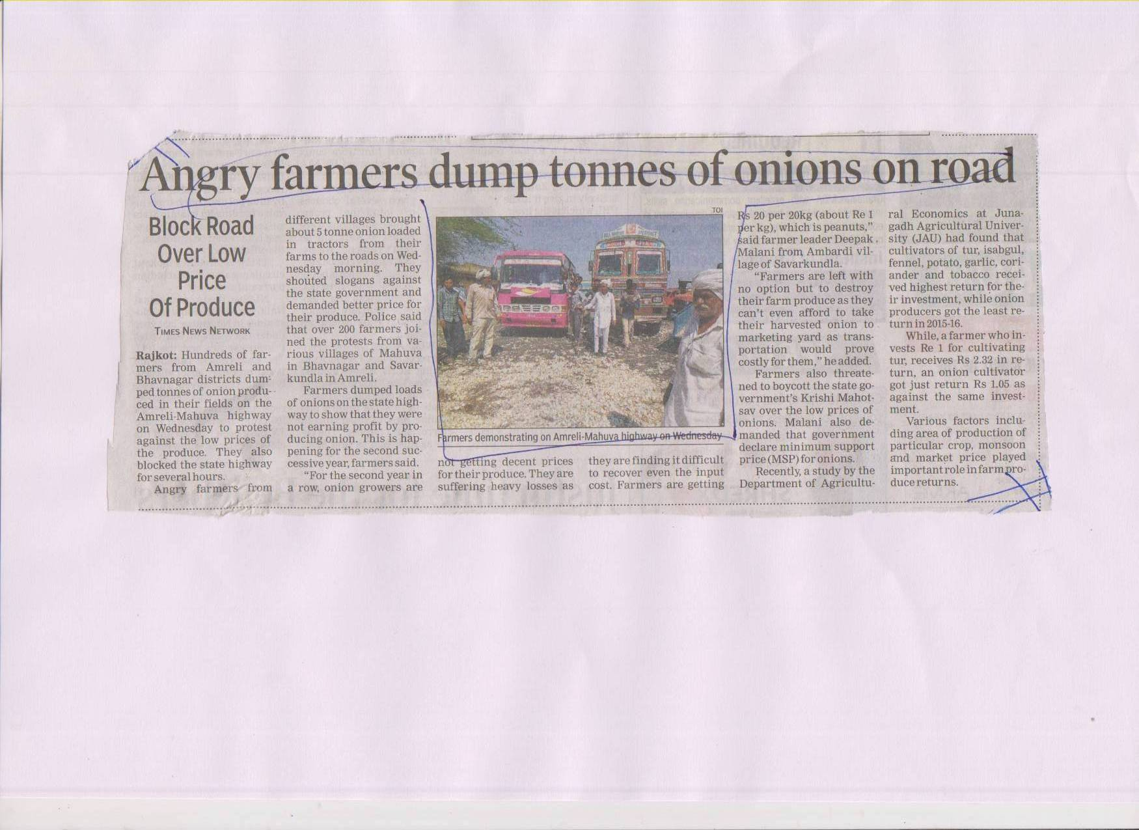

Slide 27
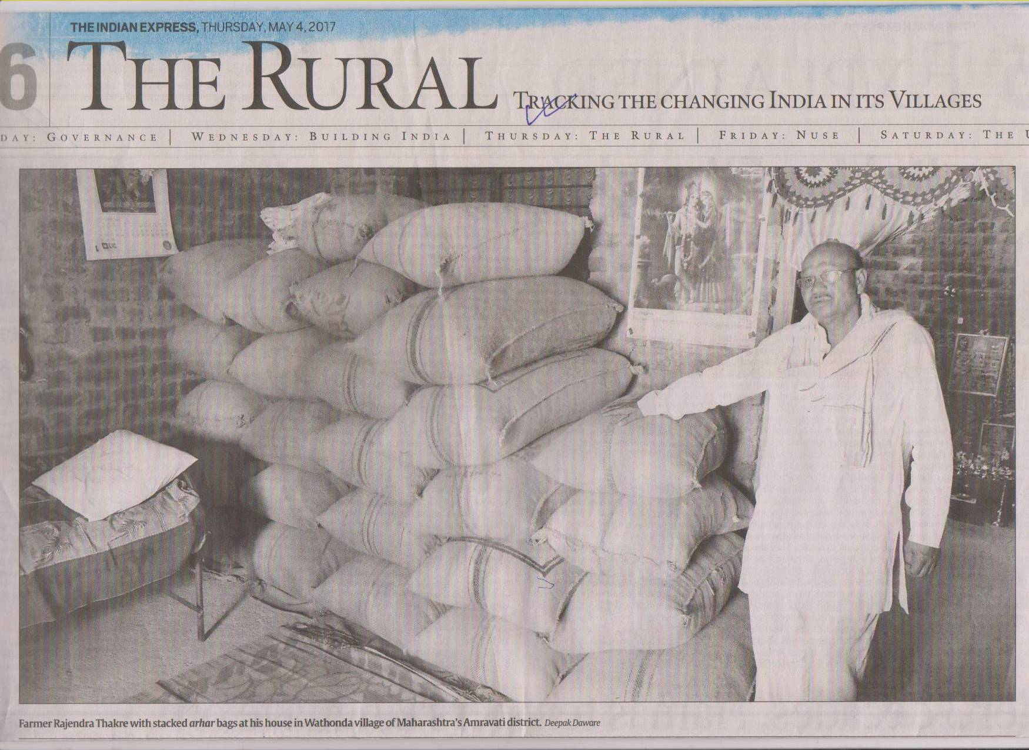

Slide 28
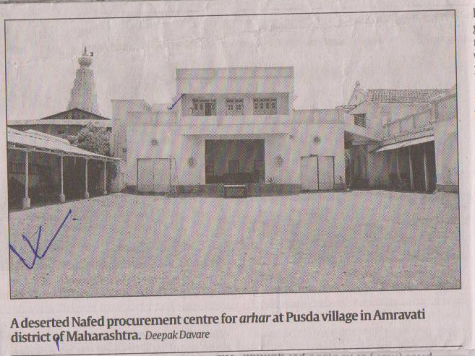

Slide 29
Way Forward -Extension Network:
Extension –reaching out to poor Farmers-new farmers Women farmers is key to Doubling of Income. as in same village with same land and water resources –one farmer make profit-other fails.
Multiple agencies:- Currently there are multiple channels-giving similar/ overlapping and or contradictory messages-The government Channels consists of:
Agriculture extension network
ATMA
KVK
SAU-Extension Education
Kisan Channel TV
All India Radio
SMS
In Addition to this there is input dealer and crop Specific guidance by private players and civil Society member.
Watershed follow its own advisory

Slide 30
Extension Gap
Knowledge Gap:-In the Study Conducted by NCCSD it was revealed that there is he Gap of Knowledge between Educated and Un Educated farmers. Overall Gap of access to Extension message was 55%.
Productivity Gap:-In the Study Conducted by Anand Agricultural University and NCCSD of Anand Block and Mandvi Kutch.It was revealed that the Gap of productivity between Progressive Farmers and average farmers varies between 20% to 30%.

Slide 31
Set up Agriculture Information Services
      There is need to streamline and integrate Extension network .All channels can be integrated under “Agriculture Information Services”. This is the need of time.
      This has to be from state level to Block level.
      No Need to create new organization but Consolidate and merge existing One.
      Integrate KVKs (Krishi Vigyan Kendras) with ATMA and Village Level Workers – and Extension Education team of State Agriculture Universities and link AIS to
      State Regional TV and All India Radio, Kishan Channel and local cable TV Network
      Make State Agricultural university accountable to provide Agriculture information
      Of following to AIS
          Crop Advisory-Prior to Monsoon
          Weather Forecasting during Season and with Agro Advisory
          Development of new high yields varieties and its availability .
          Organize village visit prior to kharif and Rabi season –of Agriculture Team-Including Scientist-to guide Farmer at door step.-Particularly they must meet poor Farmers
          Hire local cable TV network to provide Block level Crop Advisory during Season.

Slide 32
Conti………….
          To repeat what I said in the beginning –This is a challenge it can be won-
          Our Scientists and Agriculture Administration is capable to achieve this along with civil Society Members and our Farmers.

Slide 33

Thank You for your patient hearing
Dr. Kirit Shelat
National Council for Climate Change, Sustainable Development
and Public Leadership (NCCSD)
Post Box No. 4146, Navrangpura Post Office, Ahmedabad – 380 009.
Gujarat, INDIA.
Phone: 079-26421580 (Off) 09904404393(M)
Email: drkiritshelat@gmail.com Website: www.nccsdindia.org

