Slide 1
Building Climate Smart FARMERS
The Indian Perspective
Presented by
DR. KIRIT N SHELAT, I.A.S. (Rtd)
National Council for Climate Change, Sustainable Development and Public Leadership (NCCSD)
AHMEDABAD - INDIA

Slide 2
Climate Resilient Agriculture
Indian Perspective
What Climate Resilient Agriculture means:
It contributes to achievement of sustainable development goals
It integrates – social, economical and environmental development to meet challenge of providing (a) sustainable livelihood to farmers (b) food security to hungry millions, and (c) eradication of poverty.
It aims that despite climate change, the income of farmers should not decrease. They should have enough to live and their income should gradually increase on par with other sectors of economy.

Slide 3
What Climate Resilient Agriculture means:
It aims to use agriculture, which has capacity to absorb CO2 from atmosphere through photosynthesis process as a nature's tool for mitigation.
Promote agriculture vegetation on wasteland, fallow land – and sea shore by using modern technology. This will support livelihood to poor and provide food security to hungry millions.

Slide 4
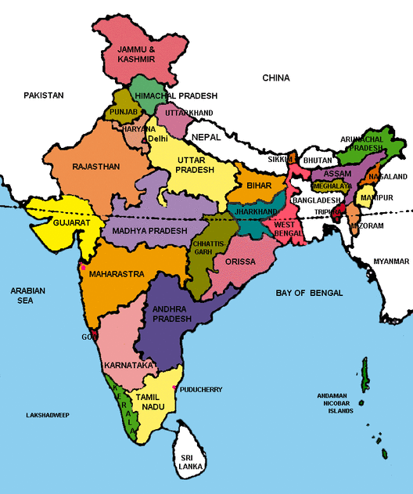
Indian Situation

Slide 5
India’s success over six decades:
  2 % to 4% sustainable agriculture growth
  Brought many out of poverty: from 90% below poverty line to 20%.
  Tackled many adverse climate and geographic challenges including droughts.
  Several states and individual farmers with productivity, higher than, or equal to international level
India had to import food in its early phase of development, but now it is self sufficient and even exports.

Slide 6
Impact of Climate Change
Small farmers stared at big losses the last monsoon season
In the year 2015-16, 302 of 604 districts have experienced deficit rain conditions – some faced drought.
In the year (2014) had deficit of 12%. In the current year (2017-18) the monsoon is good but in some areas deficit prevails.
Stressed farm income have led to slump in rural wages which has further impact on rural demand and related impact on overall economic growth.
The output of Kharif – summer grown crops – in 2017-18 is expected to fall to 134.67 million tonnes from record 138.52 M.tonnes last year (2016-17) an estimated deficit of 2.8 per cent expected.

Slide 7
Soil, Water & Climate Change
    Soil Moisture content is affected with soil erosion, washing away of upper crust of fertile soil salinity ingress in root zone due to sea water rising.
    Capacity to grow and sustain crop not certain with low yield or crop failures – agriculture has become risky.
    Drying of existing water bodies – making irrigation a challenge.

Slide 8
Effect of Climate Changes on Live stock
Milch cattle: milk yield has reduced in increased heat or cold wave condition.
Poultry: egg yield have gone down
Fisheries: fish catch goes away

Slide 9
Indian Situation
India has taken series of initiatives targeting meeting of challenges at local level by farmers with emphasis on strengthening their knowledge, capacity and provide them tools to make their agriculture Climate Resilient.

Slide 10
National Initiative for Climate Resilient Agriculture
(NICRA) – Indian Council of Agricultural Research
It is a Comprehensive Research , Development & Extension Education Programme.
Contingency Plan for every Block - how to manage crops in wake up of unforeseen weather like delay in rain, floods etc.
Implemented throughout the country.
It involves capacity building of Building Climate Smart villages and farmers.

Slide 11
THE INITIATIVES
Soil Health Card
Soil Health Card is a key to climate resilient crops.
It is a comprehensive new extension approach to provide individual farmer, a written guidance for management of soil and selection of crops which can be sustained by it. This in contrast to current system which provide farmers oral guidance. This is based on Soil Health Analysis of his land.

Slide 12
Multiple Source of Income
Farmers are encouraged to have multiple source of Income. If one fails, other helps to survive – e.g.
Poultry / Cattle with Crop
Rice – Fish
Agro Forestry
Handicraft
The Government provides 150 days assured employment in community works around and in their villages – whenever needed under Mahatma Gandhi Rural Employment Guarantee Scheme.

Slide 13
Other Initiative include
  Livestock Management – shelters during summer and vaccinations prior to monsoon.
  Micro enterprise for rural youth based on local production, market and agro services needed with easy access to Bank Finance.
  Special capacity building for woman farmers
  Use of Science & Technology, Bio-technology, use of Tissue Culture.
  Information and Communication Technology (ICT) services to reach out farmers. Special KISAN (Farmers) TV Channel and special F.M. Radio broadcasting, SMS & Free Help-line.

Slide 14
  Weather forecasting and Agro Advisory based for long term, medium term and short term by Indian Metrological Department up to Block level.
  New crop pattern - mixed crops, Perennial crops, agro forestry, organic farming – zero tillage.
  Community Bio-gas plants with Vermi-compost . This mitigates GHG emission by cattle, provide clean fuel and organic fertilizer.
  Credit to farmers – Kisan Credit Card upto Rs.50,000/-. Opening of Bank account even without deposit - JAN DHAN scheme.
  Promotion of solar appliances for drying of crops, pumping of water and street light.
  Promotion of participative scheme for water harvesting, Check dams, Community ponds and farm ponds for every village.
  Promotion of Micro irrigation .
  Helpline for guidance on phone managed and replied by Agriculture experts.

Slide 15
Agriculture Marketing – The New Initiative
  Setting up private mandis - agriculture markets
  Single license to traders for entire state
  Direct sale by farmers to processing industries exporters / bulk buyers
  Integration of market to E-NAM – National Agricultural Market.

Slide 16
Climate Justice
Comprehensive Liberal Crop Insurance scheme which covers even non-loanee farmers.
Statutory employment guarantee scheme up to 150 days in lean season in rural areas to all families below poverty line.
Food security – availability of food as reasonable price at village level to all families below poverty line.
Public Grievance Redressal System at District Level
Public distribution system for essential commodities for poor families
In wake of disaster like cyclone or drought, assistance for
  Replacement of cattle
  Household utensils.
  Support for re-building house and cattle shelter
  Employment in community projects
  Restoration of land
Accident insurance cover to farmers.

Slide 17
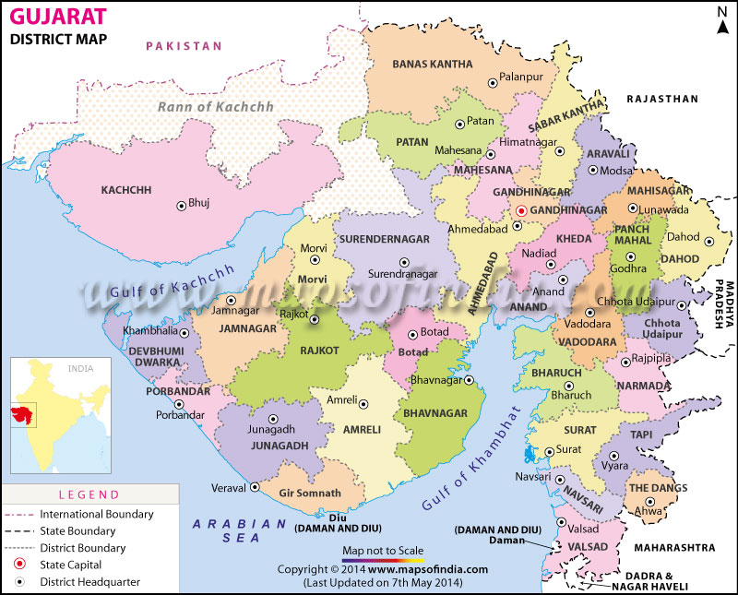
CASE STUDY
GUJARAT – INDIA - EXPERIENCE
NEW EXTENSION APPROACH
A Door step approach to farmers

Slide 18
REACH OUT TO FARMERS AT DOORSTEP:
‘KRISHI MAHOTSAV APPROACH’ –
THE GUJART EXPERIENCE OF SUSTAINABLE CLIMATE RESILIENT AGRICULTURAL DEVELOPMENT
Gujarat is situated on the western coast of India. Diverse in its topography, it has 1600 km coast line and is home to the largest desert in the country known as Rann of Kutch.
The state has had all possible handicaps faced by agriculture such as 70% of agriculture being rain-fed, recurrent droughts, untimely/irregular rainfall and some areas receiving rain only three to four days in a year.
Gujarat’s agriculture suffered heavily whenever there were droughts. The growth rate of agriculture used to be negative during such years. In a normal year, the agricultural growth rate used to be 1 to 3%.

Slide 19
In the new millennium, Gujarat, with determination and persistent efforts, changed the agriculture scenario. From 2004 onwards, agriculture witnessed a major turnaround with a growth of 11% per year. This was an initiative in all 18,000 villages known as “Krishi Mahotsav” – the festival of Agriculture.
This was led from top by Chief Minister (Who is now the Prime Minister), Shri Narendra Modi. For action at bottom - the village level and at individual farmer level.
Entire model was developed based on the needs of farmers and to provide knowledge and technology to them at their door steps.
The speaker was responsible for developing policy and the detailed implementation framework and to develop module to monitor its implementation.

Slide 20
The key to this success was direct involvement of public leadership both elected and non-elected members of Public Governance System.
Effective soil and water management and proper land use
On the water front, more than 1,00,000 check dams got constructed compared to 6000 in the last decade with public private participation. It interlinked rivers such as the Mahi, Sabarmati and Narmada.
Scientific agriculture was introduced by distributing Soil Health Card to every farmer to make them informed choice in the selection of crops. Farmers now sowed crops that gave them higher return and were sustainable in the soil of their farms.
The poor farmers were focused for assistance. Every year 15 poor farmers of each village were assisted with quality.

Slide 21
A direct door-to-door extension programme for guiding the farmers at village level was introduced under a pre-Kharif (pre-monsoon) programme.
Every village was visited by a development team comprising of agri-scientists and officers from the veterinary department, co-operative, irrigation department, rural development department and local banks etc. High-yield crops were identified.
Bhaskaracharya Institute For Space Applications and Geo-Informatics prepared a micro-level plan for land use by identifying sites for check dams and village ponds for every village which were made available to each village.

Slide 22
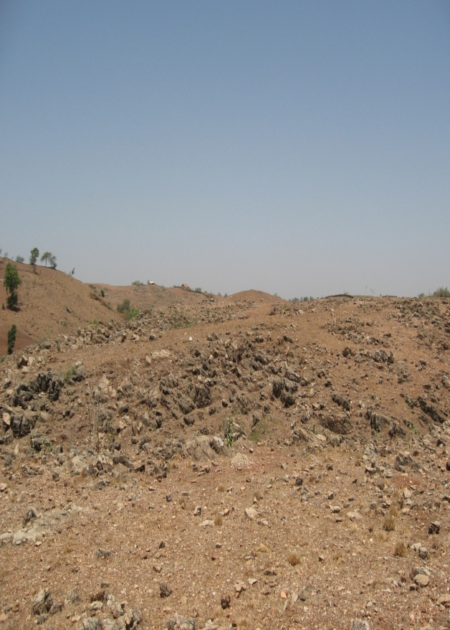
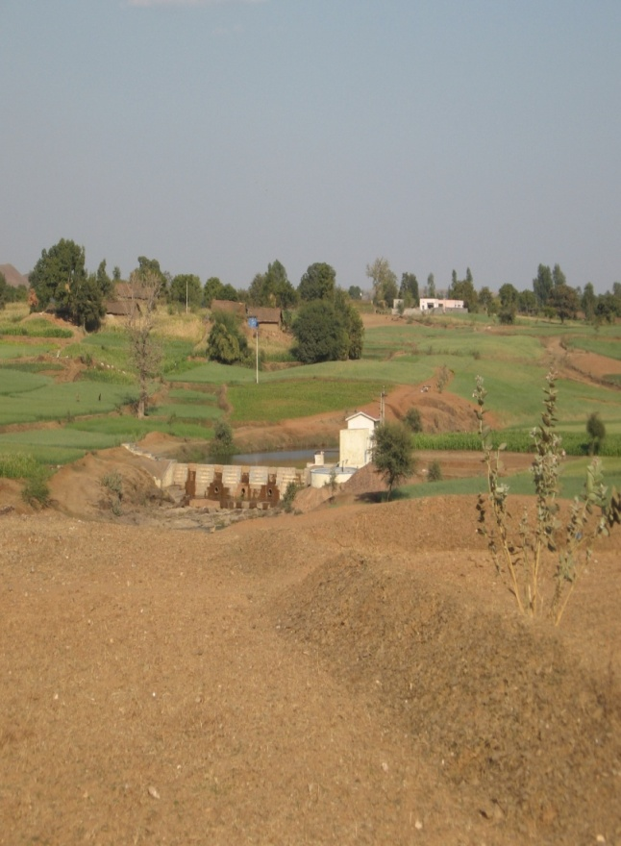
CASE STUDY : Transforming Dahod –
Dahod District – Gujarat – India

Slide 23
Prior to 1974
poorest district in the state & country too
Roughly 90 % people in tribal villages facing acute poverty
Migration rate in non-irrigated villages between 50-70 %
The irrigation coverage 10 % in records, in reality around 5 %
Agriculture yields poorest in the state
Milk production lowest in the state
Literacy rate - lowest in the state – women literacy in one digit
Landscape almost barren with hardly any tree cover
Most forest land - without tree cover
No horticulture activity
No vegetable cultivation
No floriculture

Slide 24
In 2010
Achieved food security
Housing conditions improved
School enrolment and attendance increased manifolds
Ground water improved - CGWB
Irrigation coverage is around 30 %
450 community water resources developed & managed by community
2,500 village institutions - users groups managing their affairs & assets
65 rivers and rivulets made perennial through series of structures
migration rate 10-15 %
six Crore trees planted with 50 % survival at long run
About 25,000 farmers opted for horticulture

Slide 25
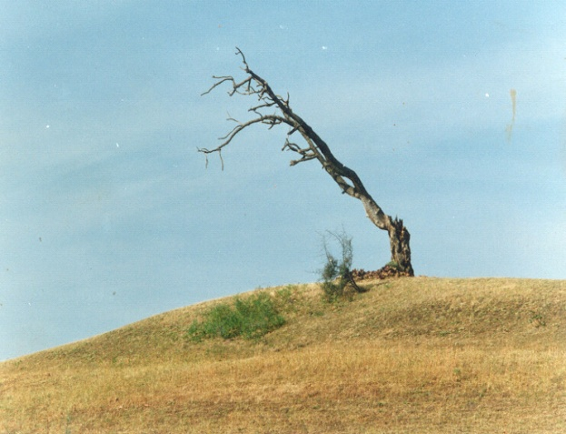
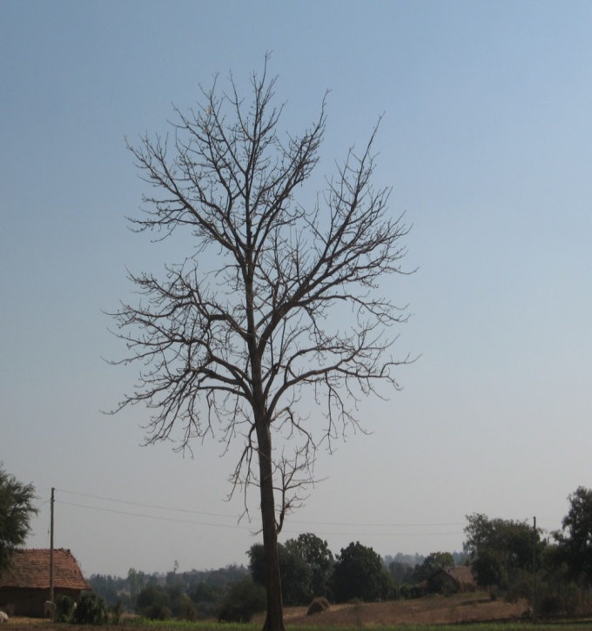
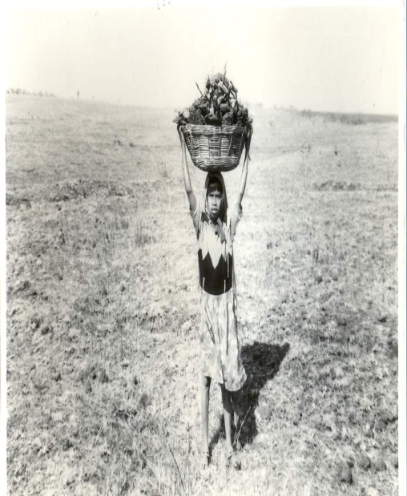
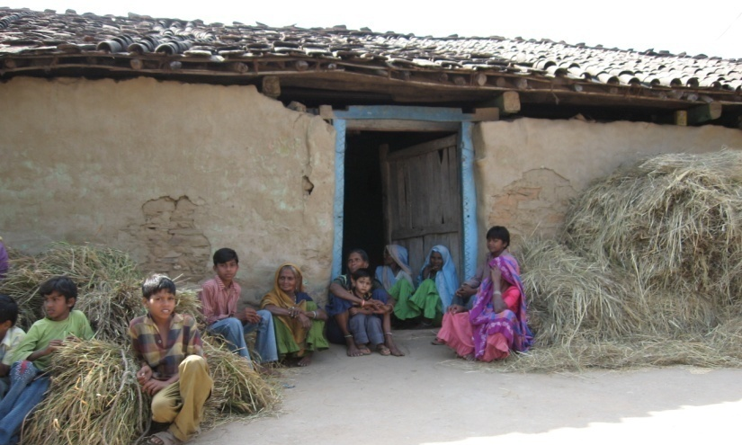
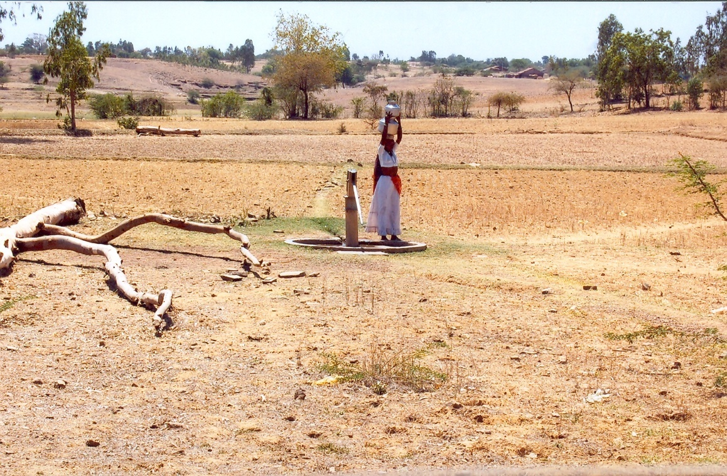

Slide 26
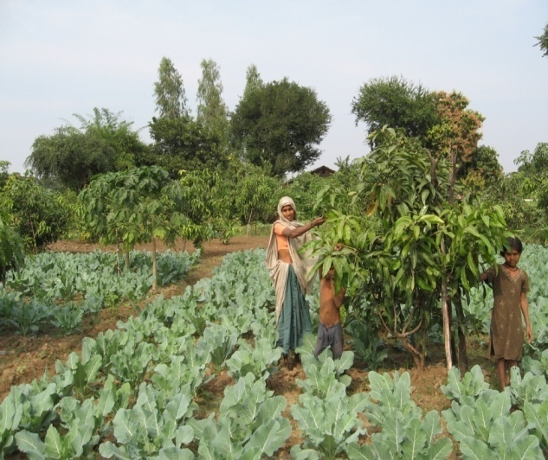
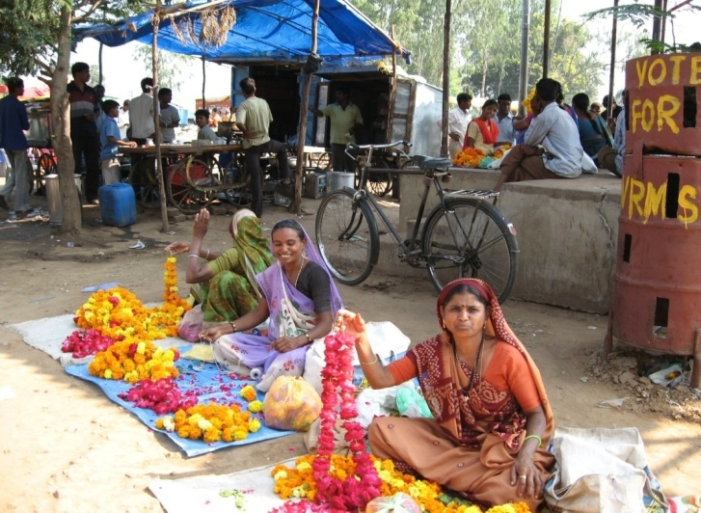
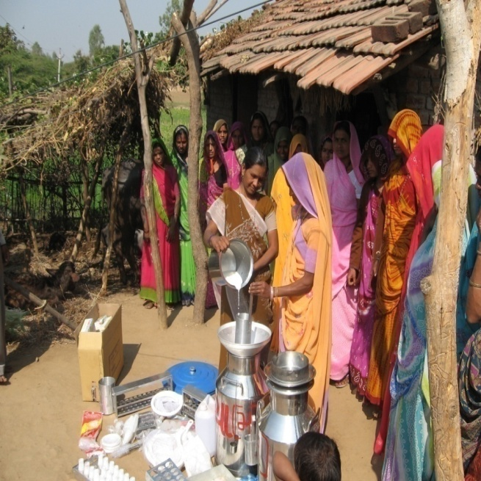
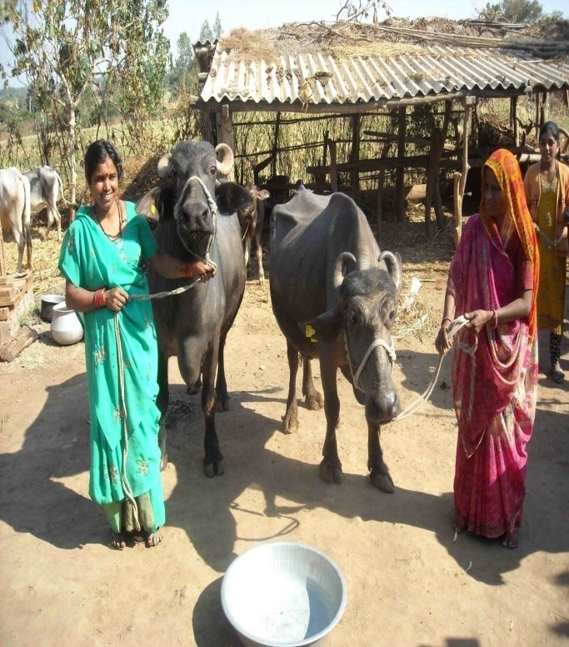

Slide 27
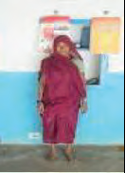
CASE STUDIES VILLAGE LEVEL
Vanbandhu Kalyan Yojana
Farmers Success Stories
Rathava Keriben Ganiyabhai
• Age: 55
• Occupation: Agriculture
• BPL No: VACHHJ00500140
• Contribution: Rs. 500/-
• Received inputs: Maiz-8 kg.- 2 bags, D.A.P-50 kg.-1 bag,
Urea-50 kg.- 1 bag, Pottash- 50 kg.- 1 bag
• Village: Judavant, Taluka: Chhota-Udepur, District: Baroda Says Smt. Keriben, We used hybrid seed of maize in all seasons & received double income. I was able to
grow 1.4 tons (14 Kwintal) of the maize from this kit.

Slide 28
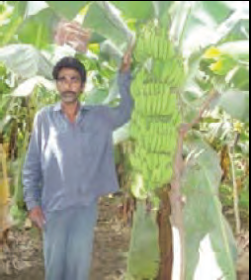
Rathava Motesinghbhai Bhanatabhai
Age: 45
• Occupation: Agriculture
• BPL No: VAJETG0100066
• Beneficiary’s contribution: Rs. 2500/-
• Received inputs: Banana tissue-culture
plantlets -1370 Nos. of plants, D.A.P-200
kgs.-4 beg, Yuria-650 kgs.-13 begs, Pottash-
900 kgs.- 18 bag, Lansargold-500 grams,
Monocrotophos-500 ML, Saf-350 grams,
Aishwarya Gold-250 ML
Village: Ghutanvad, Post: Ghutiya, Taluka: Pavi- Jetpur, District: Baroda Says Shri Motesinghbhai, I am able to earn Rs. 110000/- in a acre . Produce22 to 27 kg. of every bunches of bananas because of this kit.

Slide 29
Use of Balanced Fertilizer based on Soil Health Analysis – the case study of Jambusar, Bharuch, Gujarat
Maheshbhai Sindha, Piludra of Jambusar Taluka of Bharuch district owns three acres of land. He was using intensive chemical fertilizer and seeds with cheaper price. In his cotton, expenses were high and the yield was low. Based on Soil Health Analysis in 2012 , he started using certified seeds and balanced doze of fertilizer both organic and in organic-chemical. This reduced his cost in agricultural operations by Rs.2,800 and increased productivity in cotton by 4 quintal. He started using crop residue and cow dung along with worms to develop compost fertilizer. This increased productivity further by one quintal and simultaneously, he started selling worms to other farmers to make their compost. Within two years, his income increased to Rs.31,500/-.

Slide 30
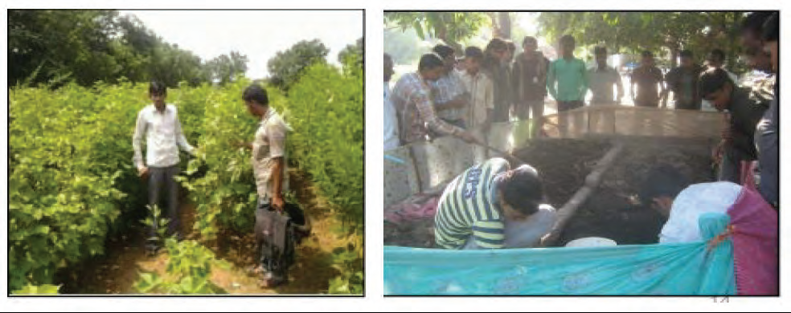

Slide 31
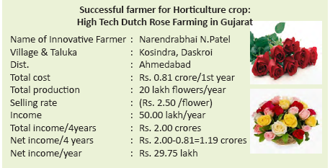

Slide 32
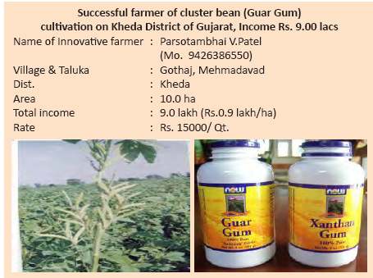

Slide 33
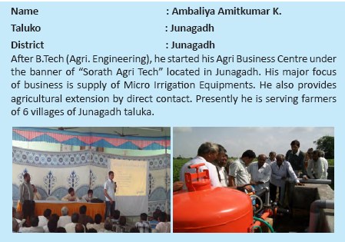
AGRO MICRO ENTERPRISE

Slide 34
Initiative Needed at International level for Local Problems
Enhancing Food Security and Reduce of Poverty
International Community need to:
Recognize agriculture as a major mitigation tool and adopt mechanism to address the loss and damage associated with the impacts of climate in highly vulnerable countries to restore agriculture and immediately prepare farmers for adaptation including mid-season. – Agro Advisory.

Slide 35
Allocate green fund for
- Technology transfer from “those who have it to those who need it”
- Bring new areas such as wasteland and wetland under agriculture for creating livelihood opportunities and to meet the challenges of food security.
Make available special financial support for community bio-gas plants, grassland development in desert areas.
Identify crops – plants species which survive on saline water soil and sea water.
Sensitize national governments to provide safety net to farmers in terms of insurance and fallback employment in community projects.
Set International Weather Advisory to support countries who do not have local advisory
Promote international trade for value added agriculture.

Slide 36
LEADERSHIP FOR GREENER AGRICULTURE
Global Warming is a threat, but it can be converted into an opportunity. It is possible to make this happen a win-win situation for all, if all efforts are channeled towards sustainable development with Greener Agriculture at its centre.
Countries-Governments-all over the world will have to view the impact of climate on farmers with a grave concern. The change which is creeping in rapidly-with dangerous consequences to habitat and its stability. This confrontation is on “Nature’s Front”. Nuclear weapons or armies are no solution. The solution lies in bringing back balance in nature’s forces : the atmosphere, the sun, the earth, the water and the vegetation. The solution lies at local level. Our endeavor should be to overcome this challenge and convert it to an opportunity.

Slide 37
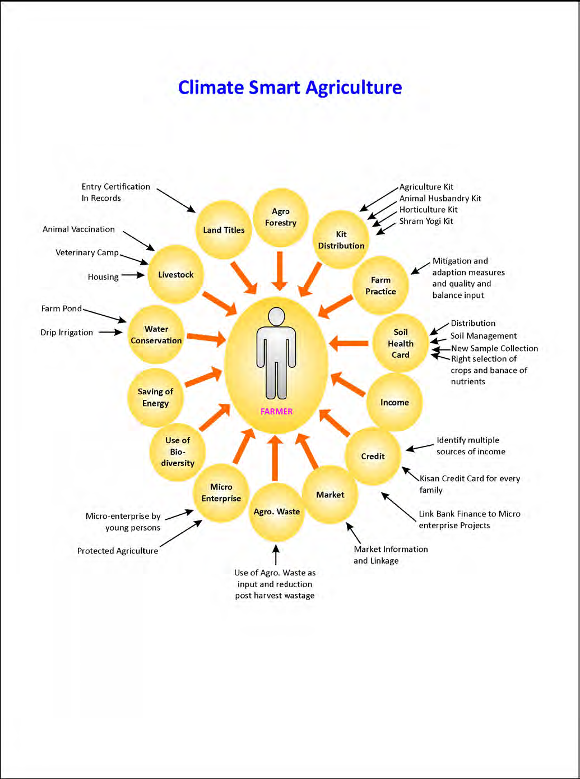

Slide 38
