Slide 1
Food Policy of India
& National Food Security Act and its Implementation
by Dr. Hemant Kumar Jaiswal, DGM(Opns)
FCI RO Ahmedabad

Slide 2
History
During the 18th and 19th centuries, the people of India were ravaged by a series of cataclysmic famines, precipitated less by failures of nature and more by colonial policies, such as of rack-renting, both legal and illegal, neglect of agriculture, “free-trade” policies and additional levies for wars. The famine codes of British had main objective to save lives at minimal cost to the colonial exchequer. There were 31 famines in 200 years of British Raj, the last one killed 4 million people in 1943.

Slide 3
Famines during pre-British era:
Famine in Indian sub-continent is a chronicle feature. Agriculture in India is heavily dependent on a suitable climate. A summer monsoon is a must for the irrigation of crops. Lack of rainfall and droughts had lead to several famines in India between 18th and 19th centuries severely. Draughts cause extreme scarcity of water and thus results in crop failure. On the other hand, floods and earthquakes can destroy the crops or food storage places. These all result in food scarcity and eventually famines. E.g.: Deccan Famine of 1630

Slide 4
Famines during colonial era
India was hit by recurrent famine from 1760 AD to till 1943 AD. As per British sources, there were more than 85 million Indians died in these famines which were in reality genocides done by the British Raj. E.g.: Doji Bara famine or Skull famine of 1788–94 killed around 11 million people. Bengal famine of 1943 killed more than 3 million people.

Slide 5
Apathy of British rulers was evident in their policies
The famines were a product both of uneven rainfall and British economic and administrative policies.
Colonial policies implicated include enhancement of taxes, levies for war, free trade policies, the expansion of export agriculture, and neglect of agricultural investment.
During the Bengal famine of 1770, East India Company raised taxes disastrously and exacerbated it, even if the famine was not caused by the British colonial government.
Indian exports of opium, rice, wheat, indigo, jute, and cotton were a key component of the economy of the British empire, generating vital foreign currency, primarily from China, and stabilising low prices in the British grain market.
Policy lapses such as prioritising distribution of vital supplies to the military, civil services and others as well as stopping rice imports

Slide 8
Famine Commissions during British Rule in India
Recurrent famine and huge loss of life due to hunger led the British Government to come under pressure in England. The devastating effects of 1876-78 famine compelled the British Government to do something substantial to check the recurrence of famines in India. Hence, they formed three commissions to evaluate the causes of the famines.
First Famine Commission
It was set up in 1878 under the Chairmanship of Sir Richard Strachey. The commission recommended state interference in food trade in the event of famine. India witnessed another major famine in 1896-97.
Second Famine Commission
It was constituted in 1897 under the Chairmanship of Sir James Lyall. This commission recommended the development of irrigation facilities.

Slide 9
Famine Commissions during British Rule in India…………..cont…..
Third Famine Commission
It was set up in 1900 under the Chairmanship of Sir Anthony (Later Lord) McDonnel to re-evaluate and recommend changes in report of the previous commission, based on the findings of the recent famine. This Commission recommended that the official machinery dealing with a famine must work around the year so that the scarcity of food grains could be controlled well in time.
Though, three Famine Commissions were constituted, but the British Government was never serious in dealing with the welfare plans for the masses. Famines continued to occur and the Famine of Bengal (1943) was the most horrifying. This was one of the worst gifts of the British Rule to India.

Slide 10
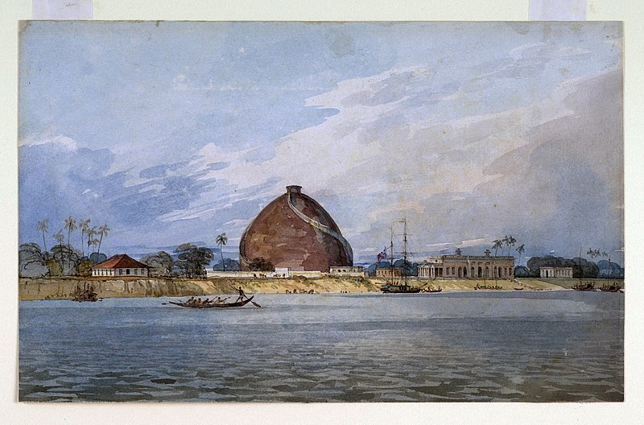

Slide 11
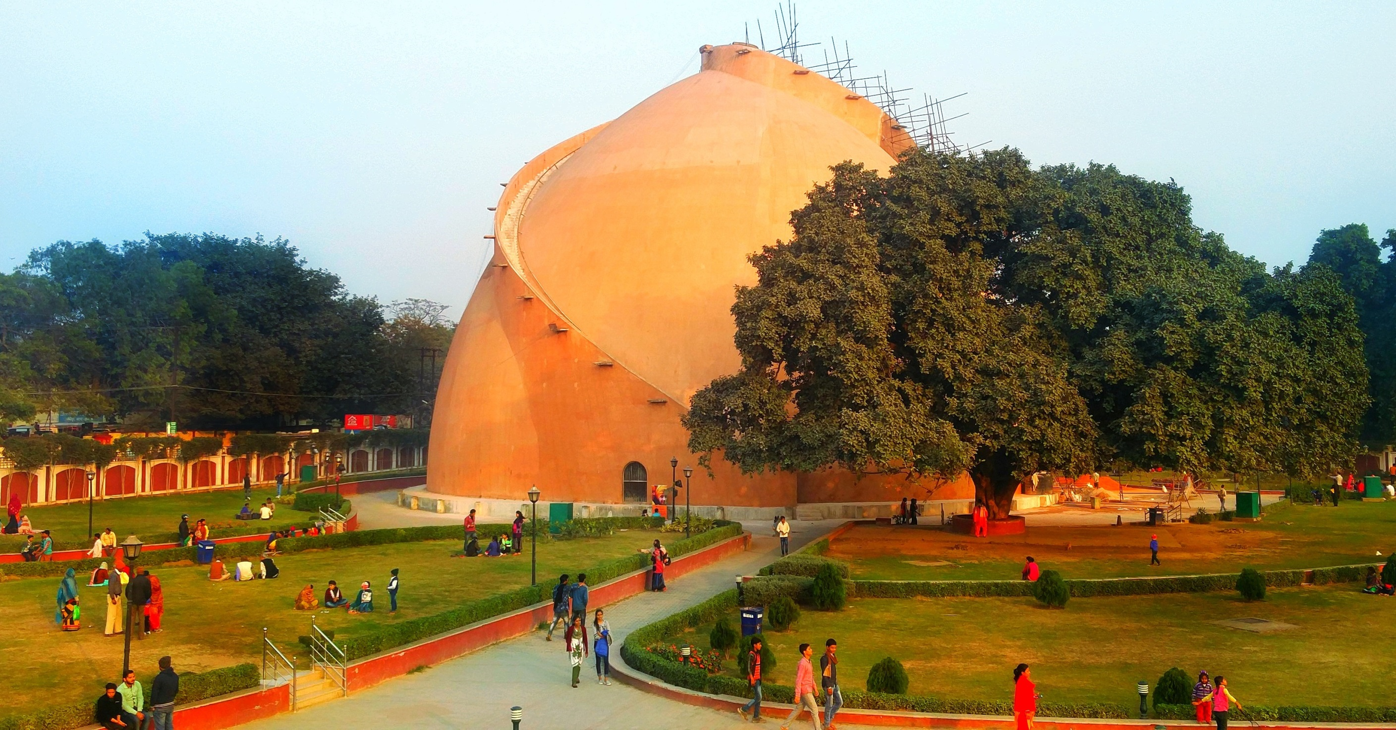

Slide 12
Golghar
According to a contemporary inscription at its base, the Golghar in Patna was intended to be just the first of a series of huge grain stores. In the end, however, no others were ever built. The granary was "part of a general plan … for the perpetual prevention of famine in these provinces".^{[1]}
The beehive - shaped structure was designed by John Garstin of the Bengal Engineers, part of the East India Company's Bengal Army. Its construction was completed on 20 July 1786.

Slide 13
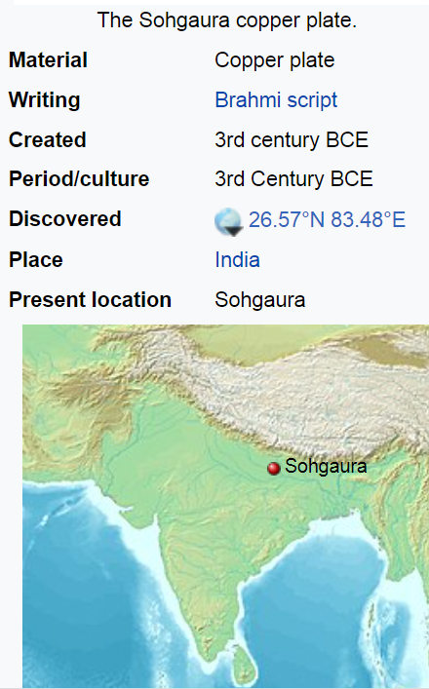
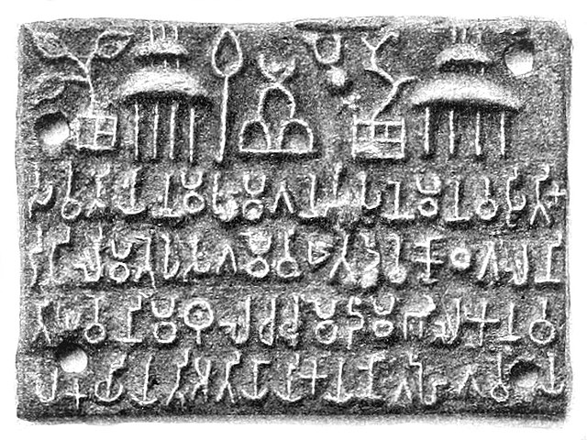
This is the oldest Indian copper plate inscription known. The Sohgaura Copper-plate was found at Sohgaura, in Gorakhpur district of Uttar Pradesh, and is supposed to be from the Mauryan period. The inscription is in Brahmi script and records a royal order to establish two grain depots and the grains stored in the granary should be carefully distributed to fight against famine.

Slide 14
Food Policy Introduction
Food policy refers to the collection of decisions made by governments, civil society, businesses, and inter-national organizations that shape our food systems, including production, processing, distribution and consumption of food.

Slide 15
Pre and Post Independence
During the World War II India faced acute food shortages and to meet the exigencies a separate Food Department was established on 1st December 1942 under the Commerce Member of the Governor General’s Council.
The Food Department was re-designated as Ministry of Food on 29th August 1947.
In 1960 the Ministry was made into two departments, namely the Department of Food and Department of Agriculture.

Slide 16
Continued….
Department of Food was given the responsibility of procurement of food grains for civil and military requirements, distribution of imported food grains to States, co-ordination, planning and guidance of national food policy and regulation of import and export of food grains.
In 1965, under the Food Corporation Act, 1964, the Food Corporation of India (FCI) was set up in the Department, as the country was facing major shortage of food grains, especially wheat.

Slide 17
Soon after independence, the government took the problem of shortage of food grains seriously. Several important measures have been taken by government to solve this problem. These measures may be enumerated as follows:
Increase in Production of Foodgrains
Agricultural development has been accorded top priority in almost all the Five Year Plans. Several programmes have been launched to increase agricultural production and productivity such as intensive farming, multi-crop programme, development of high yielding varieties of seeds, intensive use of fertilizers.

Slide 18
Import of Foodgrains
To meet the shortage of foodgrains, the government has been importing food grains from time to time. 48 lakh tonnes of food grains were imported in 1951 which increased to 103 lakh tonnes in 1966 under PL 480 of USA.
Procurement of foodgrains
Government adopted the system of procurement of food grains. Under the system, government procures foodgrains from market every year. For this purpose, procurement prices or minimum support prices are announced by government every year for all the important foodgrains and all the government purchases are made at these prices. It helps in protecting farmers against the malpractices of traders and commission agents.

Slide 19
Public Distribution of Food grains
Government adopted public distribution system to ensure fair distribution of food grains at controlled prices. Under the system, fair price shops are opened.
Buffer Stock Scheme
Government started a scheme of maintaining buffer stock of important food grains to ensure their regular supply throughout the year. Whenever there is a rise in their prices, government releases them from buffer stock to stabilise prices. Buffer stock operations are normal these days and they have become a normal part of the food policy of Government of India.

Slide 20
Establishment of Specific Institutions
A number of specific institutions have been established by government to promote agricultural production and productivity and to ensure regular supply and fair distribution of food grains. Important institutions are: National Seeds Corporation, Agro-industries Corporation, Agricultural Prices Commission, Food Corporation of India, Fertilizer Corporation of India, etc.bout 2000.
Agricultural Research & Development
Government is taking serious steps to promote agricultural research and development. A number of agricultural universities and Indian Council of Agricultural Research (ICAR) have been established to undertake research activities.

Slide 21
Objectives of Food policy
i) To attain self-sufficiency in food grains production by giving a remunerative price to the farmers through price Support Scheme
ii) To arrange and equitable distribution of available food grains augmented by imports, if necessary, at reasonable prices to the vulnerable sections of society throughout the year.
iii) To maintains stability in food grains prices during the year and throughout the country.
iv) To maintain an adequate buffer stock of food grain to deal with fluctuations in production and to meet unforeseen exigencies and natural calamities.

Slide 22
Buffer Stock
The broad functions of a buffer stock are:
1. To even out fluctuations in food supplies and prices;
2. To curb speculative activities of private trade;
3. To act as an instrument to ensure a reasonable price to the producers for continuing production;
4. To facilitate procurement by inducing the producers;
5. To create confidence among the people about Government's capacity in dealing with food situation.

Slide 23
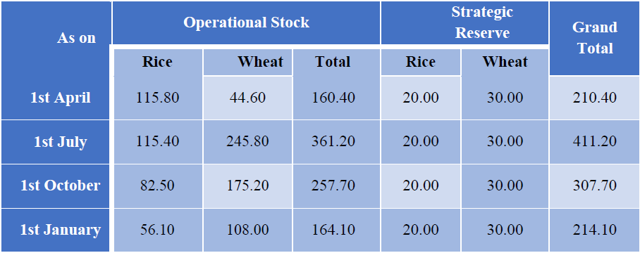
Buffer Norms (with effect from 01.07.2017)
(Figure in Lakh MTs)

Slide 24
Public Distribution System
The concept of public Distribution System in the country evolved around 1942 emanating from shortage of food grains during World War-II and the Government intervention in distribution of food started during the scarcity of food grains continued in major cities, towns and in some food deficit areas.
The policy of public Distribution System/ Rationing System has undergone several changes with every lap of five year planning in country. The Seventh Five Year Plan assigned to it a crucial role by bringing the entire population under the public Distribution System and became a permanent feature in the Country’s economy.
Objective of PDS: The main objective of the public Distribution System is to afford food security and to safeguard the interest of the consumers particularly the vulnerable section of the society.

Slide 25
What is Food Security ?
Food security, as defined by the United Nations' Committee on World Food Security, means that all people, at all times, have physical, social, and economic access to sufficient, safe, and nutritious food that meets their food preferences and dietary needs for an active and healthy life.
The term first originated in the mid-1970s, when the World Food Conference (1974) defined food security in terms of food supply - assuring the availability and price stability of basic foodstuffs at the international and national level
India ranks 72 out of 113 major countries in terms of global food security index(Dec-2019)

Slide 26
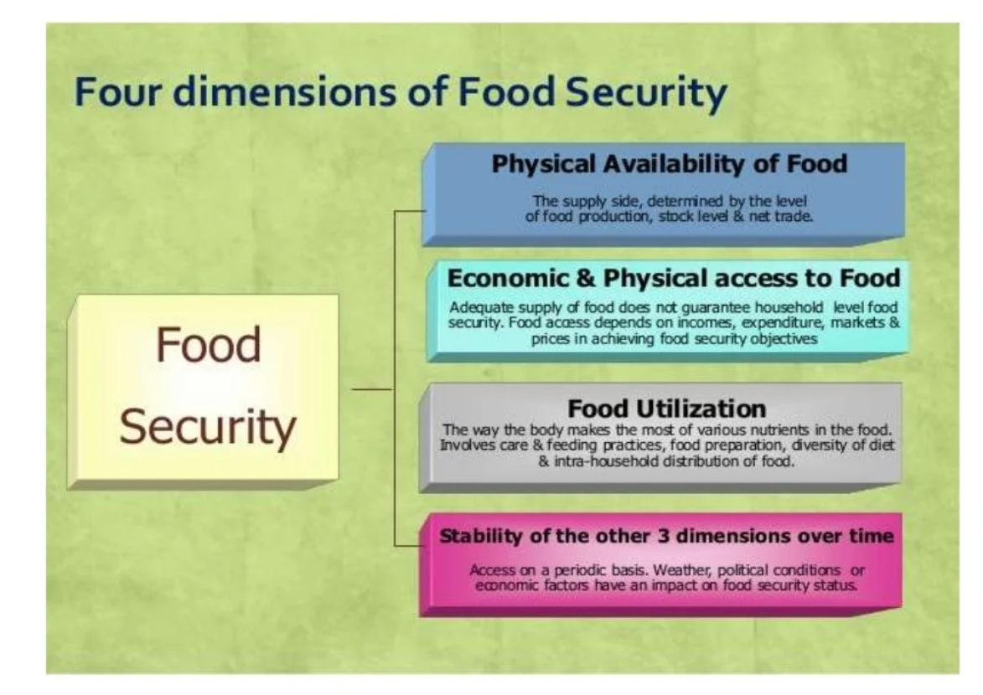

Slide 27
National Food Security Act – Introduction
The NFSA converts into legal entitlements the existing food security programmes of the Government of India.
The Act was signed into law on 12th September 2013 retroactive to 5th July 2013.
The Act is in line with Goal Two of the Sustainable Development Goals set by the United Nations General Assembly.
Goal 2 seeks sustainable solutions to end hunger in all its forms by 2030 and to achieve food security.
The aim is to ensure that everyone everywhere has enough good-quality food to lead a healthy life.
Schemes such as the Mid-Day Meal Scheme (MDMS), the Public Distribution System (PDS), and the Integrated Child Development Services (ICDS) are included under the Act.
The Act is being implemented by all the States and the Union Territories.

Slide 28
Objectives of the National Food Security Act
The Act provides for food and nutritional security in the human life cycle approach, by ensuring access to an adequate quantity of quality food at affordable prices for people to live a life with dignity and for matters connected therewith or incidental thereto.
COMMENCEMENT: 5th July 2013

Slide 29
PROVISIONS FOR FOOD SECURITY
Coverage / Identification of Beneficiaries
To the extent of up to 75% population of Rural and up to 50% population of Urban areas may be identified as eligible households for food security. The eligible households will be identified in two categories –
i. Households covered under Antyodaya Anna Yojana (Identified to the extent as may be specified by the central government for each state in accordance with the guidelines of Antyodaya Anna Yojana Scheme launched by Central government on 25th December 2000)
ii Priority Households (to be identified in accordance with such guidelines as the State Government concerned may specify)

Slide 30
Who are the beneficiaries of the National Food Security Act?
The Act covers two-thirds of the entire population under two categories of beneficiaries:
Antyodaya Anna Yojana (AAY) households
Priority Households (PHH)
AAY: households encompass the households headed by widows or disabled persons or persons aged 60 years or more with no assured means of subsistence or societal support.
It usually takes into account the households of those below the poverty line too.
It also includes support for women and children.
PHH: NFSA gives the right to receive food-grains at subsidized prices by people belonging to eligible households, i.e., the PHH. A major section of the ration cardholders in the priority sector comes under this category. This is an effort to alleviate poverty.
The work of identification of eligible households within the coverage under TPDS determined for each state is to be done by the states and the UTs.

Slide 31
Entitlements:
FOR GENERAL PEOPLE
The households covered under Antyodaya Anna Yojana shall be entitled to get 35 Kg. of foodgrains per household per month.
Every person belonging to priority household shall be entitled to get 5 kg. of foodgrains per person per month.
The said foodgrains will be provided at the prices of Rs. 3 per Kg. for rice, Rs. 2 per Kg. for wheat and Rs. 1 per Kg. for coarsegrains.

Slide 32
Entitlements: …………cont…
FOR WOMEN
Every pregnant woman and lactating mothers except those who are in regular employment with Central or State Govt. or Public Undertaking or those who are in receipt of similar benefits under any law, shall be entitled to:-
(a) Meal, free of charge, during pregnancy and six months after the child birth, through the local anganwadi.
(b) Maternity benefits of not less than Rs. 6000/-, in such installments as may be prescribed by Central Govt.

Slide 33
Entitlements: …………cont…
FOR CHILDREN
Every child upto the age of fourteen years shall be entitled to have entitlements for his nutritional needs:-
(a) Every child from the age of six months to age of six years shall be entitled to get appropriate meal, free of charge, through local anganwadi.
(b) In case of children, upto class 8 or within the age group of six years to fourteen years shall be entitled to have one mid day meal, free of charge, everyday, except on school holidays, in schools run by local bodies, government and government aided schools
(c) The state government shall, through the local anganwadi, identify and provide meals, free of charge, to children who suffer from malnutrition, so as to meat nutritional standards.

Slide 34
Significance of the National Food Security Act
The concept of food security at a global level indicates access to basic, nutritious food by all people, at all times. It is characterized by availability, access, utilization, and stability of food.
There is no explicit provision in the Indian Constitution for the right to food.
Until the enactment of the NFSA, the fundamental right to life under Article 21 was interpreted to include the right to live with human dignity, which may include the right to food and other basic necessities.

Slide 35
Obligations under NFSA

Slide 36
Obligations of the Central Government
The Central Government shall allocate the required food grains from the central pool to the State Governments under the TPDS.
The Government would have to allocate the resources keeping in mind the number of persons in the eligible households.
The Central Government would also provide for the transportation of food grains as per the allocation to the State Governments.
Assist the State Governments in meeting the expenditures incurred by the State Government towards intra-state movement, handling of the food grains, and the FPS margins.
Create and maintain storage facilities at various levels.

Slide 37
Obligations of the State Governments
The State Government shall be responsible for the implementation and monitoring of the various schemes.
Determine the eligible households and the beneficiaries and ensure that they can avail of the benefits of the schemes.
Organize intra-state allocations to deliver the allocated food grains to the beneficiaries.
Create and maintain scientific storage facilities at the district and block levels to store the allocated food grains.
licensing arrangements for the FPS under the Public Distribution System (Control) Order, 2001.

Slide 38
Features of NFSA Act
Women Empowerment : Eldest woman of the household of age 18 years or above to be the head of the household for the purpose of issuing of ration cards.
Transparency and Accountability :Provisions have been made for disclosure of records relating to PDS, social audits and setting up of Vigilance Committees in order to ensure transparency and accountability.
Grievance Redressal Mechanism : Grievance redressal mechanism at the District and State levels. States will have the flexibility to use the existing machinery or set up separate mechanism.

Slide 39
National Food Security Act: Impact
The NFSA, passed in 2013, provides for the distribution of subsidized foodgrains through ration shops to up to 75% of the rural population and 50% of the urban population, which, according to Census 2011, totals 81.35 crore people.
NFSA is currently operational in all states and union territories, with an intended coverage of 81.35 crore people across the country.
In January 2022, 25.26 LMT (Lakh Metric Tonnes) of food grains were distributed under NFSA to nearly 79 crore beneficiaries.

Slide 40
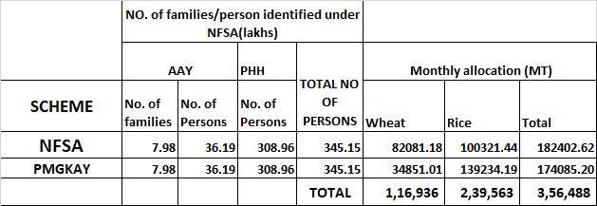
NFSA w.r.t. Gujarat State

Slide 41
Thank You

