Slide 1

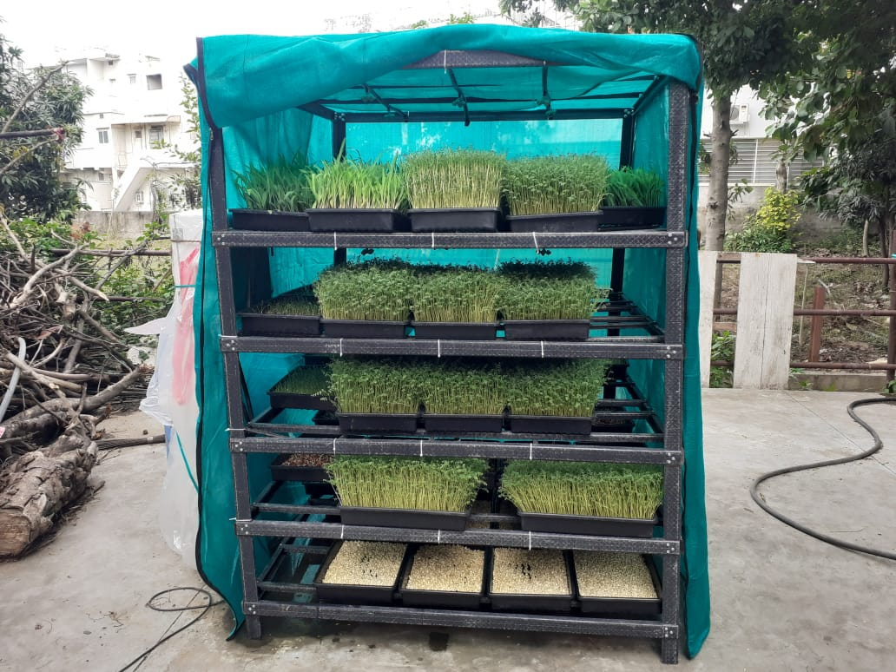
Hydroponic system for green fodder
“A smart and innovative farming “

Slide 2
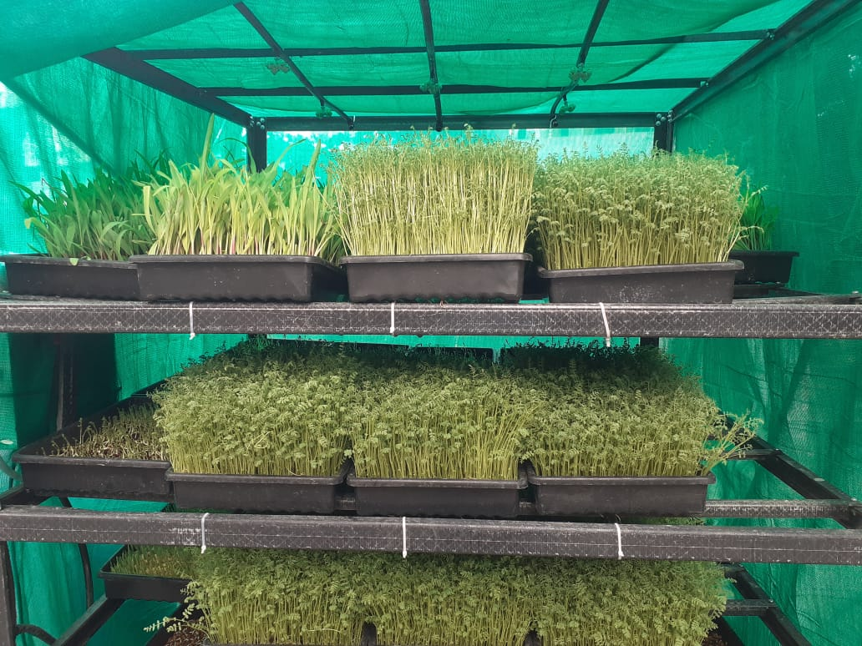
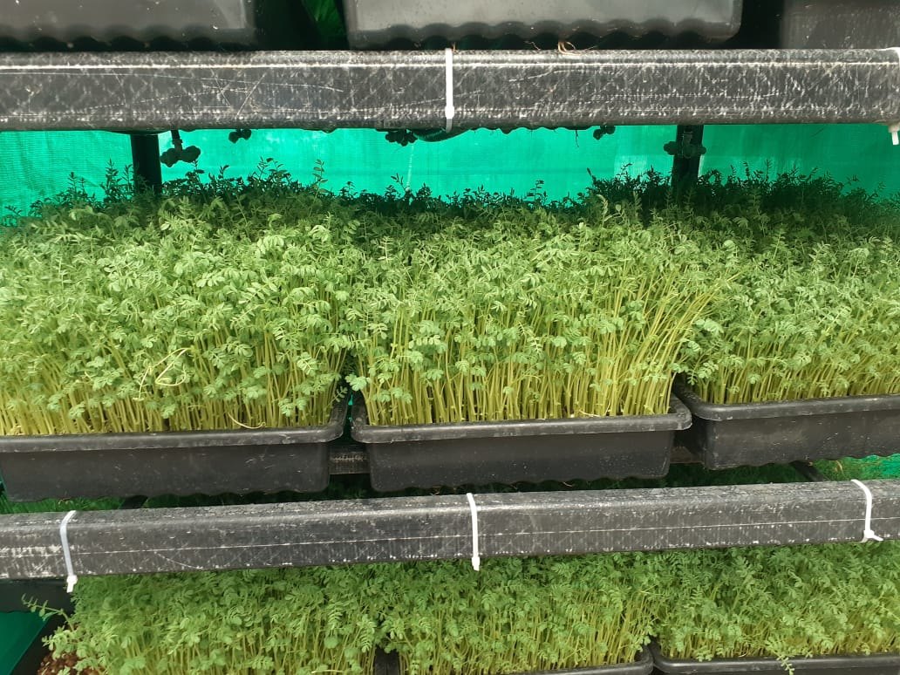
Hydroponic system capacities
20 Kg per Day | For 2 cattle's
50 Kg per Day | For 4 Cattle’s
100 Kg per Day | For 8 Cattle’s

Slide 3
COMPARISON OF CONVENTIONAL METHOD OF GROWING GREEN GRASS VIS-À-VIS HYDROPONIC METHOD
CONVENTIONAL METHOD OF GROWING GRASS |  | HYDROPONIC METHOD OF GROWING GRASS
1. | Area required 4500 sq. meter of land. | 1. | 3 sq. meter space required
2. | Production quantity 10000 Kgs per season. | 2. | 50 kgs per day.
3. | It consumes around 16 lacs liters water per season. | 3. | 50 liters water required per day.
4. | Soil required to grow grass. | 4. | Soil not required.
5. | Soil borne decease problem occur. | 5. | No soil borne decease.
6. | You don’t get fodder every day. | 6. | You get fodder every day in equal quantity.
7. | Land cost not considered. | 7. | The hydroponic grass growing unit cost approx. Rs.50,000/- per unit + tax.
8. | Electricity required to pump water. | 8. | Being it works on Solar, no electricity required.
9. | Protein content – 2 – 5% | 9. | More than 17%. Improve health of cattle, increase in milk production and fat percentage.

Slide 4
COST BENEFIT RATIO BEFORE AND AFTER USING HYDROPHONIC UNIT FOR FIVE MONTHS
Before using Hydroponic unit | Nov-21 | Dec-21 | Jan-22 | Feb-22 | Mar-22 |  | TOTAL
TOTAL DHAAN | 83,020 | 83,670 | 82,980 | 84,250 | 85,930 |  | 4,19,850
TOTAL DRY GRASS | 43,000 | - | 59,160 | 72,545 | 54,625 |  | 2,29,330
Total | 1,26,020 | 83,670 | 1,42,140 | 1,56,795 | 1,40,555 |  | 6,49,180
After using Hydroponic unit | Apr-22 | May-22 | Jun-22 | Jul-22 | Aug-22
TOTAL DHAAN | 52,390 | 36,100 | 50,390 | 51,950 | 50,490 |  | 2,41,320
TOTAL DRY GRASS | - | - | 38,650 | - | - |  | 38,650
Seeds used for Hydroponic unit | 14,590 | 16,210 | 19,018 | 18,445 | 12,434 |  | 80,697
Total | 66,980 | 52,310 | 1,08,058 | 70,395 | 62,924 |  | 3,60,667
Reduction in cost after starting of Hydroponic System |  |  |  |  |  |  | 2,88,513
AVERAGE COST REDUCTION PER MONTH |  |  |  |  |  |  | 57,703
NOTE : ONE TIME INVESTMENT FOR TWO HYDROPONIC UNITS RS. 1,60,000/- APPROX. SAVINGS RS. 57,000/- PER MONTH.

Slide 9
For more information, please contact :
Mr. bhavar upadhyay
Transchem agritech pvt ltd
988/14, gidc ESTATE, MAKARPURA, VADODARA 390 010, GUJARAT
EMAIL: bhavar.upadhyay@transchem.in
contact : +91 70690 34500

