Slide 1
Enhancing Water Productivity
Waste Water Treatment & Reuse
Exploring Climate Adaptation and Mitigation in Drylands Towards Achieving the SDGs

Slide 2
TIntroduction to Rural Liquid Waste Management
he Jal Jivan Mission (2019) provide for minimum 55 litres per capita per day (LPCD) supply of water through tap. Half of the States are providing 70 litres or 100 litres LPCD. Considering 65% of it is generated as waste, the grey water (including blackwater) would be in the range of 40 to 60 LPCD.
Thus, 1000 population would generate an average 50 KLD (taking in to account for next 5 years).
Treatment of wastewater is a big challenge. The big central treatment plants have proved to be ineffective because of the high cost of operation, increasing load of pollutants, inadequate technology, and very high capital costs.
Bio-filters technology qualifies to be a decentralised effective, efficient, cost-effective system for addressing the issues flagged above.

Slide 3
The treated water has added nutrients worth (Rs. 1.60 per thousand litres) and is acceptable for Agriculture, land scape as per CPCB norms of 2017. The nutrient rich water can fetch Rs.2.00 per thousand litres.
The treated water supply supplements dwindled water supply in summer to support summer crops.
The indirect benefit is also equivalent saving of extraction / distribution expenditure of Agriculture Water (Rs.5/- to Rs. 10/- per thousand litres depending on source and distance of transport).
Ultimately, Waste Water Treatment is crucial for reducing pollution load in ground water and streams & rivers.
Bio-Filter technology also obviate the generation of sludge and hence its management, it also can handle black water (septic tanks).

Slide 4
Village Survey Report
With request of UNICEF & in cooperation of Shroffs Foundation Trust, we have surveyed around 42 villages of Gujarat.
Based on the survey it has been found out that around 0.5 MLD of waste water is available for reuse purpose which is otherwise disposed of in nearby nalla.
(Summary Report Attached)

Slide 5
Challenges of Drylands
To resolve the challenges of drylands in terms of water scarcity, we have made an attempt at 3-4 different locations viz (KVK-Jalna, Villages - Khanderaopura, Chikodra & Kukma) using recycled waste water and observed encouraging results.
This could provide adequate water for irrigation through the year to take 3-4 agriculture crops.

Slide 6
Capital and Operating Cost
Recycled Water available through out the year.
The Capital Cost for 50000 lts. per day capacity Plant would be Rs. 10 lakhs including Solar Plant
The operating cost (including maintenance) is around Rs. 10 per thousand litres i.e. 1 paise per litre.
Grey & Black Water including sludge can be managed.

Slide 7
REUSE OF TREATED WATER FOR AGRICULTURE
“Resource of Nutrients “

Slide 8
City Sewage Treated and Recycled for Agriculture
Jalna is a city located in Marathwada and receives very less rainfall and is drought prone area. Having population of around 3.0 lakhs, availability of domestic sewage is sufficient including in summers.
KVK Jalna was facing huge shortage of water for agriculture and therefore it
was decided to treat the city sewage (from nearby nalla) through Bioflter
Technology and reuse for agriculture.
Since then the KVK is able to take 3-4 crops per year and their problem of
water shortage was completely resolved.

Slide 9
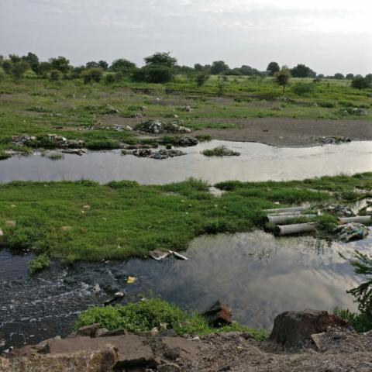
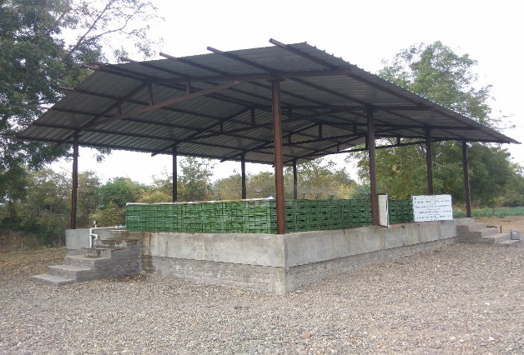
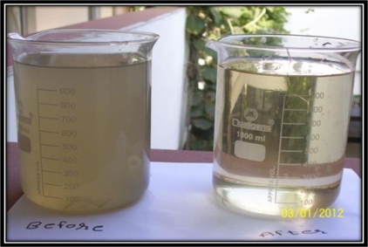
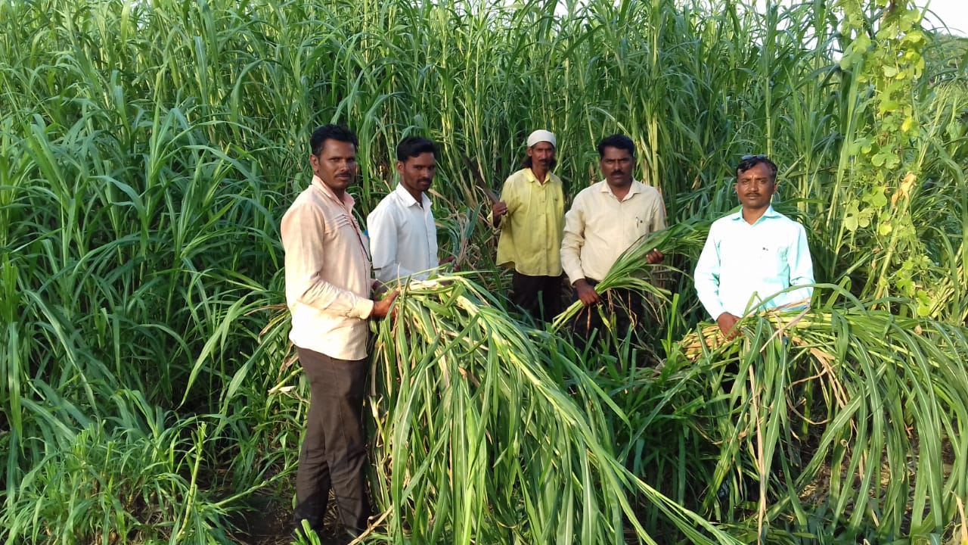
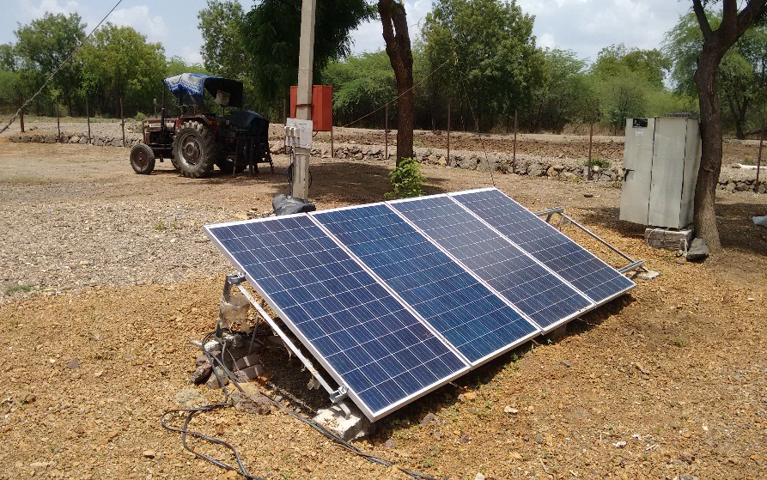
Trans Bio-Filter - 100 M3/Day at Krishi Vigyan Kendra, Jalna
( City sewage treated and recycled for Agriculture)
Intake from city Sewage
transBio-Filter Plant
Treated water used for Fodder fields
Plant Running on Solar Panels
Growth in summer
Notes:
9

Slide 10
Advantages of Biofilter Technology
  Is green technology – no use of any chemicals
  Use of all material from natural origin
  Low energy & maintenance required (no mechanical equipments.)
  No sludge generation
  Aerobic & no odour
  Resource generation in form of “Bio-nutritional" products like:
    Nutrient rich water,
    Vermi-compost &
    Earthworm biomass
  Can be implemented at De-centralized level.

Slide 11
Average Results
Parameters | Before Treatment | After Biofilter Treatment
pH | 8.7 | 8.0
TDS (ppm) | 1200 | 1200
Turbidity (NTU) | 95 | 14
COD (ppm) | 400 | 90
BOD (ppm) | 150 | 20
DO (ppm) | Nil | 2.9
Colour | Dark Grey | Pale Yellow
Odour | Strong | Odourless
Fecal Coliforms (MPN/100ml) | > 10⁶ | < 10³
Note: The treated water quality is as per the CPCB norms of 2017 for land irrigation

Slide 12
Benefits derived:
Total 30 acres of land is cultivated using Biofilter treated water.
7 types of fruits like Mango, Tamarind, Sweet orange, custard apple, Guava, Kazi Lime and Grapes are cultivated with Biofilter water .
Vegetables like Tomato, Chilli, Brinjal, Lady finger, Bitter Guard and Bottle Guard are cultivated in an year.
Fodder crops with substantial growth is grown in 1 acres of area . Getting 5-6 yields of fodder in a year.
Vigorous growth is observed in all plants, No scorteling of leaves and the crop yield has increased from 1.8 to 3.6 i.e double by usage of Biofilter treated water .
10 quintal of compost is harvested and used in KVK farm.

Slide 13

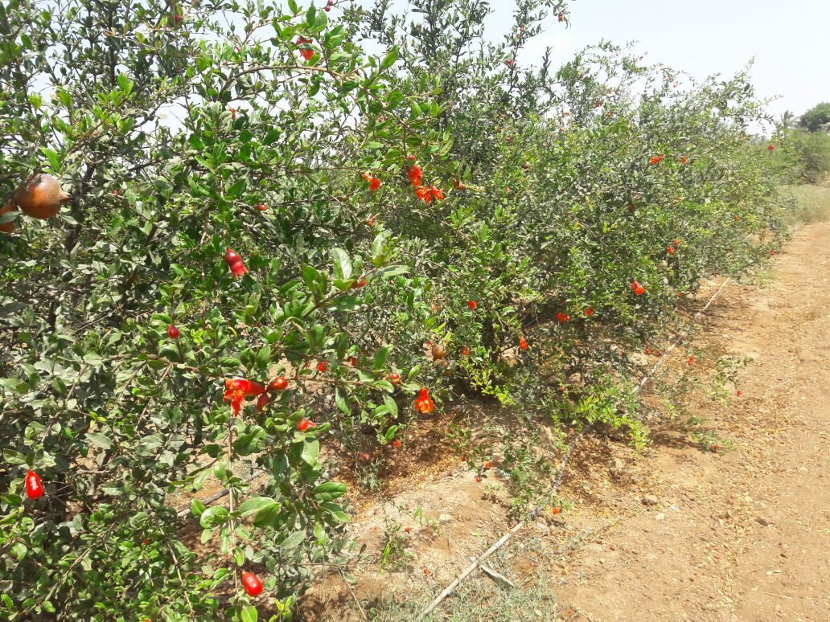
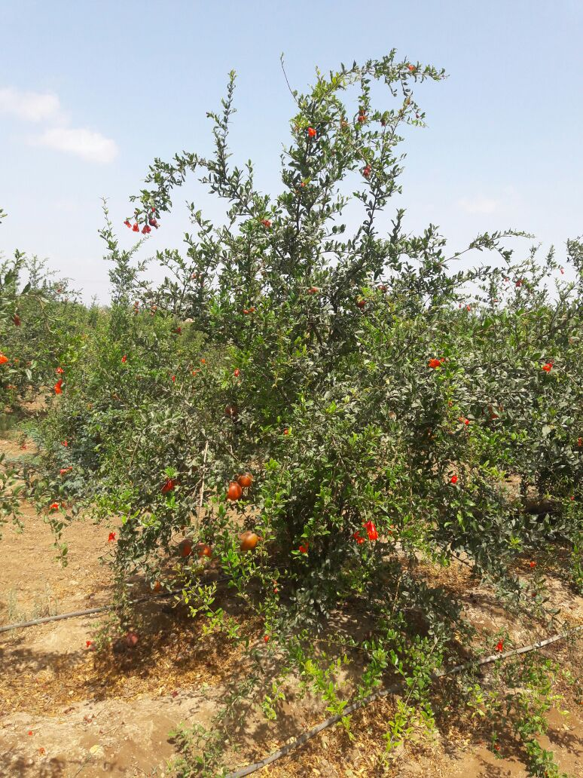
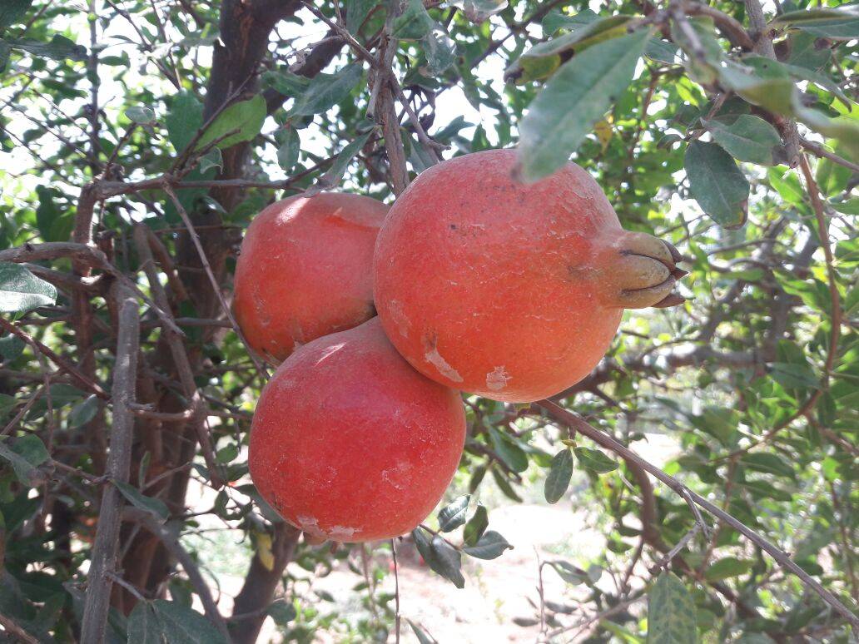
Agriculture done on transBio-Filter outlet water
water
Notes:
13

Slide 14
Decentralize waste water treatment
plants for Villages
Case Study – Khanderaopura, Taluka Padra

Slide 15
Case Study - “Zero Waste Village” by Solid and Liquid Waste Management”
Preamble :
Khanderaopura village (Padra block of Vadodara District, Gujarat) is a village having population of 1500 having 185 households.
In 2016 this village had an outbreak of Cholera and it earned a bad name. It remained focus of media for a long period. Shroff Foundation Trust was requested to look into the problems of sanitation & hygiene of this village.
Thus it was decided by the village community that this village would need to be qualified for ODF and the drainage line would be repaired to make it functional.

Slide 16
Re-use of Treated WasteWater
Khaderaopura Village generates 100 to 120 KLD domestic waste water @ 70 lts.per person per day.
Proper mapping was done to collect the entire quantity of waste water generated for further treatment.
Biofilter plant was installed of 120 KLD capacity, which is solar based and the total treated water is used by villagers for agriculture.
Even the operation of the plant is done by villagers after providing proper training and today they are able to take 3-4 crops per year.
Collector of Vadodara received Award for the Project

Slide 17
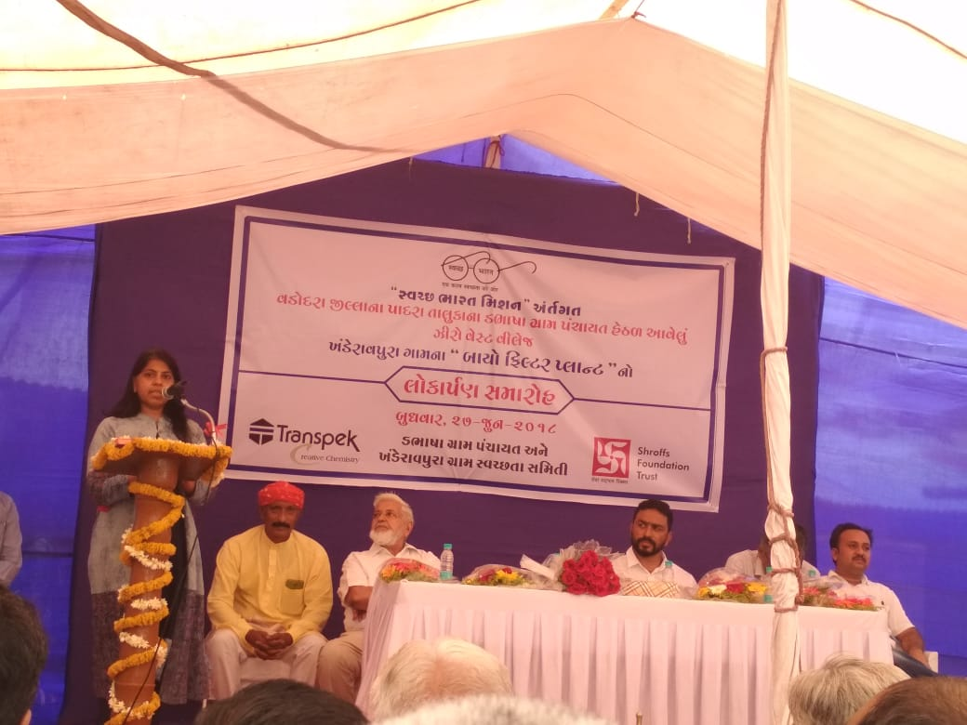
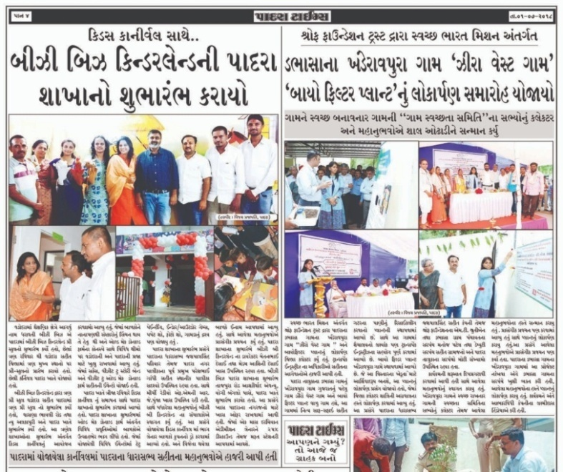
Khanderaopura Plant Inauguration

Slide 18
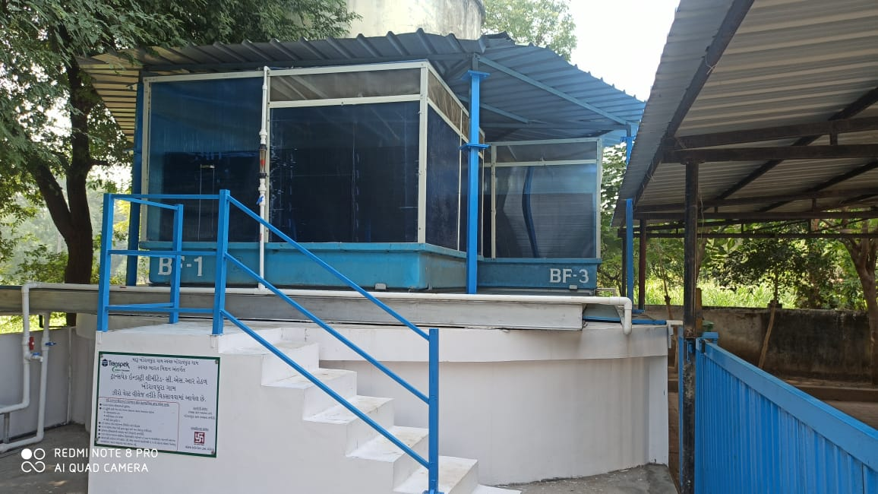
transBiofilter STP - 120 KLD at Khanderaopura, Gujarat
Occupies only 80 sq.mts.area

Slide 19
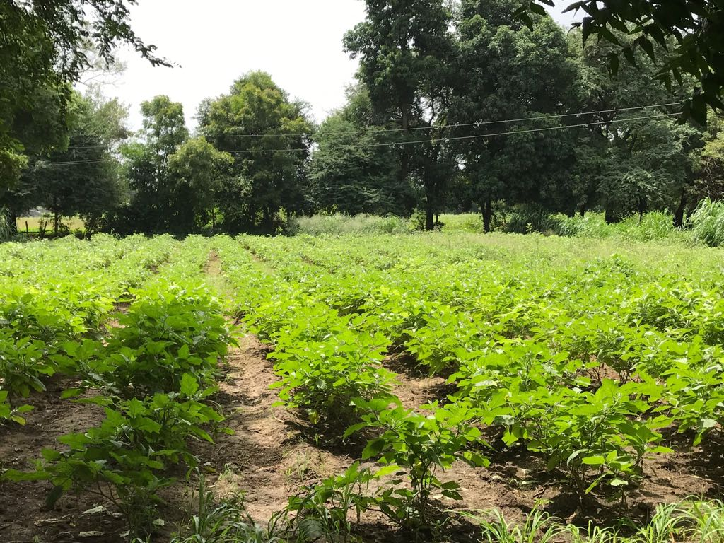
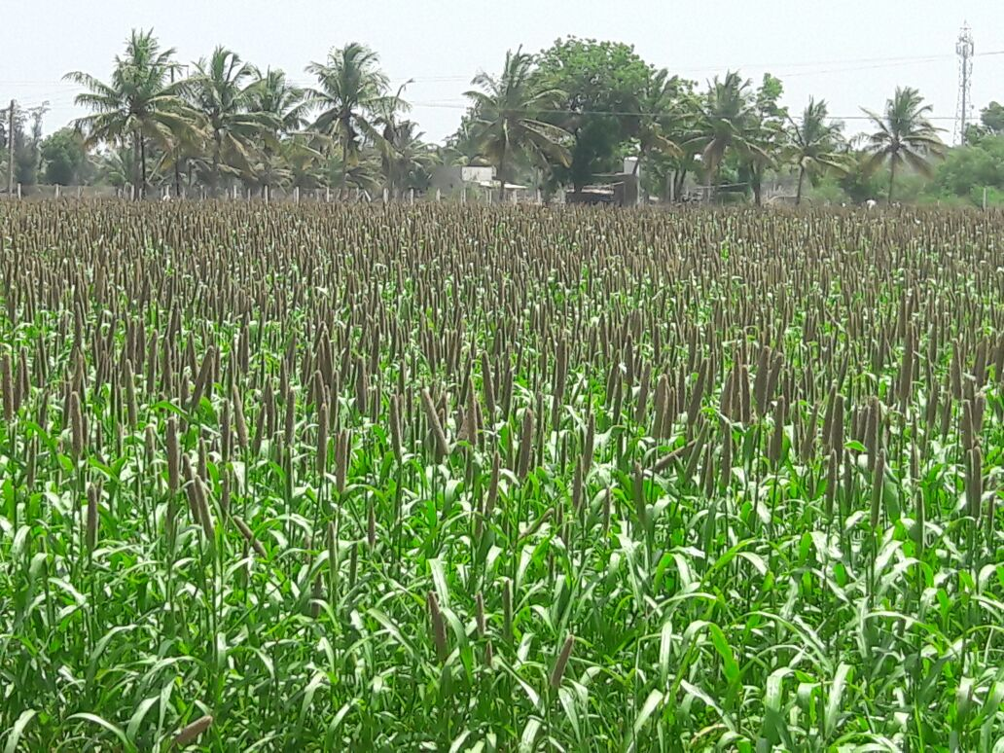
Biofilter Treated Water used for Agriculture

Slide 20
RESOURCE GENERATION PER ANNUM FOR 120 KLD PLANT
Sr. No | Particular | Basis | Quantity In Kgs / KL | Rate/Kg in Rs. | Amount in Rs. Per Annum
1. | Water for Irrigation | Cost of device & use of energy to lift water. | 120 | 10 /KL | 396000.00
2 | Nutirtive Water for Agri/horticulture | Available Nutrient contents -
 |  | a. Av. Nitrogen(NO3)-Urea | 4560 | 5.5 | 25080.00
 |  | b.Av. Phosphorus- DAP | 636 | 22 | 13992.00
 |  | c. Av.Potassium- MOP | 1740 | 11 | 19140.00
3 | Vermi-Compost generation | a. organic Media consumed - 3 MT/year b. out of which 1/4th is converted into Vermi compost | 3000 | 3 | 9000.00
4 | Earthworm Biomass | a. Fully matured Biofilter bed harbors 4-5 kgs earth per cum | 250 Kgs | 200 | 5000.00
5 | Resource Generation / Year |  |  |  | 468212.00
6 | Resource /day |  |  |  | 1418.00
7 | Resource / KL |  |  |  | 11.82
Note: The cost of water includes nutrients value, vermin-compost & earthworm biomass

Slide 21
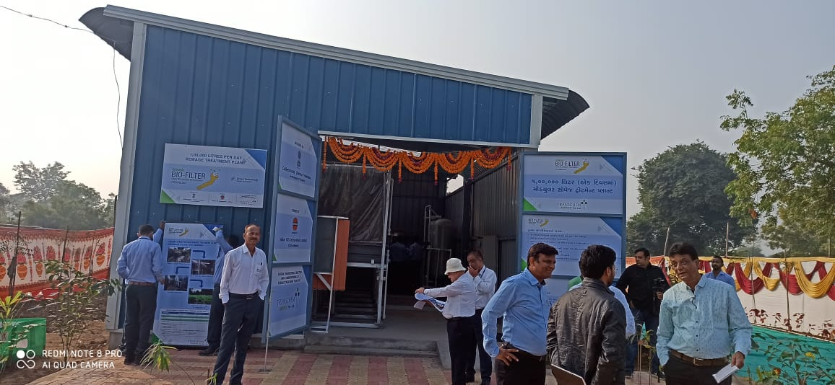
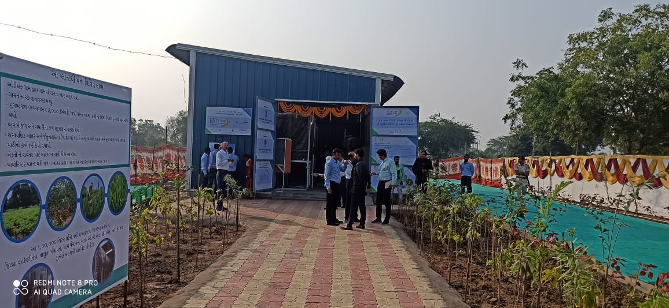
100KLD Chikhodara plant inaugrated by honorable CM of Gujarat Mr. Vijay Rupani

Slide 22
Biofilter Plant at Village Kukma
Recently 10 KLD plant was installed at Village Kukma in Bhuj, which is being run by local panchayat.
Please see the video clip at following link:
https://www.facebook.com/groups/kgksamajmember/permalink/4370375762989816/

Slide 23
For more Information please contact: shroffag@gmail.com mandar.prabhune@transpek.com
6/12/2021

