Slide 1
CASE STUDY GUJARAT – INDIA - EXPERIENCE NEW EXTENSION APPROACH A Door step approach to farmers
Presented by
DR. KIRIT N SHELAT, I.A.S. (Rtd)
National Council for Climate Change, Sustainable Development and Public Leadership (NCCSD)

Slide 2
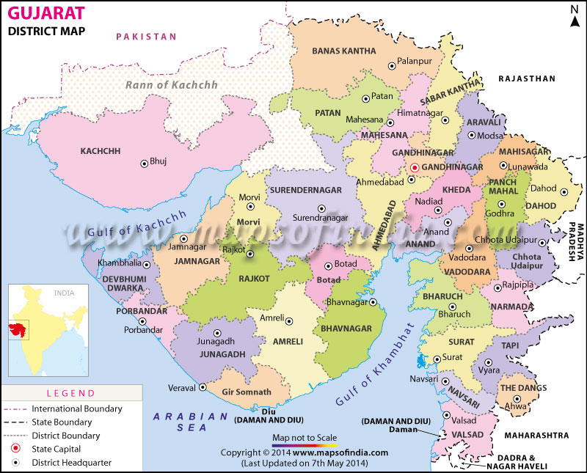
CASE STUDY GUJARAT – INDIA - EXPERIENCE NEW EXTENSION APPROACH A Door step approach to farmers

Slide 3
GUJARAT – INDIA - EXPERIENCE NEW EXTENSION APPROACH
REACH OUT TO FARMERS AT DOORSTEP : ‘KRISHI MAHOTSAV APPROACH’ –
THE GUJART EXPERIENCE OF SUSTAINABLE CLIMATE RESILIENT AGRICULTURAL DEVELOPMENT
Gujarat is situated on the western coast of India. Diverse in its topography, it has 1600 km coast line and is home to the largest desert in the country known as Rann of Kutch.
The state has had all possible handicaps faced by agriculture such as 70% of agriculture being rain-fed, recurrent droughts, untimely/irregular rainfall and some areas receiving rain only three to four days in a year.
Gujarat’s agriculture suffered heavily whenever there were droughts. The growth rate of agriculture used to be negative during such years. In a normal year, the agricultural growth rate used to be 1 to 3%.

Slide 4
NEW EXTENSION APPROACH
In the new millennium, Gujarat, with determination and persistent efforts, changed the agriculture scenario. From 2004 onwards, agriculture witnessed a major turnaround with a growth of 11% per year. This was an initiative in all 18,000 villages known as “Krishi Mahotsav” – the festival of Agriculture.
This was led from top by Chief Minister (Who is now the Prime Minister), Shri Narendra Modi. For action at bottom - the village level and at individual farmer level.
Entire model was developed based on the needs of farmers and to provide knowledge and technology to them at their door steps.
The speaker was responsible for developing policy and the detailed implementation framework and to develop module to monitor its implementation.

Slide 5
NEW EXTENSION APPROACH – 1
Farmers as centre point with services of
multiple departments
Farm Pond
Horticulture

Slide 6
NEW EXTENSION APPROACH
The key to this success was direct involvement of public leadership both elected and non-elected members of Public Governance System.
Effective soil and water management and proper land use
On the water front, more than 1,00,000 check dams got constructed compared to 6000 in the last decade with public private participation. It interlinked rivers such as the Mahi, Sabarmati and Narmada.
Scientific agriculture was introduced by distributing Soil Health Card to every farmer to make them informed choice in the selection of crops. Farmers now sowed crops that gave them higher return and were sustainable in the soil of their farms.
The poor farmers were focused for assistance. Every year 15 poor farmers of each village were assisted with quality.

Slide 7
NEW EXTENSION APPROACH - 2
FARMERS IN THE CENTRE

Slide 8
NEW EXTENSION APPROACH
A direct door-to-door extension programme for guiding the farmers at village level was introduced under a pre-Kharif (pre-monsoon) programme.
Every village was visited by a development team comprising of agri-scientists and officers from the veterinary department, co-operative, irrigation department, rural development department and local banks etc. High-yield crops were identified.
Bhaskaracharya Institute For Space Applications and Geo-Informatics prepared a micro-level plan for land use by identifying sites for check dams and village ponds for every village which were made available to each village.

Slide 9
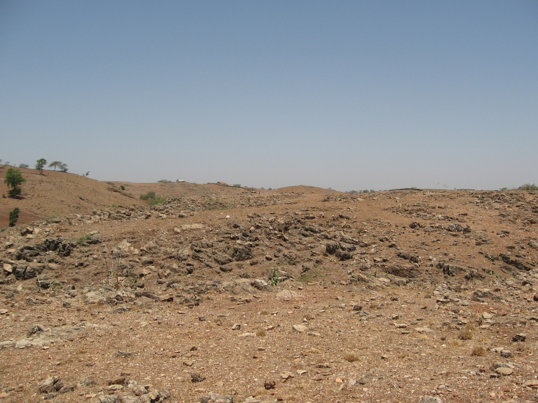
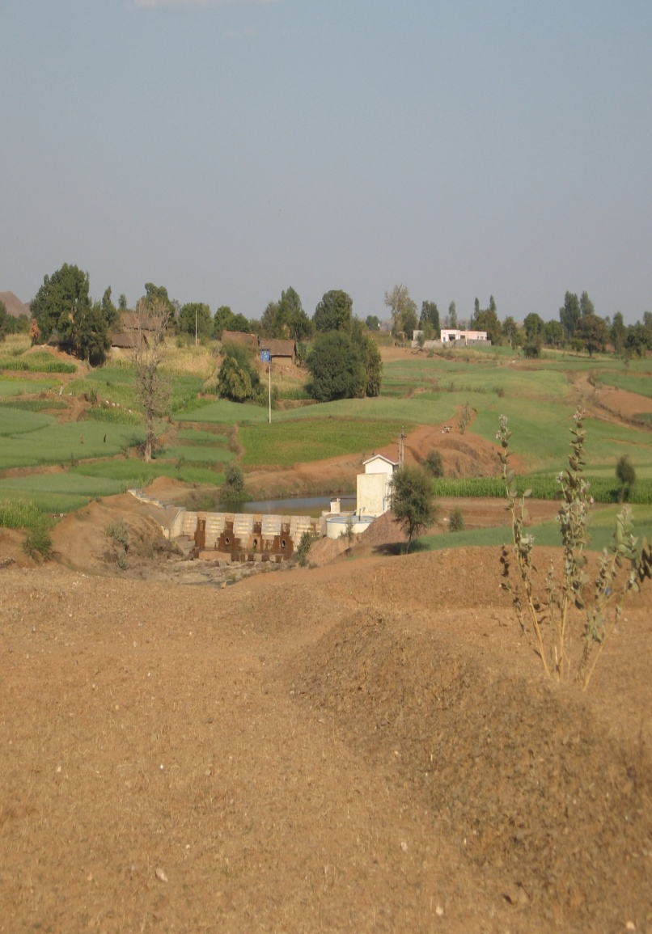
CASE STUDY : Transforming Dahod –
Dahod District – Gujarat – India
Before
After

Slide 10
Prior to 1974
poorest district in the state & country too Roughly 90 % people in tribal villages facing acute poverty Migration rate in non-irrigated villages between 50-70 % The irrigation coverage 10 % in records, in reality around 5 % Agriculture yields poorest in the state Milk production lowest in the state Literacy rate - lowest in the state – women literacy in one digit Landscape almost barren with hardly any tree cover Most forest land - without tree cover No horticulture activity No vegetable cultivation No floriculture
In 2010
Achieved food security Housing conditions improved School enrolment and attendance increased manifolds Ground water improved - CGWB Irrigation coverage is around 30 % 450 community water resources developed & managed by community 2,500 village institutions - users groups managing their affairs & assets 65 rivers and rivulets made perennial through series of structures migration rate 10-15 % six Crore trees planted with 50 % survival at long run About 25,000 farmers opted for horticulture

Slide 11
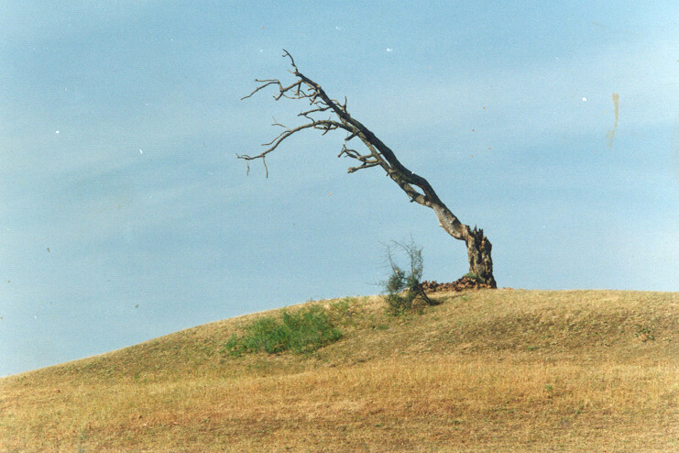
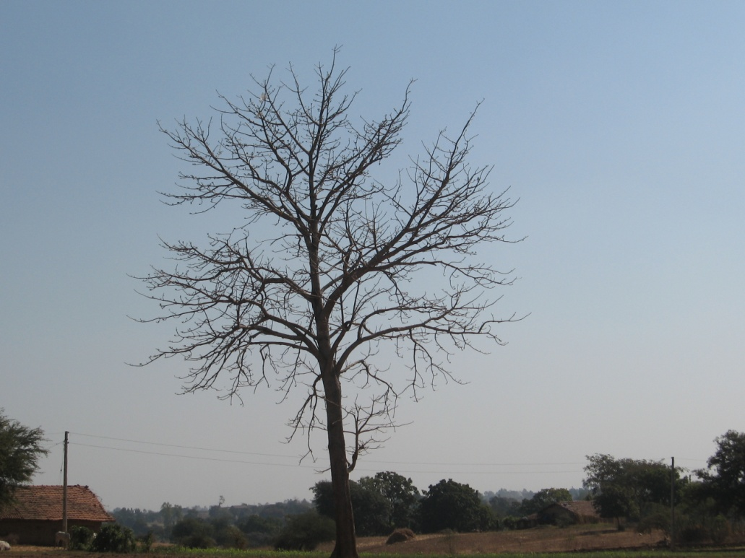
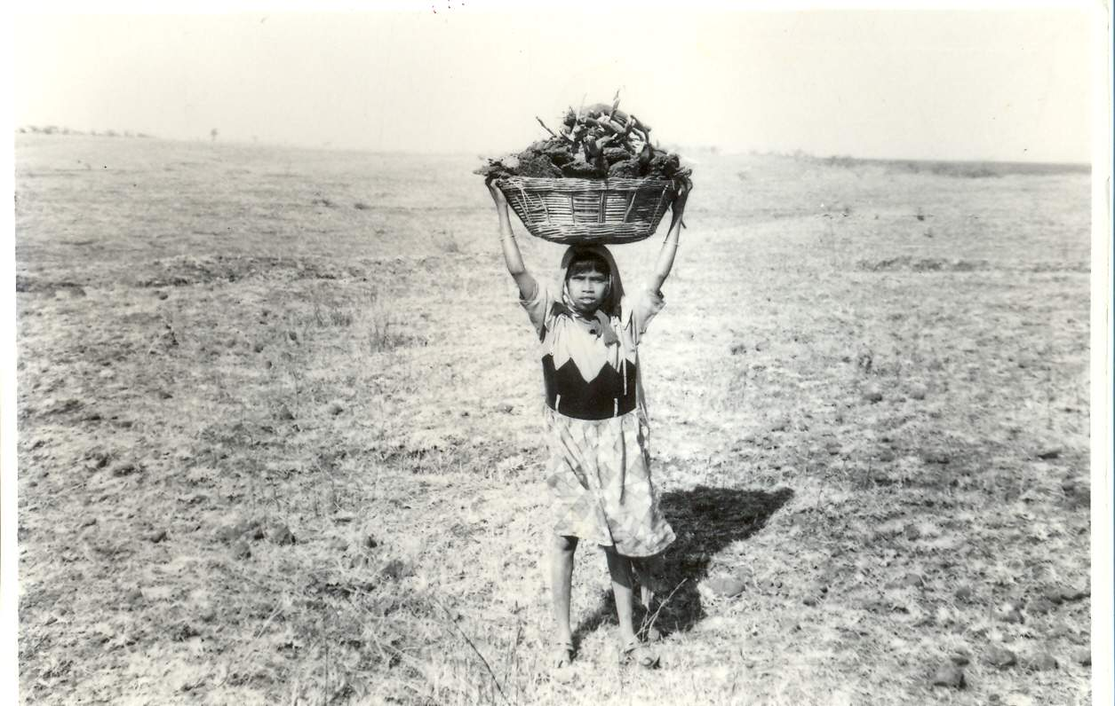
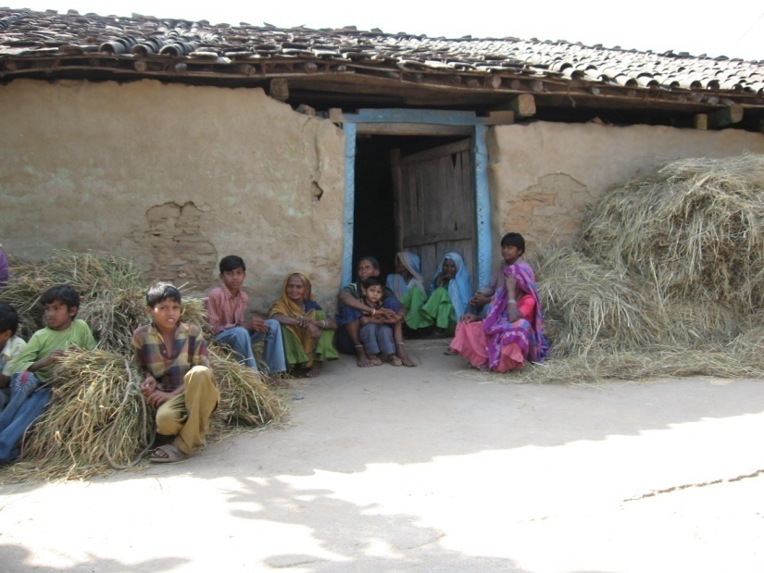

Slide 12
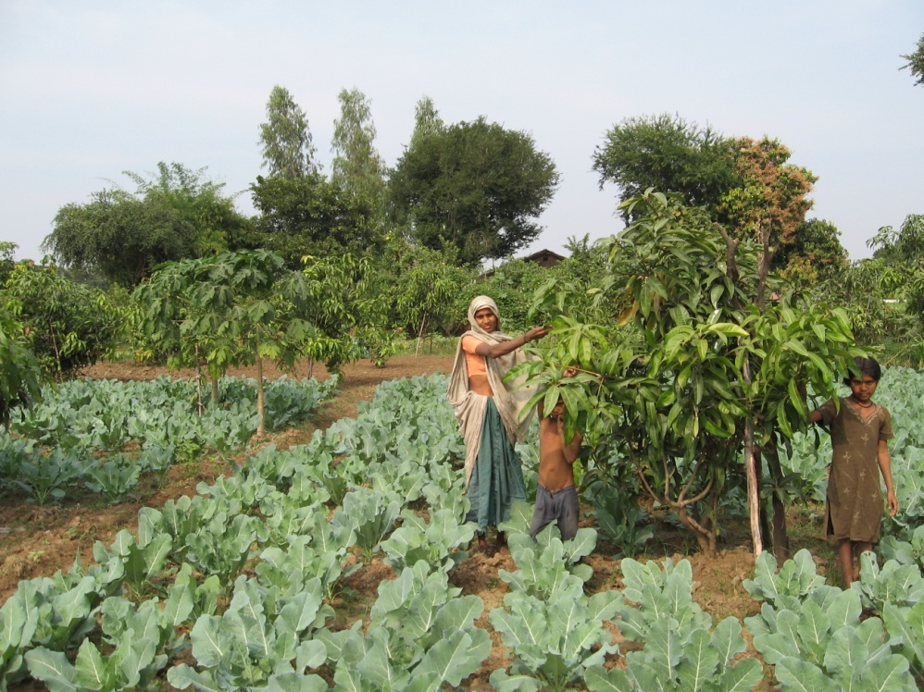
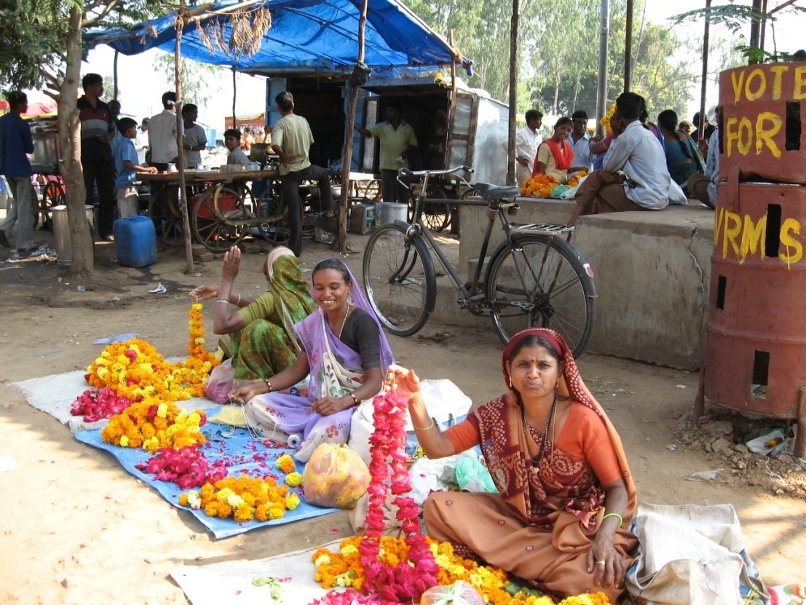
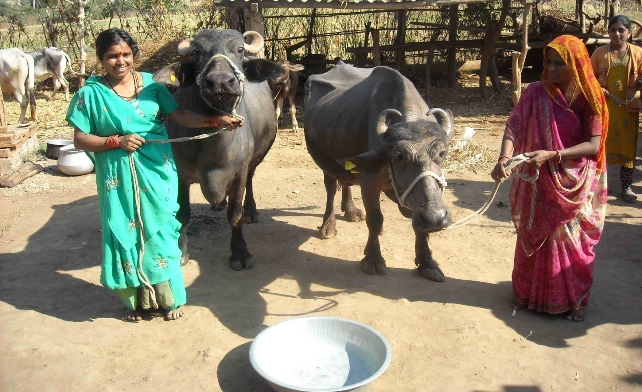
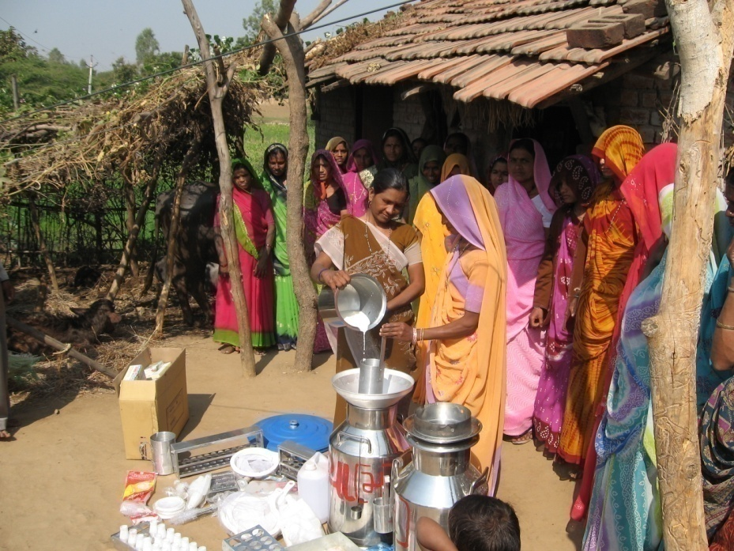

Slide 13
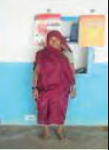
CASE STUDIES VILLAGE LEVEL
Vanbandhu Kalyan Yojana
Farmers Success Stories
Rathava Keriben Ganiyabhai
• Age: 55
• Occupation: Agriculture
• BPL No: VACHHJ00500140
• Contribution: Rs. 500/-
• Received inputs: Maiz-8 kg.- 2 bags, D.A.P-50 kg.-1 bag,
Urea-50 kg.- 1 bag, Pottash- 50 kg.- 1 bag
• Village: Judavant, Taluka: Chhota-Udepur, District: Baroda Says Smt. Keriben, We used hybrid seed of maize in all seasons & received double income. I was able to
grow 1.4 tons (14 Kwintal) of the maize from this kit.

Slide 14
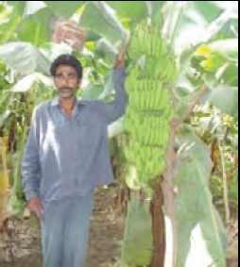
Rathava Motesinghbhai Bhanatabhai
• Age: 45
• Occupation: Agriculture
• BPL No: VAJETG0100066
• Beneficiary’s contribution: Rs. 2500/-
• Received inputs: Banana tissue-culture
plantlets -1370 Nos. of plants, D.A.P-200
kgs.-4 beg, Yuria-650 kgs.-13 begs, Pottash-
900 kgs.- 18 bag, Lansargold-500 grams,
Monocrotophos-500 ML, Saf-350 grams,
Aishwarya Gold-250 ML
• Village: Ghutanvad, Post: Ghutiya, Taluka: Pavi- Jetpur, District: Baroda Says Shri Motesinghbhai, I am able to earn Rs. 110000/- in a acre . Produce22 to 27 kg. of every bunches of bananas because of this kit.

Slide 15
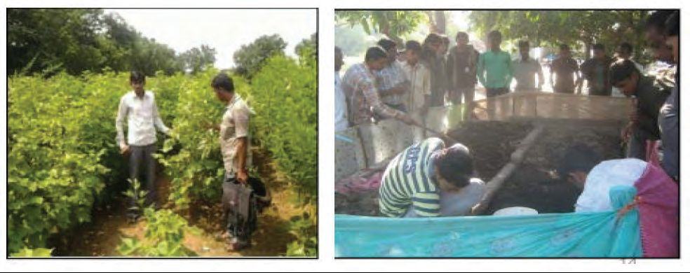
Use of Balanced Fertilizer based on Soil Health Analysis – the case
study of Jambusar, Bharuch, Gujarat
Maheshbhai Sindha, Piludra of Jambusar Taluka of Bharuch district owns three acres of land. He was using intensive chemical fertilizer and seeds with cheaper price. In his cotton , expenses were high and the yield was low. Based on Soil Health Analysis in 2012 , he started using certified seeds and balanced doze of fertilizer both organic and in organic-chemical. This reduced his cost in agricultural operations by Rs.2,800 and increased productivity in cotton by 4 quintal. He started using crop residue and cow dung along with worms to develop compost fertilizer. This increased productivity further by one quintal and simultaneously, he started selling worms to other farmers to make their compost. Within two years, his income increased to Rs.31,500/-.

Slide 16
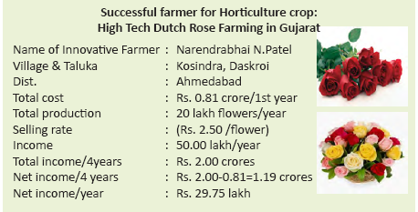

Slide 17
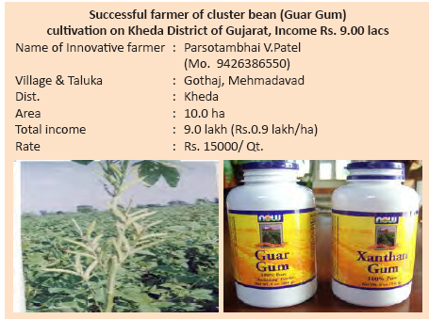

Slide 18
AGRO MICRO ENTERPRISE

Slide 19
Initiative Needed at International level for Local Problems Enhancing Food Security and Reduce of Poverty
National Council for Climate Change, Sustainable Development and Public Leadership
International Community need to:
Recognize agriculture as a major mitigation tool and adopt mechanism to address the loss and damage associated with the impacts of climate in highly vulnerable countries to restore agriculture and immediately prepare farmers for adaptation including mid-season. – Agro Advisory.
Allocate green fund for
- Technology transfer from “those who have it to those who need it”
- Bring new areas such as wasteland and wetland under agriculture for creating livelihood opportunities and to meet the challenges of food security.
Make available special financial support for community bio-gas plants, grassland development in desert areas.
Identify crops – plants species which survive on saline water soil and sea water.
Sensitize national governments to provide safety net to farmers in terms of insurance and fallback employment in community projects.
Set International Weather Advisory to support countries who do not have local advisory
Promote international trade for value added agriculture.

Slide 20
LEADERSHIP FOR GREENER AGRICULTURE
National Council for Climate Change, Sustainable Development and Public Leadership
Global Warming is a threat, but it can be converted into an opportunity. It is possible to make this happen a win-win situation for all, if all efforts are channeled towards sustainable development with Greener Agriculture at its centre.
Countries-Governments-all over the world will have to view the impact of climate on farmers with a grave concern. The change which is creeping in rapidly-with dangerous consequences to habitat and its stability. This confrontation is on “Nature’s Front”. Nuclear weapons or armies are no solution. The solution lies in bringing back balance in nature’s forces : the atmosphere, the sun, the earth, the water and the vegetation. The solution lies at local level. Our endeavor should be to overcome this challenge and convert it to an opportunity.

Slide 21
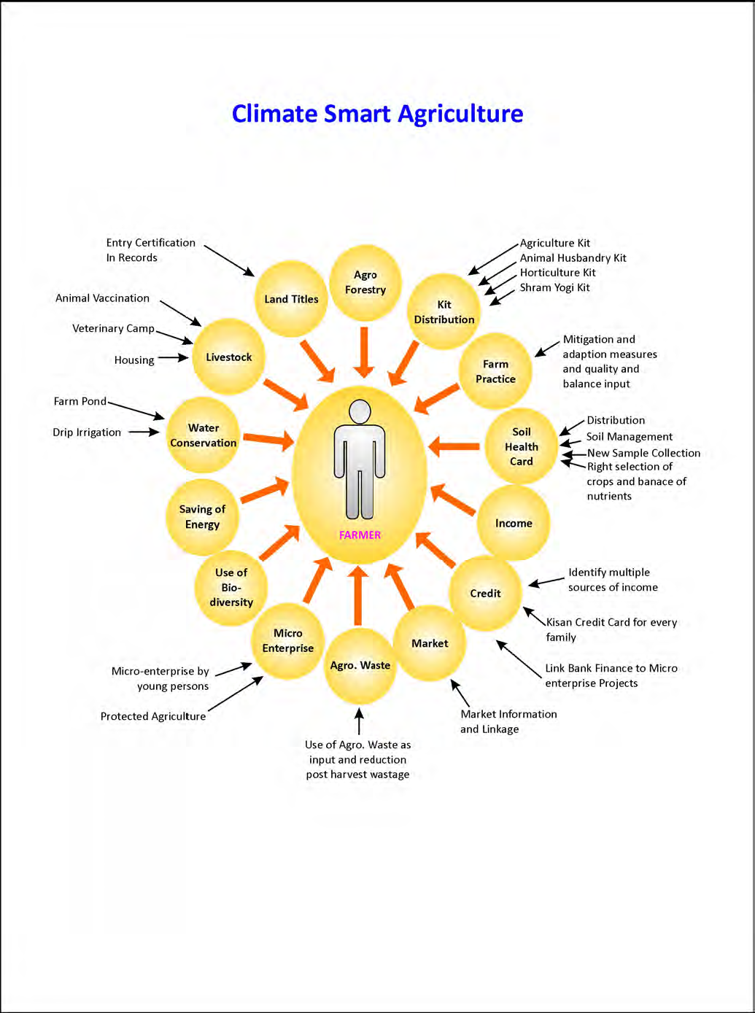

Slide 22
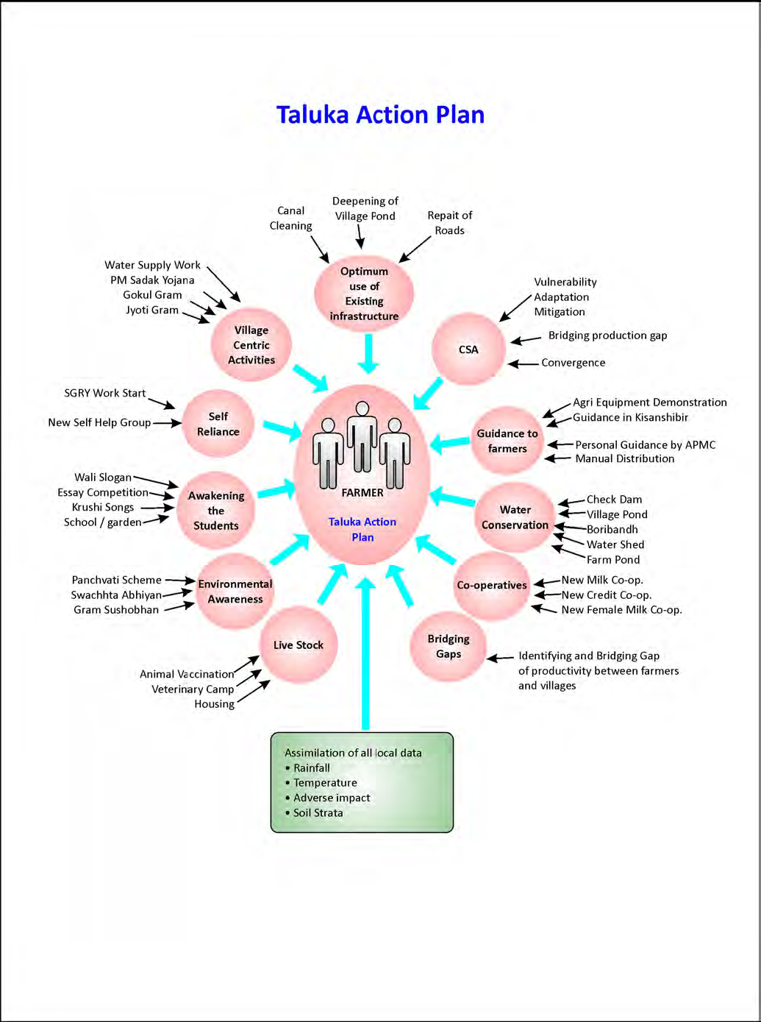

Slide 23
Let's Learn & Share Together for a global mission
Mainstreaming Agriculture for Climate Change Mitigation

Slide 24
Thank You for your patient hearing
Dr. Kirit Shelat
National Council for Climate Change, Sustainable Development
and Public Leadership (NCCSD)
Post Box No. 4146, Navrangpura Post Office, Ahmedabad – 380 009.
Gujarat, INDIA.
Phone: 079-26421580 (Off) 09904404393(M)
Email: drkiritshelat@gmail.com Website: www.nccsdindia.org

