Slide 1


Building Climate Smart FARMERS Successful practices ,India
Women Farmers
On 16th November 2016-Green Zone –Room :Salle 4
Women farmer
Presented by
DR. KIRIT N SHELAT, I.A.S. (Rtd)
National Council for Climate Change, Sustainable Development and Public Leadership (NCCSD)

Slide 2


Climate Resilient Agriculture
Indian Perspective
National Council for Climate Change, Sustainable Development and Public Leadership
What Climate Resilient Agriculture means:
It contributes to achievement of sustainable development goals
It integrates – social, economical and environmental development to meet challenge of providing (a) sustainable livelihood to farmers (b) food security to hungry millions, and ( c) eradication of poverty.
It aims that despite climate change, the income of farmers should not decrease. They should have enough to live and their income should gradually increase.
Notes:
2

Slide 3
Climate Resilient Agriculture
Indian Perspective
National Council for Climate Change, Sustainable Development and Public Leadership
What Climate Resilient Agriculture means:
It aims to use agriculture, it has capacity to absorb CO2 from atmosphere through photosynthesis process as a major nature's tool for mitigation and to expand it on un-cultivable wasteland, fallow land – margin areas of desert and sea shore by using modern technology. This supports livelihood to poor and provide food security to hungry millions.
Notes:
3

Slide 4
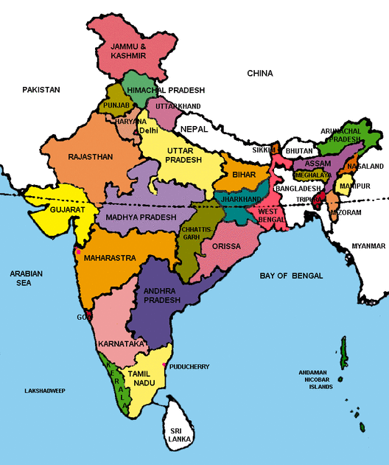
Indian Situation

Slide 5

Indian Situation
National Council for Climate Change, Sustainable Development and Public Leadership
India’s success over six decades:
  2 % to 3% sustainable agriculture growth
  Brought many out of poverty from 90% below poverty line to 20%.
  Tackled many adverse climate and geographic challenges including droughts.
  Validated research into rise in productivity
  Several states and individual farmers with productivity, higher than, or equal to international level
Adverse impacts of climate change pushes even successful farmers back to poverty
Farmers suicide / large scale exodus to urban centers
By 2030 India will need to produce additional 100 M. Tones for its growing population.
India had to import food in its early phase of development, but now it is self sufficient.

Slide 6
Small farmers stared at big losses the last monsoon season
National Council for Climate Change, Sustainable Development and Public Leadership
In the current year, 302 of 604 districts have experienced deficit rain conditions
This rainfall deficit to 10% for entire country. Last year (2014) had deficit of 12%.
Farmers are staring at poor crop with lack of soil moisture.
There is likely deficit in crops like wheat and pulses.
Stressed farm income have led to slump in rural wages which has further impact on rural demand.

Slide 7
Soil, Water & Climate Change
National Council for Climate Change, Sustainable Development and Public Leadership
    Soil Moisture content is affected
    Soil erosion, washing away of upper crust of fertile soil.
    Soil productivity
    reduced
    capacity to grow and sustain crop not certain with low yield or crop failures.
    Salinity ingress due to sea water rising
    Drying of existing water bodies – making irrigation a challenge.
Notes:
7

Slide 8
Effect of Climate Changes on Live stock
Na
National Council for Climate Change, Sustainable Development and Public Leadership
Milch cattle: milk yield has reduced in increased heat or cold wave condition.
Poultry: egg yield have gone down
Fisheries: fish catch goes away

Slide 9

Indian Situation
National Council for Climate Change, Sustainable Development and Public Leadership
  India has taken series of initiatives targeting meeting of challenges at local level by farmers with emphasis on strengthening their knowledge, capacity and provide them tools to make their agriculture Climate Resilient.
  The initiative include National Missions on:
  Food security
  Integrated development of Horticulture
  Sustainable Agriculture
  Soil Health Card
  Water Mission
  Integrated water harvesting, conservation and use of micro irrigation.

Slide 10
National Initiative for Climate Resilient Agriculture
(NICRA) – Indian Council of Agricultural Research
National Council for Climate Change, Sustainable Development and Public Leadership
It is a Comprehensive Research , Development & Extension Education Programme.
Contingency Plan for every Block - how to manage crops in wake up of unforeseen weather like delay in rain, floods etc.
Implemented throughout the country.

Slide 11
THE INITIATIVES
National Council for Climate Change, Sustainable Development and Public Leadership
Soil Health Card
Soil Health Card is a key to climate resilient crops.
It is a comprehensive new extension approach to provide individual farmer, a written guidance for management of soil and selection of crops which can be sustained by it. This in contrast to current system which provide farmers oral guidance. This is based on Soil Health Analysis of his land.
.

Slide 12
Multiple Source of Income
Farmers are encouraged to have multiple Source of Income. if one fails other helps to Survive-eg
Poultry/Cattle with crop
Rice-Fish
Agro Forestry
handicraft

Slide 13
Other Initiative include
National Council for Climate Change, Sustainable Development and Public Leadership
  Livestock Management - shelters and vaccinations and milk cooperative.
  Micro enterprise for rural youth based on local production, market and agro services needed.
  Special capacity building for woman farmers
  Use of Science & Technology, Bio-technology use of Tissue Culture
  Use of Information and Communication Technology (ICT) services to reach out farmers. Special KISAN (farmers) T. V. channel and special F.M. Radio broadcasting.
  Weather forecasting and Agro Advisory based on that for long term, medium term and short term by Indian Metrological Department up to Block level.
  New crop pattern - mixed crops, Perennial crops, agro forestry, organic farming.

Slide 14
Other Initiative include
National Council for Climate Change, Sustainable Development and Public Leadership
  Community Bio-gas plants with Vermi-compost . This mitigates GHG emission by cattle, provide clean fuel and organic fertilizer.
  Credit to farmers – opening of Bank account even without deposit - JAN DHAN scheme.
  Promotion of solar appliances for drying of crops, pumping of water and street light.
  Promotion of participative scheme for water harvesting, Check dams, Community ponds and farm ponds for every village.
  Promotion of Micro irrigation .
  Helpline for guidance on phone managed and replied by Agriculture experts.

Slide 15
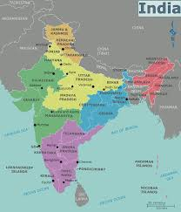
Women farmers
Indian Situation:
Women account for around 48% of the total population of the country.
Around 75% of total women normally live in rural areas. Increasingly majority of the total rural women work as cultivators.
They are also engaged in forestry, fisheries and other allied activities.
They work along with men to plough till the land prior to the monsoon.
Most of the women sow seeds and take care of plants / crops and postharvest work.
They are looking after entire Livestock Management.

Slide 16
There is pressure of multiple household activities- apart from working on farm and managing livestock:
Bringing water, fuel and food.
Cooking includes- cleaning, peeling, grinding- so and so forth.
Caring – Children and Elders, Children education, Health-care for all members.
Cleaning – utensils, house, courtyard, preparing bed, washing clothes and drying.
But they have less or no say in share of income earned by the family.
Go long way to fetch water- they walk-while men have By-cycle and Bike to fetch it- but do not do it.

Slide 17
Conti……..
They cannot manage their own time management or even leisure hours or for physical rest or pay attention their own health problem. They are made to run one task to another.
Farm tools and equipment are man centric- heavily with long hands- tractor seat is high. Even if women friendly designs are available- the accessibility is limited.
The Agriculture Extension Team pays attention to progressive Farmers and visits them.
In the Village Level Community Meets- the man dominates and decides against women- when issue relates to dispute between man and women.

Slide 18
Conti……..
There is Statutory reservation for 33% sits for all elected positions like that of Sarpanch(Elected head of vilage council),Taluka Panchayat and District Panchayat Chief.
There are now number of schemes- for free education and scholarship- including Skill building, special Capacity Building.
Development Departments; promotes Self-Help-Group of women to promote joint economic activities and subsidies their investment.

Slide 19
Further the position of Rural Women is in contrast to their urban counter parts where now there is transformation:
Working Women have their own Scooties.(Two wheeler)
In Kitchen they have electrical and mechanical tools-equipment starting from pressure cooker, micro-oven, pillers and crushers, grinder so on-so forth.
Increasingly they are a ahead of boys in studies and occupy key positions and becoming Independent in decision making within and outside family.
They have their own ATM card and Bank accounts.
But the Rural Women lag behind.

Slide 20
Following therefore need attention and action by Development Administration.
Making aware- Massive awareness campaign to convince them not to forgo their rights in ancestral property. Once they are land owner-automatically their status within the Family will shift.
Action Research by Agricultural Scientist: Make tools and equipments women friendly. There are some existing prototype even tools. They need to study
  Existing tools which are already available and friendly and detail about where they are available.
  Identify areas of gap to make other tools satiable to physical capacity of women and develop prototype and collaborate with private producers for its multiplicatim.

Slide 21
Take a look at women’s areas of knowledge
With existing support Schemes, what is their status say within house hold and in decision making on farm operations and cattle management.
To develop educational model to make man understand the new role of women and cooperate in her activities. In fact this is required to be introduced at school level.
To develop awareness about all their existing legal rights and about new schemes introduced by Government through mass communication to reach women at their door-step.
To identify Specific areas where they can play role in management of natural resources like use of domestic water and disposal of waste water , use of cow dung for organic bio-compost with food-waste and Agri- waste sel. Climate resilient practices like mix crop, Perennial crops, Selection original breeds in Livestock etc.

Slide 22
Linkages between gender, energy access and climate change actions within sustainable development
Women’s access to cleaner, more efficient energy sources and technologies for household use and productive activities is critical, since women bear a disproportionate share of the burdens of providing energy.
Women need training, financing and support for business activities—including designing, producing, marketing and managing new energy products and services.
Promoting improved environmental health through improvements in areas such as water, sanitation and hygiene services.
Women’s valuable experience, indigenous knowledge and ideas about climate change adaptation, mitigation, resilience and disaster risk management need to be incorporated by ensuring their decision-making and participation in climate change policies, mechanisms and funding.

Slide 23
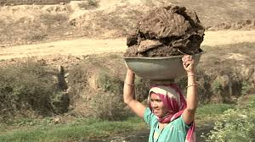
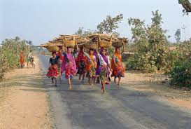
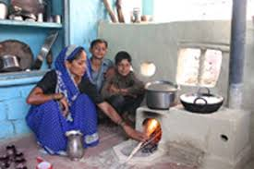
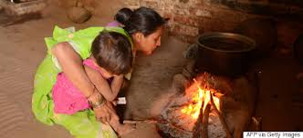
Access to improved Chulha, solar energy

Slide 24
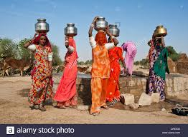
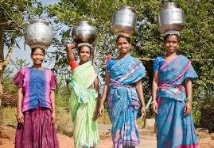
Safe Water
Access to safe water for household use, as well as for agriculture is an ongoing challenge for many poor communities in remote areas and particularly women.
In many areas, this challenge is getting exacerbated by climate change affecting both the availability and quality of water.
Establishment and improvement of water supply and sanitation systems to meet the demand is a priority.

Slide 25
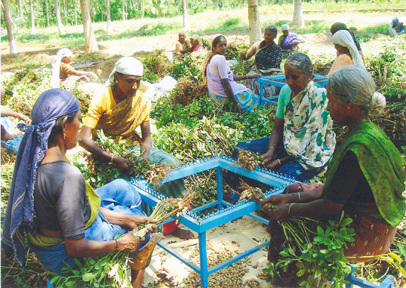
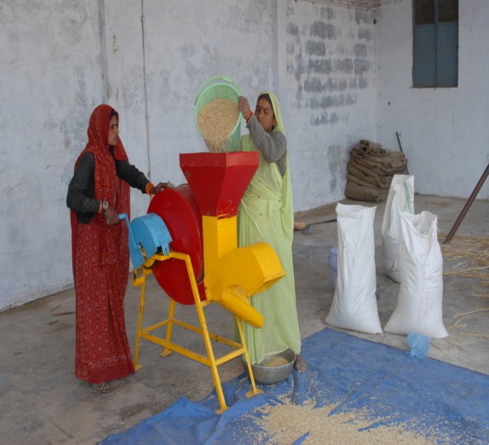
Women improved farm tools – Drudgery Reduction

Slide 26
Value added Communication Perspective
FOUR FACETS
1. Move ahead “From Gender mainstreaming to Gender Harmony”
2. Taking Technologies to women at grass root level
3. Create a Community of Practitioners of local stakeholders to advise need based adaptations
4. Help converge in women in agriculture

Slide 27
Conclusion
Already in India we are conscious about women status in both Social and economic fronts and its importance for Food Security and Family well-being therefore, they have been given statutory reservation in Elected Public Bodies. But still there are obvious gaps between what is envisaged and what exists in reality at village level. There is need to identify gaps in policies –programmes, and bridge them. There is need to identify barriers both social and economic, and even legal which come in way of their progress and overcome it. Further initiate existing elected and non elected women leaders from all walks of life to pay attention their counterparts in rural areas. Ensure that every woman gets her name in land records- in ‘Inheritance’ and their consent to withdraw to relinquish such rights is only before a Judicial Magistrate.
And finally- it must be mentioned that already change is taking - but it is at slow rate and this needs to be accelerated.

Slide 28
NCCSD
National Council for Climate Change, Sustainable Development & Public Leadership (NCCSD) is the outcome of the deliberations that took place during an International Conference on “Global Warming, Agriculture, Sustainable Development & Public Leadership” which was organized at the Gujarat Vidyapith – Ahmadabad in March
The NCCSD is registered under Bombay Charitable Trust Act 1950 Rule-29-No. E/19344/Ahmedabad as Public Trust on 17th September 2010.It is accredited to UN and UNFCCC and working in close co-operation and with support of ICAR, Planning commission, Vigyan prasar,MoEs ,State and central Government.

Slide 29

WHAT WE DO?
NCCSD is organizing Inter-action Meet and Think-Tank Meet for policy formulation and sensitization on issues related to farmers with their participation.
NCCSD is organizing Interactive and Capacity Building to Farmers with focus on local level leaders, young farmers and women farmers.
It is train to young faculty members and students on Leadership and Climate Smart Agriculture.
NCCSD is conducting action research work for developing communication modules including guidebook, posters and documentary films for farmers.
NCCSD is sensitizing State and Central Government on important policy issues which concern farmers. It is also taking up similar issues with UNFCCC and UN at international level
NCCSD is publishing books on important issues related to farmers and agriculture.

Slide 30
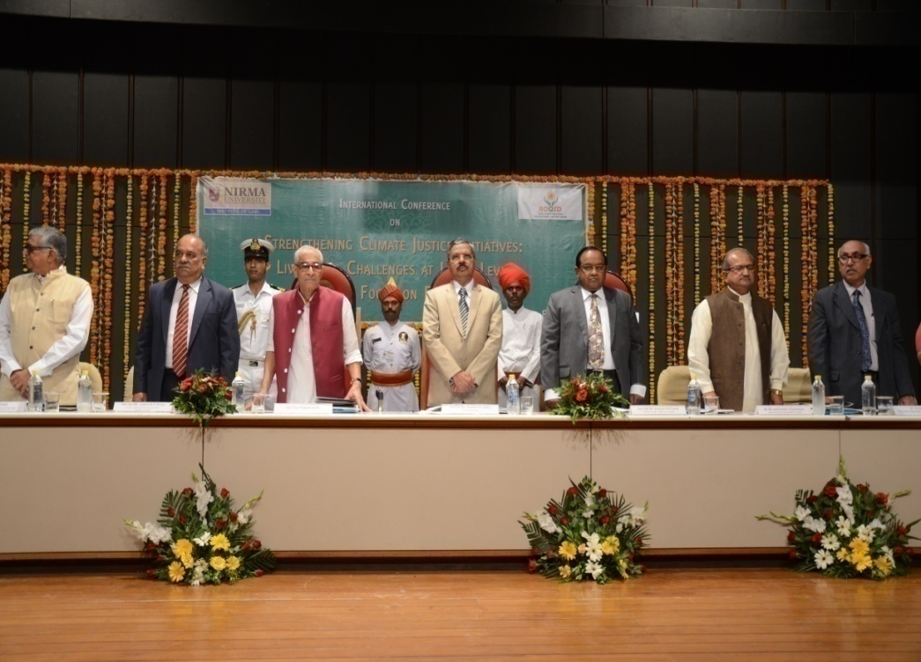
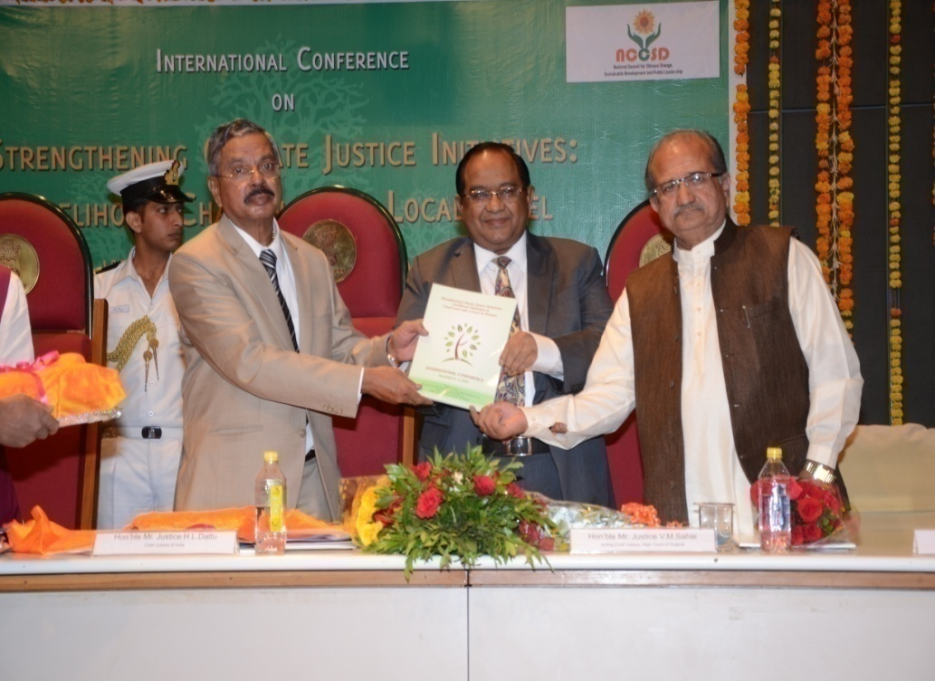
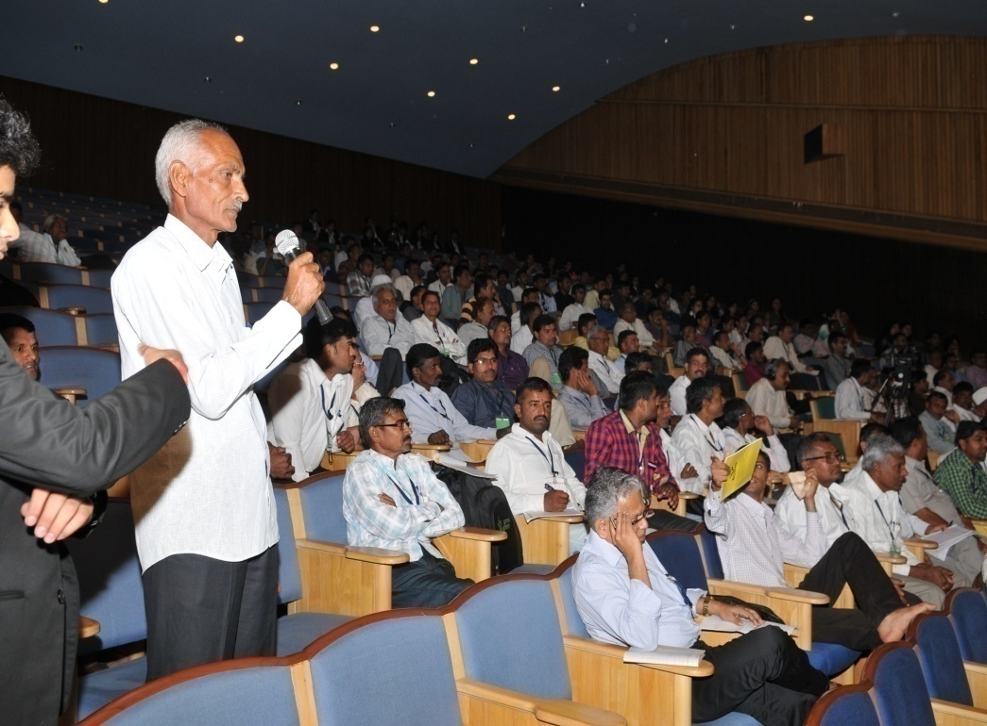
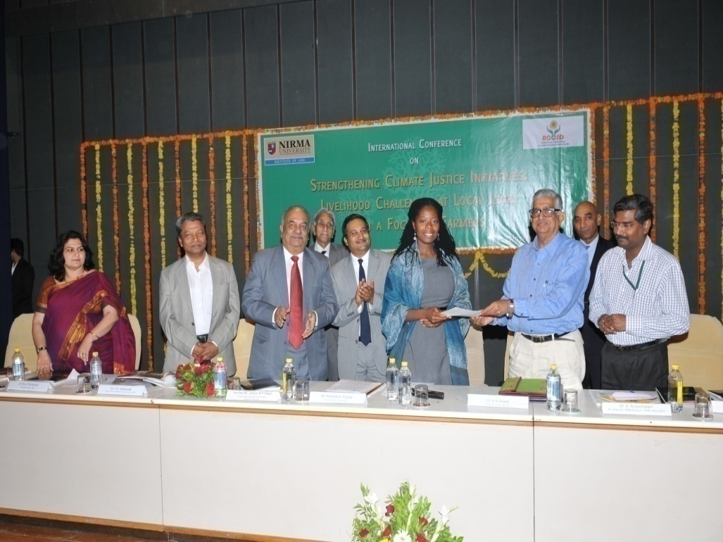

Slide 31
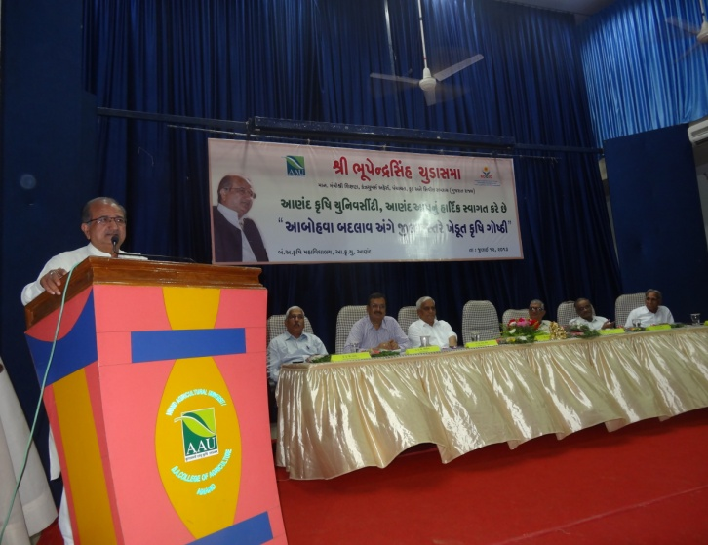
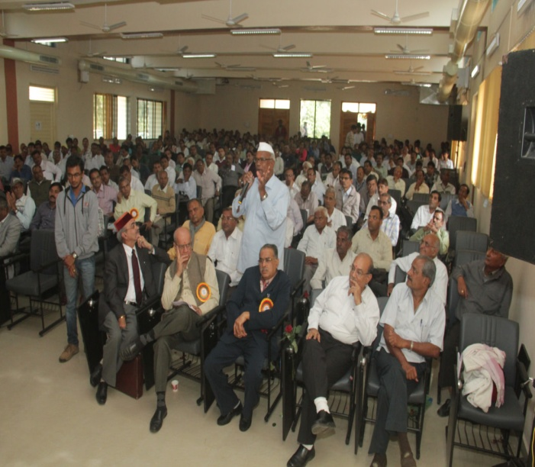
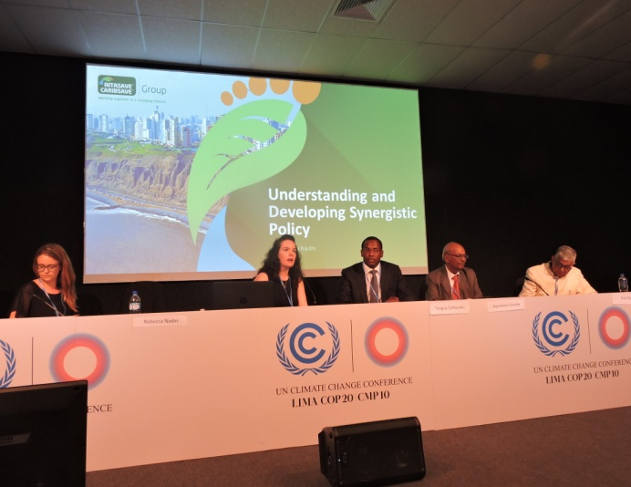
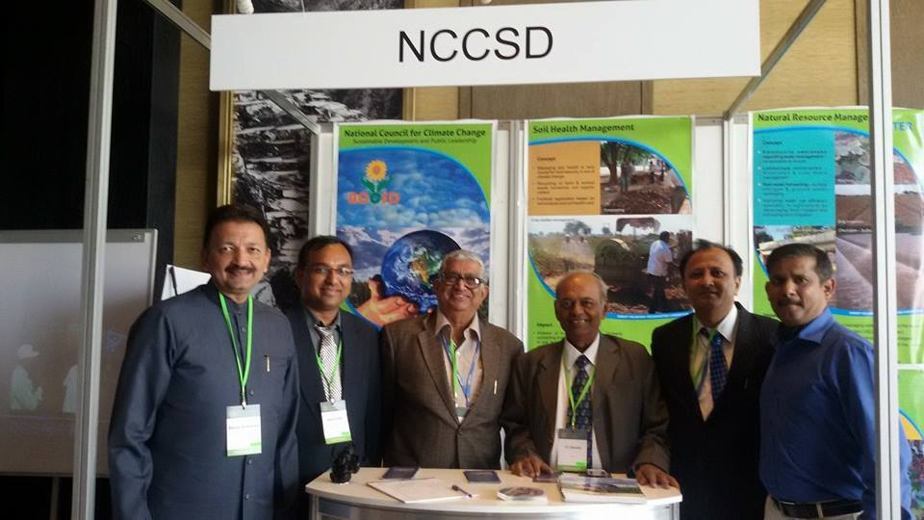

Slide 32
Accreditation
United Nations Framework Convention on Climate Change (UNFCCC)
Global Alliance on Climate Smart Agriculture GACSA
Green Climate Fund-GCF
Climate Technology Centre & Network (CTCN)
APN South Asia
Central Research Institute for Dry land Agriculture (ICAR)
NITI Aayog.-
The Department of Science & Technology (Vigyan Prasar)
The Department of Environment and Forests (Climate Change) for organizing District and State level awareness Workshops-Government of Gujarat

Slide 33

Let's Learn & Share Together for a global mission
Mainstreaming Agriculture for Climate Change Mitigation

Slide 34

Thank You for your patient hearing
Dr. Kirit Shelat
National Council for Climate Change, Sustainable Development
and Public Leadership (NCCSD)
Post Box No. 4146, Navrangpura Post Office, Ahmedabad – 380 009.
Gujarat, INDIA.
Phone: 079-26421580 (Off) 09904404393(M)
Email: drkiritshelat@gmail.com Website: www.nccsdindia.org

