Slide 1
ON-FARM RENEWABLE: HOW THE WORLD'S FARMERS CAN ADDRESS CLIMATE CHANGE AND SUPPORT FOOD SECURITY On 9th November 2016-Blue Zone –
Room :Pacific(150)
Presented by
DR. KIRIT N SHELAT, I.A.S. (Rtd)
National Council for Climate Change, Sustainable Development and Public Leadership (NCCSD)

Slide 2
Water, energy and food are inextricably linked.
Water is an input for producing agricultural goods in the fields and along the entire agro-food supply chain.
Energy is required to produce and distribute water and food to pump water from ground water or surface water sources, to power tractors and irrigation machinery, and to process and transport agricultural goods.

Slide 3
The demand for fresh water, energy and food will increase significantly over next decades under pressure of increased urbanization, growing middle income families, increased manufacturing activities, transportation, diversified diets, so on and so forth.
As per FAO estimates, this situation is expected to be exacerbated in near future as 60 percent more food will be needed for the growing world population.

Slide 4
The Global Energy Consumption is projected to grow up by 50% by 2035. Total Global water withdrawals for irrigation are projected to increase by 10 percent by 2050.
As demand grows, there is competition between different stakeholders particularly agriculture, the farmers and urbanities and within the village level for drinking purpose of families and livestock and for farming.

Slide 5
As a concerned citizen, we are aware of food, energy and water challenges, but address them in isolation, within sectoral boundaries.
At Local level, fragmented sectoral responsibilities, lack of coordination and inconsistencies exists.
The Public Leaders both: Elected and Non Elected members of Public Governance System. Need to understand the need for nexus between all three: that is Water, Energy and Food Production.
This is Crucial in the arena of the Climate Change which is already affecting each one of them severally and jointly and in turn affecting the Food Security.

Slide 6
The Complementarities and co-benefits from nexus-based adaptation are as under
Key Characteristic | Nexus approach | Climate change adaptation | Complementarities and co-benefits from nexus-based adaptation
Goal | Achieving water, energy, and food security objectives and sustaining resources through efficient use of available resources | Build resilience and enhance adaptive capacities against climate and other risks | Understanding adaptation to climate change is critical for addressing nexus challenges, and efficient use of resources is critical for effective adaptation
Core principles | Minimize resource waste and maximize economic efficiency, while accelerating the sustainable supply | Reduce vulnerability by managing climate risks and building response capacity | Since resource scarcity often increases people’s vulnerability, the nexus approach may contribute to facilitating adaptation and vice versa
Main focus | Provide integrated solutions at Implementable policy Frame work with solution at multiple stage. | Minimize shock, risks, and vulnerability and address impacts and risks associated with climate change | Understanding vulnerability to climate change is crucial for assessing nexus challenges; equally, integrated nexus solutions can contribute to reducing vulnerability and poverty

Slide 7
continuee
Key Characteristic | Nexus approach | Climate change adaptation | Complementarities and co-benefits from nexus-based adaptation
Broad strategies | Policy integration, Harmonization of existing schematic local level planning and implementing by involving public governance system with multi by and crust cutting stakeholders with community partnership harmonization, and governance to build synergies and generate co-benefits across sectors by engaging multiple stakeholders, public–private partnership | Addressing the drivers of vulnerability to climate change in specific sectors through building adaptive capacity and resilience | Addressing the drivers of vulnerability to climate change in specific sectors through building adaptive capacity and resilience
Source: Adapted from Golam Rasul & Bikash Sharma (2015)

Slide 8
Synergies between the climate change adaptation and nexus approaches
 | Sector-specific adaptation measures | Positive implication for the Sector | Potential for synergies across the nexus
Water | Increasing water use efficiency E.g. Switching to drip irrigating Switching from use freshwater to wastewater-recycle-water-for Farm-irrigating Switching from wet to dry cooling at thermoelectric power plants Desalinization New storage and conveyance of water to serve new demands Watershed and river basin management | Reduces water use per capita Reduces freshwater use per capita Reduces water use and associated thermal pollution Increase in brackish and freshwater supplies Increased water supplies to meet demand Increased water supplies to meet demand | Increased availability of water for energy and Agriculture Increased availability of freshwater for food, energy, and other uses Increased availability of water for energy and agriculture Increased availability of freshwater and overall water supply for energy, agriculture, and other uses Increased availability of freshwater and overall water supply for energy, agriculture, and other uses Increased water supply for energy and other uses, improved water quality, reduction in flood potential

Slide 9
Continue…
 | Sector-specific adaptation measures | Positive implication for the Sector | Potential for synergies across the nexus
Land | Switching to drought-tolerant crops and promote drought resistant original and breeds develop Sea-weed as a marketable product. Using waste or marginal land for grass land development to support Livestock development. | Increased/maintained cropyield in drought areas Increase in renewable energy | Reduced water demand Reduced pressure on non-renewable energy as some fossil fuels are replaced with biofuels
Energy | Increasing transmission capacity and reduce transmission losses Enhancing efficiency of existing renewable energy, like solar, wind, biogas, and bio energy at local level and replicating them on mass-scale. | Reduced economic and social impacts Increased clean energy and reduced pressure on energy | Potential for reduced emissions if new transmission and wind/solar power supplied to the grid Reduced GHG emissions, reduced water demand for cooling, thermal power
Source: adapted from Skaggs, Hibbard, Janetos, and Rice (2012).

Slide 10
Food Security:
Due to rapid increase of non-agriculture activities like urbanization, industrialization and infrastructure development, area under agriculture and food production is getting reduced. With increasing urban middle class population, demand for food, Dairy and Meat products is increasing. There will be huge gap between demand and supply position in years to come.

Slide 11
Water Scarcity:
Again due to enhanced urbanization and Industrial activity, even water meant for irrigation in Dams and Reservoirs– Lake are getting diverted to meet increased urbanities demand. Further big new Township are using huge pumps which draw out daily large quantity underground water which resource is becoming increasingly depleted.

Slide 12
Energy Scarcity:
Deficient supply of Electrical energy in rural areas –There is only 30% to 40% of energy demands of rural household is met-with. The Farmers get supply from 6 to 8 hours – but there are frequent break downs. Due to delay in rain-Speed or drought- Farmers demand for energy is increasing –Further efficient energy supply (24 hours) is needed for local Processing of Agro-produce. There are huge transportation –losses and theft in electrical Supply lines.

Slide 13
Impact of Climate Change:
The Climate change has increased water and energy related, already existing shocks, temperature is rising; monsoon is becoming more irregular with long dry spell and incidence of heavy rainfall in one day.
The Agriculture productivity is directly related with Soil Moisture and availability of timely water and same is true for livestock, the milk yield, the poultry yield goes down.
The world is already seeing this impact on decline of Food productivity and production and run for drinking water, both in urban and rural areas.

Slide 14
Some examples of other inefficiency in use of water resources are:
Majority of farm irrigation is flood irrigation. Water gets wasted in soil- areas where it is not needed. Whether it is from underground tube well or canal irrigation, water gets spread through entire farm. Drip irrigation exists – but to very limited areas.
The public irrigation system – Canals are all open subject to evaporation with increased temperature and long dry spells. Actually this reduces available water resources drastically.

Slide 15
We do not have yet standardized actual need – quantum of water needed for first, second or third irrigation for crop, plant or fruit tree or for that matter livestock (depending on its weight). In many a cases, excess water is given then needed. There is a need to calculate this and give farmers Agro advisory.
Another important factor is the entire canal irrigation water is almost free and energy charges for pumping water are heavily subsidized. Hence there is tendency to waste. The value of water as a scarce resource is unknown. Even in urban areas, there is no control in use of water – like having water meter.

Slide 16
Further there are recurrent floods now even in dry land areas. Historically, Uttarakhand, Uttar Pradesh, Assam and many other parts were affected by floods. This is resulting into a huge lose to both of human beings, property and erosion of infrastructure and soil Apart from affecting livelihood of people. It also results into lose of sweet water every year. While the areas of Saurastra, Kutch, North Gujarat and Vidarbha Maharashtra are most often affected by water scarcity. But due to Climate change even in these areas there are days of heavy rain in last few years causing instant flood. Management of flood is an important policy matter. But due to lack of care, even water is wasted due to many other reasons which become the cause of flood!

Slide 17
But due to lack of care, even water is wasted due to many others reasons which become the cause of Flood!
Silting in check dam/Dams
Silting in river valley
Silting in river bed
Growth of bushes and leakage in canal
In correct data about absorbing capacity of river
Data about sea-water-level not coordinated
Soil erosion in river basin area
Data about sedimentation – old
Flood level not marked
Encroachment on river- side.
In fact all these Cause Flooding which did not exist.

Slide 18
Wastage of food
While we are producing enough Food-today-but in recent past there has been decline of food production due to adverse climate condition. But on other head there is huge food wastage-at production stage and by consumers- When they are using it.
Farmers:
The Farmers with little more care, education and support can save 5% to 25% of his produce which is lost due to inefficient methods:
While harvesting.
Cleaning (thrashing on road side).
Packaging (in bags with holes).
Transporting-putting his produce with other item – like gasoline or kerosene or having his product at bottom and others piled up – resulting into spoilage.
Due to heat wave.
UN seasonal frost.
If proper inter-connected chain is developed-so that his produce is collected from farm to packaging station and then to market yard, these losses can easily saved and his income enhanced up to 25%.

Slide 19
Consumers:
There are several stages. Again improper storage and further transportation from market yard to whole-solar-to retailer due inefficient handling and improper packaging huge losses are taking place.
The concerned citizens also make waste-by peeling of vegetables more than needed, cooking more than needs of Family and throwing away. But huge wastage is in parties- dinners- and in restaurant – people take more in their plate then they can consume. For last one – a regulatory framework needed.

Slide 20
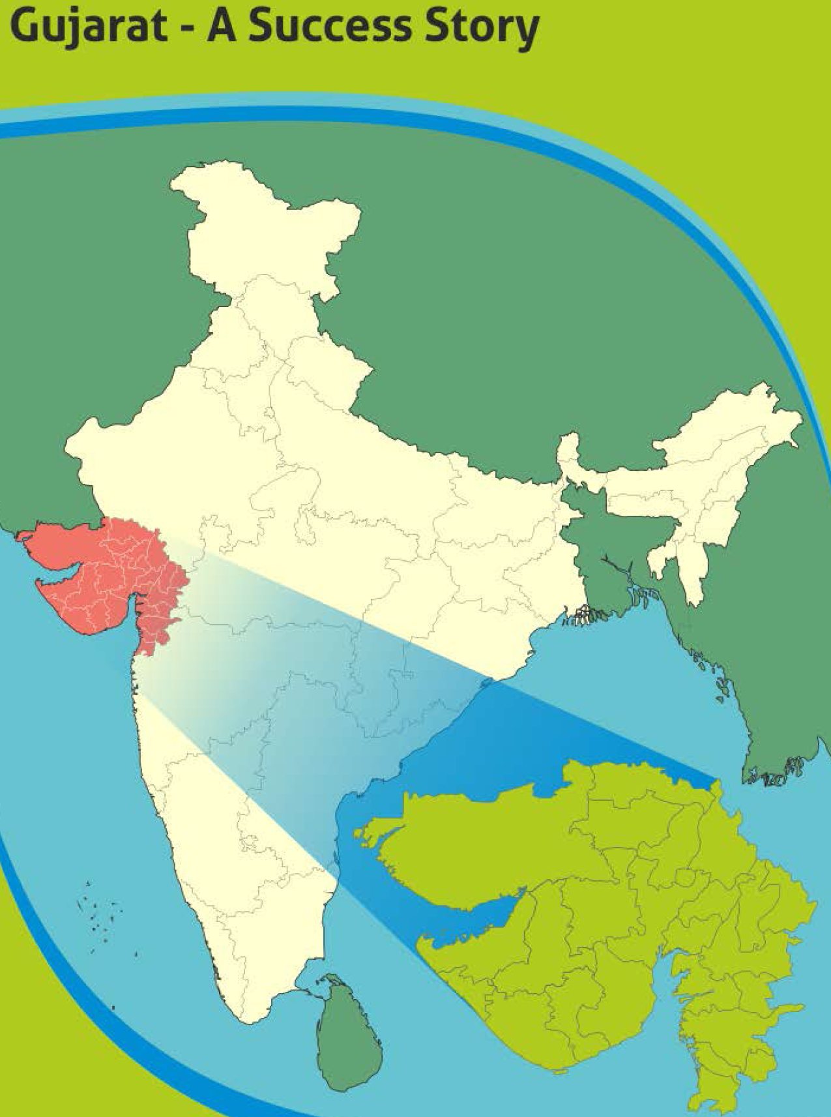
The Gujarat Approach India

Slide 21
Water conservation–dams-check–dams, watersheds, borri bandh, village ponds-Farm ponds.
Inter linking of river and canals – like Narmada canal with Sabarmati River.
The Sardar Sarovar Dam on Narmada river- which is linked by canals water for irrigation to water-starved districts and also providing water to urban areas and Narmada water pipeline is linked 11000 villages in water starved area to meet drinking water requirement of human beings and cattle.

Slide 22
Gujarat has adopted Participatory approach: The check – dams, water-sheds, minor-irrigation canals are under participating approach- right from construction to maintenance and management of its use by village community. More than 1, 00,000 check dams have been constructed under this approach.
Milro- Irrigation is propagated – Government has set up an independent organization for mass introduction of drip and sprinkler irrigation known as Gujarat Green revolution Co Ltd- which is providing subsidies for laying of drip irrigation and its maintenance for three year with insurance cover and guiding farmer for its use and maintains and monitors its implementation.
As a result of above approach while ground water level of many states have declined in recent years, the Gujarat is an exception.

Slide 23
Energy:
Gujarat Introduced took a bold approach to provide electricity to rural areas under Jyotir Gram Yojana.
It provided three phase power for 24 hours in rural areas. It introduced normal electricity terrif for residential area of village. It continued subsidized electricity to agriculture for eight hours. It crated two different greed- one for residential area and another agriculture area. Hence now its entire village has 24 hours electricity. This has encouraged local processing of agriculture products and improved quality of village life and that of students who can study at night also and has also reduced migration.

Slide 24
Solar Pumps:
This is an innovative project who can study can evening and night to use solar energy in Dhundi village of Anand district –by Setting up Dhundi Solar Pump Irrigation Cooperative.
Install solar pumps for pumping of water.
Use solar panels for producing electricity.
When pump is not used, panels are linked with local electrical greed and farmers are paid for electricity produced.

Slide 25
This provide permanent source of Income (case study at annexturs)
The most important point to keep in view that despite all above and a very strong Climate Resilient Agriculture developed under Krishi Mahotsav approach –in last two years-due to drought and adverse Climatic Condition which included heat wave , Frost , the food production in Gujarat had declined so has position of water in major dams which got dried up and many village were required to be provided drinking water by tankers .

Slide 26
Way Forward

Slide 27
With increasing adverse climate events and rapid urban development, new challenges are required to be addressed and ways focused to meet them.
Add value to water: Water is becoming very scares. It is the key requirement for Food Productivity hence how to make it as a commodity with value – price as of now both urbanities and farmers get it almost free.

Slide 28
Introduce compulsory water cycling in urban areas: How to control new Urban Township – they consume huge underground and canal water resources? How to introduce compulsory recycling of water both in Urban – Rural areas and make it available irrigation. Where this is not feasible, can we have compulsory “Recharge of water?”
Micro Irrigation: Make drip irrigation – a way of life in farming.

Slide 29
Can we decide to have ‘piped’ canals instead of current open system or replace it? Can we learn from Israel or from our own traditional water conservation system like that of “step well or tunnels”?
Safe Drinking Water: How to ensure safe drinking water even in years of drought.
Solar Energy: The pilot project at Anand Show the way. It was solar energy initially to pump water-but more to produce electricity which can be linked to local greed and farmers get paid first. The case Study is at annexative. This need to be replicated.

Slide 30
Use Biodiversity – Salinity Resistant/loving crops and trees: How to use bio-diversity, identify salinity resistance crops and propagate them.
Village level water plan: Can we introduce micro-level Water, Energy Agriculture production plan for every Village and Block.
Flood Prope Area Development Policy: Every year we lose water in very many parts of our country, due to Flooding of rivers now even Fields.

Slide 31
CONCLUSION

Slide 32
Climate change impacts the extent and productivity of both irrigated and rain fed agriculture. Rising temperatures will translate into increased crop water demand, so will be demand of increasing Urbanities. Both the livelihoods of rural communities and the food security of a predominantly urban population are therefore at risk from water-related impacts linked primarily to climate variability.
Increasing soil salinity is already affecting the root zone and hence productivity. Management of saline water ingress is the third dimension of impeding challenges.

Slide 33
The rural poor, who are the most vulnerable, are likely to be disproportionately affected, so will be their livelihood. Various adaptation measures that deal with climate variability and build upon improved land and water management practices conservation and its efficient use have the potential to create resilience to climate change and to enhance water security.
In order to meet the challenge of Food Security, first, there is a need to understand the need of efficient use of water and energy.

Slide 34
In addition to existing programmes, there is a need to educate and make responsible citizen including our Public Leaders about value that water energy and reduction of wastage of food will have in years to come – its likely scarcity and impact on livelihood and Food Security both of urban and rural population. And also importantly on social tranquil and tensions resulting into water riots!
It must be mentioned that some of above approaches like above do exist – but time has now come to identify ‘inefficiencies’, ‘Gaps’ new technology serious understanding of problem related food , water and energy quality due to Climate Change inter connection. That is way Nexus approach is reduced.

Slide 35
NCCSD
National Council for Climate Change, Sustainable Development & Public Leadership (NCCSD) is the outcome of the deliberations that took place during an International Conference on “Global Warming, Agriculture, Sustainable Development & Public Leadership” which was organized at the Gujarat Vidyapith – Ahmadabad in March
The NCCSD is registered under Bombay Charitable Trust Act 1950 Rule-29-No. E/19344/Ahmedabad as Public Trust on 17th September 2010.It is accredited to UN and UNFCCC and working in close co-operation and with support of ICAR, Planning commission, Vigyan prasar,MoEs ,State and central Government.

Slide 36
WHAT WE DO?
NCCSD is organizing Inter-action Meet and Think-Tank Meet for policy formulation and sensitization on issues related to farmers with their participation.
NCCSD is organizing Interactive and Capacity Building to Farmers with focus on local level leaders, young farmers and women farmers.
It is train to young faculty members and students on Leadership and Climate Smart Agriculture.
NCCSD is conducting action research work for developing communication modules including guidebook, posters and documentary films for farmers.
NCCSD is sensitizing State and Central Government on important policy issues which concern farmers. It is also taking up similar issues with UNFCCC and UN at international level
NCCSD is publishing books on important issues related to farmers and agriculture.

Slide 37
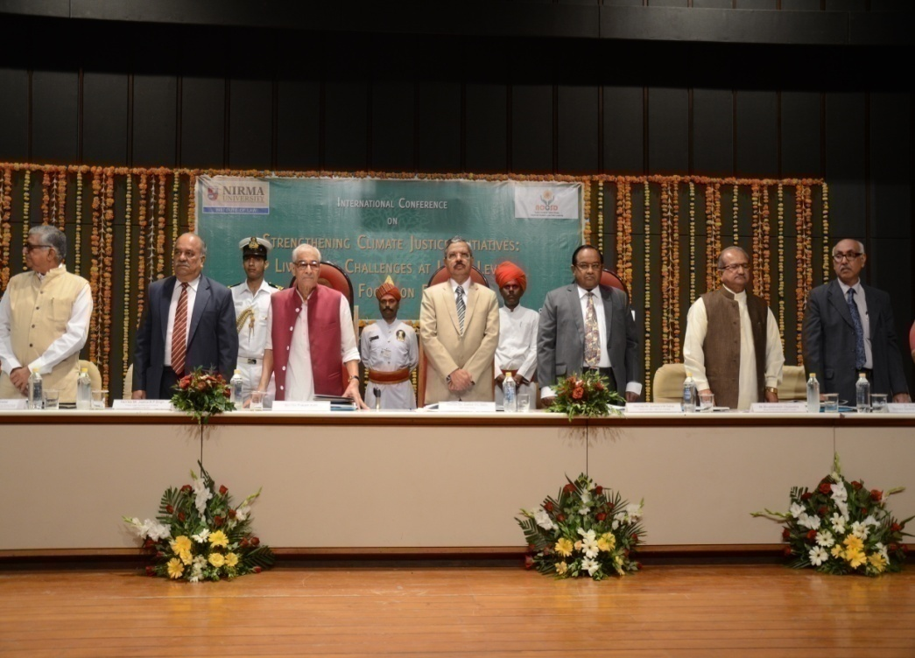
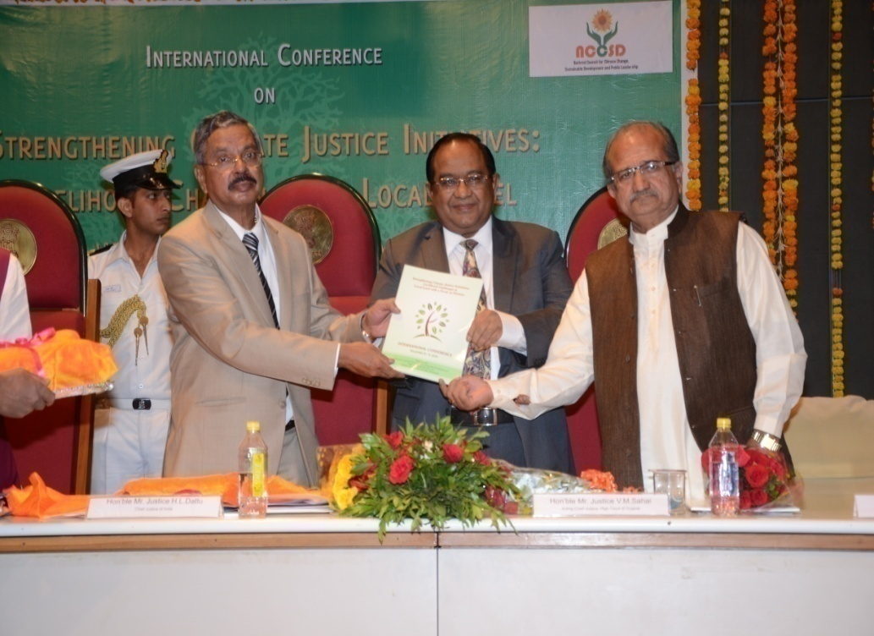
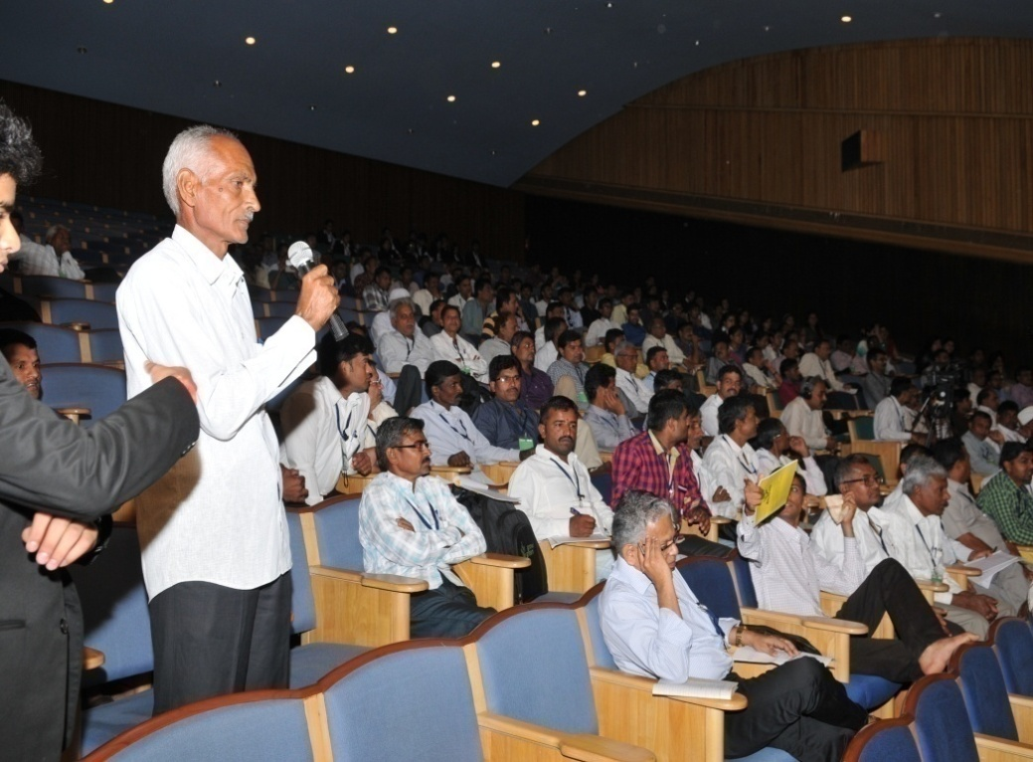
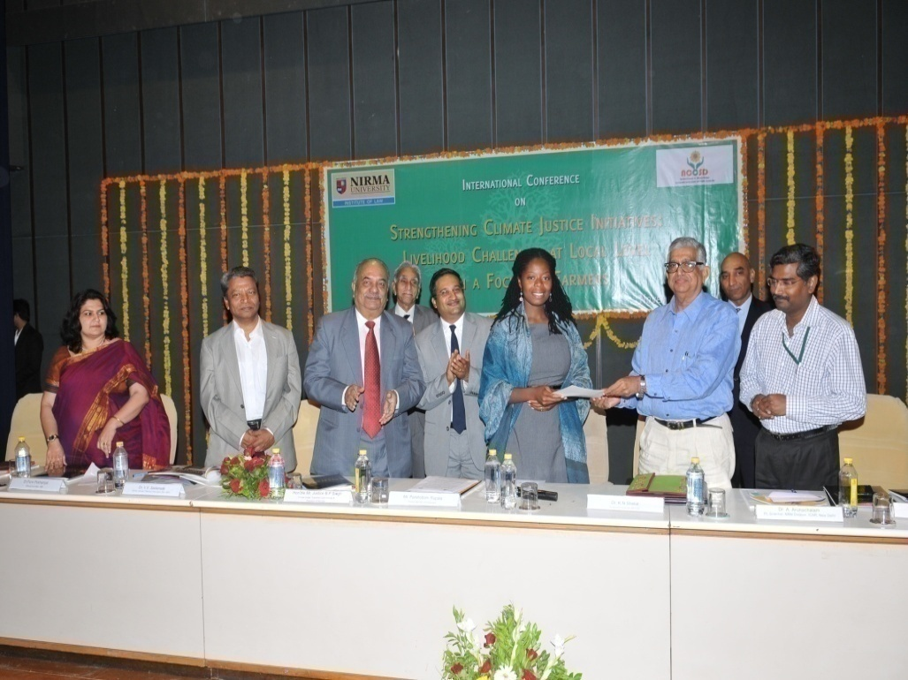

Slide 38
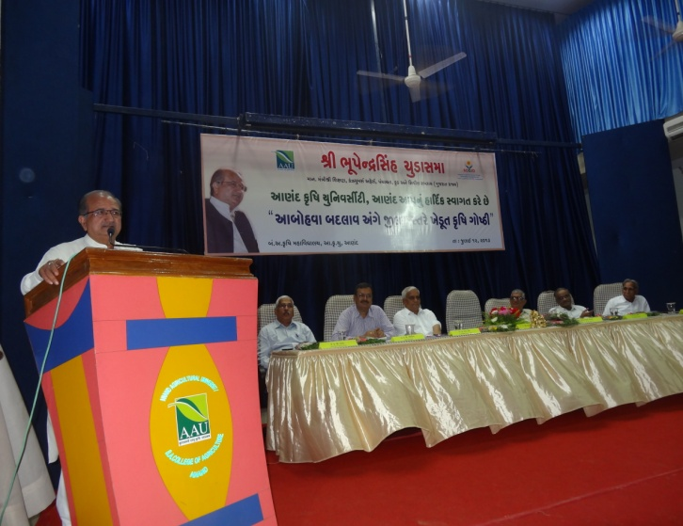
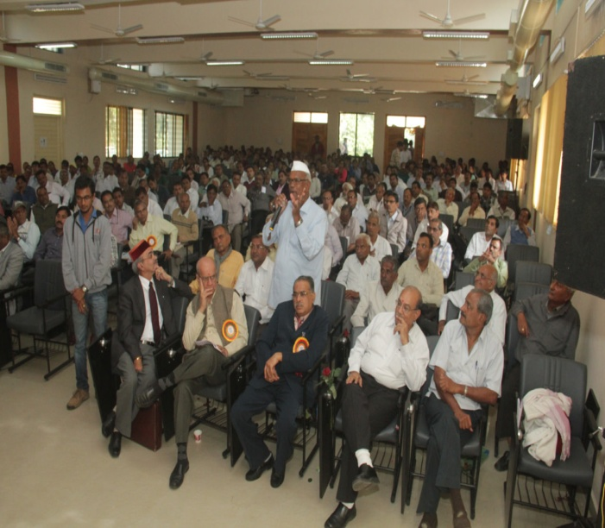
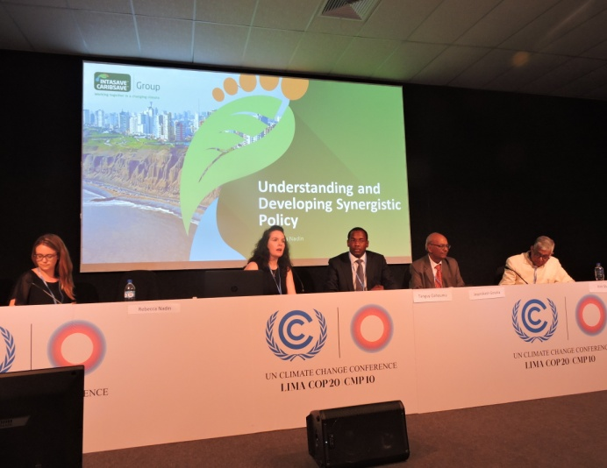
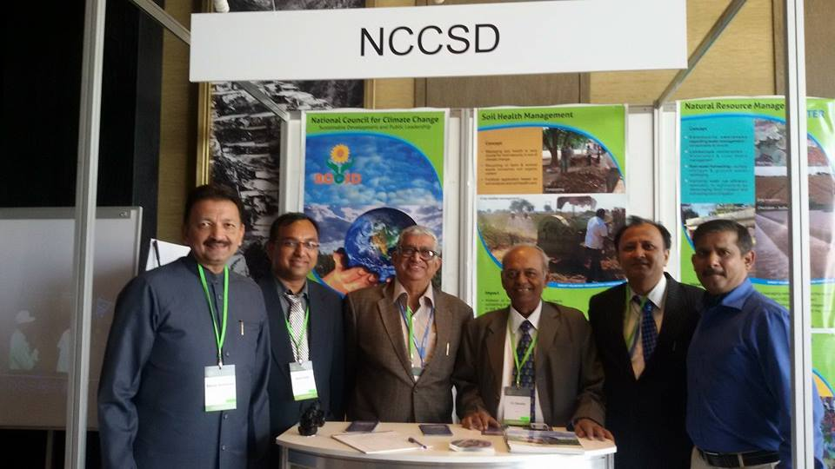

Slide 39
Accreditation
United Nations Framework Convention on Climate Change (UNFCCC)
Global Alliance on Climate Smart Agriculture GACSA
Green Climate Fund-GCF
Climate Technology Centre & Network (CTCN)
APN South Asia
Central Research Institute for Dry land Agriculture (ICAR)
NITI Aayog.-
The Department of Science & Technology (Vigyan Prasar)
The Department of Environment and Forests (Climate Change) for organizing District and State level awareness Workshops-Government of Gujarat

Slide 40
Let's Learn & Share Together for a global mission
Mainstreaming Agriculture for Climate Change Mitigation

Slide 41
Thank You for your patient hearing
DR. KIRIT N SHELAT, IAS (RTD) Executive Chairman National Council for Climate Change Sustainable Development and Public Leadership (NCCSD) Patel Block, Rajdeep Electronic's Compound, Near Stadium Six Road, Navrangpura, Ahmedabad-380 0014 Phone/Fax: (00 91 79) 26421580 Mobile: 091 9904404393 Email: drkiritshelat@gmail.com, Website: www.nccsdindia.org

