Slide 1
Circular Economy Sustainable Development: Nature’s Forces:- The Role of Farmers and Ranchers in Concurrently Delivering Climate Change, Agro ecosystems Services and Food & Nutrition Security
Side Event for FAO COP 27 Pavilion
By
Dr. Kirit Shelat, I.A.S. (Retd)
Executive Chairman
National Council for Climate Change, Sustainable Development
and Public Leadership (NCCSD)-Ahmedabad

Slide 2
Inter-dependent Forces
Appropriate use of these forces of nature generate basic resources for livelihood and sustains the habitat and promote sustainable development.
Improper use and reckless exploitation of these resources has disturbed the balance of nature and affected sustainable development. For example, overdrawing of underground water leads to salinity ingress and advancement of desert while excessive use of fossil fuel leads to excess of gases in the atmosphere that disturb heat balances. Inequitable use of resources leads to social turmoil and political instability.
The sustainable development is centered on nature’s principles. Nature has five important forces –Sky (atmosphere), Sun, Earth, Water and Vegetation. These forces are inter-dependent and maintain equilibrium in nature. These cyclic and circular - forces are responsible for different seasons round the year - including weather cycles and climate.

Slide 3
How Nature Operates its System
Photosynthesis is a process by which green plants use sunlight to make their food. They use sunlight along with carbon dioxide and water to create simple sugar or glucose. Plants absorb CO2 from the atmosphere and release oxygen.
They use these to build leaves, flowers and fruits and seeds to convert glucose into cellulose - the structural material in their cell walls. Most plants produce more glucose than they can use. Hence, they store it in the form of starch and other carbohydrates in roots, stem and leaves. Nutrients are also transferred by plants into the soil, which increases its fertility. This is a part of the process of carbon assimilation by plants.
The ancient by-products of photosynthesis are fossil fuels such as natural gas, coal and petroleum essential for the energy needs of human.
Humans and other animals too depend on glucose as an energy sources, but they are not capable of producing it on their own. They are dependent on plants for glucose.
Thus, virtually all life on earth, directly or indirectly, depends on photosynthesis - the process of interaction between the five forces of nature.
Currently the excess use of fossil fuel and reduction in vegetative cover which used to absorb Co2 has nature’s balance or equilibrium of its forces is disturbed and the weather cycle is adversely affected, resulting in climate change. Hence what is needed is to restore this balance by reduction of use of fossil fuels and increased in vegetative to bring back equilibrium – which is both cyclic and circular.

Slide 4
Strategy
Objective is to Restore Equilibrium.
Action Points:
Reduce GHG emission
Increase vegetation
Increase use of Renewable Energy Sources
Already this is under progress – but while emphasis is on GHG reduction – Agriculture Vegetation is not prioritized. The need is to prioritize agriculture and farmers. But in reality they are discriminated – eg:
An industry gets Carbon Credit for planting trees. But farmers who plan Horticulture trees, Agro Forestry – do not get it.
Carbon emission by industry is what they discharge as GHG but Industry or that matter any non-agricultural activity – removes vegetation and that stops absorption of Co2 from atmosphere – but this not debited on account of industry and added their share of GHG.
Agriculture – vegetation has its share in GHG emission – but while calculating that share deduction is not given to carbon sequestration by agriculture – vegetation – Co2 it stores in soil, stem, leaves and seeds or fruits.
Hence to promote Co2 absorption agriculture has to be given fair and equitable treatment.
We now share some of illustration circular economy practices adapted in India.

Slide 5
Some of illustration:- Circular economy practices adapted in India.

Slide 6
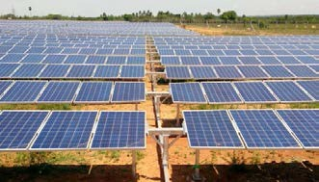
CASE-1 Solar
Village:-Dhundhi
District Anand,
State Gujarat. India
-Pumping Water
-In Shadow area grow vegetables
Excess-sell to Electricity company- Permanent source of income

Slide 7
CASE STUDY-2-“Zero Waste Village” by Solid and Liquid Waste Management” Genesis:
Khanderaopura village (Padra block of Vadodara District, Gujarat)is a village having population of 1500 having 185 households.
In 2016 this village had anoutbreak of Cholera and it earned a bad name.It remained focus of media for a long period. Shroff Foundation Trust was requested to look in to the problems of sanitation & hygiene of this village.
Thus, it was decided by the village community that this village would need to be qualified for ODF and the drainage line would be repaired to make it functional.

Slide 8
CASE STUDY-3 -Use of Technology –City Sewage Treated and Recycled for Agriculture
Jalna is a city located in Marathwada and receives very less rainfall and is drought prone area. Having population of around 3.0 lakhs, availability of domestic sewage is sufficient including in summers. Farmers of Jalna here facing shortage of water for agriculture and therefore it was decided to treat the city sewage (from nearby nallah) through Bioflter Technology and reuse for agriculture. Since then the farmer are able to take 3-4 crops per year and their problem of water shortage was completely resolved.

Slide 9
Contd….

Slide 10
Introduction to Rural Liquid Waste Management
The Jal Jivan Mission (2019) provide for minimum 55 litres per capita per day (LPCD) supply of water through tap. Half of the States are providing 70 litres or 100 litres LPCD. Considering 65% of it is generated as waste, the grey water (including blackwater) would be in the range of 40 to 60 LPCD.
Thus, 1000 population would generate an average 50 KLD (taking in to account for next 5 years).
Treatment of wastewater is a big challenge. The big central treatment plants have proved to be ineffective because of the high cost of operation, increasing load of pollutants, inadequate technology, and very high capital costs.
Bio-filters technology qualifies to be a decentralised effective, efficient, cost-effective system for addressing the issues flagged above.
The treated water has added nutrients worth (Rs. 1.60 per thousand litres) and is acceptable for Agriculture, land scape as per CPCB norms of 2017. The nutrient rich water can fetch Rs.2.00 per thousand litres.
The treated water supply supplements dwindled water supply in summer to support summer crops.

Slide 11
Contd….
The indirect benefit is also equivalent saving of extraction / distribution expenditure of Agriculture Water (Rs.5/- to Rs. 10/- per thousand litres depending on source and distance of transport).
Ultimately, Waste Water Treatment is crucial for reducing pollution load in ground water and streams & rivers.
Bio-Filter technology also obviate the generation of sludge and hence its management, it also can handle black water (septic tanks).

Slide 12
CASE-4 Village Level Hydro Power-Maharashtra

Slide 13
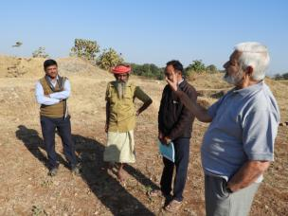
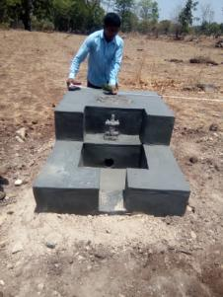
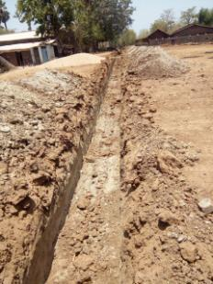
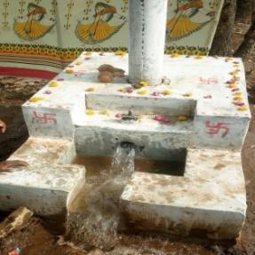
CASE-5 ,Creation of Irrigation Facilities Based on Development of Water Reservoirs In closed Dolomite Mines
Baseline income per acre- Rs. 21000/- Post Project Rs.72000/- per acre
35.94 hac of land, benefitting 54 tribal farmer families – 35.60 hac of land under Rabi Season (100% assured irrigation)
B. Objectives
To demonstrate use of unused mine area for developing irrigation scheme in Chhotaudepur block
To increase irrigation potential in and around villages having dead dolomite mines.
Organize tribal farmers under co-operative structure for using common resource.
Bring private wasteland under agriculture and irrigation.
Operation of scheme based on co-operative irrigation system.
Target population & Geographical Outreach- One Village- Zer in Chhotaudepur block- 54 Farmers
Complete project period (Total period 18 Months and Completed period- 6 Months)

Slide 14
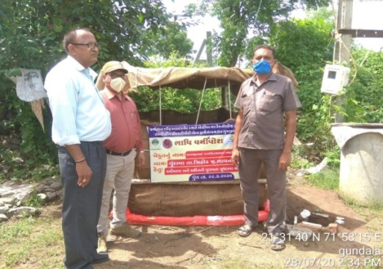
CASE-6 Vermiwash

Slide 15
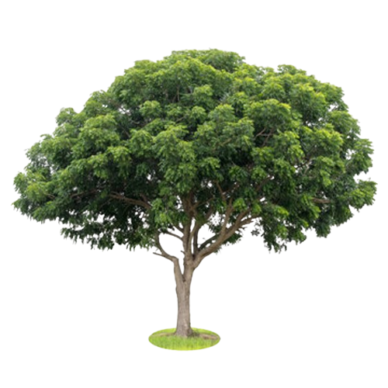
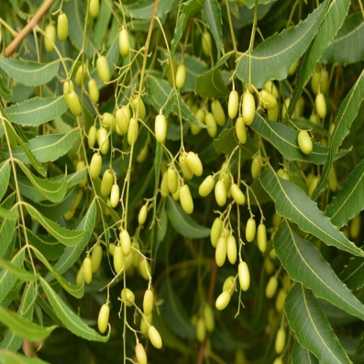
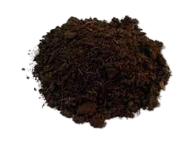
CASE-7 Azadirachta indica (Neem): A Multiutilities Tree
Azadirachta indica, commonly known as neem has cultural significance in India
It grows exuberantly in drought-prone areas giving cool shade and therby is a good anti-desertification tool with good carbon dioxide sink to sequester around 1.45 lakh tons carbon/tree with a girth of around 15-30cm. .
It is also used for maintaining soil fertility. Fertilizer: neem extract is added to fertilizers (urea) as a nitrification inhibitor. Neem leaves can be occasionally used as forage for ruminants and rabbits.
Neem cake is dense with several micro and macronutrients. Unlike a chemical fertilizer, Neem cake releases those nutrients gradually into the soil with plants having adequate time to use them as nutrition.
Being natural, it is compatible with soil microbes and rhizosphere microflora. It acts as a nitrification inhibitor, and slows down the conversion process of nitrogenous compounds in ammonia, nitrates, and nitrites.
It is bio-degradable and can be used with many other different types of fertilizers.,
Oil Cake

Slide 16
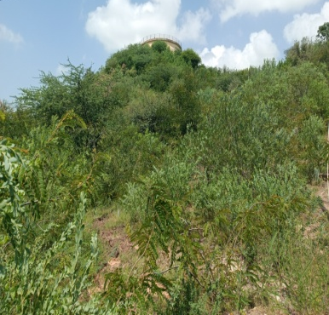
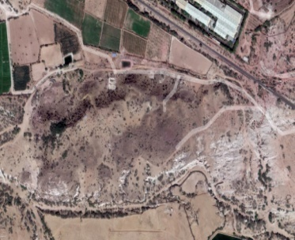
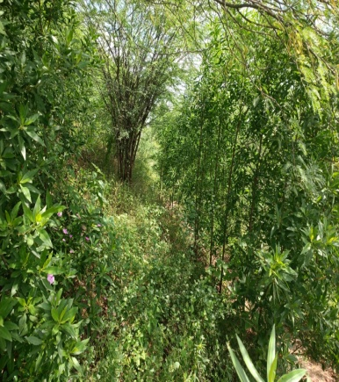
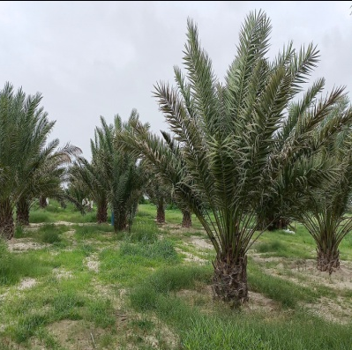
CASE-8 Greening The Earth ,Hill 1-18,000and HILL -2 35000
In Kutch the area where Rann of kutch located in state of Gujarat and salt is produced. AGROCEL is involved in salt production and bromine.
Experiments growing of plants in molded areas within salt extraction areas, with proper rain water harvesting and soil management .
Hill 1 started in 2017, with the belief that water from Panchayat would become available for raising saplings. Alas! it did not and the stray cattle were the biggest nuisance. As if this was not enough, the land was eroded to last grain of the soil such that it has exposed even the bed Rocks. The odds did not dampen the resolve to green the hill, pits were dug and filled with soil, organic matter and Zeba that increases the water holding capacity of soil and helps in the reduction of leachates and associated contaminants to the environment. The retained moisture in the soil is also beneficial to the crops and the soil microbiome. Water was managed from leakage and only nongrazing species like Kasid, Karanj were planted. The efforts have transformed the hill-1, it is totally green now entailing over 18,000 plants and lot many diversity has come up on its own. This encouraged the attempt at Hill 2, that was more obstinate than Hill 1.
on Hill 2 like impregnation of seed pallets were adopted but it failed miserably draining both moral and investments. Took help of Panchayat, villagers for creating a feeling of “Joint Ownership”. Contour terracing was done in second attempt from top, water harvesting was done in 5 ponds and pumping of water was done from base of the hill water storage structure and planted 85 different species in 9 blocks. It was successful and till this monsoon, it had 35000 odd plants growing exuberantly.
Hill in 2017 and now
Salty pan growing quality dates

Slide 17
CASE-9 Seaweed Cultivation

Slide 18
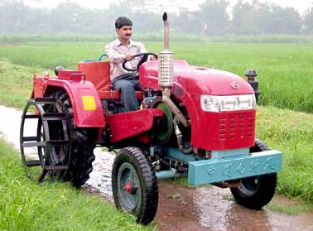
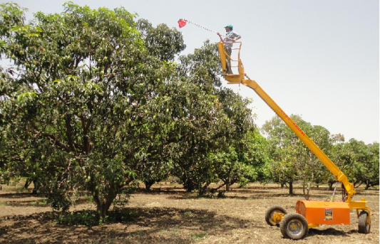
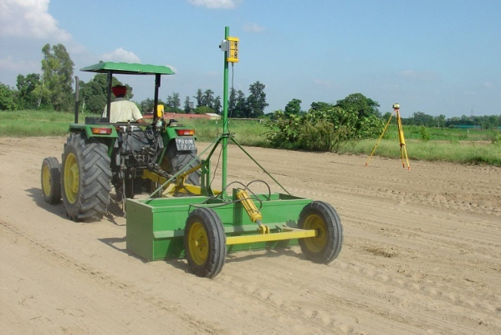
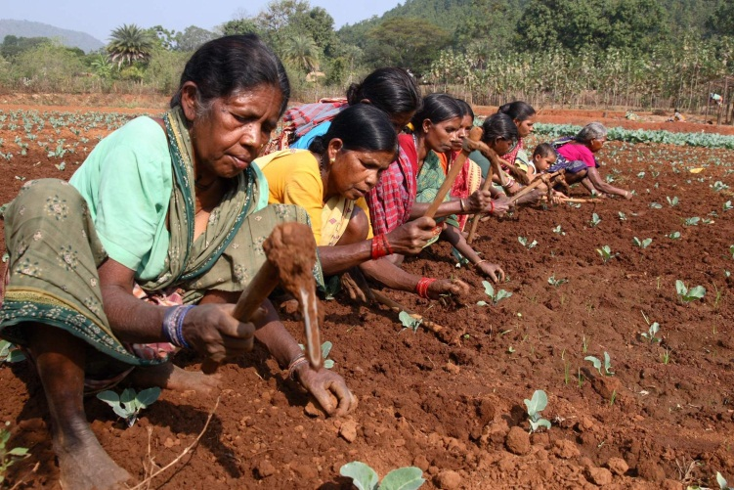
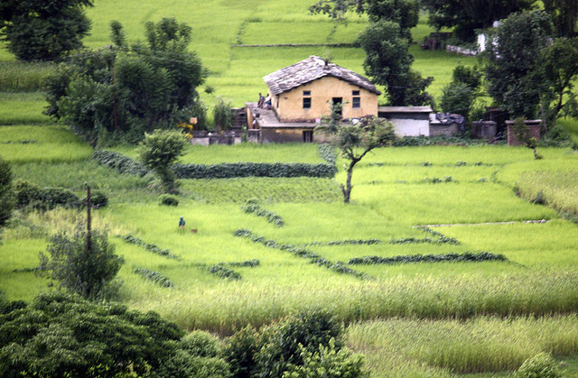
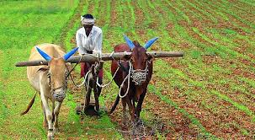
envision smart farming & enable small farmers

Slide 19
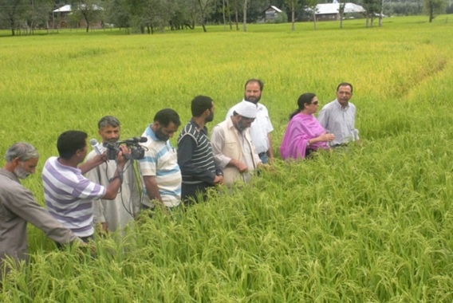
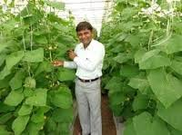
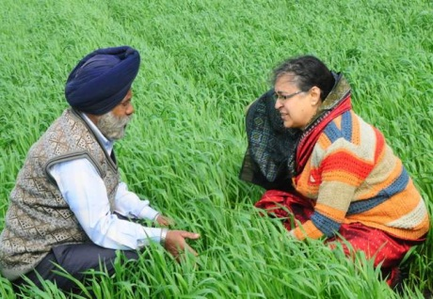
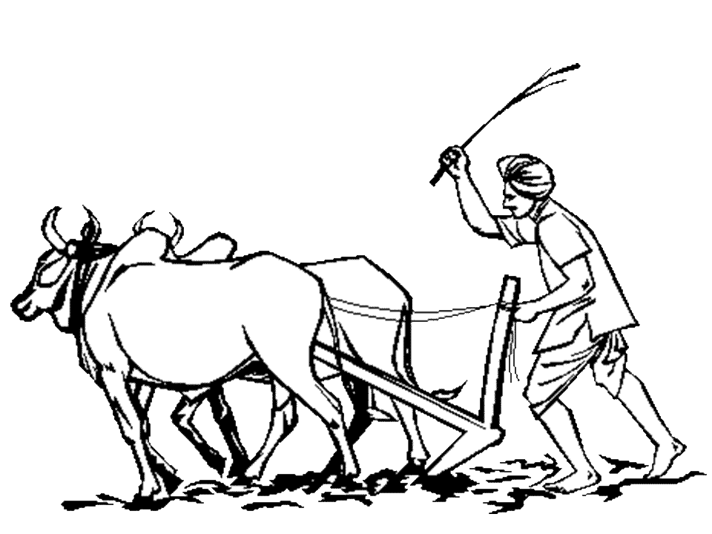
मेरा गाँव मेरा गौरव
Scientists, as Social Change Agents

Slide 20
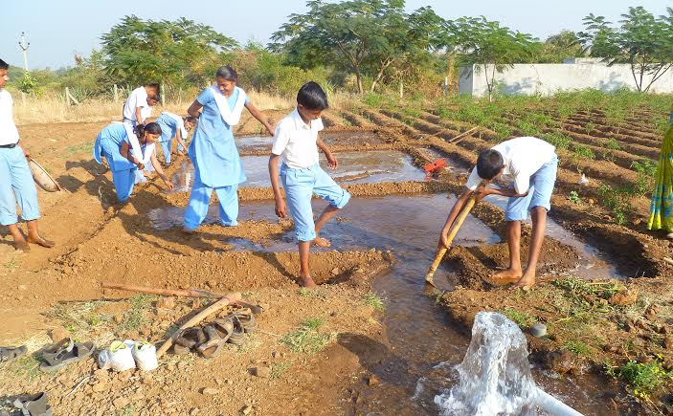
Skilling Indian Youth……..

Slide 21
Dr.Kirit Shelat, I.A.S.(Rtd.) Executive Chairman – NCCSD
National Council for Climate Change Sustainable Development and Public Leadership (NCCSD) Patel Block, Rajdeep Electronic's Compound, Near Stadium Six Road, Navrangpura, Mobile: 091 9904404393 Email: drkiritshelat@gmail.com
Website: www.nccsdindia.org

