Slide 1


Farmers constituency
A Global Farmers Market’
ON 4 th Capacity-building Hub within COP27 (Blue zone)
11.20-12.20,November 14th , 2022, Monday
By
Dr. Kirit Shelat, I.A.S. (Retd)
Executive Chairman
National Council for Climate Change, Sustainable Development
and Public Leadership (NCCSD)-Ahmedabad

Slide 2










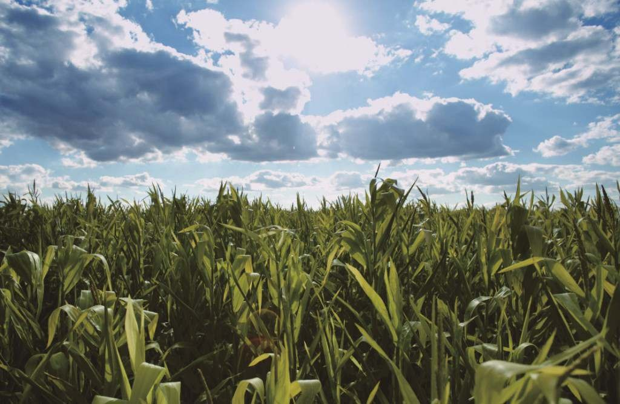


Slide 3
Building Climate Smart Farmers
An Indian Perspective

Slide 4
Background of NCSD
NCCSD is civil Society organization
Is has Consortium of 12 NGOS
It is working in 2,000 villages with 3,00,000 farmers in India states of Gujarat & Maharashtra
It has taken of 600 field level workers
It is also think-tank organization and working with Agriculture & related Departments of government , Agriculture Universities and more particularly with community leader to build climate smart farmers in area of climate change
NCCSD is closely with GACSA in all meetings of COP- organized by UNFCCC.

Slide 5
Farmer to Farmer – Indian Perspective on “CSA”
Over - View
Indian Agriculture has sustainable growth over last six decade at an average of 20% to 40%.
It has 90 per cent small holders and they were below poverty line – over a period time. This is brought down 20%. The initiatives are under implementation to reduce this further by comprehensive programme to reach out farmers at door-step

Slide 6
Climate Smart Agriculture
Farmer to Farmer Approach in Arena of Climate Change:
Soil health Card Programme is launched to advise farmers to select crops which can be sustained by his soil.
Massive integrated water management involving harvesting of water, its conservation – canal – river linking, efficient use through micro-irrigation.
Massive programme to use renewable energy – through bio-gas and solar energy.
An integrated programme NICRA – National Initiative for Climate Resilient Agriculture.
Climate Related Service through local level weather advisory – followed by agro-advisory and contingency plan.
A liberal and comprehensive Crop - Insurance Programme which covers even non-loanee farmers.
Employment Guarantee in community works at local level for 150 days to those who need in lean season or due to crop-failure.
The Presentation deals with case study of Gujarat State.

Slide 7
LAB TO LAND
Successful technology Adaptation
NCCSD’s Initiative

Slide 8
Technology,adaptation and mitigation with 300 faremrs:
Involved uses of improved seeds demonstration and crop practices and castor, cotton and onion crops were suggested to farmers.
It further involved use of Microbes Trichoderma(an effective bio-fungicide); Pseudomonades /
Bacillus (Promote growth and imparts drought and salinity tolerance); and NPK culture for both seed treatment and soil application.
Bhavi vermiwash as organic input as manure.
Introduction of Laser Irrigation for increasing water use efficiency.
Capacity building and training.

Slide 9
Participative efforts: NCCSD,VRTI,AATAPI-3 organization
Involved integration of all at block and village level.
Community leaders
Village Panchayat – Sarpanch
Govt. functionary
  Extension Officer
  VLW
  ATMA team
  KVK
NABARD Dy. Director
Junagadh and Navsari Agri. Universities’ Scientists.
Experts from NCCSD

Slide 10
Detail | Amount in Rs
Contribution from Agency and farmers | 11,65,824 | 40.43%
Contribution sought from NABARD
 | 17,17,600 | 59.56%
Total Project Cost | 28,83,424 | 100%

Slide 11
Barriers / Obstacles
The project was implemented in time of peak of Covid-19 pandemic – but farmers and field extension still worked hard – made it success.
There were adverse weather events like delay in rains and one day heavy episodes of rain – however time management helped farmers to protect crops.
There was shortage of laborers due to migrant workers returning home.

Slide 12
first category on improved seed and technologies in castor, cotton and onion -increase in gross income due to new technologies over farmers’ practices was 9.4% increase due to technological intervention like improved seed,
second category is technology of vermiwash resulted In to Rs 75 lakh with investment of Rs 1.2 lakh , additionally saving fertilizer cost .
The another low cost technologies of microbes and vermiwash resulted in 15-20%.reduction in cost of production and no/less use of chemical insecticides favoring eco friendly .
The third technology of lesser irrigation, easy to operate,water saving, 20%reduction in cost of cultivation (no laborer for irrigation, weeding less).
The overall increase in farmers’ gross income due to technological intervention done under the project can be estimated up to around 34-40% during the first year.

Slide 13
Key Action Points
Redefine Climate Smart Agriculture
Add – Agri-tech, Knowledge economy, Market intervention and support, Climate Advisory and skilling, Re-skilling and up-skilling farmers as key drivers.
Consider and make entire agriculture as Climate Resilient and Smart Agriculture.
Transfer Knowledge Economy and agri-tech from “those who have it” to “those who need it”.

Slide 14
Contd….
Move ‘Green Fund’ and CTCN to prioritise agriculture in their operation with above perspective – to meet challenges Food Productivity, Food Security and Food for hungry millions.
Tap new growing demand for immunity and nutritious food – orphan crops.
Enhance agriculture areas – on wasteland.
Promote sea-weed.

Slide 15
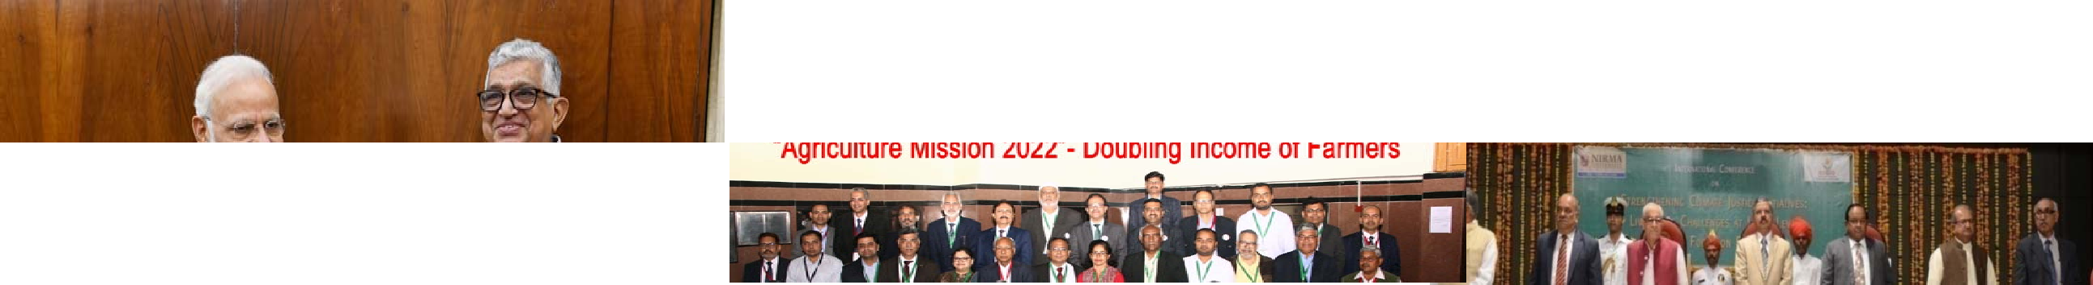
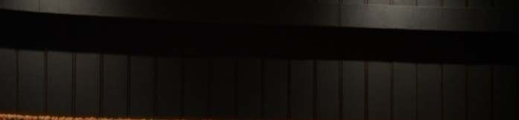

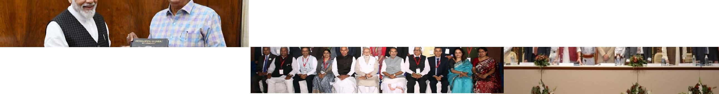


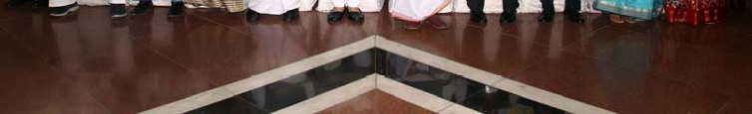
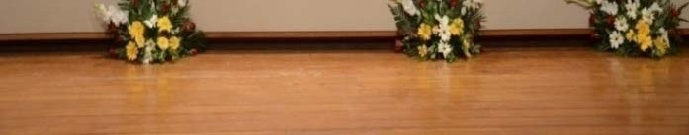
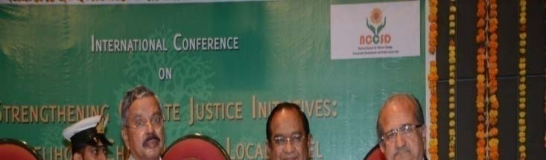
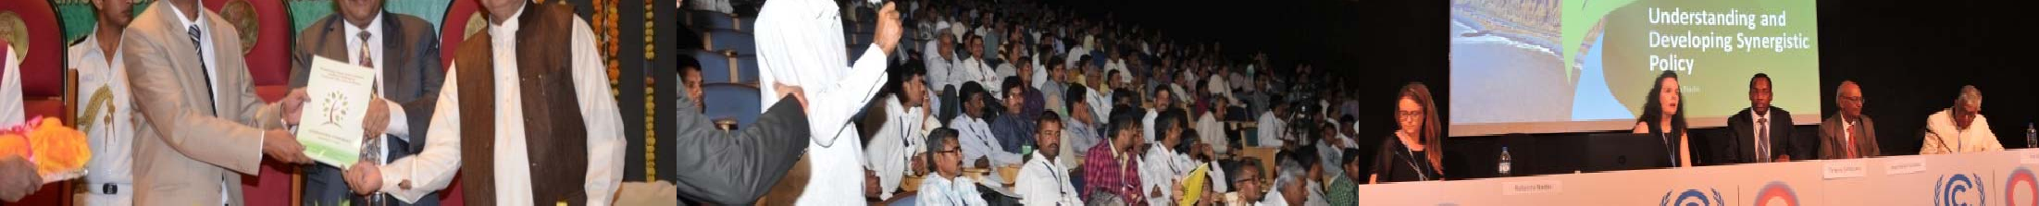
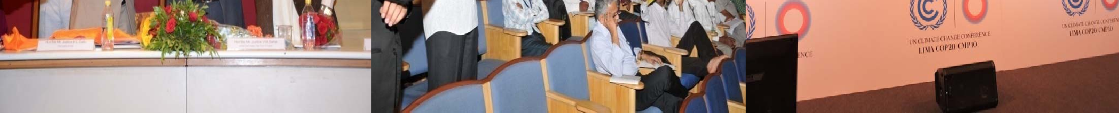
37

Slide 16




National Council for Climate Change, Sustainable Development and Public Leadership (NCCSD)
Patel Block, Rajdeep Electronics Compound, Stadium Circle, Navrangpura, Ahmedabad – 380 014. Gujarat, INDIA. Phone: + 91 79-26421580 (Off) + 91 9904404393(M)
Email: drkiritshelat@gmail.com, Website: www.nccsdindia.org
38

